Slide 1
Forex and CFD Trading

Slide 2
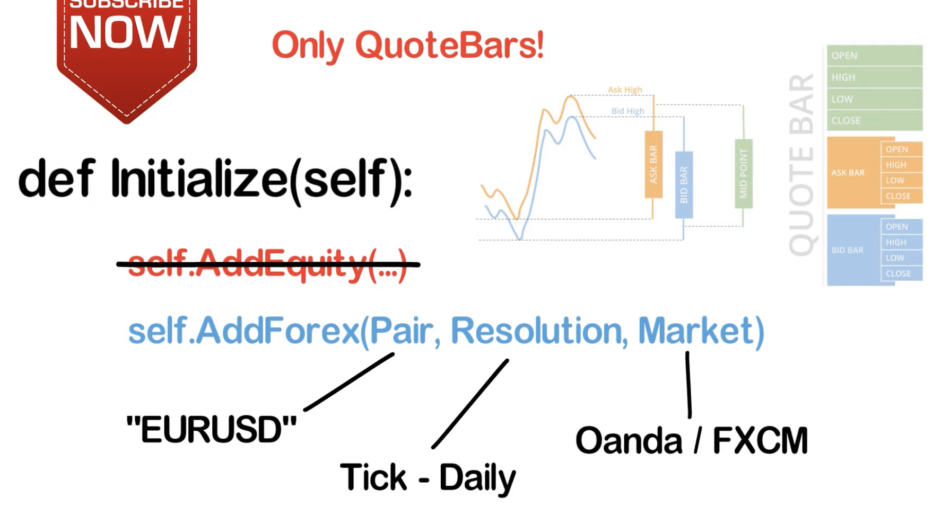

Slide 3


Slide 4
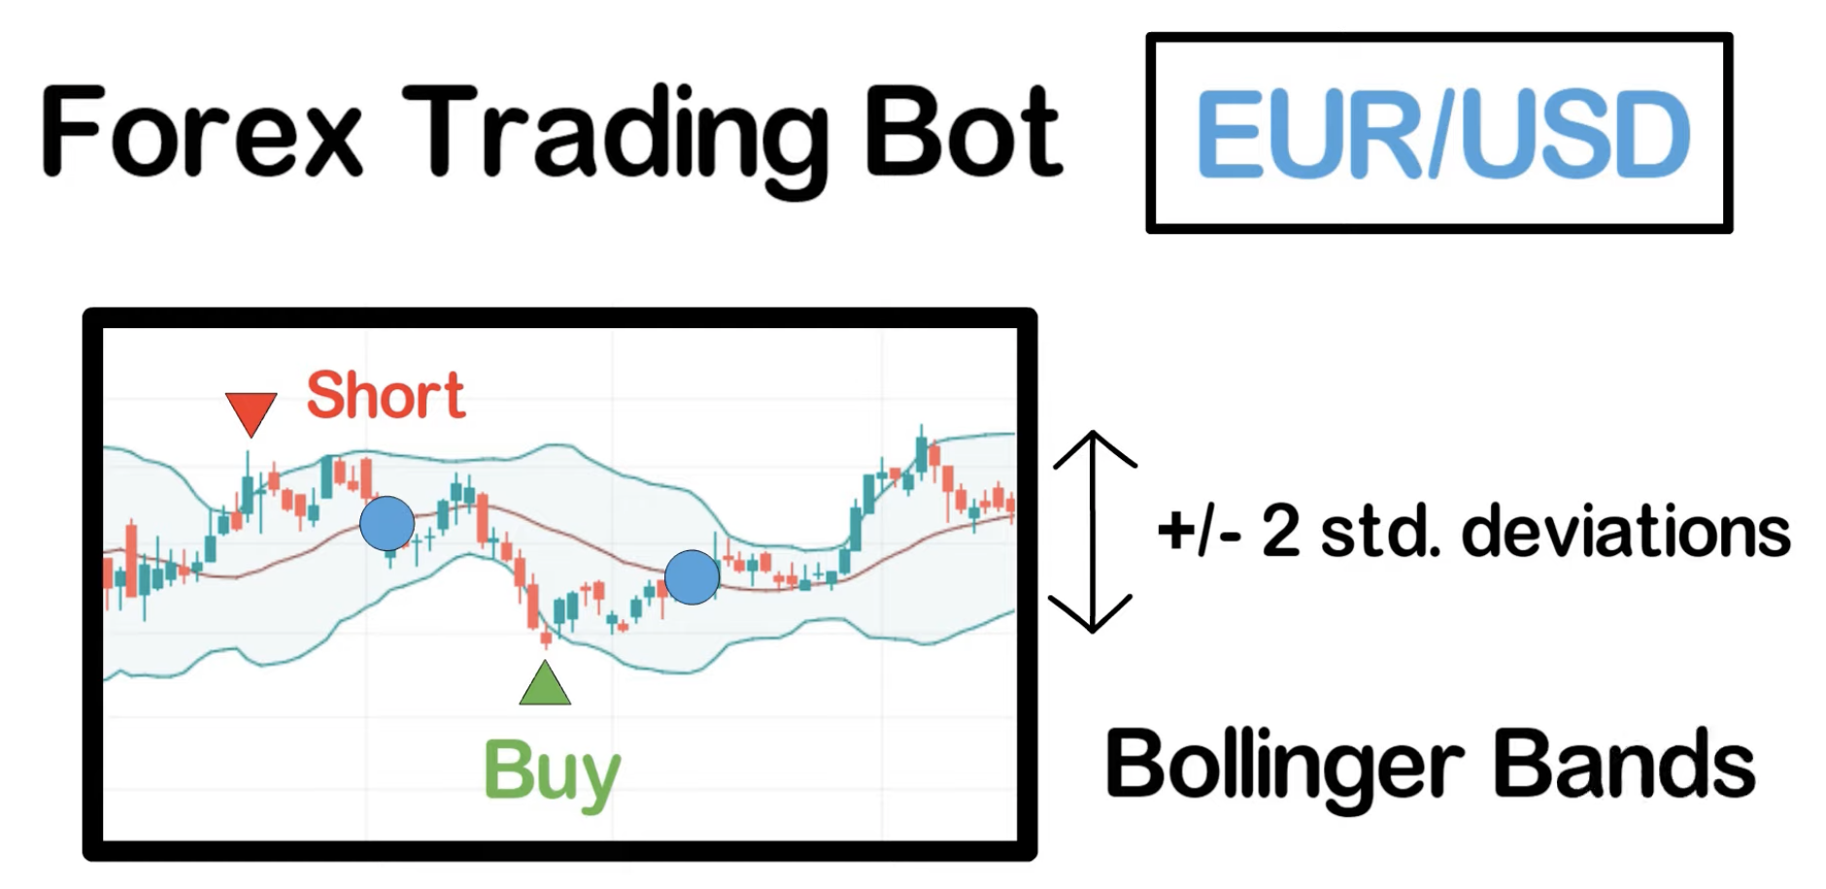

Slide 5
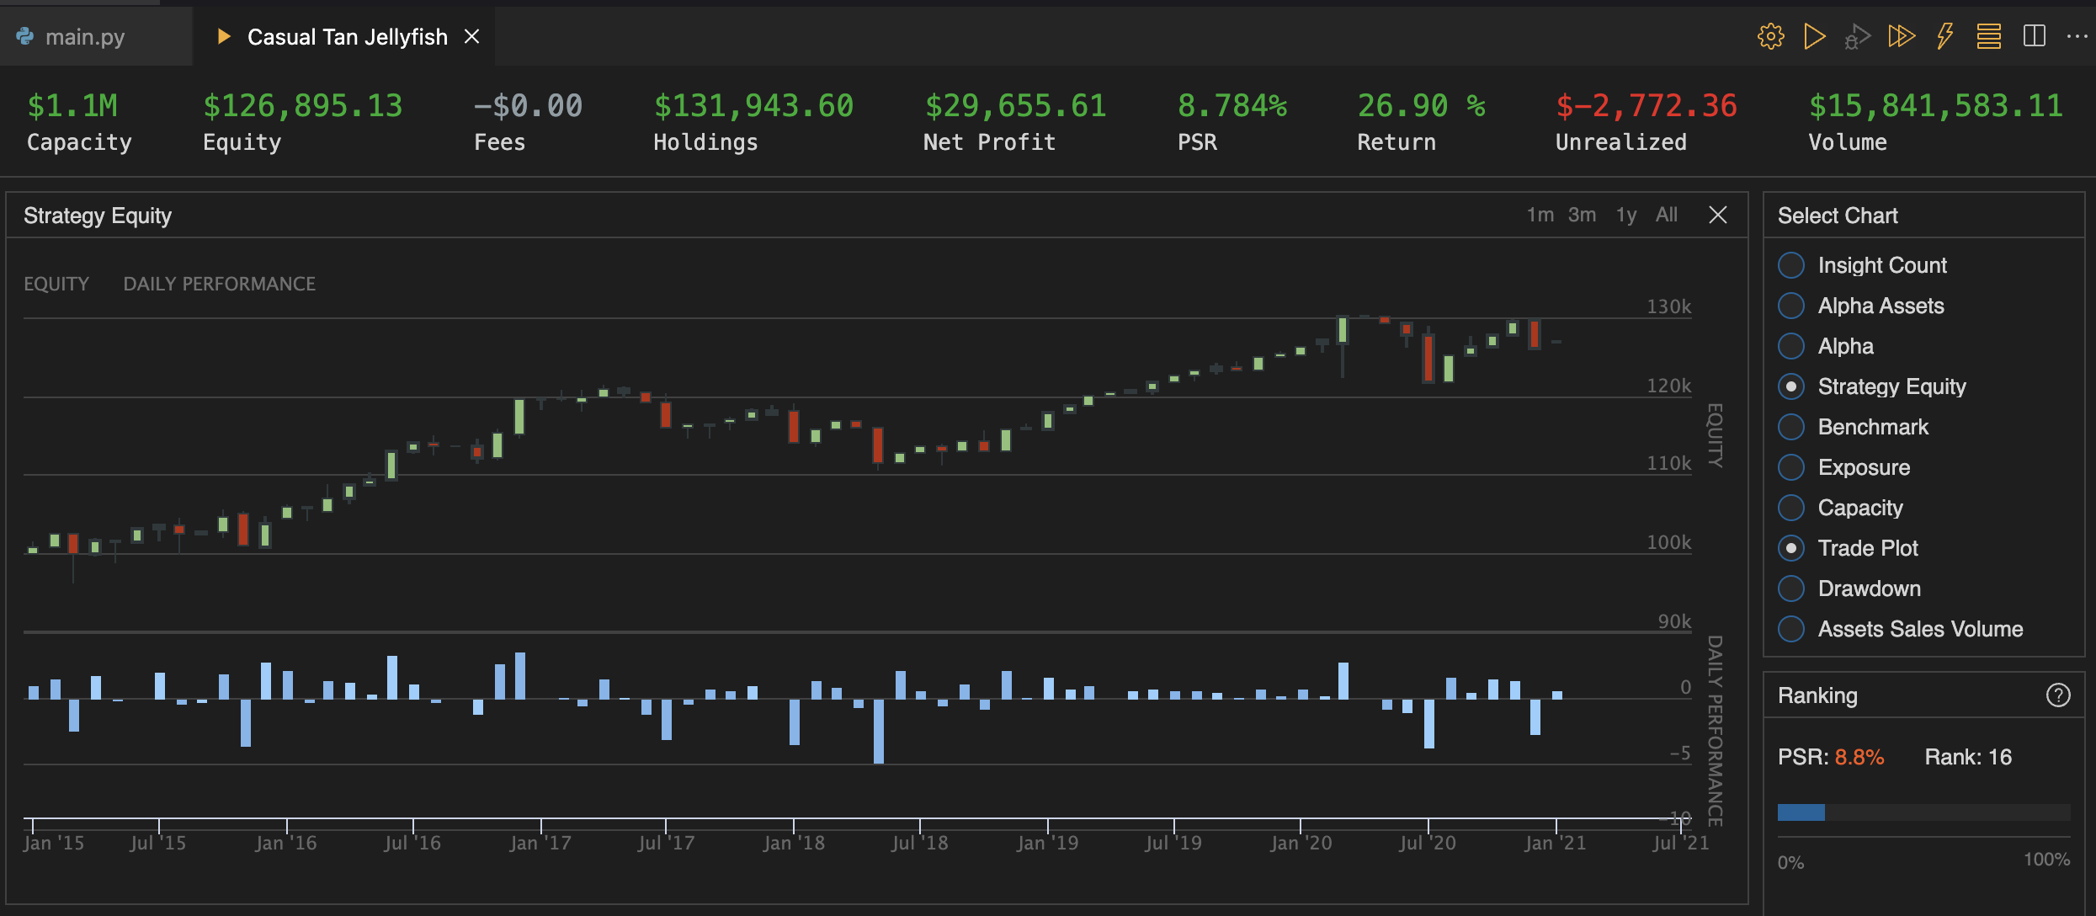

Slide 6
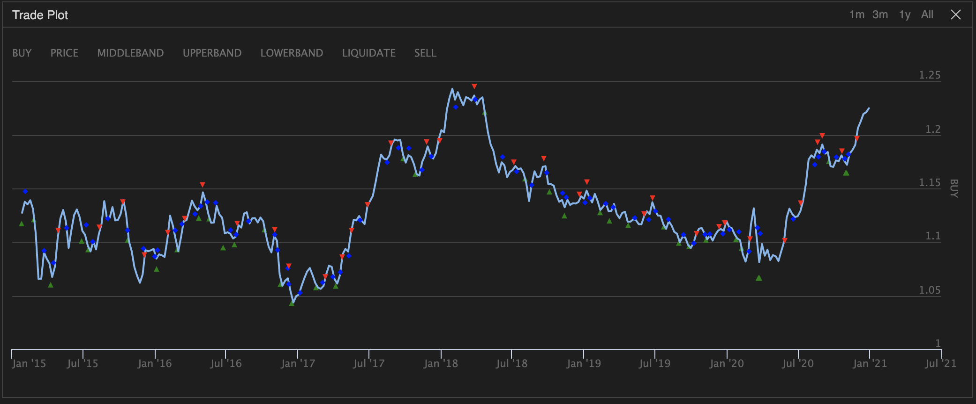

Slide 7
Forex documentation page: https://www.quantconnect.com/docs/data-library/forex?ref=towm
CFD documentation page: https://www.quantconnect.com/docs/data-library/cfd?ref=towm
Charting documentation page: https://www.quantconnect.com/docs/algorithm-reference/charting?ref=towm

