Slide 1
The Algorithm Framework

Slide 2
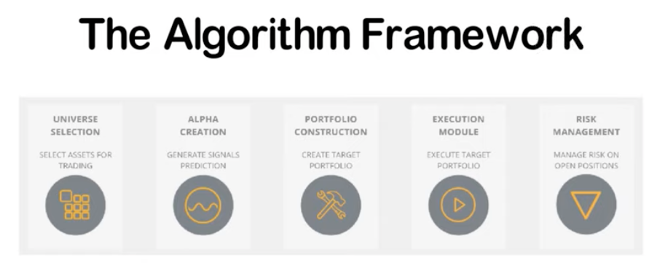
Note that the theoretical breakdown of the algorithm framework is based on the quantitative trading book "Inside the black box" ( https://amzn.to/2YrqSRW ). QuantConnect's algorithm framework does not include a dedicated transaction cost model.

Slide 3
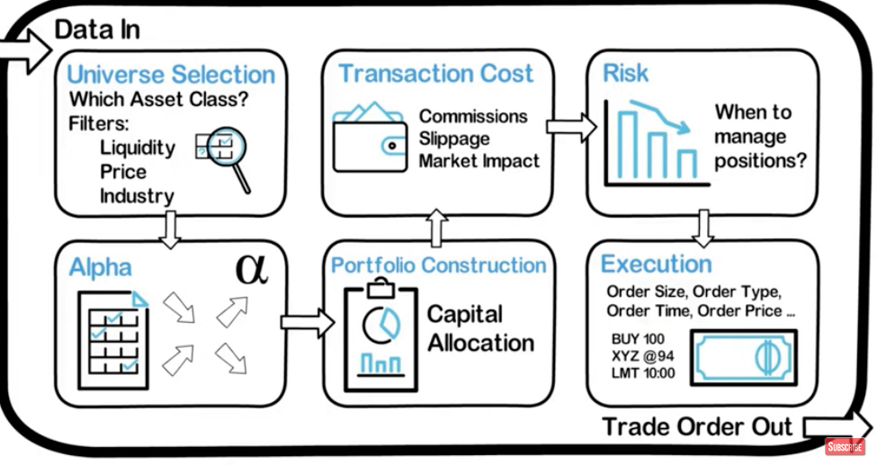

Slide 4
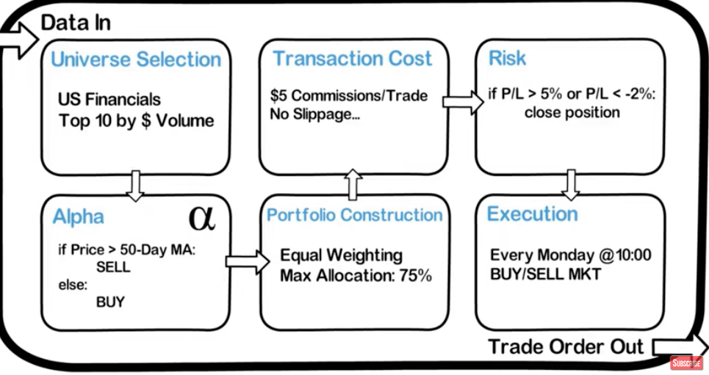

Slide 5
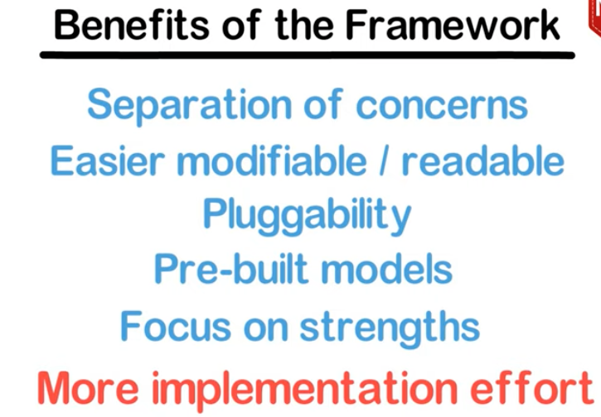

Slide 6
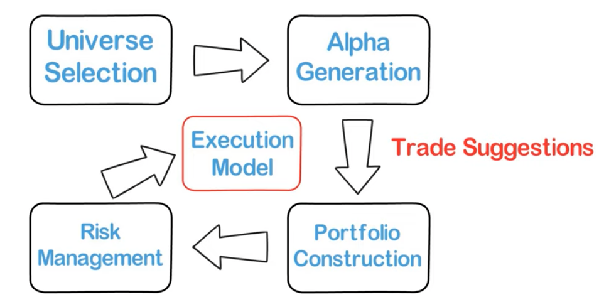
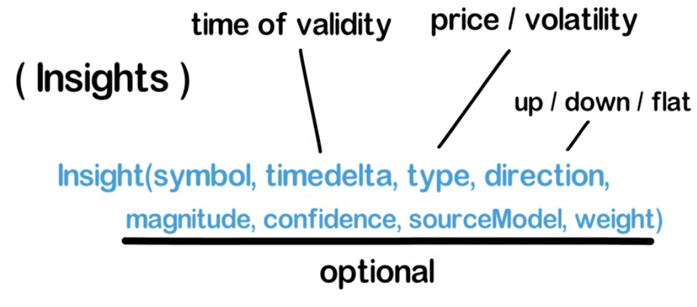


Slide 7
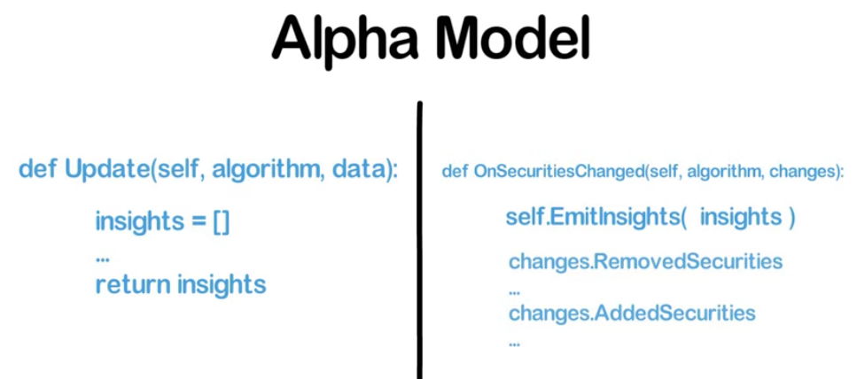
Update: update alpha model with new data and emits new insights

Slide 8
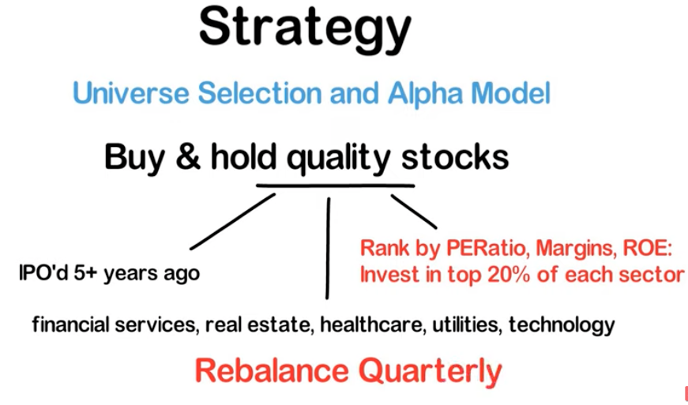

Slide 9
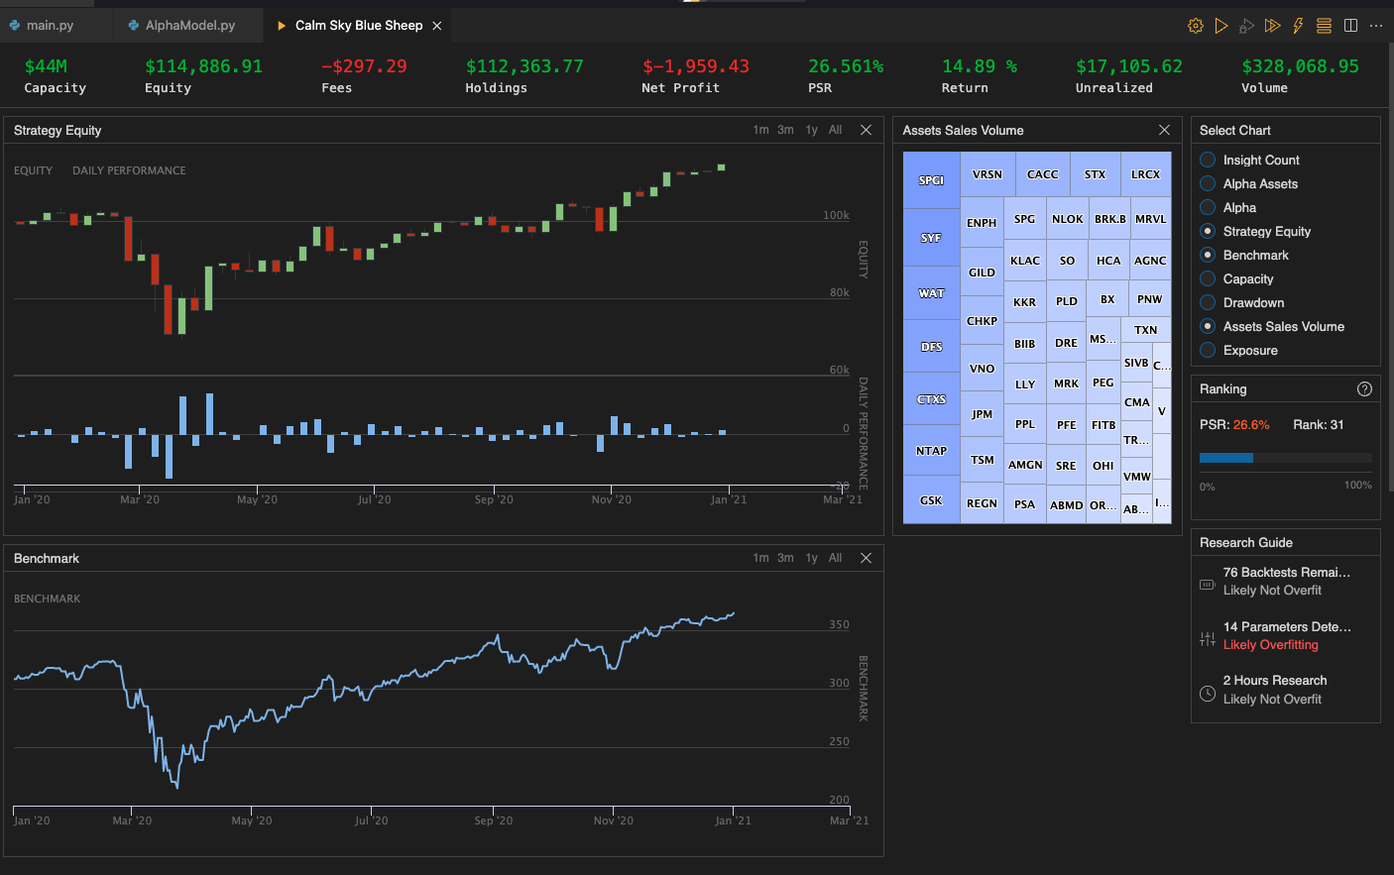

Slide 10
Algorithm framework documentation page: https://www.quantconnect.com/docs/algorithm-framework/overview?ref=towm

