Slide 1
Key Concepts

Slide 2


Slide 3
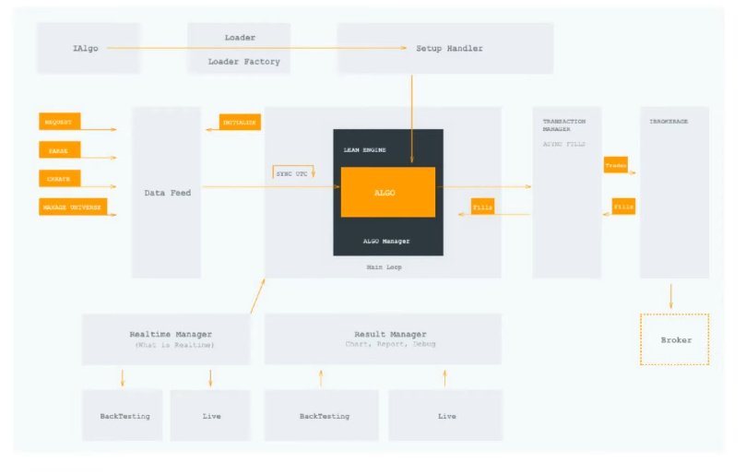

Slide 4
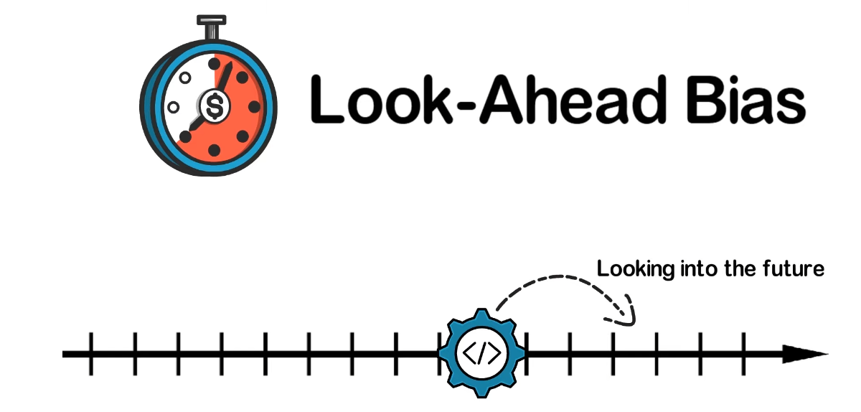

Slide 5
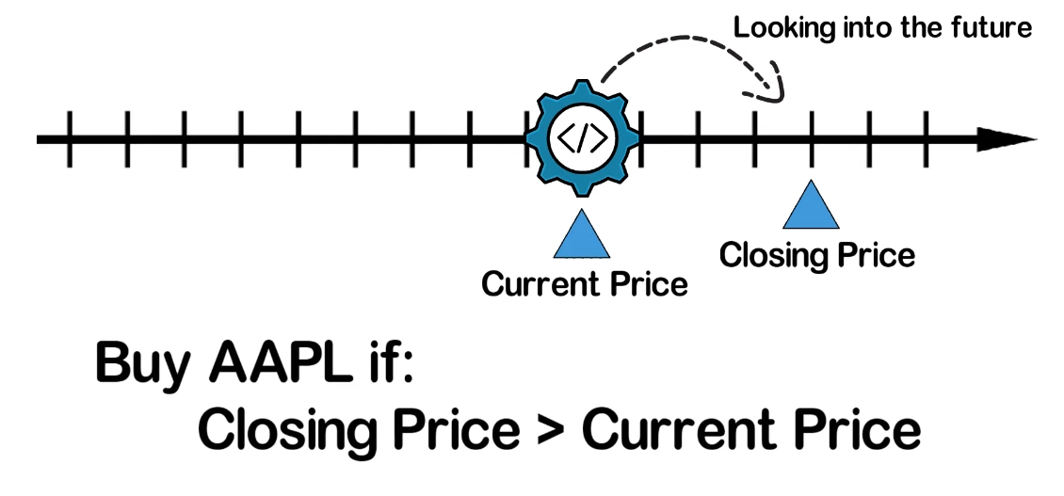
Lean engine uses streaming technology which allows you to use past or future data,
And helps you to handle look-ahead bias

Slide 6
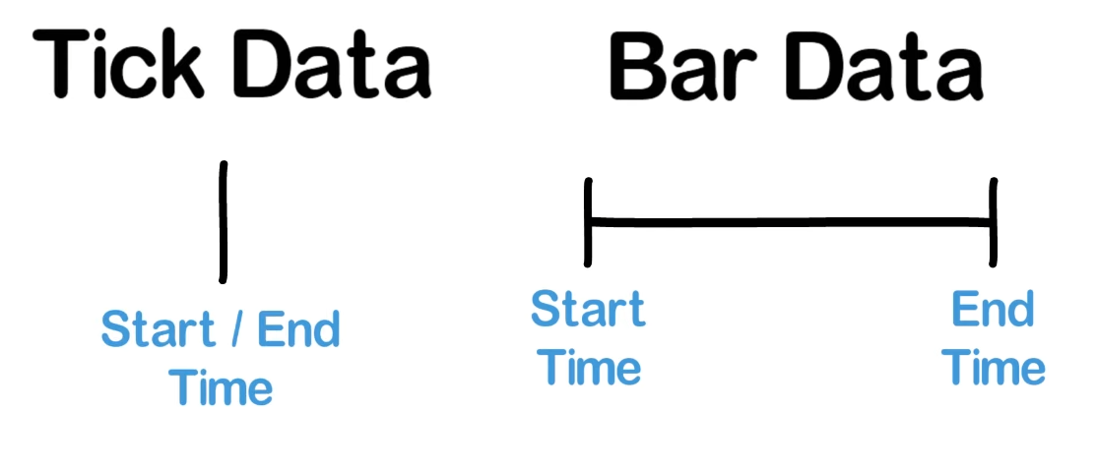
Lean engine allows you to access a Bar Data only after its End Time

Slide 7
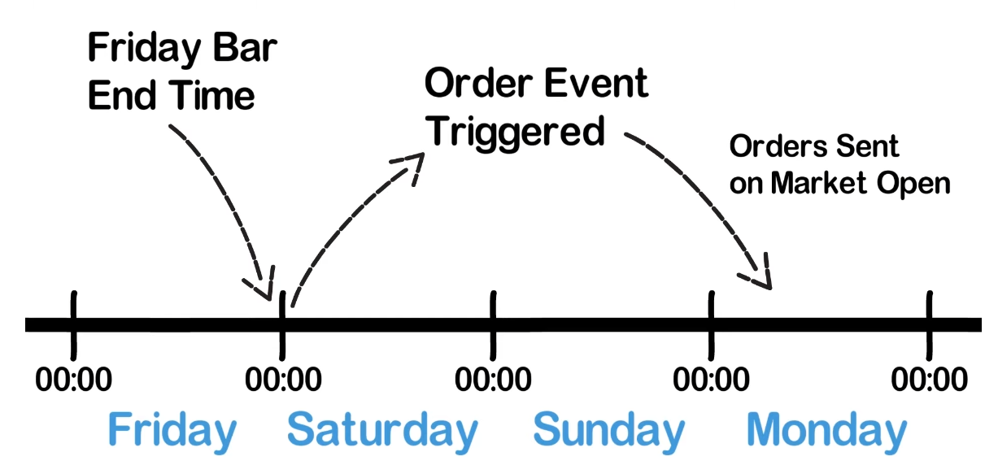

Slide 8
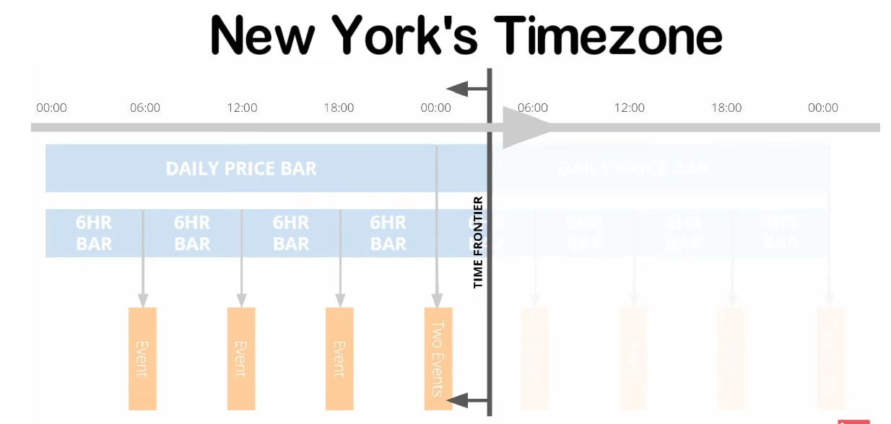

Slide 9
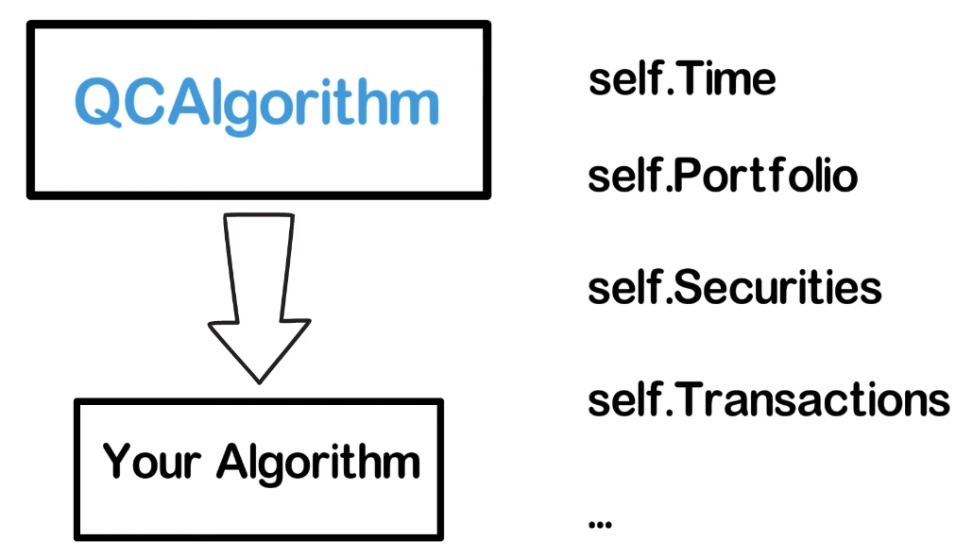

Slide 10
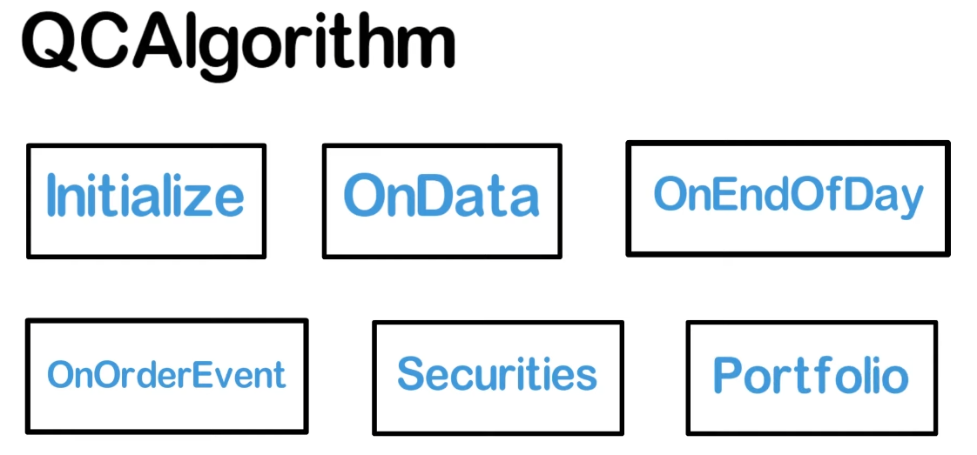

Slide 11
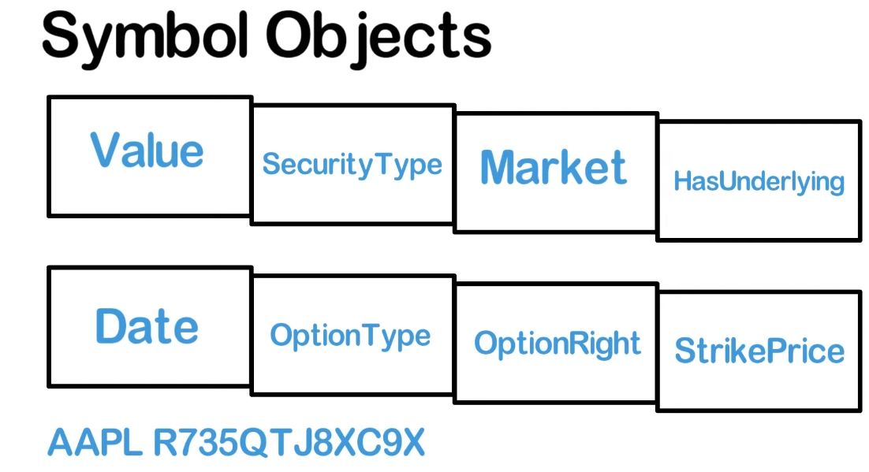

Slide 12
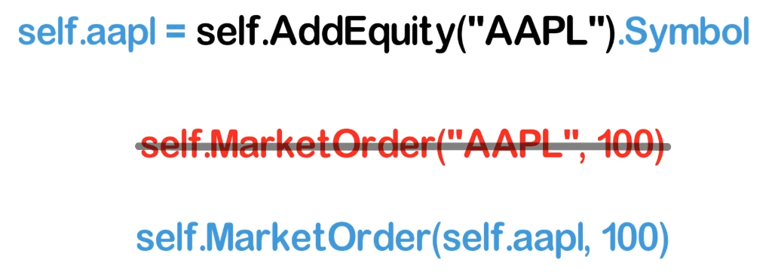
You should always use the symbol object, instead of the ticker string.
Because a ticker string can be ambiguous across multiple markets, and may also be reused.

