Slide 1
Custom Data

Slide 2
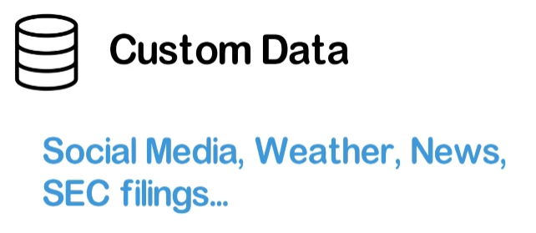


Slide 3
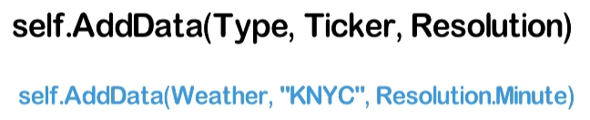
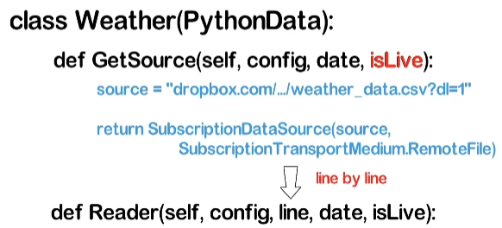
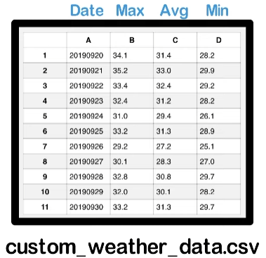
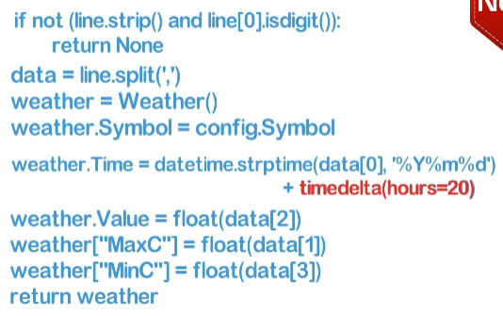
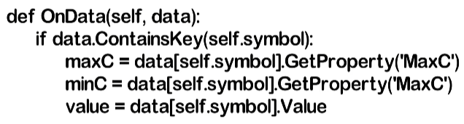
Set isLive=false for backtesting
Add a delay to prevent look-ahead bias
(weather read at start of the day)

Slide 4
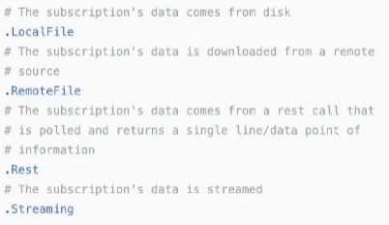

Slide 5
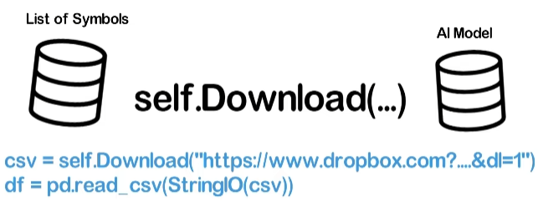

Slide 6
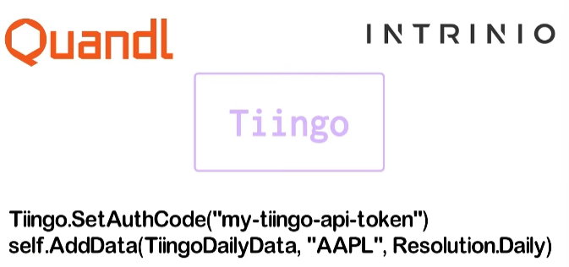

Slide 7
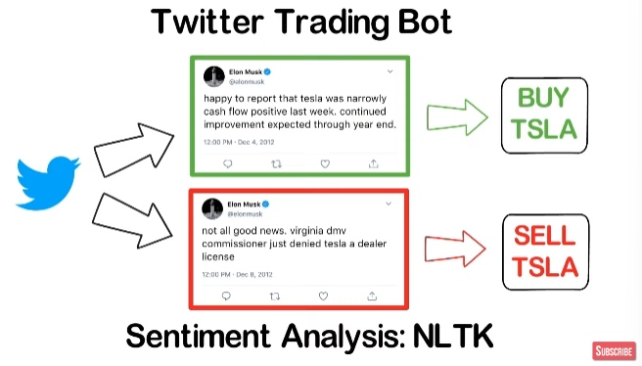

Slide 8
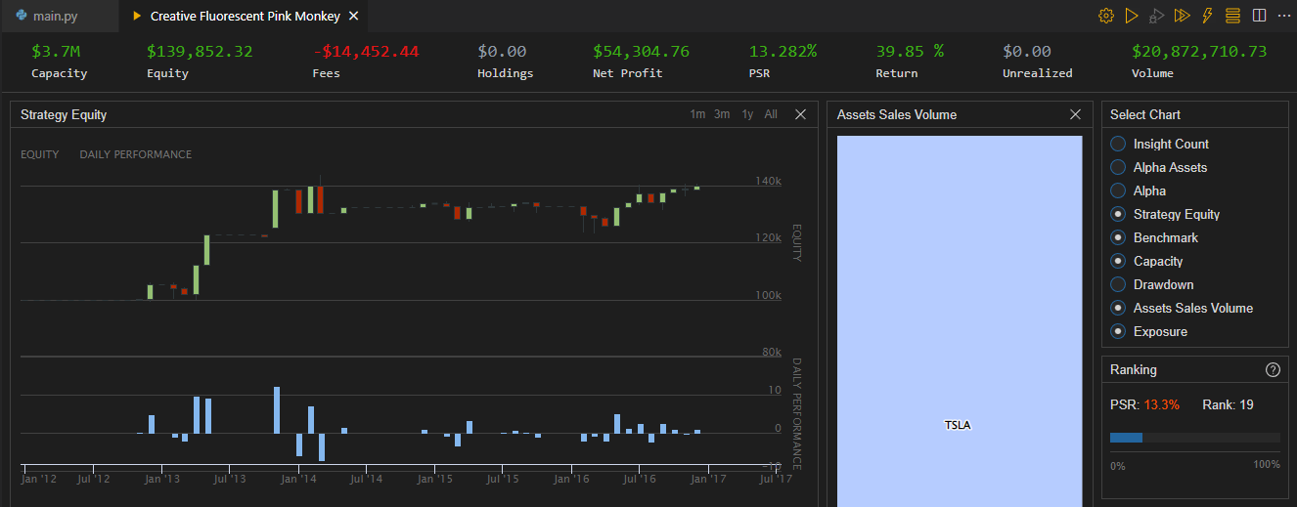

Slide 9
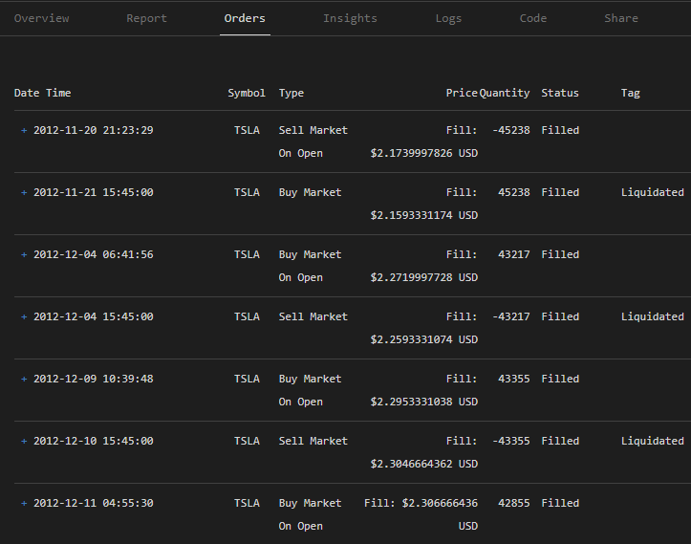
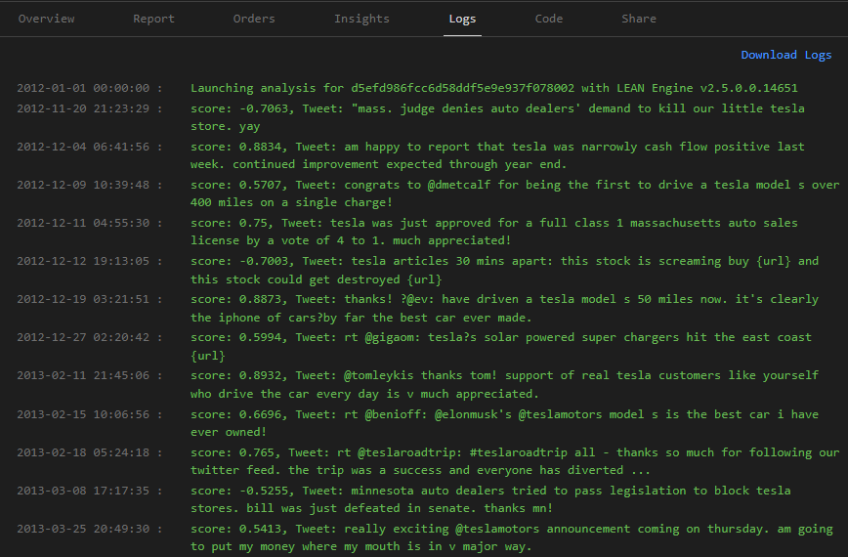

Slide 10
Preprocessed Elon Musk data https://www.dropbox.com/s/ovnsrgg1fou1y0r/MuskTweetsPreProcessed.csv?dl=0
Kaggle Elon Musk dataset https://www.kaggle.com/kulgen/elon-musks-tweets
QuantConnect custom data docs https://www.quantconnect.com/docs/algorithm-reference/importing-custom-data?ref=towm

