Slide 1

521146S - Research Methods in Computer Science Exercise 4: handout 4
HAEJONG DONG

Slide 2
Outline
Research Question
Method and Experiment
Result
Discussion

Slide 3
Research Question
Comparison between texts from hard copy and e-book regarding to the rate of eye blink
Relation between eye blink and visual fatigue
E-book gives more tiredness on eyes
Reading text increases rate of eye blink

Slide 4
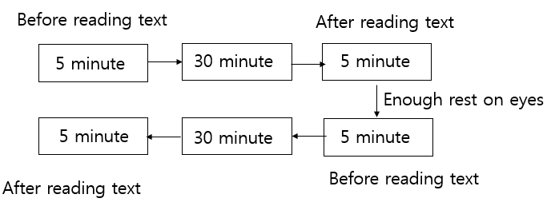
Method and Experiment
- 6 participants - 2 of younger age group (21-22) - 3 of computer major students
- 2 female - 4 of older age group (25-32)
- 4 male - 3 wear a glasses

Slide 5
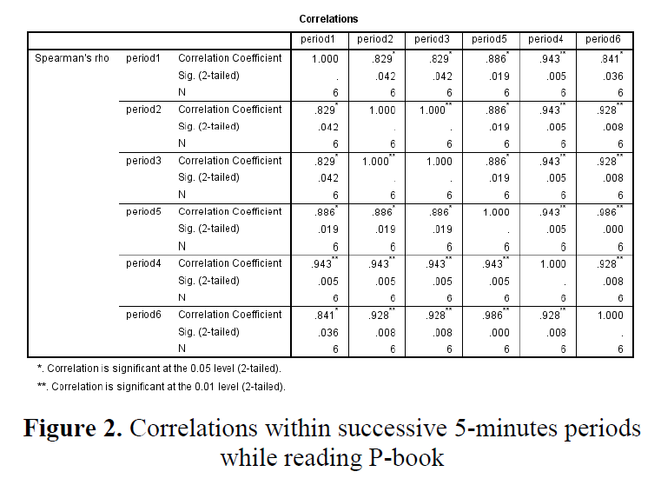
Result

Slide 6
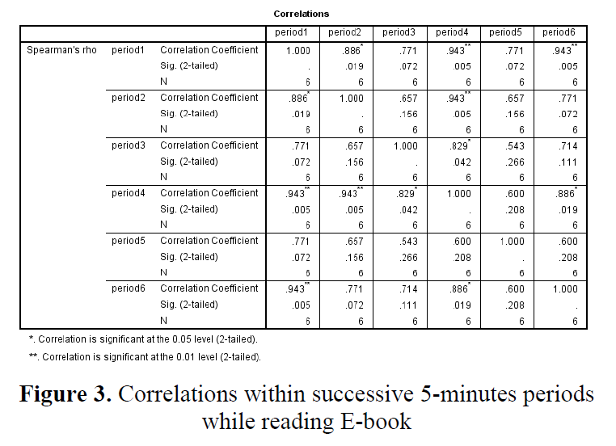
Result

Slide 7
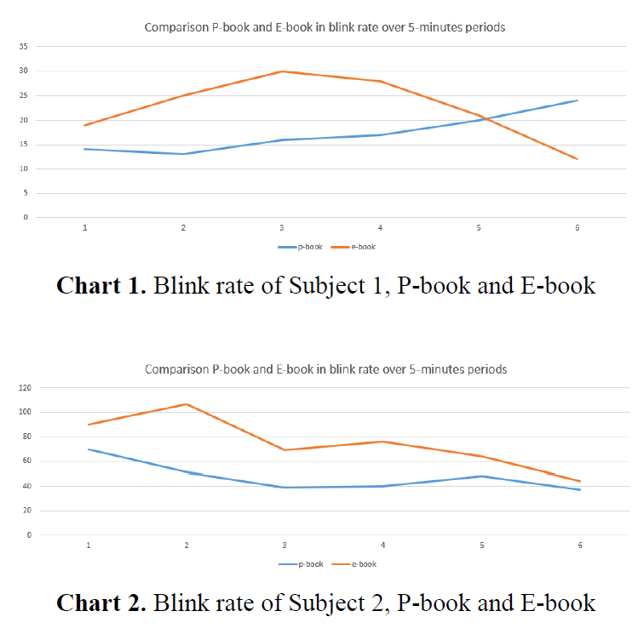
Result

Slide 8
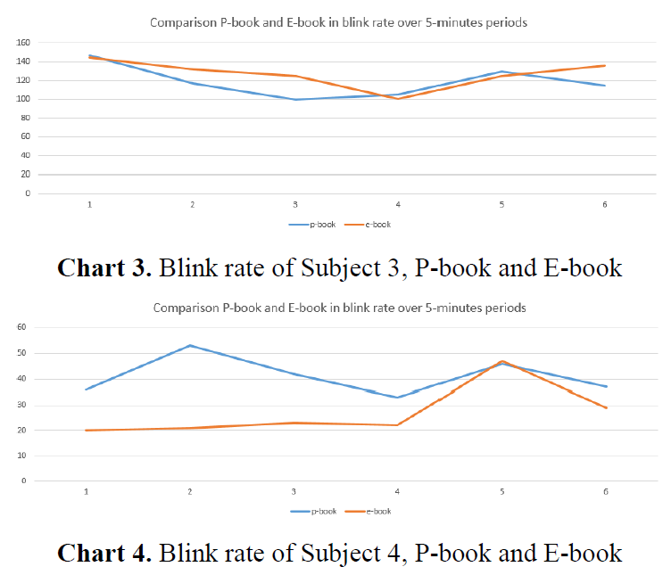
Result

Slide 9
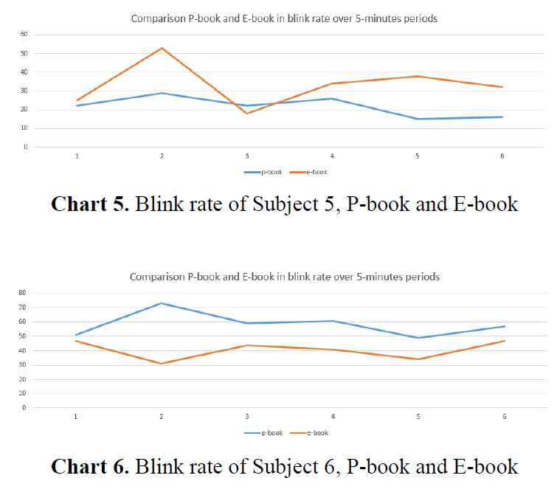
Result

Slide 10
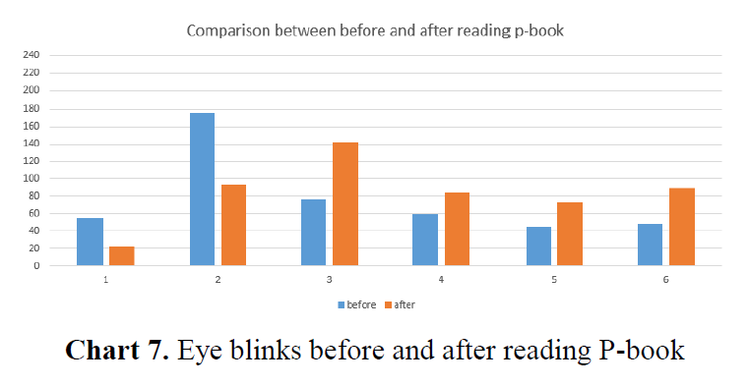
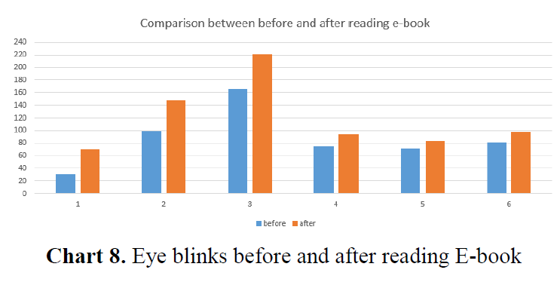
Result

Slide 11
Discussion
Couldn’t find any significant pattern on rate of eye blink
Could find a decrease on rate of eye blink when reading.
- Regardless of type of material
Subjects with glasses tend to blink more frequently
Interesting fact that people prefer text material in digital format
Lack of data
Lack in accuracy of counting eye blink

