Slide 1
CS33 Lecture 16: (a little more) Advanced Synchronization
Tony Nowatzki

Slide 2
Malloc lab: Not much cheating so far!
Possible Reasons:
Better more ethical bunch of students (compared to winter)
(or we scared you enough this time?)
We made it enough easier and explained it better (and maybe first-fit + implicit list was too easy)
You are better at cheating
People who will cheat haven’t turned in their assignment yet

Slide 3
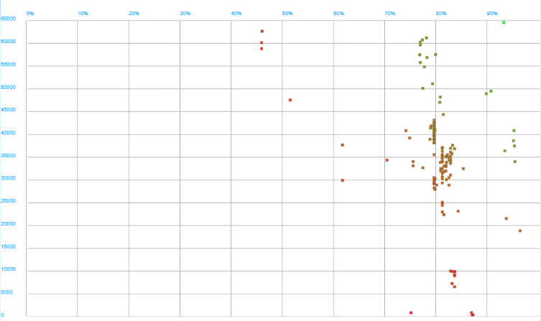
Malloc Lab so far…

Slide 4
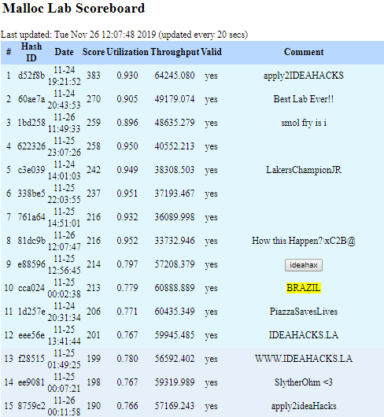

Slide 5
Review: Using semaphores to protect shared resources via mutual exclusion
Basic idea:
Associate a unique semaphore mutex, initially 1, with each shared variable (or related set of shared variables)
Surround each access to the shared variable(s) with P(mutex) and
V(mutex) operations
mutex = 1
P(mutex)
cnt++
V(mutex)

Slide 6
Our view so far
Synchronization
Process
Thread 1
Thread 2
Shared State
Critical Region: Access (often update) of a shared variable
shared libraries
Program code
run-time heap
Kernel context:
Page Table
…
P (lock)
Time
V (unlock)
P (lock)
Thread 1
(peer thread)
Thread 2
(peer thread)
V (unlock)
stack 1
stack 2
Thread 1 Registers
Thread 2 Registers
Semaphores (mutex) let us synchronize regions so they don’t overlap

Slide 7
Review: Semaphores
Semaphore: non-negative global integer synchronization variable. Manipulated by P and V operations.
P(s)
If s is nonzero, then decrement s by 1 and return immediately.
If s is zero, then suspend thread until s becomes nonzero and the thread is restarted by a V operation.
After restarting, the P operation decrements s and returns control to the caller.
V(s):
Increment s by 1.
If there are any threads blocked in a P operation waiting for s to become non-zero, then restart exactly one of those threads, which then completes its P operation by decrementing s.
Semaphore invariant: (s >= 0)

Slide 8
Review Questions
Which of the following are guaranteed to be thread-private (ie. not shared)?
Values on Thread’s stack
Values on Heap
Value stored in register
Global Value
Static Value
Which of the above are guaranteed to be shared?
Semaphore calls are often hundreds of cycles long (if not longer) -- why are semaphores so slow?
When a thread is joined, some of the memory has to be cleaned up by the OS. What is an example region of memory that must be cleaned up?

Slide 9
badcnt.c: Improper Synchronization
/* Global shared variable */
volatile long cnt = 0; /* Counter */
int main(int argc, char **argv)
{
long niters;
pthread_t tid1, tid2;
niters = atoi(argv[1]);
Pthread_create(&tid1, NULL,
thread, &niters);
Pthread_create(&tid2, NULL,
thread, &niters);
Pthread_join(tid1, NULL);
Pthread_join(tid2, NULL);
/* Check result */
if (cnt != (2 * niters))
printf("BOOM! cnt=%ld\n", cnt);
else
printf("OK cnt=%ld\n", cnt);
exit(0);
}
/* Thread routine */
void *thread(void *vargp)
{
long i, niters =
*((long *)vargp);
for (i = 0; i < niters; i++)
cnt++;
return NULL;
}
Global cnt variable can become inconsistent…
badcnt.c

Slide 10
goodcnt.c: Proper Synchronization
Define and initialize a mutex for the shared variable cnt:
volatile long cnt = 0; /* Counter */
sem_t mutex; /* Semaphore that protects cnt */
Sem_init(&mutex, 0, 1); /* mutex = 1 */
Surround critical section with P and V:
for (i = 0; i < niters; i++) {
P(&mutex);
cnt++;
V(&mutex);
}
linux> ./goodcnt 10000
OK cnt=20000
linux> ./goodcnt 10000
OK cnt=20000
linux>
goodcnt.c
This is really really slow (too many system calls). Assuming we have to count one-by-one, how would we make it faster?

Slide 11
Today
Challenges program synchronization:
Data races
Deadlock
Properties of thread-friendly code
Thread-safe
Re-entrant
Parallelization Paradigms (how to use semaphores)
Bulk Synchronous Parallel
Single reader / multiple writers
Producer-consumer

Slide 12
Data Races
A race occurs when correctness of the program depends on one thread reaching point x before another thread reaches point y

Slide 13
Data Race Example
Data race: correctness depends on thread ordering
/* A threaded program with a race */
int main() {
pthread_t tid[N];
int i;
for (i = 0; i < N; i++)
Pthread_create(&tid[i], NULL, thread, &i);
for (i = 0; i < N; i++)
Pthread_join(tid[i], NULL);
exit(0);
}
/* Thread routine */
void *thread(void *vargp) {
int myid = *((int *)vargp);
printf("Hello from thread %d\n", myid);
return NULL;
}
N threads are sharing i
race.c

Slide 14
Race Illustration
for (i = 0; i < N; i++)
Pthread_create(&tid[i], NULL, thread, &i);
Main thread
i = 0
Peer thread 0
i = 1
myid = *((int *)vargp)
Race!
Race between increment of i in main thread and deref of vargp in peer thread:
If deref happens while i = 0, then OK
Otherwise, peer thread gets wrong id value

Slide 15
Could this race really occur?
Main thread
Peer thread
int i;
for (i = 0; i < 100; i++) {
Pthread_create(&tid, NULL,
thread,&i);
}
void *thread(void *vargp) {
Pthread_detach(pthread_self());
int i = *((int *)vargp);
save_value(i);
return NULL;
}
race.c
Race Test
If no race, then each thread would get different value of i
Set of saved values would consist of one copy each of 0 through 99

Slide 16
Experimental Results
No Race
Single core laptop
Multicore server
The race can really happen!

Slide 17
Race Elimination
/* Threaded program without the race */
int main()
{
pthread_t tid[N];
int i, *ptr;
for (i = 0; i < N; i++) {
ptr = Malloc(sizeof(int));
*ptr = i;
Pthread_create(&tid[i], NULL, thread, ptr);
}
for (i = 0; i < N; i++)
Pthread_join(tid[i], NULL);
exit(0);
}
/* Thread routine */
void *thread(void *vargp)
{
int myid = *((int *)vargp);
Free(vargp);
printf("Hello from thread %d\n", myid);
return NULL;
}
One solution (slow): Malloc and free each thread id
norace.c

Slide 18
Another worry: Deadlock
Def: A process is deadlocked iff it is waiting for a condition that will never be true
Typical Scenario
Processes 1 and 2 needs two resources (A and B) to proceed
Process 1 acquires A, waits for B
Process 2 acquires B, waits for A
Both will wait forever!

Slide 19
Deadlocking With Semaphores
int main()
{
pthread_t tid[2];
Sem_init(&mutex[0], 0, 1); /* mutex[0] = 1 */
Sem_init(&mutex[1], 0, 1); /* mutex[1] = 1 */
Pthread_create(&tid[0], NULL, count0, (void*) 0);
Pthread_create(&tid[1], NULL, count1, (void*) 1);
Pthread_join(tid[0], NULL);
Pthread_join(tid[1], NULL);
printf("cnt=%d\n", cnt);
exit(0);
}
Tid[0]:
P(s₀);
P(s₁);
cnt++;
V(s₀);
V(s₁);
Tid[1]:
P(s₁);
P(s₀);
cnt++;
V(s₁);
V(s₀);
void *count0(void *vargp)
{
int i;
int id = (int) vargp;
for (i = 0; i < NITERS; i++) {
P(&mutex[0]); P(&mutex[1]);
cnt++;
V(&mutex[0]); V(&mutex[1]);
}
return NULL;
}
void *count1(void *vargp)
{
int i;
int id = (int) vargp;
for (i = 0; i < NITERS; i++) {
P(&mutex[1]); P(&mutex[0]);
cnt++;
V(&mutex[1]); V(&mutex[0]);
}
return NULL;
}

Slide 20
Deadlock Visualized in Progress Graph
Thread 1
Locking introduces the
potential for deadlock:
waiting for a condition that will never be true
Any trajectory that enters
the deadlock region will
eventually reach the
deadlock state, waiting for either s₀ or s₁ to become nonzero
Other trajectories luck out and skirt the deadlock region
Unfortunate fact: deadlock is often nondeterministic (race)
Deadlock
state
V(s₀)
Forbidden region
for s₀
V(s₁)
P(s₀)
Forbidden region
for s₁
Deadlock
region
P(s₁)
Thread 0
P(s₀)
P(s₁)
V(s₀)
V(s₁)
s₀=s₁=1

Slide 21
Avoiding Deadlock
Acquire shared resources in same order
int main()
{
pthread_t tid[2];
Sem_init(&mutex[0], 0, 1); /* mutex[0] = 1 */
Sem_init(&mutex[1], 0, 1); /* mutex[1] = 1 */
Pthread_create(&tid[0], NULL, count, (void*) 0);
Pthread_create(&tid[1], NULL, count, (void*) 1);
Pthread_join(tid[0], NULL);
Pthread_join(tid[1], NULL);
printf("cnt=%d\n", cnt);
exit(0);
}
Tid[0]:
P(s0);
P(s1);
cnt++;
V(s0);
V(s1);
Tid[1]:
P(s0);
P(s1);
cnt++;
V(s1);
V(s0);
void *count0(void *vargp)
{
int i;
int id = (int) vargp;
for (i = 0; i < NITERS; i++) {
P(&mutex[0]); P(&mutex[1]);
cnt++;
V(&mutex[0]); V(&mutex[1]);
}
return NULL;
}
void *count1(void *vargp)
{
int i;
int id = (int) vargp;
for (i = 0; i < NITERS; i++) {
P(&mutex[0]); P(&mutex[1]);
cnt++;
V(&mutex[1]); V(&mutex[0]);
}
return NULL;
}

Slide 22
Avoided Deadlock in Progress Graph
Thread 1
No way for trajectory to get stuck
Processes acquire locks in same order
Order in which locks released immaterial
V(s₀)
Forbidden region
for s₀
V(s₁)
P(s₁)
Forbidden region
for s₁
P(s₀)
Thread 0
P(s₀)
P(s₁)
V(s₀)
V(s₁)
s₀=s₁=1

Slide 23
Crucial concept: Thread Safety
Functions called from a thread must be thread-safe
Def: A function is thread-safe iff it will always produce correct results when called repeatedly from multiple concurrent threads
Ie. No races when accessed concurrently
Classes of thread-unsafe functions:
Class 1: Functions that do not protect shared variables
Class 2: Functions that keep state across multiple invocations
Class 3: Functions that return a pointer to a static variable
Class 4: Functions that call thread-unsafe functions ☺

Slide 24
Thread-Unsafe Functions (Class 1)
Failing to protect shared variables
Fix: Use P and V semaphore operations
Example: badcnt.c
Issue: Synchronization operations will slow down code
for (i = 0; i < niters; i++) {
P(&mutex);
cnt++;
V(&mutex);
}
goodcnt.c

Slide 25
Thread-Unsafe Functions (Class 2)
Relying on persistent state across multiple function invocations
Example: Random number generator that relies on static state
Key property: pseudo-random property: random numbers are generated deterministically the next time the program runs
static unsigned int next = 1;
/* rand: return pseudo-random integer on 0..32767 */
int rand(void)
{
next = next*1103515245 + 12345;
return (unsigned int)(next/65536) % 32768;
}
/* srand: set seed for rand() */
void srand(unsigned int seed)
{
next = seed;
}

Slide 26
Example of repeatedly calling rand
Example with 1 Thread
Example with 2 Thread
Thread 1
Thread 1
Thread 2
21468
9988
30236
16481
15884
6859
10726
8193
6196
21468
9988
10726
8193
6196
21577
2606
14751
26536
30236
16481
15884
6859
14192
11013
16535
5783
6174

Slide 27
Thread-Safe Random Number Generator
Pass state as part of argument
and, thereby, eliminate global state
Consequence: programmer using rand_r must maintain seed
/* rand_r - return pseudo-random integer on 0..32767 */
int rand_r(int *nextp)
{
*nextp = *nextp * 1103515245 + 12345;
return (unsigned int)(*nextp/65536) % 32768;
}

Slide 28
Thread-Unsafe Functions (Class 3)
Returning a pointer to a static variable
Eg. char* ctime(time_t* timep)
Input: time structure
Output: string representing time (pointer to static)
Fix 1. Rewrite function so caller passes address of variable to store result
Requires changes in caller and callee
Fix 2. Lock-and-copy
Requires simple changes in caller (and none in callee)
However, caller must free memory.
/* lock-and-copy version */
char *ctime_ts(const time_t *timep,
char *privatep)
{
char *sharedp;
P(&mutex);
sharedp = ctime(timep);
strcpy(privatep, sharedp);
V(&mutex);
return privatep;
}

Slide 29
Thread-Unsafe Functions (Class 4)
Calling thread-unsafe functions
Calling one thread-unsafe function makes the entire function that calls it thread-unsafe
Fix: Modify the function so it calls only thread-safe functions ☺

Slide 30
Reentrant Functions
Def: A function is reentrant iff it accesses no shared variables when called by multiple threads.
Important subset of thread-safe functions
Require no synchronization operations
Only way to make a Class 2 function thread-safe is to make it reetnrant (e.g., rand_r )
All functions
Thread-safe
functions
Reentrant
functions
Thread-unsafe
functions

Slide 31
Thread-Safe Library Functions
All functions in the Standard C Library (at the back of your K&R text) are thread-safe
Examples: malloc, free, printf, scanf
Most Unix system calls are thread-safe, with a few exceptions:
Thread-unsafe function Class Reentrant version
asctime 3 asctime_r
ctime 3 ctime_r
gethostbyaddr 3 gethostbyaddr_r
gethostbyname 3 gethostbyname_r
inet_ntoa 3 (none)
localtime 3 localtime_r
rand 2 rand_r

Slide 32
Parallelization Paradigms

Slide 33
Example Paradigms
Bulk Parallel
Concurrent threads (shared var. update)
Single Writer, Multiple Reader
Producer/
Consumer
Prod-
ucers
Consumers
Thread 1
Thread 2
P
V
P
V
Eg. Matrix Multiplication
Eg. Count,
Reduction
Eg. Transaction Processing
Eg. Compression
Pipeline

Slide 34
Bulk Parallel
Bulk Synchronous Parallel
Sequential followed by parallel program phases
How: Need a way to quickly start multiple threads, then synchronize
Existing Approach?
Many pthread_creates
Many pthread_joins
Downsides?
Barrier:
All threads wait at barrier until “count” many have reached it

Slide 35
Pthread Barriers
At initialization time:
pthread_barrier_t barrier;
void main(void)
{
pthread_barrier_init(&barrier, NULL, numThreads);
...
}
After we create the threads
void thread1(void*)
{
…
pthread_barrier_wait();
if(tid==0) {
//single threaded
}
pthread_barrier_wait();
…
}
void thread2(void*)
{
…
pthread_barrier_wait();
// do nothing
pthread_barrier_wait();
…
}
void thread3(void*)
{
…
pthread_barrier_wait();
// do nothing
pthread_barrier_wait();
…
}

Slide 36
Example Paradigms
Bulk Parallel
Concurrent threads (shared var. update)
Single Writer, Multiple Reader
Producer/
Consumer
Prod-
ucers
Consumers
Thread 1
Thread 2
P
V
P
V
Eg. Matrix Multiplication
Eg. Count,
Reduction
Eg. Transaction Processing
Eg. Compression
Pipeline

Slide 37
Using Semaphores to Coordinate Access to Shared Resources
Basic idea: Thread uses a semaphore operation to notify another thread that some condition has become true
Use counting semaphores to keep track of resource state and to notify other threads
Use mutex to protect access to resource
Two classic examples:
The Producer-Consumer Problem
The Readers-Writers Problem

Slide 38
Producer-Consumer Problem
Producer
thread
Consumer
thread
Shared
buffer
Examples
Multimedia processing:
Producer creates MPEG video frames, consumer renders them
Event-driven graphical user interfaces
Producer detects mouse clicks, mouse movements, and keyboard hits and inserts corresponding events in buffer
Consumer retrieves events from buffer and paints the display

Slide 39
Issues we need to think about?
Notes:
Producing faster than consuming -> semaphore for slots
Consuming faster than producing -> sem for items
Two producers push at same time (mutex)
Two consumers pop at same time (mutex)
Producer/consumer push pop at same itme (mutex)

Slide 40
Brainstorm an implementation?

Slide 41
Producer-Consumer on an n-element Buffer
Common synchronization pattern:
Producer waits for empty slot, inserts item in buffer, and notifies consumer
Consumer waits for item, removes it from buffer, and notifies producer
Requires a mutex and two counting semaphores:
mutex: enforces mutually exclusive access to the the buffer
slots: counts the available slots in the buffer
items: counts the available items in the buffer
Implemented using a shared buffer package called sbuf.

Slide 42
sbuf Package - Declarations
#include "csapp.h”
typedef struct {
int *buf; /* Buffer array */
int n; /* Maximum number of slots */
int front; /* buf[(front+1)%n] is first item */
int rear; /* buf[rear%n] is last item */
sem_t mutex; /* Protects accesses to buf */
sem_t slots; /* Counts available slots */
sem_t items; /* Counts available items */
} sbuf_t;
void sbuf_init(sbuf_t *sp, int n);
void sbuf_deinit(sbuf_t *sp);
void sbuf_insert(sbuf_t *sp, int item);
int sbuf_remove(sbuf_t *sp);
sbuf.h

Slide 43
sbuf Package - Implementation
Initializing and deinitializing a shared buffer:
/* Create an empty, bounded, shared FIFO buffer with n slots */
void sbuf_init(sbuf_t *sp, int n)
{
sp->buf = Calloc(n, sizeof(int));
sp->n = n; /* Buffer holds max of n items */
sp->front = sp->rear = 0; /* Empty buffer iff front == rear */
Sem_init(&sp->mutex, 0, 1); /* Binary semaphore for locking */
Sem_init(&sp->slots, 0, n); /* Initially, buf has n empty slots */
Sem_init(&sp->items, 0, 0); /* Initially, buf has 0 items */
}
/* Clean up buffer sp */
void sbuf_deinit(sbuf_t *sp)
{
Free(sp->buf);
}
sbuf.c

Slide 44
sbuf Package - Implementation
Inserting an item into a shared buffer:
/* Insert item onto the rear of shared buffer sp */
void sbuf_insert(sbuf_t *sp, int item)
{
P(&sp->slots); /* Wait for available slot */
P(&sp->mutex); /* Lock the buffer */
sp->buf[(++sp->rear)%(sp->n)] = item; /* Insert the item */
V(&sp->mutex); /* Unlock the buffer */
V(&sp->items); /* Announce available item */
}
sbuf.c

Slide 45
sbuf Package - Implementation
Removing an item from a shared buffer:
/* Remove and return the first item from buffer sp */
int sbuf_remove(sbuf_t *sp)
{
int item;
P(&sp->items); /* Wait for available item */
P(&sp->mutex); /* Lock the buffer */
item = sp->buf[(++sp->front)%(sp->n)]; /* Remove the item */
V(&sp->mutex); /* Unlock the buffer */
V(&sp->slots); /* Announce available slot */
return item;
}
sbuf.c

Slide 46
Readers-Writers Problem
Generalization of the mutual exclusion problem
Problem statement:
Reader threads only read the object
Writer threads modify the object
Writers must have exclusive access to the object
Unlimited number of readers can access the object
Occurs frequently in real systems, e.g.,
Online airline reservation system
Multithreaded caching Web proxy

Slide 47
Issues/Brainstorm Solution?
Notes:
Read and write simultaneous
Two writers at same time -> mutex for writes
Reader should wait if currently active writer (both read and write wait on mutex)
If we are writing, and active readers -> wait (counter for readers)

Slide 49
Solution to Readers-Writers Problem
Readers:
Writers:
int readcnt; /* Initially = 0 */
sem_t mutex, w; /* Initially = 1 */
void reader(void)
{
while (1) {
P(&mutex);
readcnt++;
if (readcnt == 1) /* First in */
P(&w);
V(&mutex);
/* Critical section */
/* Reading happens */
P(&mutex);
readcnt--;
if (readcnt == 0) /* Last out */
V(&w);
V(&mutex);
}
}
void writer(void)
{
while (1) {
P(&w);
/* Critical section */
/* Writing happens */
V(&w);
}
}
rw1.c

Slide 50
Variants of Readers-Writers
First readers-writers problem (favors readers)
No reader should be kept waiting unless a writer has already been granted permission to use the object
A reader that arrives after a waiting writer gets priority over the writer
Second readers-writers problem (favors writers)
Once a writer is ready to write, it performs its write as soon as possible
A reader that arrives after a writer must wait, even if the writer is also waiting
Starvation (where a thread waits indefinitely) is possible in both cases
Notes:
Basic idea: count number of writers on write side (synchronized)

Slide 52
Amdahl’s Law
Gene Amdahl (Nov. 16, 1922 – Nov. 10, 2015)
Captures the difficulty of using parallelism to speed things up.
Principle:
Program can be decomposed into sequential part/parallel part
p Fraction of program which is parallel (0 ≤ p ≤ 1)
s Speedup factor
Resulting Speedup
Sequential Time = T
Parallel Time = pT/s + (1-p)T (parallel part) + (sequential part)
Speedup(s) = 1 / ( p/s + 1-p)
Best Possible Speedup: 1 / (1-p)

Slide 53
Amdahl’s Law Example
Overall problem
p = 0.9 Fraction of total which can be sped up
s = 9 Speedup factor
Resulting Performance
Speedup : 1 / ( 0.9 / 9 + .1 ) = 5x
Best Speedup : 1 / (.1) = 10x (let s -> inf)

Slide 54
Wrap-Up Threading
Caches + Threading = Fun
Keeping coherent state
Subtle example of how threads affect performance
Atomics Operations
Alternative to Sempahores for simple read-modify-write ops

Slide 55
Typical Multicore Processor
Core 0
Core n-1
Regs
Regs
L1
d-cache
L1
i-cache
…
L1
d-cache
L1
i-cache
L2 unified cache
L2 unified cache
L3 unified cache
(shared by all cores)
Main memory
Multiple processors operating with coherent view of memory

Slide 56
Caches and Multicores (simplified)
CPU1
CPU2
Thread1 Cache
Thread2 Cache
Small
Addr: 100
Addr: 100
Communication
Network
Shared Cache
Large
Memory

Slide 57
Two Independent Reads
Thread1 Cache
Thread2 Cache
Thread1:
… =foo_array[0]
Addr: 100
Addr: 200
(foo @ address: 100)
Shared Cache
Thread2:
…=bar_array[0]
Addr: 100
Addr: 200
(bar @ address: 200)

Slide 58
Two reads of a shared variable
Thread1 Cache
Thread2 Cache
Thread1:
… =foo_array[0]
Addr: 100
Addr: 100
(foo @ address: 100)
Shared Cache
Thread2:
…=foo_array[0]
Addr: 100
Multiple copies are okay, and they are good for performance!
(imagine we had more reads to foo_array later)

Slide 59
Read and a Write (same variable, wrong)
Thread1:
… =foo_array[0]
…
Thread1 Cache
Thread2 Cache
Thread1:
… =foo_array[0]
…
… =foo_array[0]
old_val
new_val
Wrong answer
Shared Cache
Thread2:
foo_array[0] =new_val
old_val
Note: Alternatively could update the old_value to the new value … this turns out to be a bad idea in practice…

Slide 60
Read and a Write (same variable, better)
Thread1:
… =foo_array[0]
…
Thread1 Cache
Thread2 Cache
old_val
new_val
Invalidate
Shared Cache
Thread2:
foo_array[0] =new_val
old_val
Note 1: This is a gross simplification, which you can learn more about in CS151b
Note 2: Alternatively could update the old_value to the new value … this turns out to be a bad idea in practice…

Slide 61
False Sharing
Thread1:
… =foo_array[0]
…
foo_array[0] = …
Thread1 Cache
Thread2 Cache
addr:100
Addr:104
Invalidate
Invalidate
Thread2:
… =foo_array[1]
…
foo_array[1] = …
Shared Cache
Maybe updated
Scenario: Repeatedly write two different variables but on the same cache line … slow

Slide 62
Example: Parallel Summation
Sum numbers 0, …, n-1
Should add up to ((n-1)*n)/2
Partition values 1, …, n-1 into t ranges
⎣n/t⎦ values in each range
Each of t threads processes 1 range
For simplicity, assume n is a multiple of t
Let’s consider different ways that multiple threads might work on their assigned ranges in parallel

Slide 63
First attempt: psum-mutex
Simplest approach: Threads sum into a global variable protected by a semaphore mutex.
void *sum_mutex(void *vargp); /* Thread routine */
/* Global shared variables */
long gsum = 0; /* Global sum */
long nelems_per_thread; /* Number of elements to sum */
sem_t mutex; /* Mutex to protect global sum */
int main(int argc, char **argv)
{
long i, nelems, log_nelems, nthreads, myid[MAXTHREADS];
pthread_t tid[MAXTHREADS];
/* Get input arguments */
nthreads = atoi(argv[1]);
log_nelems = atoi(argv[2]);
nelems = (1L << log_nelems);
nelems_per_thread = nelems / nthreads;
sem_init(&mutex, 0, 1);
psum-mutex.c

Slide 64
psum-mutex (cont)
Simplest approach: Threads sum into a global variable protected by a semaphore mutex.
/* Create peer threads and wait for them to finish */
for (i = 0; i < nthreads; i++) {
myid[i] = i;
Pthread_create(&tid[i], NULL, sum_mutex, &myid[i]);
}
for (i = 0; i < nthreads; i++)
Pthread_join(tid[i], NULL);
/* Check final answer */
if (gsum != (nelems * (nelems-1))/2)
printf("Error: result=%ld\n", gsum);
return 0;
}
psum-mutex.c

Slide 65
psum-mutex Thread Routine
Simplest approach: Threads sum into a global variable protected by a semaphore mutex.
/* Thread routine for psum-mutex.c */
void *sum_mutex(void *vargp)
{
long myid = *((long *)vargp); /* Extract thread ID */
long start = myid * nelems_per_thread; /* Start element index */
long end = start + nelems_per_thread; /* End element index */
long i;
for (i = start; i < end; i++) {
P(&mutex);
gsum += i;
V(&mutex);
}
return NULL;
}
psum-mutex.c

Slide 66
psum-mutex Performance
Machine with 8 cores, n=2³¹
Threads (Cores) | 1 (1) | 2 (2) | 4 (4) | 8 (8) | 16 (8)
psum-mutex (secs) | 51 | 456 | 790 | 536 | 681
Nasty surprise:
Single thread is very slow
Gets slower as we use more cores

Slide 67
Next Attempt: psum-array
Peer thread i sums into global array element psum[i]
Main waits for theads to finish, then sums elements of psum
Eliminates need for mutex synchronization
/* Thread routine for psum-array.c */
void *sum_array(void *vargp)
{
long myid = *((long *)vargp); /* Extract thread ID */
long start = myid * nelems_per_thread; /* Start element index */
long end = start + nelems_per_thread; /* End element index */
long i;
for (i = start; i < end; i++) {
psum[myid] += i;
}
return NULL;
}
psum-array.c

Slide 68
psum-array Performance
Orders of magnitude faster than psum-mutex

Slide 69
Next Attempt: psum-local
Reduce memory references by having peer thread i sum into a local variable (register)
/* Thread routine for psum-local.c */
void *sum_local(void *vargp)
{
long myid = *((long *)vargp); /* Extract thread ID */
long start = myid * nelems_per_thread; /* Start element index */
long end = start + nelems_per_thread; /* End element index */
long i, sum = 0;
for (i = start; i < end; i++) {
sum += i;
}
psum[myid] = sum;
return NULL;
}
psum-local.c

Slide 70
psum-local Performance
Significantly faster than psum-array

Slide 71
Advanced Synchronization!
Problem: Semaphores are slow, because we often call into the operating system.
P() -> if semaphore is zero, ask the OS to de-schedule the thread
V() -> if semaphore is zero, ask the OS to schedule a new thread
Why slow? Context switch takes time!
So … is there a lower level primitives that we can use to update shared data that doesn’t require OS support?
Answer: yes, “Atomics Instructions”
Instruction which reads and updates state “all-at-once”
Eg. No intervening writes between read and update

Slide 72
Atomic Example: Compare and Swap
Atomic Compare and Swap CAS(mem,oldval,newval):
Semantics: Compare mem with oldval, if equal, set mem to newval
In x86-64: CMPXCHG
GCC Provides intrinsic:
bool __sync_bool_compare_and_swap (type *ptr, type oldval, type newval)
return value is whether the compare and swap succeeded
Can be used to implement mutual exclusion without OS support!
int mutex=1; //1 means unlocked in this example
while(!__sync_bool_compare_and_swap (mutex, 1, 0)) {
}
//Critical Section
// ie. Increment a shared var.
__sync_bool_compare_and_swap (mutex, 0, 1);
sem_t semaphore_mutex;
Sem_init(&mutex, 0, 1);
P(&semaphore_mutex);
//Critical Section
// ie. Increment a shared var.
V(&semaphore_mutex);
Involves OS – and blocks threads
(good for long critical section)
Spinlock: CAS until locked (good for short critical section)

Slide 73
Atomic Example: Atomic Add
Atomic Add (mem,value):
Semantics: Atomically add a value to a memory location
X86-64: Implemented with lock prefix (“lock addq %rax %rdx”)
GCC Provides intrinsic: type __sync_fetch_and_add(type* ptr, type value)
Increment number at ptr by value, and return old value.
This can be useful for Histogramming : )

Slide 74
badcnt.c: Improper Synchronization
/* Global shared variable */
volatile long cnt = 0; /* Counter */
int main(int argc, char **argv)
{
long niters;
pthread_t tid1, tid2;
niters = atoi(argv[1]);
Pthread_create(&tid1, NULL,
thread, &niters);
Pthread_create(&tid2, NULL,
thread, &niters);
Pthread_join(tid1, NULL);
Pthread_join(tid2, NULL);
/* Check result */
if (cnt != (2 * niters))
printf("BOOM! cnt=%ld\n", cnt);
else
printf("OK cnt=%ld\n", cnt);
exit(0);
}
/* Thread routine */
void *thread(void *vargp)
{
long i, niters =
*((long *)vargp);
for (i = 0; i < niters; i++) {
cnt++;
}
return NULL;
}
__sync_fetch_and_add(&cnt,1)
Global cnt variable can become inconsistent…
badcnt.c

Slide 75
Bonus

Slide 76
A More Substantial Example: Sort
Sort set of N random numbers
Multiple possible algorithms
Use parallel version of quicksort
Sequential quicksort of set of values X
Choose “pivot” p from X
Rearrange X into
L: Values ≤ p
R: Values ≥ p
Recursively sort L to get L′
Recursively sort R to get R′
Return L′ : p : R′

Slide 77
Sequential Quicksort Visualized
X
p
L
p
R
p2
L2
p2
R2
•
•
•
L′

Slide 78
Sequential Quicksort Visualized
X
L′
p
R
p3
L3
p3
R3
•
•
•
R′
L′
p
R′

Slide 79
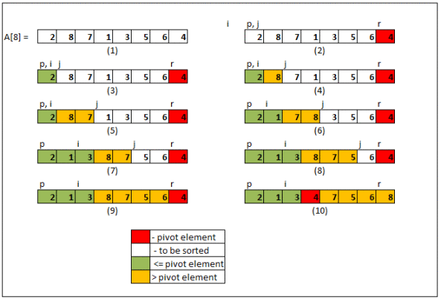
Partition
Notes:
https://sadakurapati.wordpress.com/2013/10/25/quicksort-a-practical-and-efficient-sorting-algorithm/

Slide 80
Sequential Quicksort Code
void qsort_serial(data_t *base, size_t nele) {
if (nele <= 1)
return;
if (nele == 2) {
if (base[0] > base[1])
swap(base, base+1);
return;
}
/* Partition returns index of pivot */
size_t m = partition(base, nele);
if (m > 1)
qsort_serial(base, m);
if (nele-1 > m+1)
qsort_serial(base+m+1, nele-m-1);
}
Sort nele elements starting at base
Recursively sort L or R if has more than one element

Slide 81
Parallel Quicksort
Parallel quicksort of set of values X
If N ≤ Nthresh, do sequential quicksort
Else
Choose “pivot” p from X
Rearrange X into
L: Values ≤ p
R: Values ≥ p
Recursively spawn separate threads
Sort L to get L′
Sort R to get R′
Return L′ : p : R′

Slide 82
Parallel Quicksort Visualized
X
p
L
p
R
p2
p3
L2
p2
R2
p
L3
p3
R3
•
•
•
•
•
•
L′
p
R′

Slide 83
Thread Structure: Sorting Tasks
X
• • •
Task Threads
Task: Sort subrange of data
Specify as:
base: Starting address
nele: Number of elements in subrange
Run as separate thread

Slide 84
Small Sort Task Operation
X
• • •
Task Threads
Sort subrange using serial quicksort

Slide 85
Large Sort Task Operation
X
L
p
R
Partition Subrange
• • •
X
L
p
R
Spawn 2 tasks
• • •

Slide 86
Top-Level Function (Simplified)
void tqsort(data_t *base, size_t nele) {
init_task(nele);
global_base = base;
global_end = global_base + nele - 1;
task_queue_ptr tq = new_task_queue();
tqsort_helper(base, nele, tq);
join_tasks(tq);
free_task_queue(tq);
}
Sets up data structures
Calls recursive sort routine
Keeps joining threads until none left
Frees data structures

Slide 87
Recursive sort routine (Simplified)
/* Multi-threaded quicksort */
static void tqsort_helper(data_t *base, size_t nele,
task_queue_ptr tq) {
if (nele <= nele_max_sort_serial) {
/* Use sequential sort */
qsort_serial(base, nele);
return;
}
sort_task_t *t = new_task(base, nele, tq);
spawn_task(tq, sort_thread, (void *) t);
}
Small partition: Sort serially
Large partition: Spawn new sort task

Slide 88
Sort task thread (Simplified)
/* Thread routine for many-threaded quicksort */
static void *sort_thread(void *vargp) {
sort_task_t *t = (sort_task_t *) vargp;
data_t *base = t->base;
size_t nele = t->nele;
task_queue_ptr tq = t->tq;
free(vargp);
size_t m = partition(base, nele);
if (m > 1)
tqsort_helper(base, m, tq);
if (nele-1 > m+1)
tqsort_helper(base+m+1, nele-m-1, tq);
return NULL;
}
Get task parameters
Perform partitioning step
Call recursive sort routine on each partition

Slide 89
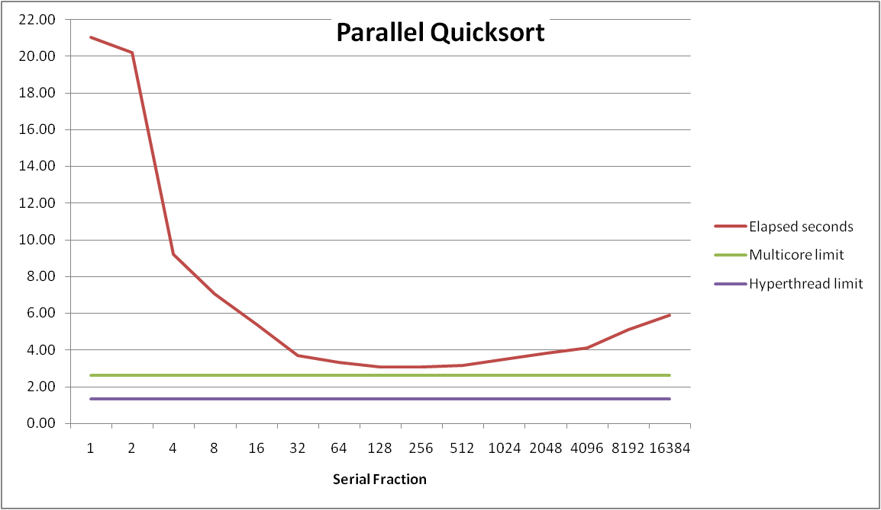
Parallel Quicksort Performance
Serial fraction: Fraction of input at which do serial sort
Sort 2²⁷ (134,217,728) random values
Best speedup = 6.84X

Slide 90
Parallel Quicksort Performance
Good performance over wide range of fraction values
F too small: Not enough parallelism
F too large: Thread overhead + run out of thread memory

Slide 91
Amdahl’s Law & Parallel Quicksort
Sequential bottleneck
Top-level partition: No speedup
Second level: ≤ 2X speedup
k^{th} level: ≤ 2^{k-1}X speedup
Implications
Good performance for small-scale parallelism
Would need to parallelize partitioning step to get large-scale parallelism
Parallel Sorting by Regular Sampling
H. Shi & J. Schaeffer, J. Parallel & Distributed Computing, 1992

Slide 92
Parallelizing Partitioning Step
X₁
X₂
X₃
X₄
p
Parallel partitioning based on global p
L₁
R₁
L₂
R₂
L₃
R₃
L₄
R₄
Reassemble into partitions
L₁
L₂
L₃
L₄
R₁
R₂
R₃
R₄

Slide 93
Reduction Problem
Problem Statement:
N worker threads do a portion of work in parallel
At the end of the computation, perform reduction to compute final result
Example: Count the number of words in N files
Each thread chooses some files to processes
Master thread reduces the files
Helpful Construct: barrier
Initialize the barrier with the number of threads to wait for
Barrier_wait() function waits for all threads to arrive

