Slide 1
Machine-Level Programming III: Procedures

Slide 2

Review 1
Instruction: movq %rdx,%rbx
How many bytes are moved?
8
What C datatype could %rdx be?
long long int, long long unsigned int, double
Pointer
Less likely: int, unsigned int, char, short …
Instruction: shrq %eax, %ebx
What does this instruction do?
Logical Shift Right (ebx = ebx >> eax)
What C datatype is %ebx likely to be?
unsigned int

Slide 3

Review 2: Why do we have registers???
Hardware principle: Accessing a larger storage structure takes longer (and more energy)!
Without registers this requires >10 memory operations
With registers, only 2 (1 load&store)
Memory
int a = array[i];
int b = a+1;
int c = a/10;
int d = a*20;
int e = a+c;
int f = e+d;
int array[i] = f;
…
Registers
CPU

Slide 4
Review 3
Where is “i”? (register or memory)
Register %edi (you’ll know why shortly)
Where is “v”?
Memory (it’s on the stack, you’ll know why shortly)
Where is “t” on line 5?
Likely in some register, don’t know which one. (possible its in memory)
Where is “t” on line 9?
Register %rax
How do I set %r14 from this code?
You can’t – compiler decides
How do I set a condition code?
Can’t directly, but can do a comparison.
How do I set memory? (eg. v[3])
v[3] = …
0: int func(int i)
1: {
2: int v[10];
3: •
4: •
5: int t = v[i];
6: •
7: •
8: t+=5;
9: return t;
10: }
Notes:
Why would it be a bad idea to allow a C-program to set a condition code?

Slide 5

Why learn assembly?!?
This is what Compilers do!
Understanding how to write fast programs.
Understanding sources of errors.
C
Program
X86-64
Assembly
This is what Hackers do!
Reverse engineering code without source.
Debugging low-level program errors.

Slide 6
Basic Block
Single-entry/Single-exit region of program
Control can only leave from the bottom
<+0>: mov $0x0,%eax
<+5>: mov $0x0,%edx
<+10>: jmp <func+22>

Slide 7
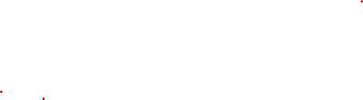
How to hack 1: break into basic blocks.
<+0>: mov $0x0,%eax
<+5>: mov $0x0,%edx
<+10>: jmp <func+22>
<+0>: mov $0x0,%eax
<+5>: mov $0x0,%edx
<+10>: jmp <func+22>
<+12>: test $0x1,%dl
<+15>: je <func+19>
<+17>: add %edx,%eax
<+19>: add $0x1,%edx
<+22>: cmp %edi,%edx
<+24>: jl <func+12>
<+26>: repz retq
<+12>: test $0x1,%dl <+15>: je <func+19>
<+17>: add %edx,%eax
<+19>: add $0x1,%edx
<+22>: cmp %edi,%edx
<+24>: jl <func+12>
<+26>: repz retq

Slide 8
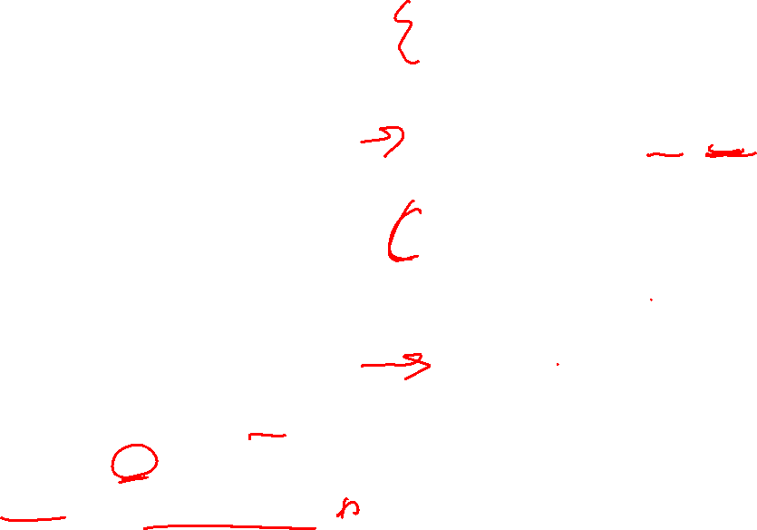
How to hack 2: put it together.
<+0>: mov $0x0,%eax
<+5>: mov $0x0,%edx
<+10>: jmp <func+22>
int func(int n) {
int ret = 0, x = 0;
goto L22
L12:
if(x & 1) {
ret += x;
}
++x;
L22:
if(x < n) goto L12
return ret;
}
<+12>: test $0x1,%dl <+15>: je <func+19>
<+17>: add %edx,%eax
<+19>: add $0x1,%edx
<+22>: cmp %edi,%edx
<+24>: jl <func+12>
Register | Use
%eax | Return Value: ret
%edx | x
%edi | Func First Arg.
<+26>: repz retq

Slide 9

How to hack 3: Make it pretty!
int func(int n) {
int ret = 0, x = 0;
goto L22
L12:
if(x & 1) {
ret += x;
}
++x;
L22:
if(x < n) goto L12
return ret;
}
int func(int n) {
int ret = 0, x = 0;
while(x < n) {
if(x & 1) {
ret += x;
}
++x;
}
return ret;
}

Slide 10
Did we get it right?????
int func(unsigned n) {
int ret = 0, i = 0;
for(; i < n; ++i) {
if(i & 1) {
ret += i;
}
}
return ret;
}
int func(int n) {
int ret = 0, x = 0;
while(x < n) {
if(x & 1) {
ret += x;
}
++x;
}
return ret;
}
original code
our guess

Slide 11
Program Structures 1
Loop
“If” statement
“If/else” statement

Slide 12
Program Structures 2
“switch” statement

Slide 13
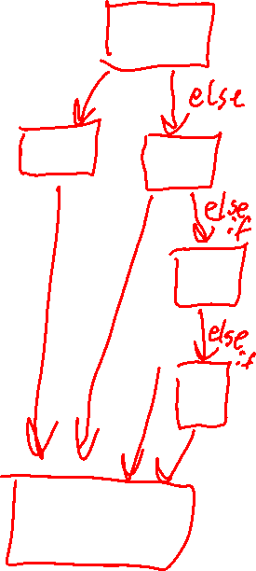
Machine-Level Programming III: Procedures

Slide 14
Outline
Procedures
Stack Structure
Calling Conventions
Passing control
Passing data
Managing local data
Illustration of Recursion

Slide 15
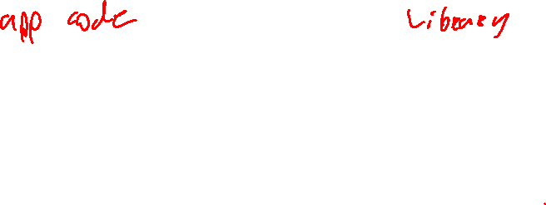
API: Application Programming Interface
void multstore
(long x, long y, long *dest) {
long t = mult2(x, y);
*dest = t;
}
long mult2
(long a, long b)
{
long s = a * b;
return s;
}
Compilation
0000000000400540 <multstore>:
400540: push %rbx
400541: mov %rdx,%rbx
400544: callq 400550 <mult2>
400549: mov %rax,(%rbx)
40054c: pop %rbx
40054d: retq
0000000000400550 <mult2>:
400550: mov %rdi,%rax
400553: imul %rsi,%rax
400557: retq
ABI: Application Binary Interface

Slide 16
ABI Mechanisms in Procedures
Passing control
To beginning of procedure code
Back to return point
Passing data
Procedure arguments
Return value
Memory management
Allocate during procedure execution
Deallocate upon return
Mechanisms all implemented with machine instructions
x86-64 implementation of a procedure uses only those mechanisms required
P(…) {
•
•
y = Q(x);
print(y)
•
}
int Q(int i)
{
int t = 3*i;
int v[10];
•
•
return v[t];
}

Slide 17
How to manage memory local to a function?
One idea:
Give each function a special place in memory to put its temporary values.
Why doesn’t this work?
Think about if Q calls itself…
Or maybe P -> Q -> P -> Q
How to distinguish?
What data-structure could we use to keep track of which functions are active?
int Q(int i)
{
int t = 3*i;
int v[10];
•
•
return v[t];
}
Notes:
We can use a version of a stack to keep track of the live data

Slide 18

x86-64 Stack
Stack “Bottom”
Region of memory managed with stack discipline
Grows toward lower addresses
Register %rsp contains lowest stack address
address of “top” element
Could use normal instructions to modify %rsp, but it would cost two instructions: push: decrement and write pop: read and increment
Increasing
Addresses
Stack Grows
Down
Stack Pointer: %rsp
Stack “Top”

Slide 19
x86-64 Stack: Push
Stack “Bottom”
pushq Src
Fetch operand at Src
Decrement %rsp by 8
Write operand at address given by %rsp
Increasing
Addresses
Stack Grows
Down
Stack Pointer: %rsp
-8
Stack “Top”

Slide 20

x86-64 Stack: Pop
Stack “Bottom”
popq Dest
Read value at address given by %rsp
Increment %rsp by 8
Store value at Dest (must be register)
Increasing
Addresses
Stack Grows
Down
Stack Pointer: %rsp
+8
Stack “Top”

Slide 21
Outline
Procedures
Stack Structure
Calling Conventions
Passing control
Passing data
Managing local data
Illustration of Recursion

Slide 22
Code Examples
void multstore
(long x, long y, long *dest) {
long t = mult2(x, y);
*dest = t;
}
0000000000400540 <multstore>:
400540: push %rbx # Save %rbx
400541: mov %rdx,%rbx # Save dest
400544: callq 400550 <mult2> # mult2(x,y)
400549: mov %rax,(%rbx) # Save at dest
40054c: pop %rbx # Restore %rbx
40054d: retq # Return
long mult2
(long a, long b)
{
long s = a * b;
return s;
}
0000000000400550 <mult2>:
400550: mov %rdi,%rax # a
400553: imul %rsi,%rax # a * b
400557: retq # Return

Slide 23
Procedure Control Flow
Now explain how to use stack to support procedure call and return
Two new instructions:
Procedure call: call label
Push return address on stack
Jump to label
Return address:
Address of the next instruction right after call
Example from disassembly
Procedure return: ret
Pop address from stack
Jump to address

Slide 24

Control Flow Example #1
•
•
•
0x130
0000000000400540 <multstore>:
•
•
400544: callq 400550 <mult2>
400549: mov %rax,(%rbx)
•
•
0x128
0x120
%rsp
0x120
%rip
0x400544
0000000000400550 <mult2>:
400550: mov %rdi,%rax
•
•
400557: retq
Registers
Memory

Slide 25
Control Flow Example #2
•
•
•
0x130
0000000000400540 <multstore>:
•
•
400544: callq 400550 <mult2>
400549: mov %rax,(%rbx)
•
•
0x128
0x120
0x118
0x400549
%rsp
0x118
%rip
0x400550
0000000000400550 <mult2>:
400550: mov %rdi,%rax
•
•
400557: retq
Registers
Memory

Slide 26
Control Flow Example #3
•
•
•
0x130
0000000000400540 <multstore>:
•
•
400544: callq 400550 <mult2>
400549: mov %rax,(%rbx)
•
•
0x128
0x120
0x118
0x400549
%rsp
0x118
%rip
0x400557
0000000000400550 <mult2>:
400550: mov %rdi,%rax
•
•
400557: retq
Registers
Memory

Slide 27
Control Flow Example #4
•
•
•
0x130
0000000000400540 <multstore>:
•
•
400544: callq 400550 <mult2>
400549: mov %rax,(%rbx)
•
•
0x128
0x120
%rsp
0x120
%rip
0x400549
0000000000400550 <mult2>:
400550: mov %rdi,%rax
•
•
400557: retq
Registers
Memory

Slide 28
Outline
Procedures
Stack Structure
Calling Conventions
Passing control
Passing data
Managing local data
Illustrations of Recursion & Pointers

Slide 29
Procedure Arguments and Return Value (determined by ABI)
Registers
Stack
First 6 arguments
Return value
• • •
%rdi
%rsi
Arg n
%rdx
• • •
%rcx
%r8
Arg 8
%r9
Arg 7
%rax
Only allocate stack space when needed

Slide 30
Proceed. Arg. Examples
void multstore
(long x, long y, long *dest) {
long t = mult2(x, y);
*dest = t;
}
Now we can fill in the arguments & return val!
0000000000400540 <multstore>:
# x in %rdi, y in %rsi, dest in %rdx
• • •
400541: mov %rdx,%rbx # Save dest
400544: callq 400550 <mult2> # mult2(x,y)
# t in %rax
400549: mov %rax,(%rbx) # Save at dest
• • •
long mult2
(long a, long b)
{
long s = a * b;
return s;
}
0000000000400550 <mult2>:
# a in %rdi, b in %rsi
400550: mov %rdi,%rax # a
400553: imul %rsi,%rax # a * b
# s in %rax
400557: retq # Return

Slide 31
Outline
Procedures
Stack Structure
Calling Conventions
Passing control
Passing data
Managing local data
Illustration of Recursion

Slide 32
Stack-Based Languages
Languages that support recursion
e.g., C, Pascal, Java
Code must be “Reentrant”
Multiple simultaneous instantiations of single procedure
Need some place to store state of each instantiation
Arguments
Local variables
Return pointer
Stack discipline
State for given procedure needed for limited time
From when called to when return
Callee returns before caller does
Stack allocated in Frames
state for single procedure instantiation

Slide 33
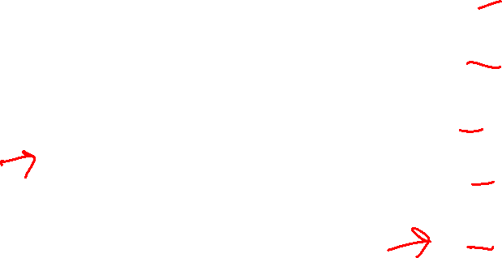
Call Chain Example
Example
Call Chain
yoo(…)
{
•
•
who();
•
•
}
yoo
who(…)
{
• • •
amI();
• • •
amI();
• • •
}
who
amI(…)
{
•
•
amI();
•
•
}
amI
amI
amI
amI
Procedure amI() is recursive

Slide 34
Stack Frames
Previous Frame
Frame for proc
Contents
Return information
Local storage (if needed)
Temporary space (if needed)
Management
Space allocated when enter procedure
“Set-up” code
Includes push by call instruction
Deallocated when return
“Finish” code
Includes pop by ret instruction
Stack Pointer: %rsp
Stack “Top”

Slide 35
Example
Stack
yoo
yoo(…)
{
•
•
who();
•
•
}
yoo
yoo
who
%rsp
amI
amI
amI
amI

Slide 36
Example
Stack
yoo
who
yoo(…)
{
•
•
who();
•
•
}
yoo
who(…)
{
• • •
amI();
• • •
amI();
• • •
}
yoo
who
amI
amI
%rsp
amI
amI

Slide 37
Example
Stack
yoo
who
amI
yoo(…)
{
•
•
who();
•
•
}
yoo
who(…)
{
• • •
amI();
• • •
amI();
• • •
}
yoo
amI(…)
{
•
•
amI();
•
•
}
who
amI
amI
amI
%rsp
amI

Slide 38
Example
Stack
yoo
who
amI
amI
yoo(…)
{
•
•
who();
•
•
}
yoo
who(…)
{
• • •
amI();
• • •
amI();
• • •
}
yoo
amI(…)
{
•
•
amI();
•
•
}
who
amI(…)
{
•
•
amI();
•
•
}
amI
amI
amI
amI
%rsp

Slide 39
Example
Stack
yoo
who
amI
amI
amI
yoo(…)
{
•
•
who();
•
•
}
yoo
who(…)
{
• • •
amI();
• • •
amI();
• • •
}
yoo
amI(…)
{
•
•
amI();
•
•
}
who
amI(…)
{
•
•
amI();
•
•
}
amI
amI
amI(…)
{
•
•
amI();
•
•
}
amI
amI
%rsp

Slide 40
Example
Stack
yoo
who
amI
amI
yoo(…)
{
•
•
who();
•
•
}
yoo
who(…)
{
• • •
amI();
• • •
amI();
• • •
}
yoo
amI(…)
{
•
•
amI();
•
•
}
who
amI(…)
{
•
•
amI();
•
•
}
amI
amI
amI
amI
%rsp

Slide 41
Example
Stack
yoo
who
amI
yoo(…)
{
•
•
who();
•
•
}
yoo
who(…)
{
• • •
amI();
• • •
amI();
• • •
}
yoo
amI(…)
{
•
•
amI();
•
•
}
who
amI
amI
amI
%rsp
amI

Slide 42
Example
Stack
yoo
who
yoo(…)
{
•
•
who();
•
•
}
yoo
who(…)
{
• • •
amI();
• • •
amI();
• • •
}
yoo
who
amI
amI
%rsp
amI
amI

Slide 43
Example
Stack
yoo
who
amI
yoo(…)
{
•
•
who();
•
•
}
yoo
who(…)
{
• • •
amI();
• • •
amI();
• • •
}
yoo
amI(…)
{
•
•
amI();
•
•
}
who
amI
amI
amI
%rsp
amI

Slide 44
Example
Stack
yoo
who
yoo(…)
{
•
•
who();
•
•
}
yoo
who(…)
{
• • •
amI();
• • •
amI();
• • •
}
yoo
who
amI
amI
%rsp
amI
amI

Slide 45
Example
Stack
yoo
yoo
yoo(…)
{
•
•
who();
•
•
}
yoo
who
%rsp
amI
amI
amI
amI

Slide 46
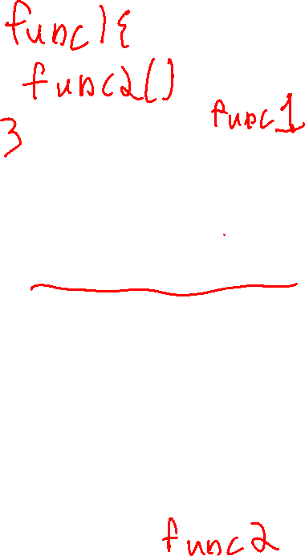
x86-64/Linux Stack Frame
Current Stack Frame (“Top” to Bottom)
“Argument build:” Parameters for function about to call
Local variables If can’t keep in registers
Saved register context
Caller Stack Frame
Return address
Pushed by call instruction
Arguments for this call
Caller
Frame
Arguments
7+
Return Addr
Saved
Registers
+
Local
Variables
Argument
Build
(Optional)
Stack pointer
%rsp

Slide 47
Optional Base Pointer
Stack
yoo
who
amI
Caller
Frame
Arguments
7+
yoo
Frame pointer %rbp
Return Addr
Old %rbp
(Optional)
Saved
Registers
+
Local
Variables
%rbp
%rsp
Argument
Build
(Optional)
Stack pointer
%rsp

Slide 48
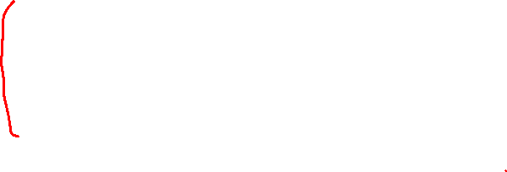
Example: incr
long incr(long *p, long val) {
long x = *p;
long y = x + val;
*p = y;
return x;
}
Increment *p by val
incr:
movq (%rdi), %rax
addq %rax, %rsi
movq %rsi, (%rdi)
ret
Register | Use(s)
%rdi | Argument p
%rsi | Argument val, y
%rax | x, Return value

Slide 49
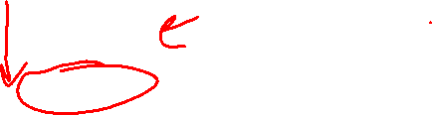
Example: Calling incr #1
Initial Stack Structure
long call_incr() {
long v1 = 39000;
long v2 = incr(&v1, 3000);
return v1+v2;
}
. . .
Rtn address
%rsp
Why is v1 (ie. 39000) being stored in memory?
call_incr:
subq $16, %rsp
movq $39000, 8(%rsp)
movl $3000, %esi
leaq 8(%rsp), %rdi
call incr
addq 8(%rsp), %rax
addq $16, %rsp
ret
Resulting Stack Structure
. . .
Rtn address
39000
%rsp+8
Unused
%rsp
Notes:
…. Because we are passing a *POINTER* to it, so it has to be in memory

Slide 50
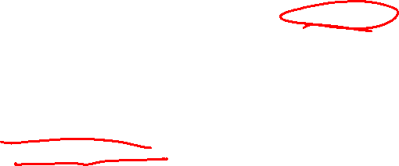
Example: Calling incr #2
Stack Structure
long call_incr() {
long v1 = 39000;
long v2 = incr(&v1, 3000);
return v1+v2;
}
. . .
Rtn address
39000
%rsp+8
Unused
%rsp
call_incr:
subq $16, %rsp
movq $39000, 8(%rsp)
movl $3000, %esi
leaq 8(%rsp), %rdi
call incr
addq 8(%rsp), %rax
addq $16, %rsp
ret
Register | Use(s)
%rdi | &v1
%rsi | 3000
What are we doing here?
Notes:
Setting up the arguments to incr!

Slide 51
Example: Calling incr #3
Stack Structure
long call_incr() {
long v1 = 39000;
long v2 = incr(&v1, 3000);
return v1+v2;
}
. . .
Rtn address
42000
%rsp+8
Unused
%rsp
call_incr:
subq $16, %rsp
movq $39000, 8(%rsp)
movl $3000, %esi
leaq 8(%rsp), %rdi
call incr
addq 8(%rsp), %rax
addq $16, %rsp
ret
Register | Use(s)
%rdi | &v1
%rsi | 3000

Slide 52
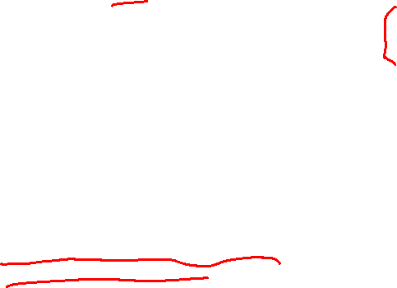
Example: Calling incr #4
Stack Structure
long call_incr() {
long v1 = 39000;
long v2 = incr(&v1, 3000);
return v1+v2;
}
. . .
Rtn address
42000
%rsp+8
Unused
%rsp
call_incr:
subq $16, %rsp
movq $39000, 8(%rsp)
movl $3000, %esi
leaq 8(%rsp), %rdi
call incr
addq 8(%rsp), %rax
addq $16, %rsp
ret
Register | Use(s)
%rax | Return value
Updated Stack Structure
. . .
Rtn address
%rsp

Slide 53
Example: Calling incr #5
Updated Stack Structure
long call_incr() {
long v1 = 39000;
long v2 = incr(&v1, 3000);
return v1+v2;
}
. . .
Rtn address
%rsp
call_incr:
subq $16, %rsp
movq $39000, 8(%rsp)
movl $3000, %esi
leaq 8(%rsp), %rdi
call incr
addq 8(%rsp), %rax
addq $16, %rsp
ret
Register | Use(s)
%rax | Return value
Final Stack Structure
. . .
%rsp

Slide 54
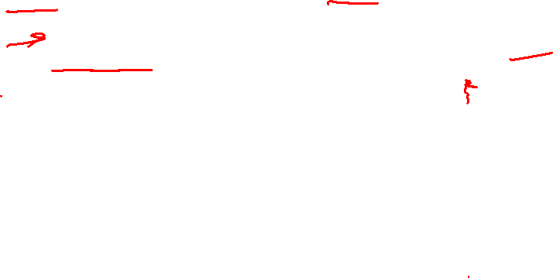
Register Saving Conventions
When procedure yoo calls who:
yoo is the caller
who is the callee
Problem with rdx!
Contents of register %rdx overwritten by who
This could be trouble ➙ something should be done!
Need some coordination
Can register be used for temporary storage across call?
yoo:
• • •
movq $39000, %rdx
call who
addq %rdx, %rax
• • •
ret
who:
• • •
subq $42000, %rdx
• • •
ret

Slide 55
Register Saving Conventions
Who is responsible for saving the register?
ABI Conventions for register saving:
“Caller Saved”
Caller’s responsibility to save if the register is live (if its still needed)
Caller saves temporary values in its frame before the call
“Callee Saved”
Callee saves temporary values in its frame before using
Callee restores them before returning to caller

Slide 56
x86-64 Linux Register Usage #1
%rax
Return value
Also caller-saved
Can be modified by procedure
%rdi, ..., %r9
Arguments
Also caller-saved
Can be modified by procedure
%r10, %r11
Caller-saved
Can be modified by procedure
Return value
%rax
%rdi
%rsi
%rdx
Arguments
%rcx
%r8
%r9
%r10
Caller-saved
temporaries
%r11

Slide 57


x86-64 Linux Register Usage #2
%rbx
%r12
%rbx, %rbp,%r12-%r15
Callee-saved
Callee must save & restore
%rsp
Special form of callee save
Restored to original value upon exit from procedure
Callee-saved
Temporaries
%r13
%r14
%r15
%rbp
Special
%rsp
‘s are callee saved

Slide 58
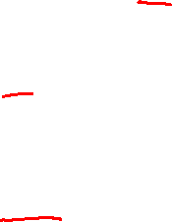
Callee-Saved Example #1
Initial Stack Structure
long call_incr2(long x) {
long v1 = 39000;
long v2 = incr(&v1, 3000);
return x+v2;
}
. . .
Rtn address
%rsp
call_incr2:
pushq %rbx
subq $16, %rsp
movq %rdi, %rbx
movq $39000, 8(%rsp)
movl $3000, %esi
leaq 8(%rsp), %rdi
call incr
addq %rbx, %rax
addq $16, %rsp
popq %rbx
ret
Resulting Stack Structure
. . .
Rtn address
Saved %rbx
39000
%rsp+8
Unused
%rsp

Slide 59
Callee-Saved Example #2
Resulting Stack Structure
long call_incr2(long x) {
long v1 = 39000;
long v2 = incr(&v1, 3000);
return x+v2;
}
. . .
Rtn address
Saved %rbx
42000
%rsp+8
call_incr2:
pushq %rbx
subq $16, %rsp
movq %rdi, %rbx
movq $39000, 8(%rsp)
movl $3000, %esi
leaq 8(%rsp), %rdi
call incr
addq %rbx, %rax
addq $16, %rsp
popq %rbx
ret
Unused
%rsp
Pre-return Stack Structure
. . .
Rtn address
%rsp

Slide 60
Outline
Procedures
Stack Structure
Calling Conventions
Passing control
Passing data
Managing local data
Illustration of Recursion

Slide 61
Recursive Function
/* Recursive popcount */
long pcount_r(unsigned long x) {
if (x == 0)
return 0;
else
return (x & 1)
+ pcount_r(x >> 1);
}
pcount_r:
movl $0, %eax
testq %rdi, %rdi
je .L6
pushq %rbx
movq %rdi, %rbx
andl $1, %ebx
shrq %rdi # (by 1)
call pcount_r
addq %rbx, %rax
popq %rbx
.L6:
ret

Slide 62
Recursive Function Terminal Case
/* Recursive popcount */
long pcount_r(unsigned long x) {
if (x == 0)
return 0;
else
return (x & 1)
+ pcount_r(x >> 1);
}
pcount_r:
movl $0, %eax
testq %rdi, %rdi
je .L6
pushq %rbx
movq %rdi, %rbx
andl $1, %ebx
shrq %rdi # (by 1)
call pcount_r
addq %rbx, %rax
popq %rbx
.L6:
ret
Register | Use(s) | Type
%rdi | x | Argument
%rax | Return value | Return value

Slide 63
Recursive Function Register Save
/* Recursive popcount */
long pcount_r(unsigned long x) {
if (x == 0)
return 0;
else
return (x & 1)
+ pcount_r(x >> 1);
}
pcount_r:
movl $0, %eax
testq %rdi, %rdi
je .L6
pushq %rbx
movq %rdi, %rbx
andl $1, %ebx
shrq %rdi # (by 1)
call pcount_r
addq %rbx, %rax
popq %rbx
.L6:
ret
Register | Use(s) | Type
%rdi | x | Argument
. . .
Rtn address
Saved %rbx
%rsp

Slide 64
Recursive Function Call Setup
/* Recursive popcount */
long pcount_r(unsigned long x) {
if (x == 0)
return 0;
else
return (x & 1)
+ pcount_r(x >> 1);
}
pcount_r:
movl $0, %eax
testq %rdi, %rdi
je .L6
pushq %rbx
movq %rdi, %rbx
andl $1, %ebx
shrq %rdi # (by 1)
call pcount_r
addq %rbx, %rax
popq %rbx
.L6:
ret
Register | Use(s) | Type
%rdi | x >> 1 | Rec. argument
%rbx | x & 1 | Callee-saved

Slide 65
Recursive Function Call
/* Recursive popcount */
long pcount_r(unsigned long x) {
if (x == 0)
return 0;
else
return (x & 1)
+ pcount_r(x >> 1);
}
pcount_r:
movl $0, %eax
testq %rdi, %rdi
je .L6
pushq %rbx
movq %rdi, %rbx
andl $1, %ebx
shrq %rdi # (by 1)
call pcount_r
addq %rbx, %rax
popq %rbx
.L6:
ret
Register | Use(s) | Type
%rbx | x & 1 | Callee-saved
%rax | Recursive call return value

Slide 66
Recursive Function Result
/* Recursive popcount */
long pcount_r(unsigned long x) {
if (x == 0)
return 0;
else
return (x & 1)
+ pcount_r(x >> 1);
}
pcount_r:
movl $0, %eax
testq %rdi, %rdi
je .L6
pushq %rbx
movq %rdi, %rbx
andl $1, %ebx
shrq %rdi # (by 1)
call pcount_r
addq %rbx, %rax
popq %rbx
.L6:
ret
Register | Use(s) | Type
%rbx | x & 1 | Callee-saved
%rax | Return value

Slide 67
Recursive Function Completion
/* Recursive popcount */
long pcount_r(unsigned long x) {
if (x == 0)
return 0;
else
return (x & 1)
+ pcount_r(x >> 1);
}
pcount_r:
movl $0, %eax
testq %rdi, %rdi
je .L6
pushq %rbx
movq %rdi, %rbx
andl $1, %ebx
shrq %rdi # (by 1)
call pcount_r
addq %rbx, %rax
popq %rbx
.L6:
ret
Register | Use(s) | Type
%rax | Return value | Return value
. . .
%rsp

Slide 68
Observations About Recursion
Handled Without Special Consideration
Stack frames mean that each function call has private storage
Saved registers & local variables
Saved return pointer
Register saving conventions prevent one function call from corrupting another’s data
Unless the C code explicitly does so (e.g., buffer overflow)
Stack discipline follows call / return pattern
If P calls Q, then Q returns before P
Last-In, First-Out
Also works for mutual recursion
P calls Q; Q calls P

Slide 69
x86-64 Procedure Summary
Important Points
Stack is the right data structure for procedure call / return
If P calls Q, then Q returns before P
Recursion (& mutual recursion) handled by normal calling conventions
Can safely store values in local stack frame and in callee-saved registers
Put function arguments at top of stack
Result return in %rax
Pointers are addresses of values
On stack or global
Caller
Frame
Arguments
7+
Return Addr
Saved
Registers
+
Local
Variables
Argument
Build
%rsp

Slide 70
