Slide 1


CS33 Lecture 13: Exceptional Control Flow: Exceptions and Processes
Tony Nowatzki
Trigger Warning: Zombies and Dead Children

Slide 2
Today
Exceptional Control Flow
Exceptions
Processes
Process Control
Signals (if time)

Slide 3
Control Flow
CPU Execution model (Von Neumann):
Each instruction modifies program state (registers/memory)
Sequentially interpret instructions
Next instruction determined only by previous instruction and state of the program
Control Flow Mechanisms:
Jumps (direct/indirect)
Conditional Branches (maybe jump)
Calls and returns (jump but keep track of stack)
React to changes in program state

Slide 4
How to React to Events?
Insufficient for a useful system: Difficult to react to changes in system (external) state
Data arrives from a disk or a network adapter
Instruction divides by zero
User hits Ctrl-C at the keyboard
System timer expires
Couldn’t we poll this state?
while(keyboard_pressed == false) { do something else}
System needs mechanisms for “exceptional control flow”

Slide 5
Exceptional Control Flow
Exceptions:
Change in control flow in response to a system event (i.e., change in system state)
Implemented using combination of hardware and OS software
What can you do with exceptions?
Process context switch
Implemented by OS software and hardware timer
Signals (messages from operating system)
Implemented by OS software

Slide 6
Today
Exceptional Control Flow
Exceptions
Processes
Process Control

Slide 7
Exceptions
An exception is a transfer of control to the OS kernel in response to some event (i.e., change in processor state)
Kernel is the memory-resident part of the OS (manages core functionality)
Examples of events: Divide by 0, arithmetic overflow, page fault, I/O request completes, typing Ctrl-C
User code
Kernel code
Event
I_current
Exception
I_next
Exception processing
by exception handler
Return to I_current
Return to I_next
Abort

Slide 8
Exception Tables
Exception
numbers
Code for
exception handler 0
Each type of event has a unique exception number k
k = index into exception table (a.k.a. interrupt vector)
Handler k is called each time exception k occurs
Exception
Table
Code for
exception handler 1
0
1
Code for
exception handler 2
2
...
n-1
...
Code for
exception handler n-1

Slide 9
Asynchronous Exceptions (Interrupts)
Caused by events external to the processor
Indicated by setting the processor’s interrupt pin
Handler returns to “next” instruction
Examples:
Timer interrupt
Every few ms, an external timer chip triggers an interrupt
Used by the kernel to take back control from user programs
I/O interrupt from external device
Hitting Ctrl-C at the keyboard
Arrival of a packet from a network
Arrival of data from a disk

Slide 10
Synchronous Exceptions
Caused by events that occur as a result of executing an instruction:
Traps
Intentional
Examples: system calls, breakpoint traps, special instructions
Returns control to “next” instruction
Faults
Unintentional but possibly recoverable
Examples: page faults (recoverable), protection faults (unrecoverable), floating point exceptions
Either re-executes faulting (“current”) instruction or aborts
Aborts
Unintentional and unrecoverable
Examples: illegal instruction, parity error, machine check
Aborts current program

Slide 11
Exception Disambiguation
Exception Handling (in the programming language sense)
Exception (to the OS)
User code
Kernel code
try {
if(something_bad) {
throw an_exception;
}
}
catch(exception e) {
///... do something with e
}
Event
I_current
Exception
I_next
Our Focus
Implemented with non-local jumps:
setjmp() and longjmp()in C runtime library – no OS necessary

Slide 12
System Calls
Each x86-64 system call has a unique ID number
syscall instruction switches control into the OS
Number | Name | Description
0 | read | Read file
1 | write | Write file
2 | open | Open file
3 | close | Close file
4 | stat | Get info about file
12 | sbrk | Change data segment size
57 | fork | Create process
59 | execve | Execute a program
60 | _exit | Terminate process
62 | kill | Send signal to process

Slide 13
System Call Example: Opening File
User calls: open(filename, options)
Calls __open function, which invokes system call instruction syscall
00000000000e5d70 <__open>:
...
e5d79: b8 02 00 00 00 mov $0x2,%eax # open is syscall #2
e5d7e: 0f 05 syscall # Return value in %rax
e5d80: 48 3d 01 f0 ff ff cmp $0xfffffffffffff001,%rax
...
e5dfa: c3 retq
User code
Kernel code
%rax contains syscall number
Other arguments in %rdi, %rsi, %rdx, %r10, %r8, %r9
Return value in %rax
Negative value is an error corresponding to negative errno
syscall
Exception
cmp
Open file
Returns

Slide 14
Fault Example: Page Fault
int a[1000];
main ()
{
a[500] = 13;
}
User writes to memory location
That portion (page) of user’s memory is currently on disk
80483b7: c7 05 10 9d 04 08 0d movl $0xd,0x8049d10
User code
Kernel code
Exception: page fault
movl
Allocate a page of memory
Return and reexecute movl

Slide 15
Fault Example: Invalid Memory Reference
int a[1000];
main ()
{
a[5000] = 13;
}
80483b7: c7 05 60 e3 04 08 0d movl $0xd,0x804e360
User code
Kernel code
Exception: page fault
movl
Detect invalid address
Signal process
Sends SIGSEGV signal to user process
User process exits with “segmentation fault”

Slide 16
Today
Exceptional Control Flow
Exceptions
Processes
Process Control

Slide 17
Processes
Definition: A process is an instance of a running program.
Not the same as “program” or “processor”
Process provides each program with two key abstractions:
Logical control flow
Each program seems to have exclusive use of the CPU
Provided by kernel mechanism called context switching
Private address space
Each program seems to have exclusive use of main memory.
Provided by kernel mechanism called virtual memory
Memory
Stack
Heap
Data
Code
CPU
Registers

Slide 18
Multiprocessing: The Illusion
Memory
Memory
Memory
Stack
Stack
Stack
Heap
Heap
…
Heap
Data
Data
Data
Code
Code
Code
CPU
CPU
CPU
Registers
Registers
Registers
Computer runs many processes simultaneously
Applications for one or more users
Web browsers, email clients, editors, …
Background tasks
Monitoring network & I/O devices

Slide 19
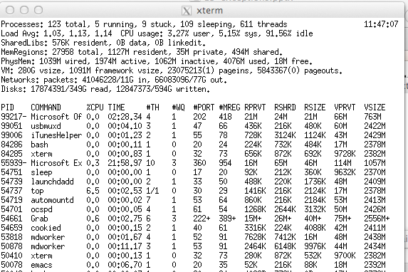
Multiprocessing Example
Running program “top” on Mac
System has 123 processes, 5 of which are active
Identified by Process ID (PID)

Slide 20
Multiprocessing On a Single Core
Memory
Stack
Stack
Stack
Heap
Heap
…
Heap
Data
Data
Data
Code
Code
Code
Saved registers
Saved registers
Saved registers
CPU
Registers
Single processor executes multiple processes concurrently
Process executions interleaved (multitasking)
Address spaces managed by virtual memory system (later in course)
Register values for nonexecuting processes saved in memory

Slide 21
Multiprocessing On a Single Core
Memory
Stack
Stack
Stack
Heap
Heap
…
Heap
Data
Data
Data
Code
Code
Code
Saved registers
Saved registers
Saved registers
CPU
Registers
Save current registers in memory

Slide 22
Multiprocessing On a Single Core
Memory
Stack
Stack
Stack
Heap
Heap
…
Heap
Data
Data
Data
Code
Code
Code
Saved registers
Saved registers
Saved registers
CPU
Registers
Schedule next process for execution

Slide 23
Multiprocessing On a Single Core
Memory
Stack
Stack
Stack
Heap
Heap
…
Heap
Data
Data
Data
Code
Code
Code
Saved registers
Saved registers
Saved registers
CPU
Registers
Load saved registers and switch address space (context switch)

Slide 24
Multiprocessing On Multiple Cores
Memory
Stack
Stack
Stack
Heap
Heap
…
Heap
Data
Data
Data
Code
Code
Code
Saved registers
Saved registers
Saved registers
CPU
CPU
Multicore processors
Multiple CPUs on single chip
Share main memory (and some of the caches)
Each can execute a separate process
Scheduling of processors onto cores done by kernel
Registers
Registers

Slide 25
Concurrent Processes
Each process is a logical control flow.
Two processes run concurrently (are concurrent) if their flows overlap in time
Otherwise, they are sequential
Examples (running on single core):
Concurrent: A & B, A & C
Sequential: B & C
Process A
Process B
Process C
Time

Slide 26
User View of Concurrent Processes
Control flows for concurrent processes are physically disjoint in time
However, we can think of concurrent processes as running in parallel with each other
Process A
Process B
Process C
Time

Slide 27
Context Switching
Processes are managed by a shared chunk of memory-resident OS code called the kernel
Important: the kernel is not a separate process, but rather runs as part of some existing process.
Control flow passes from one process to another via a context switch
Process A
Process B
user code
kernel code
context switch
Time
user code
kernel code
context switch
user code

Slide 28
Today
Exceptional Control Flow
Exceptions
Processes
Process Control (functions for manipulating processes)

Slide 29
Linux Process Hierarchy
[0]
init [1]
Daemon
e.g. httpd
…
…
…
shell
shell
Child
Child
Child
Grandchild
Grandchild
Note: you can view the hierarchy using the Linux pstree command

Slide 30
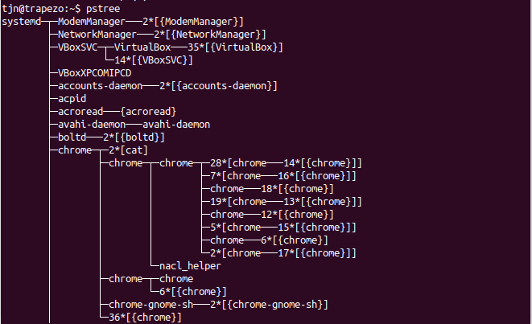

Slide 31
Obtaining Process IDs
pid_t getpid(void)
Returns PID of current process
pid_t getppid(void)
Returns PID of parent process

Slide 32
Creating and Terminating Processes
From a programmer’s perspective, we can think of a process as being in one of three states
Running
Process is either executing, or waiting to be executed and will eventually be scheduled (i.e., chosen to execute) by the kernel
Stopped
Process execution is suspended and will not be scheduled until further notice
Terminated
Process is stopped permanently

Slide 33
Terminating Processes
Process becomes terminated for one of three reasons:
Receiving a signal whose default action is to terminate
Returning from the main routine
Calling the exit function
void exit(int status)
Terminates with an exit status of status
Convention: normal return status is 0, nonzero on error
Another way to explicitly set the exit status is to return an integer value from the main routine
exit is called once but never returns.

Slide 34
Creating Processes
Parent process creates a new running child process by calling fork
int fork(void)
Returns 0 to the child process, child’s PID to parent process
Child is almost identical to parent:
Child has a different PID than the parent
Child get an identical (but separate) copy of the parent’s virtual address space (and file descriptors).
fork is interesting (and often confusing) because it is called once but returns twice

Slide 35
fork Example
Call once, return twice
Concurrent execution
Can’t predict execution order of parent and child
Duplicate but separate address space
x has a value of 1 when fork returns in parent and child
Subsequent changes to x are independent
Shared open files
stdout is the same in both parent and child
int main()
{
pid_t pid;
int x = 1;
pid = Fork();
if (pid == 0) { /* Child */
printf("child : x=%d\n", ++x);
exit(0);
}
/* Parent */
printf("parent: x=%d\n", --x);
exit(0);
}
fork.c
linux> ./fork
parent: x=0
child : x=2

Slide 36
Modeling fork with Process Graphs
A process graph is a useful tool for capturing the partial ordering of statements in a concurrent program:
Each vertex is the execution of a statement
a -> b means a happens before b
Edges can be labeled with current value of variables
printf vertices can be labeled with output
Each graph begins with a vertex with no inedges
Any topological sort of the graph corresponds to a feasible total ordering.
Total ordering of vertices where all edges point from left to right

Slide 37
Process Graph Example
int main()
{
pid_t pid;
int x = 1;
pid = Fork();
if (pid == 0) { /* Child */
printf("child : x=%d\n", ++x);
exit(0);
}
/* Parent */
printf("parent: x=%d\n", --x);
exit(0);
}
child: x=2
Child
printf
exit
x==1
parent: x=0
Parent
main
fork
printf
exit
fork.c

Slide 38
Interpreting Process Graphs
Original graph:
Relabled graph:
child: x=2
printf
exit
x==1
parent: x=0
main
fork
printf
exit
Feasible total ordering:
e
f
a
b
e
c
f
d
a
b
c
d
Infeasible total ordering:
a
b
f
c
e
d

Slide 39
fork Example: Two consecutive forks
Bye
void fork2()
{
printf("L0\n");
fork();
printf("L1\n");
fork();
printf("Bye\n");
}
printf
L1
Bye
printf
fork
printf
Bye
printf
L0
L1
Bye
forks.c
printf
fork
printf
fork
printf
Feasible output:
L0
L1
Bye
Bye
L1
Bye
Bye
Infeasible output:
L0
Bye
L1
Bye
L1
Bye
Bye

Slide 40
fork Example: Nested forks in parent
void fork4()
{
printf("L0\n");
if (fork() != 0) {
printf("L1\n");
if (fork() != 0) {
printf("L2\n");
}
}
printf("Bye\n");
}
Bye
Bye
printf
printf
L0
L1
L2
Bye
printf
fork
printf
fork
printf
printf
forks.c
Feasible output:
L0
L1
Bye
Bye
L2
Bye
Infeasible output:
L0
Bye
L1
Bye
Bye
L2

Slide 41
fork Example: Nested forks in children
void fork5()
{
printf("L0\n");
if (fork() == 0) {
printf("L1\n");
if (fork() == 0) {
printf("L2\n");
}
}
printf("Bye\n");
}
L2
Bye
printf
printf
L1
Bye
printf
fork
printf
L0
Bye
printf
fork
printf
Feasible output:
L0
Bye
L1
L2
Bye
Bye
Infeasible output:
L0
Bye
L1
Bye
Bye
L2
forks.c

Slide 42
System Call Error Handling
On error, Linux system-level functions typically return -1 and set global variable errno to indicate cause.
Hard and fast rule:
You must check the return status of every system-level function
Only exception is the handful of functions that return void
Example:
if ((pid = fork()) < 0) {
fprintf(stderr, "fork error: %s\n", strerror(errno));
exit(1);
}

Slide 43
Error-handling Wrappers
We simplify the code we present to you even further by using Stevens-style error-handling wrappers:
pid = Fork();
pid_t Fork(void)
{
pid_t pid;
if ((pid = fork()) < 0)
unix_error("Fork error");
return pid;
}
void unix_error(char *msg) /* Unix-style error */
{
fprintf(stderr, "%s: %s\n", msg, strerror(errno));
exit(0);
}

Slide 44
Reaping Child Processes
Idea
When process terminates, it still consumes system resources
Examples: Exit status, various OS tables
Called a “zombie”
Living corpse, half alive and half dead
Reaping
Performed by parent on terminated child (using wait or waitpid)
Parent is given exit status information
Kernel then deletes zombie child process
What if parent doesn’t reap?
If any parent terminates without reaping a child, then the orphaned child will be reaped by init process (pid == 1)
So, only need explicit reaping in long-running processes
e.g., shells and servers

Slide 45
Child dies-> Zombie
void fork7() {
if (fork() == 0) {
/* Child */
printf("Terminating Child, PID = %d\n", getpid());
exit(0);
} else {
printf("Running Parent, PID = %d\n", getpid());
while (1)
; /* Infinite loop */
}
}
linux> ./forks 7 &
[1] 6639
Running Parent, PID = 6639
Terminating Child, PID = 6640
linux> ps
PID TTY TIME CMD
6585 ttyp9 00:00:00 tcsh
6639 ttyp9 00:00:03 forks
6640 ttyp9 00:00:00 forks <defunct>
6641 ttyp9 00:00:00 ps
linux> kill 6639
[1] Terminated
linux> ps
PID TTY TIME CMD
6585 ttyp9 00:00:00 tcsh
6642 ttyp9 00:00:00 ps
forks.c
ps shows child process as “defunct” (i.e., a zombie)
Killing parent allows child to be reaped by init

Slide 46
Its okay if your parents die (no zombies)
void fork8()
{
if (fork() == 0) {
/* Child */
printf("Running Child, PID = %d\n",
getpid());
while (1)
; /* Infinite loop */
} else {
printf("Terminating Parent, PID = %d\n",
getpid());
exit(0);
}
}
linux> ./forks 8
Terminating Parent, PID = 6675
Running Child, PID = 6676
linux> ps
PID TTY TIME CMD
6585 ttyp9 00:00:00 tcsh
6676 ttyp9 00:00:06 forks
6677 ttyp9 00:00:00 ps
linux> kill 6676
linux> ps
PID TTY TIME CMD
6585 ttyp9 00:00:00 tcsh
6678 ttyp9 00:00:00 ps
forks.c
Child process still active even though parent has terminated
Must kill child explicitly, or else will keep running indefinitely

Slide 47
Lesson: Its okay to fork children… But always clean them up after they die?

Slide 48
Processes
Definition: A process is an instance of a running program.
Not the same as “program” or “processor”
Process provides each program with two key abstractions:
Logical control flow
Each program seems to have exclusive use of the CPU
Provided by kernel mechanism called context switching
Private address space
Each program seems to have exclusive use of main memory.
Provided by kernel mechanism called virtual memory
Memory
Stack
Heap
Data
Code
CPU
Registers

Slide 49
fork Example: Nested forks in children
void fork5()
{
printf("L0\n");
if (fork() == 0) {
printf("L1\n");
if (fork() == 0) {
printf("L2\n");
}
}
printf("Bye\n");
}
L2
Bye
printf
printf
L1
Bye
printf
fork
printf
L0
Bye
printf
fork
printf
Feasible output:
L0
Bye
L1
L2
Bye
Bye
Infeasible output:
L0
Bye
L1
Bye
Bye
L2
forks.c

Slide 50
Review: Count the zombies
void forkme1()
{
if (fork() == 0) {
while (1) {
printf(”I’m alive! \n”);
}
} else if (fork() ==0) {
printf(”Goodbye cruel world! \n”);
exit(1);
} else {
while ((c = getchar()) != EOF) {
putchar(c);
}
}
}
void forkme2()
{
if (fork() == 0) {
while (1) {
printf(”I’m still alive! \n”);
}
} else if (fork() ==0) {
printf(”Goodbye cruel world! \n”);
exit(1);
} else {
printf(”Goodbye cruel world! \n”);
exit(1);
}
}
Notes:
Forkme – one zombie, b/c

Slide 51
Review: Count the zombies 2
void forkever1()
{
while (fork() != 0) {
}
printf(”Zombified!\n”);
exit(1);
}
void forkever2()
{
while (fork() == 0) {
}
printf(”Zombified?\n”);
exit(1);
}

Slide 52
Review: Count the zombies 3
void forkfork()
{
while (1) {
fork();
}
}
Notes:
There is no zombies, just a lot of procreating threads!

Slide 53
wait: Synchronizing with Children
Parent reaps a child by calling the wait function
int wait(int *child_status)
Suspends current process until one of its children terminates
Return value is the pid of the child process that terminated
If child_status != NULL, then the integer it points to will be set to a value that indicates reason the child terminated and the exit status:
Checked using macros defined in wait.h
WIFEXITED, WEXITSTATUS, WIFSIGNALED, WTERMSIG, WIFSTOPPED, WSTOPSIG, WIFCONTINUED
See textbook for details

Slide 54
wait: Synchronizing with Children
void fork9() {
int child_status;
if (fork() == 0) {
printf("HC: hello from child\n");
exit(0);
} else {
printf("HP: hello from parent\n");
wait(&child_status);
printf("CT: child has terminated\n");
}
printf("Bye\n");
}
HC
exit
printf
CT
Bye
HP
fork
printf
wait
printf
forks.c
Feasible output:
HC
HP
CT
Bye
Infeasible output:
HP
CT
Bye
HC

Slide 55
Another wait Example
If multiple children completed, will take in arbitrary order
Can use macros WIFEXITED and WEXITSTATUS to get information about exit status
void fork10() {
pid_t pid[N];
int i, child_status;
for (i = 0; i < N; i++)
if ((pid[i] = fork()) == 0) {
exit(100+i); /* Child */
}
for (i = 0; i < N; i++) { /* Parent */
pid_t wpid = wait(&child_status);
if (WIFEXITED(child_status))
printf("Child %d terminated with exit status %d\n",
wpid, WEXITSTATUS(child_status));
else
printf("Child %d terminate abnormally\n", wpid);
}
}
forks.c

Slide 56
waitpid: Waiting for a Specific Process
pid_t waitpid(pid_t pid, int &status, int options)
Suspends current process until specific process terminates
Various options (see textbook)
void fork11() {
pid_t pid[N];
int i;
int child_status;
for (i = 0; i < N; i++)
if ((pid[i] = fork()) == 0)
exit(100+i); /* Child */
for (i = N-1; i >= 0; i--) {
pid_t wpid = waitpid(pid[i], &child_status, 0);
if (WIFEXITED(child_status))
printf("Child %d terminated with exit status %d\n",
wpid, WEXITSTATUS(child_status));
else
printf("Child %d terminate abnormally\n", wpid);
}
}
forks.c

Slide 57
execve: Loading and Running Programs
int execve(char *filename, char *argv[], char *envp[])
Loads and runs in the current process:
Executable file filename
Can be object file or script file beginning with #!interpreter (e.g., #!/bin/bash)
…with argument list argv
By convention argv[0]==filename
…and environment variable list envp
“name=value” strings (e.g., PATH=$PATH:/usr/bin/gcc)
getenv, putenv, printenv
Overwrites code, data, and stack
Retains PID, open files and signal context
Called once and never returns
…except if there is an error

Slide 58
Structure of the stack when a new program starts
Null-terminated
environment variable strings
Bottom of stack
Null-terminated
command-line arg strings
envp[n] == NULL
envp[n-1]
environ
(global var)
...
envp[0]
argv[argc] = NULL
envp
(in %rdx)
argv[argc-1]
...
argv
(in %rsi)
argv[0]
argc
(in %rdi)
Stack frame for
libc_start_main
Top of stack
Future stack frame for
main

Slide 59
execve Example
Executes “/bin/ls –lt /usr/include” in child process using current environment:
myargv[argc] = NULL
(argc == 3)
myargv[2]
“/usr/include”
myargv[1]
“-lt”
myargv
myargv[0]
“/bin/ls”
envp[n] = NULL
envp[n-1]
“PWD=/usr/tjn”
…
“PATH=/usr/bin/gcc:…”
envp[0]
“USER=tjn”
environ
if ((pid = Fork()) == 0) { /* Child runs program */
if (execve(myargv[0], myargv, environ) < 0) {
printf("%s: Command not found.\n", myargv[0]);
exit(1);
}
}

Slide 60
Signals
A signal is a small message that notifies a process that an event of some type has occurred in the system
Exceptions used to implement signals
Sent from the kernel (sometimes at the request of another process) to a process
Signal type is identified by small integer ID’s (1-30)
Only information in a signal is its ID and the fact that it arrived
ID | Name | Default Action | Corresponding Event
2 | SIGINT | Terminate | User typed ctrl-c
9 | SIGKILL | Terminate | Kill program (cannot override or ignore)
11 | SIGSEGV | Terminate | Segmentation violation
14 | SIGALRM | Terminate | Timer signal
17 | SIGCHLD | Ignore | Child stopped or terminated
24 | SIGTSTP | Suspend | User typed ctrl-z

Slide 61
Signal Concepts: Sending a Signal
Kernel sends (delivers) a signal to a destination process by updating some state in the context of the destination process
Kernel sends a signal for one of the following reasons:
Kernel detects some event:
Eg. a system event such as divide-by-zero (SIGFPE) or the termination of a child process (SIGCHLD)
Another process has sent a signal
E.g. with the kill system call to explicitly request the kernel to send a signal to the destination process

Slide 62
Signal Concepts: Receiving a Signal
A destination process receives a signal when it is forced by the kernel to react in some way to the delivery of the signal
Some possible ways to react:
Ignore the signal (do nothing)
Terminate the process (with optional core dump)
Catch the signal by executing a user-level function called signal handler
(1) Signal received by process
(2) Control passes
to signal handler
I_{curr}
I_{next}
(3) Signal handler runs
(4) Signal handler
returns to
next instruction

Slide 63
Default Actions & Overriding
Each signal type has a predefined default action, which is one of:
The process terminates
The process stops until restarted by a SIGCONT signal
The process ignores the signal
The signal function modifies the default action associated with the receipt of signal signum:
handler_t *signal(int signum, handler_t *handler)
Called when process receives signal of type signum
Referred to as “installing” the handler
Executing handler is called “catching” or “handling” the signal
Returns back to interrupted process

Slide 64
Signal Handler Details
handler_t *signal(int signum, handler_t *handler)
When the handler executes its return statement, control passes back to instruction in the control flow of the process that was interrupted by receipt of the signal
Different values for handler:
SIG_IGN: ignore signals of type signum
SIG_DFL: revert to the default action on receipt of signals of type signum
Otherwise, handler is the address of a user-level signal handler

Slide 65
Signal Handling Example
void sigint_handler(int sig) /* SIGINT handler */
{
printf("So you think you can stop the bomb with ctrl-c, do you?\n");
sleep(2);
printf("Well...");
fflush(stdout);
sleep(1);
printf("OK. :-)\n");
exit(0);
}
int main()
{
/* Install the SIGINT handler */
if (signal(SIGINT, sigint_handler) == SIG_ERR)
unix_error("signal error");
/* Wait for the receipt of a signal */
pause();
return 0;
}
sigint.c

Slide 66
Signals Handlers as Concurrent Flows
A signal handler is a separate logical flow (not process) that runs concurrently with the main program
Process A
while (1)
;
Process A
handler(){
…
}
Process B
Time

Slide 67
Another View of Signal Handlers as Concurrent Flows
Process A
Process B
Signal delivered
to process A
I_{curr}
user code (main)
kernel code
context switch
user code (main)
kernel code
context switch
Signal received
by process A
user code (handler)
kernel code
I_{next}
user code (main)

Slide 68
How to send a signal?
Kill command in linux
Programmatically through system call (basically the same)
Cause some event (ctrl-c, ctrl-z)

Slide 69
Sending Signals with /bin/kill Program
/bin/kill program sends arbitrary signal to a process or process group
Examples
/bin/kill –9 24818 Send SIGKILL to process 24818
linux> ./forks 16
Child1: pid=24818
Child2: pid=24819
linux> ps
PID TTY TIME CMD
24788 pts/2 00:00:00 tcsh
24818 pts/2 00:00:02 forks
24819 pts/2 00:00:02 forks
24820 pts/2 00:00:00 ps
linux> /bin/kill -9 -24817
linux> ps
PID TTY TIME CMD
24788 pts/2 00:00:00 tcsh
24823 pts/2 00:00:00 ps
linux>

Slide 70
Sending Signals with kill Function
void fork12()
{
pid_t pid[N];
int i;
int child_status;
for (i = 0; i < N; i++)
if ((pid[i] = fork()) == 0) {
/* Child: Infinite Loop */
while(1)
;
}
for (i = 0; i < N; i++) {
printf("Killing process %d\n", pid[i]);
kill(pid[i], SIGINT);
}
for (i = 0; i < N; i++) {
pid_t wpid = wait(&child_status);
if (WIFEXITED(child_status))
printf("Child %d terminated with exit status %d\n",
wpid, WEXITSTATUS(child_status));
else
printf("Child %d terminated abnormally\n", wpid);
}
}
forks.c

Slide 71
Example of ctrl-c and ctrl-z
bluefish> ./forks 17
Child: pid=28108
Parent: pid=28107
<types ctrl-z>
Suspended
bluefish> ps w
PID TTY STAT TIME COMMAND
27699 pts/8 Ss 0:00 -tcsh
28107 pts/8 T 0:01 ./forks 17
28108 pts/8 T 0:01 ./forks 17
28109 pts/8 R+ 0:00 ps w
bluefish> fg
./forks 17
<types ctrl-c>
bluefish> ps w
PID TTY STAT TIME COMMAND
27699 pts/8 Ss 0:00 -tcsh
28110 pts/8 R+ 0:00 ps w
STAT (process state) Legend:
First letter:
S: sleeping
T: stopped
R: running
Second letter:
+: foreground proc group
See “man ps” for more
details
Notes:
s: session leader

Slide 72
Why should we forking care?

Slide 73
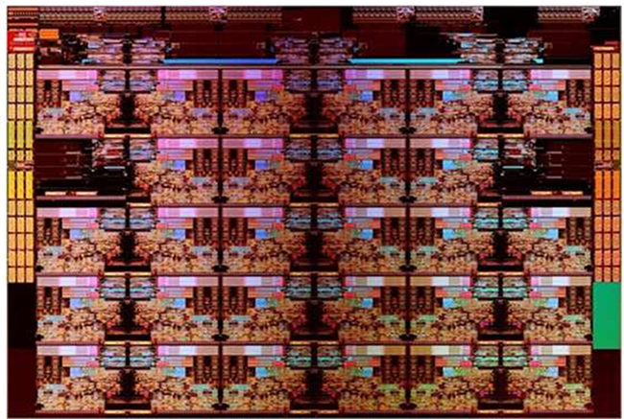
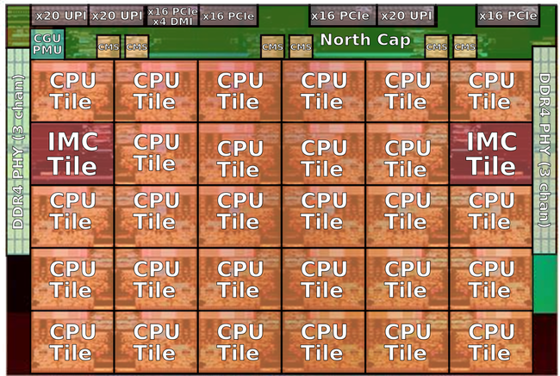
Take advantage of many processors!
Intel Skylake Server

Slide 74
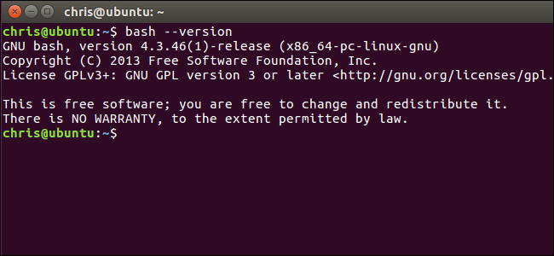


We can also do practical things too, like build a shell!
TRASH
TOTALLY RIDICULOUSLY-AWESOME SHELL

Slide 75
TRASH Shell Implementation
void trash_loop(void) {
char *line, **args;
while(1) {
printf("> ");
line = read_line();
args = split_line(line);
status = execvp(args[0], args);
}
}
What’s the problem with this code?
Notes:
What’s the problem with this code? Does it do what you want to do?

Slide 76
TRASH++ Shell Implementation
void trash_loop(void) {
char *line, **args;
while (1) {
printf("> ");
line = read_line();
args = split_line(line);
if (Fork()) == 0) {
if (execvp(args[0], args) < 0) {
printf("%s: Command not found.\n", args[0]);
exit(1);
}
}
}
}
What’s the problem with this code?
Notes:
Problem 1: we don’t wait for programs to be finished + weird behavior
Problem 2: we can’t background a process
Problem 3: we can’t clean up a background process – need a signal

Slide 77
Summary
Exceptions
Events that require nonstandard control flow
Generated externally (interrupts) or internally (traps and faults)
Processes
At any given time, system has multiple active processes
Only one can execute at a time on a single core, though
Each process appears to have total control of processor + private memory space

Slide 78
Summary (cont.)
Spawning processes
Call fork
One call, two returns
Process completion
Call exit
One call, no return
Reaping and waiting for processes
Call wait or waitpid
Loading and running programs
Call execve (or variant)
One call, (normally) no return

Slide 79
Bonus – more complete shell

Slide 80
Shell Programs
A shell is an application program that runs programs on behalf of the user.
sh Original Unix shell (Stephen Bourne, AT&T Bell Labs, 1977)
csh/tcsh BSD Unix C shell
bash “Bourne-Again” Shell (default Linux shell)
int main()
{
char cmdline[MAXLINE]; /* command line */
while (1) {
/* read */
printf("> ");
Fgets(cmdline, MAXLINE, stdin);
if (feof(stdin))
exit(0);
/* evaluate */
eval(cmdline);
}
}
Execution is a sequence of read/evaluate steps
shellex.c

Slide 81
Simple Shell eval Function
void eval(char *cmdline)
{
char *argv[MAXARGS]; /* Argument list execve() */
char buf[MAXLINE]; /* Holds modified command line */
int bg; /* Should the job run in bg or fg? */
pid_t pid; /* Process id */
strcpy(buf, cmdline);
bg = parseline(buf, argv);
if (argv[0] == NULL)
return; /* Ignore empty lines */
if (!builtin_command(argv)) {
if ((pid = Fork()) == 0) { /* Child runs user job */
if (execve(argv[0], argv, environ) < 0) {
printf("%s: Command not found.\n", argv[0]);
exit(0);
}
}
/* Parent waits for foreground job to terminate */
if (!bg) {
int status;
if (waitpid(pid, &status, 0) < 0)
unix_error("waitfg: waitpid error");
}
else
printf("%d %s", pid, cmdline);
}
return;
}
shellex.c

