Slide 1
CS33 Lecture 17: Linking
Tony Nowatzki

Slide 2
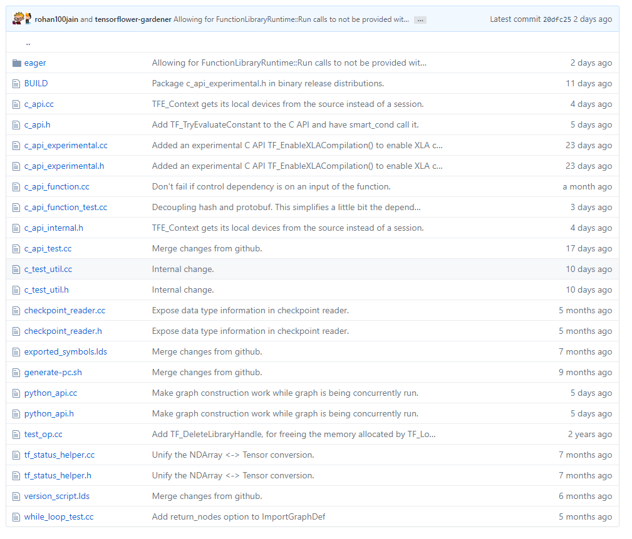
Tensorflow snapshot…
A lot of code

Slide 3
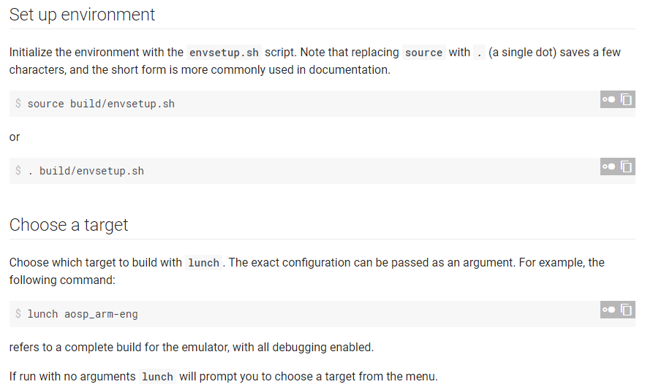
Android: A LOT of code

Slide 4
How to make compiling code faster?
Insight: Normally edit one or two files, and recompile
Maybe we can reuse the compilation results for files we did not modify!
Basic Idea:
Compile to an intermediate form: Object Files (*.o)
Object files: assembly snippets that can be linked together later to create a final binary
They represent the assembly for one C file (*.c)
When you make a change to one C file (*.c), you only have to:
Recompile the files that actually changed
Link all the objects together
“Makefile” or another build system coordinates what to do when (we don’t cover this)

Slide 5
Example C Program
int sum(int *a, int n);
int array[2] = {1, 2};
int main()
{
int val = sum(array, 2);
return val;
}
int sum(int *a, int n)
{
int i, s = 0;
for (i = 0; i < n; i++) {
s += a[i];
}
return s;
}
main.c
sum.c

Slide 6
Static Linking
linux> gcc -c main.c
linux> gcc -c sum.c
linux> gcc main.o sum.o –o prog
main.c
sum.c
Source files
Translators
(cpp, cc1, as)
Translators
(cpp, cc1, as)
cpp: Preprocessing
cc1: Compiling
as: Assembling
1.
2.
Separately compiled
relocatable object files
main.o
sum.o
3.
Linker (ld)
Fully linked executable object file
(contains code and data for all functions
defined in main.c and sum.c)
prog
By default compiler driver will automate these steps:
linux> gcc -Og -o prog main.c sum.c

Slide 7
Why Linkers?
Reason 1: Modularity
Program can be written as a collection of smaller source files, rather than one monolithic entity.
Can build libraries of common functions (more on this later)
e.g., Math library, standard C library
Can use different compilers for different libraries, no problem

Slide 8
Why Linkers? (cont)
Reason 2: Efficiency
Time: Separate compilation
Change one source file, compile, and then relink.
No need to recompile other source files.
Space: Libraries
Common functions can be aggregated into a single file...
Yet executable files and running memory images contain only code for the functions they actually use.
(we talked about this kind of idea in the context of forking, but this also works for shared libraries – e.g. glibc)

Slide 9
What Do Linkers Do?
Step 1: Symbol resolution
Programs define and reference symbols (global variables and functions):
void swap() {…} /* define symbol swap */
swap(); /* reference symbol swap */
int *xp = &x; /* define symbol xp, reference x */
Symbol definitions are stored in object file (by assembler) in symbol table.
Symbol table is an array of structs
Each entry includes name, size, and location of symbol.
During symbol resolution step, the linker associates each symbol reference with exactly one symbol definition.

Slide 10
What Do Linkers Do? (cont)
Step 2: Relocation
Merges separate code and data sections into single sections
Relocates symbols from their relative locations in the .o files to their final absolute memory locations in the executable.
Updates all references to these symbols to reflect their new positions.
Let’s look at these two steps in more detail….

Slide 11
Three Kinds of Object Files (Modules)
Relocatable object file (.o file)
Contains code and data in a form that can be combined with other relocatable object files to form executable object file.
Each .o file is produced from exactly one source (.c) file
Executable object file (a.out file)
Contains code and data in a form that can be copied directly into memory and then executed.
Shared object file (.so file)
Special type of relocatable object file that can be loaded into memory and linked dynamically, at either load time or run-time.
Called Dynamic Link Libraries (DLLs) by Windows

Slide 12
Executable and Linkable Format (ELF)
Standard binary format for object files
One unified format for
Relocatable object files (.o),
Executable object files (a.out)
Shared object files (.so)
Generic name: ELF binaries

Slide 13
ELF Object File Format
Elf header
Word size, byte ordering, file type (.o, exec, .so), machine type, etc.
Segment header table
Tells the system how to create a virtual memory image for the program (map sections to virtual memory addresses)
.text section
Code
.rodata section
Read only data: jump tables, ...
.data section
Initialized global variables
.bss section
Uninitialized global variables
“Block Started by Symbol” | “Better Save Space”
Has section header but occupies no space
0
ELF header
Segment header table
(required for executables)
.text section
.rodata section
.data section
.bss section
.symtab section
.rel.txt section
.rel.data section
.debug section
Section header table

Slide 14
ELF Object File Format (cont.)
.symtab section
Symbol table
Procedure and static variable names
Section names and locations
.rel.text section
Relocation info for .text section
Addresses of instructions that will need to be modified in the executable
.rel.data section
Relocation info for .data section
Addresses of pointer data that will need to be modified in the merged executable
.debug section
Info for symbolic debugging (gcc -g)
Section header table
Offsets and sizes of each section
0
ELF header
Segment header table
(required for executables)
.text section
.rodata section
.data section
.bss section
.symtab section
.rel.txt section
.rel.data section
.debug section
Section header table

Slide 15
Linker Symbols
Global symbols
Symbols defined by module m that can be referenced by other modules.
E.g.: non-static C functions and non-static global variables.
External symbols
Global symbols that are referenced by module m but defined by some other module.
Can be explicit with: “extern” keyword before variable name (e.g. extern int c;)
Local symbols
Symbols that are defined and referenced exclusively by module m.
E.g.: C functions and global variables defined with the static attribute.
Local linker symbols are not local program variables

Slide 16
Step 1: Symbol Resolution
Referencing
a global…
…that’s defined here
int sum(int *a, int n);
int array[2] = {1, 2};
int main()
{
int val = sum(array, 2);
return val;
}
int sum(int *a, int n)
{
int i, s = 0;
for (i = 0; i < n; i++) {
s += a[i];
}
return s;
}
main.c
sum.c
Defining
a global
Referencing
a global…
Linker knows
nothing of i or s
Linker knows
nothing of val
…that’s defined here

Slide 17
Local Symbols
Local non-static C variables vs. local static C variables
local non-static C variables: stored on the stack
local static C variables: stored in either .bss, or .data
int f()
{
static int x = 0;
return x;
}
int g()
{
static int x = 1;
return x;
}
Compiler allocates space in .data for each definition of x
Creates local symbols in the symbol table with unique names, e.g., x.1 and x.2.

Slide 18
How Linker Resolves Duplicate Symbol Definitions
Program symbols are either strong or weak
Strong: procedures and initialized globals
Weak: uninitialized globals
p1.c
p2.c
strong
int foo=5;
p1() {
}
int foo;
p2() {
}
weak
strong
strong

Slide 19
Linker’s Symbol Rules
Rule 1: Multiple strong symbols are not allowed
Each item can be defined only once
Otherwise: Linker error
Rule 2: Given a strong symbol and multiple weak symbols, choose the strong symbol
References to the weak symbol resolve to the strong symbol
Rule 3: If there are multiple weak symbols, pick an arbitrary one
Can override this with gcc –fno-common

Slide 20
Linker Puzzles
int x;
p1() {}
p1() {}
Link time error: two strong symbols (p1)
References to x will refer to the same
uninitialized int. Is this what you really want?
(was sharing intended?)
int x;
p1() {}
int x;
p2() {}
int x;
int y;
p1() {}
double x;
p2() {}
Writes to x in p2 might overwrite y!
Evil!
int x=7;
int y=5;
p1() {}
double x;
p2() {}
Writes to x in p2 will overwrite y!
Nasty!
int x=7;
p1() {}
int x;
p2() {}
References to x will refer to the same initialized
variable.
Nightmare scenario: two identical weak structs, compiled by different compilers
with different alignment rules.

Slide 21
Global Variables
Avoid if you can
Use static if you can
Use local variables (pass data explicitly)
Otherwise…
Initialize if you define a global variable
Use extern if you reference an external global variable
int x=7;
p1() {}
extern int x;
p2() {}

Slide 22
Step 2: Relocation
Relocatable Object Files
Executable Object File
System code
.text
0
Headers
System data
.data
System code
main()
.text
main.o
sum()
main()
.text
.data
More system code
int array[2]={1,2}
System data
.data
sum.o
sum()
int array[2]={1,2}
.text
.symtab
.debug

Slide 23
Relocation Entries
int array[2] = {1, 2};
int main()
{
int val = sum(array, 2);
return val;
}
main.c
0000000000000000 <main>:
0: 48 83 ec 08 sub $0x8,%rsp
4: be 02 00 00 00 mov $0x2,%esi
9: bf 00 00 00 00 mov $0x0,%edi # %edi = &array
a: R_X86_64_32 array # Relocation entry
e: e8 00 00 00 00 callq 13 <main+0x13> # sum()
f: R_X86_64_PC32 sum-0x4 # Relocation entry
13: 48 83 c4 08 add $0x8,%rsp
17: c3 retq
main.o
Source: objdump –r –d main.o

Slide 24
Relocated .text section
00000000004004d0 <main>:
4004d0: 48 83 ec 08 sub $0x8,%rsp
4004d4: be 02 00 00 00 mov $0x2,%esi
4004d9: bf 18 10 60 00 mov $0x601018,%edi # %edi = &array
4004de: e8 05 00 00 00 callq 4004e8 <sum> # sum()
4004e3: 48 83 c4 08 add $0x8,%rsp
4004e7: c3 retq
00000000004004e8 <sum>:
4004e8: b8 00 00 00 00 mov $0x0,%eax
4004ed: ba 00 00 00 00 mov $0x0,%edx
4004f2: eb 09 jmp 4004fd <sum+0x15>
4004f4: 48 63 ca movslq %edx,%rcx
4004f7: 03 04 8f add (%rdi,%rcx,4),%eax
4004fa: 83 c2 01 add $0x1,%edx
4004fd: 39 f2 cmp %esi,%edx
4004ff: 7c f3 jl 4004f4 <sum+0xc>
400501: f3 c3 repz retq
Using PC-relative addressing for sum(): 0x4004e8 = 0x4004e3 + 0x5
Source: objdump -dx prog

Slide 25
Loading
Memory
invisible to
user code
Kernel virtual memory
Loading
execve allocates virtual pages for .text and .data sections & creates PTEs marked as invalid
The .text and .data sections are copied, page by page, on demand by the virtual memory system
User stack
(created at runtime)
%rsp
(stack
pointer)
Memory-mapped region for
shared libraries
brk
Run-time heap
(created by malloc)
Read/write segment
(.data, .bss)
Loaded
from
the
executable
file
Read-only segment
(.init, .text, .rodata)
0x400000
Unused
0

Slide 26
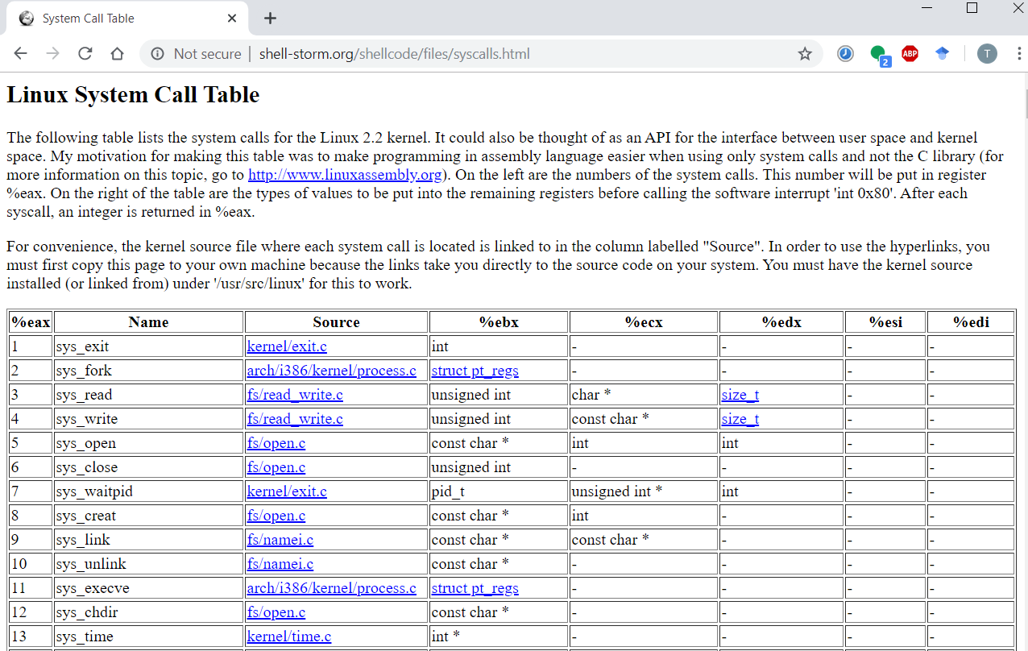

Slide 27
Loading Executable Object Files
Memory
invisible to user code
Executable Object File
Kernel virtual memory
0
ELF header
User stack
(created at runtime)
Program header table
(required for executables)
%rsp
(stack
pointer)
.init section
.text section
Memory-mapped region for
shared libraries
.rodata section
.data section
.bss section
brk
.symtab
Run-time heap
(created by malloc)
.debug
Read/write data segment
(.data, .bss)
Loaded
from
the
executable
file
.line
.strtab
Read-only code segment
(.init, .text, .rodata)
Section header table
(required for relocatables)
0x400000
Unused
0

Slide 28
Packaging Commonly Used Functions
How to package functions commonly used by programmers?
Math, I/O, memory management, string manipulation, etc.
Awkward, given the linker framework so far:
Option 1: Put all functions into a single source file
Programmers link big object file into their programs
Space and time inefficient
Option 2: Put each function in a separate source file
Programmers explicitly link appropriate binaries into their programs
More efficient, but burdensome on the programmer

Slide 29
Old-fashioned Solution: Static Libraries
Static libraries (.a archive files)
Concatenate related relocatable object files into a single file with an index (called an archive).
Enhance linker so that it tries to resolve unresolved external references by looking for the symbols in one or more archives.
If an archive member file resolves reference, link it into the executable.

Slide 30
Creating Static Libraries
atoi.c
printf.c
random.c
Translator
Translator
...
Translator
atoi.o
printf.o
random.o
Archiver (ar)
unix> ar rs libc.a \
atoi.o printf.o … random.o
libc.a
C standard library
Archiver allows incremental updates
Recompile function that changes and replace .o file in archive.

Slide 31
Commonly Used Libraries
libc.a (the C standard library)
4.6 MB archive of 1496 object files.
I/O, memory allocation, signal handling, string handling, data and time, random numbers, integer math
libm.a (the C math library)
2 MB archive of 444 object files.
floating point math (sin, cos, tan, log, exp, sqrt, …)
% ar –t libc.a | sort
…
fork.o
…
fprintf.o
fpu_control.o
fputc.o
freopen.o
fscanf.o
fseek.o
fstab.o
…
% ar –t libm.a | sort
…
e_acos.o
e_acosf.o
e_acosh.o
e_acoshf.o
e_acoshl.o
e_acosl.o
e_asin.o
e_asinf.o
e_asinl.o
…

Slide 32
Linking with Static Libraries
libvector.a
void addvec(int *x, int *y,
int *z, int n) {
int i;
for (i = 0; i < n; i++)
z[i] = x[i] + y[i];
}
#include <stdio.h>
#include "vector.h"
int x[2] = {1, 2};
int y[2] = {3, 4};
int z[2];
int main()
{
addvec(x, y, z, 2);
printf("z = [%d %d]\n”,
z[0], z[1]);
return 0;
}
addvec.c
void multvec(int *x, int *y,
int *z, int n)
{
int i;
for (i = 0; i < n; i++)
z[i] = x[i] * y[i];
}
main2.c
multvec.c

Slide 33
Linking with Static Libraries
addvec.o
multvec.o
main2.c
vector.h
Archiver
(ar)
Translators
(cpp, cc1, as)
libvector.a
libc.a
Static libraries
Relocatable
object files
main2.o
addvec.o
printf.o and any other
modules called by printf.o
Linker (ld)
Fully linked
executable object file
prog2c

Slide 34
Using Static Libraries
Linker’s algorithm for resolving external references:
Scan .o files and .a files in the command line order.
During the scan, keep a list of the current unresolved references.
As each new .o or .a file, obj, is encountered, try to resolve each unresolved reference in the list against the symbols defined in obj.
If any entries in the unresolved list at end of scan, then error.
Problem:
Command line order matters!
Moral: put libraries at the end of the command line.
unix> gcc -L. libtest.o -lmine
unix> gcc -L. -lmine libtest.o
libtest.o: In function `main':
libtest.o(.text+0x4): undefined reference to `libfun'

Slide 35
Modern Solution: Shared Libraries
Static libraries have the following disadvantages:
Duplication in the stored executables (disk space)
Duplication in the running executables (virtual & physical memory)
Minor bug fixes of system libraries require each application to explicitly relink (compile time)
Modern solution: Shared Libraries (.so files)
Main idea: These are object files that contain code and data that are shared among multiple processes
How it works: Loaded and linked into an application dynamically, at either load-time or run-time
Also called: dynamic link libraries(DLLs) – on windows

Slide 36
Shared Libraries (cont.)
Dynamic linking can occur when executable is first loaded and run (load-time linking).
Common case for Linux, handled automatically by the dynamic linker (ld-linux.so).
Standard C library (libc.so) usually dynamically linked.
Dynamic linking can also occur after program has begun (run-time linking).
In Linux, this is done by calls to the dlopen() interface.
Distributing software.
High-performance web servers.
Runtime library interpositioning.
Shared library routines can be shared by multiple processes.
More on this when we learn about virtual memory

Slide 37
Dynamic Linking at Load-time
main2.c
vector.h
unix> gcc -shared -o libvector.so \
addvec.c multvec.c
Translators
(cpp, cc1, as)
libc.so
libvector.so
Relocatable
object file
main2.o
Relocation and symbol table info
Linker (ld)
Partially linked
executable object file
prog2l
Loader (execve)
libc.so
libvector.so
Code and data
Fully linked
executable
in memory
Dynamic linker (ld-linux.so)

Slide 38
Bonus

Slide 39
Dynamic Linking at Run-time
#include <stdio.h>
#include <stdlib.h>
#include <dlfcn.h>
int x[2] = {1, 2};
int y[2] = {3, 4};
int z[2];
int main()
{
void *handle;
void (*addvec)(int *, int *, int *, int);
char *error;
/* Dynamically load the shared library that contains addvec() */
handle = dlopen("./libvector.so", RTLD_LAZY);
if (!handle) {
fprintf(stderr, "%s\n", dlerror());
exit(1);
}
dll.c

Slide 40
Dynamic Linking at Run-time
...
/* Get a pointer to the addvec() function we just loaded */
addvec = dlsym(handle, "addvec");
if ((error = dlerror()) != NULL) {
fprintf(stderr, "%s\n", error);
exit(1);
}
/* Now we can call addvec() just like any other function */
addvec(x, y, z, 2);
printf("z = [%d %d]\n", z[0], z[1]);
/* Unload the shared library */
if (dlclose(handle) < 0) {
fprintf(stderr, "%s\n", dlerror());
exit(1);
}
return 0;
}
dll.c

Slide 41
Linking Summary
Linking is a technique that allows programs to be constructed from multiple object files.
Linking can happen at different times in a program’s lifetime:
Compile time (when a program is compiled)
Load time (when a program is loaded into memory)
Run time (while a program is executing)
Understanding linking can help you avoid nasty errors and make you a better programmer.

Slide 42
Today
Linking
Case study: Library interpositioning

Slide 43
Case Study: Library Interpositioning
Library interpositioning : powerful linking technique that allows programmers to intercept calls to arbitrary functions
Interpositioning can occur at:
Compile time: When the source code is compiled
Link time: When the relocatable object files are statically linked to form an executable object file
Load/run time: When an executable object file is loaded into memory, dynamically linked, and then executed.

Slide 44
Some Interpositioning Applications
Security
Confinement (sandboxing)
Behind the scenes encryption
Debugging
In 2014, two Facebook engineers debugged a treacherous 1-year old bug in their iPhone app using interpositioning
Code in the SPDY networking stack was writing to the wrong location
Solved by intercepting calls to Posix write functions (write, writev, pwrite)
Source: Facebook engineering blog post at https://code.facebook.com/posts/313033472212144/debugging-file-corruption-on-ios/

Slide 45
Some Interpositioning Applications
Monitoring and Profiling
Count number of calls to functions
Characterize call sites and arguments to functions
Malloc tracing
Detecting memory leaks
Generating address traces

Slide 46
Example program
Goal: trace the addresses and sizes of the allocated and freed blocks, without breaking the program, and without modifying the source code.
Three solutions: interpose on the lib malloc and free functions at compile time, link time, and load/run time.
#include <stdio.h>
#include <malloc.h>
int main()
{
int *p = malloc(32);
free(p);
return(0);
}
int.c

Slide 47
Compile-time Interpositioning
#ifdef COMPILETIME
#include <stdio.h>
#include <malloc.h>
/* malloc wrapper function */
void *mymalloc(size_t size)
{
void *ptr = malloc(size);
printf("malloc(%d)=%p\n",
(int)size, ptr);
return ptr;
}
/* free wrapper function */
void myfree(void *ptr)
{
free(ptr);
printf("free(%p)\n", ptr);
}
#endif
mymalloc.c

Slide 48
Compile-time Interpositioning
#define malloc(size) mymalloc(size)
#define free(ptr) myfree(ptr)
void *mymalloc(size_t size);
void myfree(void *ptr);
malloc.h
linux> make intc
gcc -Wall -DCOMPILETIME -c mymalloc.c
gcc -Wall -I. -o intc int.c mymalloc.o
linux> make runc
./intc
malloc(32)=0x1edc010
free(0x1edc010)
linux>
Needs to match

Slide 49
Link-time Interpositioning
#ifdef LINKTIME
#include <stdio.h>
void *__real_malloc(size_t size);
void __real_free(void *ptr);
/* malloc wrapper function */
void *__wrap_malloc(size_t size)
{
void *ptr = __real_malloc(size); /* Call libc malloc */
printf("malloc(%d) = %p\n", (int)size, ptr);
return ptr;
}
/* free wrapper function */
void __wrap_free(void *ptr)
{
__real_free(ptr); /* Call libc free */
printf("free(%p)\n", ptr);
}
#endif
mymalloc.c

Slide 50
Link-time Interpositioning
linux> make intl
gcc -Wall -DLINKTIME -c mymalloc.c
gcc -Wall -c int.c
gcc -Wall -Wl,--wrap,malloc -Wl,--wrap,free -o intl int.o mymalloc.o
linux> make runl
./intl
malloc(32) = 0x1aa0010
free(0x1aa0010)
linux>
The “-Wl” flag passes argument to linker, replacing each comma with a space.
The “--wrap,malloc ” arg instructs linker to resolve references in a special way:
Refs to malloc should be resolved as __wrap_malloc
Refs to __real_malloc should be resolved as malloc

Slide 51
Load/Run-time Interpositioning
#ifdef RUNTIME
#define _GNU_SOURCE
#include <stdio.h>
#include <stdlib.h>
#include <dlfcn.h>
/* malloc wrapper function */
void *malloc(size_t size)
{
void *(*mallocp)(size_t size);
char *error;
mallocp = dlsym(RTLD_NEXT, "malloc"); /* Get addr of libc malloc */
if ((error = dlerror()) != NULL) {
fputs(error, stderr);
exit(1);
}
char *ptr = mallocp(size); /* Call libc malloc */
printf("malloc(%d) = %p\n", (int)size, ptr);
return ptr;
}
mymalloc.c

Slide 52
Load/Run-time Interpositioning
/* free wrapper function */
void free(void *ptr)
{
void (*freep)(void *) = NULL;
char *error;
if (!ptr)
return;
freep = dlsym(RTLD_NEXT, "free"); /* Get address of libc free */
if ((error = dlerror()) != NULL) {
fputs(error, stderr);
exit(1);
}
freep(ptr); /* Call libc free */
printf("free(%p)\n", ptr);
}
#endif
mymalloc.c

Slide 53
Load/Run-time Interpositioning
linux> make intr
gcc -Wall -DRUNTIME -shared -fpic -o mymalloc.so mymalloc.c -ldl
gcc -Wall -o intr int.c
linux> make runr
(LD_PRELOAD="./mymalloc.so" ./intr)
malloc(32) = 0xe60010
free(0xe60010)
linux>
The LD_PRELOAD environment variable tells the dynamic linker to resolve unresolved refs (e.g., to malloc)by looking in mymalloc.so first.

Slide 54
Interpositioning Recap
Compile Time
Apparent calls to malloc/free get macro-expanded into calls to mymalloc/myfree
Link Time
Use linker trick to have special name resolutions
malloc → __wrap_malloc
__real_malloc → malloc
Load/Run Time
Implement custom version of malloc/free that use dynamic linking to load library malloc/free under different names

