Slide 1
CS33 Lecture 18: Goodbye <3
Tony Nowatzki
Fall 2019 (Revised 12/6/2019)

Slide 2
Data Representations:
What did we learn?
Integers
Floats
Bit Manipulation
Relationship between hardware/software Data Types (in C)
What to learn next:
Fixed-point numbers
How to compute these efficiently (arithmetic hardware)
New formats for Machine Learning!

Slide 3
Machine Level Programming:
What did we learn?
X86, Instruction Types (memory, control, computation)
Control Flow (conditionals, procedure calls, switch/case)
Stack Discipline
Buffer Overflow (carrying out an attack)
Accessing data types (struct, union, arrays, linked lists)
What’s the role of the ISA?
Translation (Process of compilation and Linking programs)
What to learn next:
ISA Design Tradeoffs (why include certain instructions/formats?)
Alternate ISAs for Super-efficient computers! (GPUs)

Slide 4
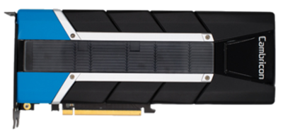
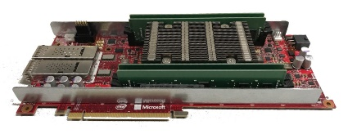
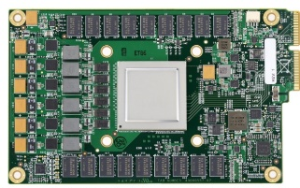
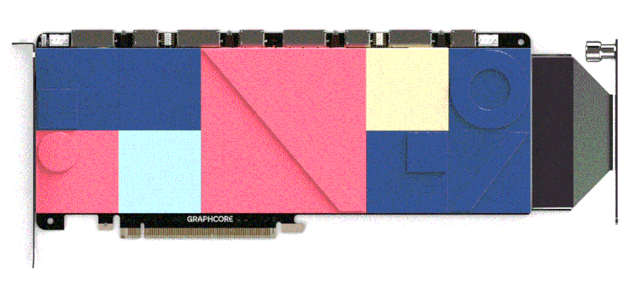
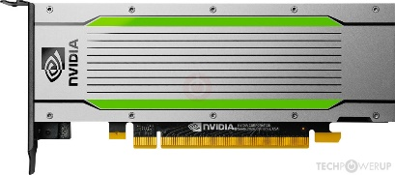
Computer Core Organization
What did we learn?
Basic Core Design: Fetch, decode, execute, access memory, writeback
Basic principles of computer architecture:
Pipelining Instructions: increase freq. of processor
OOO Execution: increase instruction level parallelism
Iron law of performance:
time/program = insts/program * cycles/inst* time/cycle
What to learn next:
CPU Core Microarchitecture Design (Billions per year)
Radically New Processors for AI
Cambricon
MLU-100
Microsoft
Brainwave
Google
TPU
GraphCore
Colossus
NVIDIA
T4

Slide 5
Memory Systems
What did we learn?
Principle of locality (temporal, spatial)
Memory Hierarchy(disks, memory, cache, register),
Automatically exploiting locality with caches
Virtual memory (page tables, TLBs)
What to learn next:
Advanced Cache and Interconnect Design (more architecture)
Notes:
Caches in a multicore setting (consistency, coherence)
Intricate cache policies (replacement, etc..)
There are even more aspects of virtual memory than we learned!
How does main memory (usually DRAM) work?
How do flash disks work?

Slide 6
Optimizing/Parallelizing Programs
What did we learn?
Analysis: Calculating latency, CPE, cache miss rates
Optimizations for cache (blocking, loop ordering)
Function inlining, unrolling, strength reduction
Mechanics of multi-threading, multi-process
Race conditions, deadlocks.
Synchronization: Semaphores, locks, barriers
Amdahl’s law: Speedup = 1 / ( (1 – p) + p / s )
What to learn next:
Doing this automatically with compilers
Notes:
Inter-process communication
Distributing computations across computers (and anything to do with networking)

Slide 7
Operating Systems
What did we learn?
Role of the operating system:
Virtualized Execution (Context Switching)
Virtualized Memory Access (Virtual Memory)
Interface between program and OS
System Calls, Traps/Exceptions
Forking/Loading
What to learn next?
Systems for X [Machine learning, Internet of Things (IoT), etc…]
Distributed Systems (systems at scale)
Whole system virtualization

Slide 8
CS33: We Learned a Bunch of Stuff
Data Representations:
Integers, Bit Manipulation, Floats, Casting & Data Types
Machine Level Programming:
Instruction Types, Control Flow (conditionals, procedure calls), Data Types (struct, union), Buffer Overflow
Memory Hierarchy:
Principle of caching, locality (temporal, spatial), Memory Hierarchy(disks, memory, cache, register), Virtual memory (TLBs)
Low-level Program Optimizations:
Analysis: Calculating latency, CPE, cache miss rates
Optimizations for cache (blocking, loop ordering), function inlining, unrolling, strength reduction
Parallelism:
Threading (pthreads), race conditions, semaphores, deadlocks.
System Guts:
Linking, System Calls, Traps/Exceptions, Forking/Loading

Slide 9

CS33: Taking the magic out of computer science!

Slide 10

Test Logistics
Date: Mon, Dec 9, 2019
Time: 11:30am – 2:30pm (whole time, please be 5-10 min early)
Place: Young Hall CS76
What’s okay to bring:
Books (strongly recommended), notes, simple calculator
Not okay: smart watch/smartphone/laptop (wandering eyes)
Exam Scoring:
Total Points: X + Y
Y Points considered extra credit
Grade will show up as out of X+Y b/c of CCLE….

Slide 11
Probable Set of Questions on Final
Bunch of multiple choice questions on broad topics (make sure to circle all that apply)
One or two short answer questions on various topics
Performance (CPE, loop optimizations/blockers)
Cache Question
Virtual Memory question
Linking question
Lab-specific questions
Buffer overflow lab
Malloc lab
Threads/deadlocks
Secret challenge question (not sure what it is yet)

Slide 12
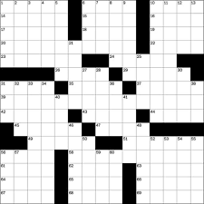

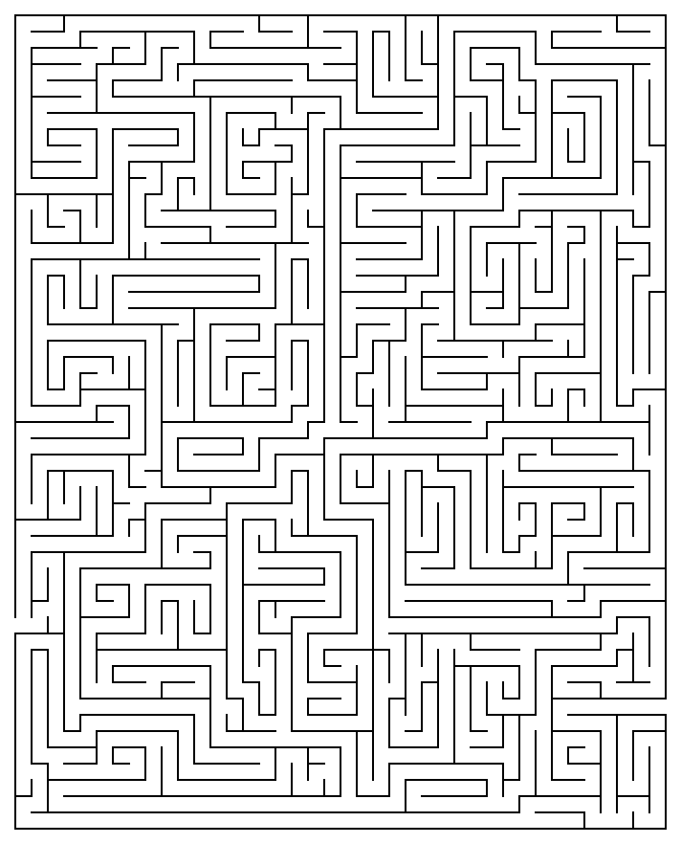
Fun Problems
Crossword
Word Search
Maze
Matching

Slide 13

Performance -- Critical Path – CPE

Slide 14
Multiple Choice Example
Why could loop unrolling sometimes be harmful to performance?
It introduces extra dynamic instructions, potentially adding to the critical path length.
It introduces extra static instructions, putting more strain on the instruction cache.
It results in unnecessary strength reduction, causing more expensive operations to be executed.
Trick question, it is never harmful for performance.
Notes:
b
Advice: if I say it’s a trick question, its likely not a trick question

Slide 15
Linked List Example
struct linked_list;
typedef struct linked_list {
struct linked_list* next;
long long int value;
} linked_list;
long long int traverse(linked_list* root) {
linked_list* current = root;
long long int total=10000;
while(current->next) {
total = total * current->value;
current = current->next;
}
return total;
}
Struct
next
value

Slide 16
Cycles Per Element
Q1. What are the possible critical paths through the loop?
0000000000000000 <traverse>:
0: b8 10 27 00 00 mov $0x2710,%eax
5: eb 08 jmp f <traverse+0xf>
7: 48 0f af 47 08 imul 0x8(%rdi),%rax
c: 48 89 d7 mov %rdx,%rdi
f: 48 8b 17 mov (%rdi),%rdx
12: 48 85 d2 test %rdx,%rdx
15: 75 f0 jne 7 <traverse+0x7>
17: f3 c3 repz retq
(why isn’t
rdi->mul->rax
on the critical path?)
Q2. Assume loads take one cycle, and multiplies take 3 cycles, what is the latency bound on CPE?
rdi
rax
rdx
Consider the Loop from 0x7 to 0x15
ld
ld
Q3. Assume that all instructions take one cycle, and you only have one of each FU, what is the throughput bound on CPE?
test
x
rax
rdi
rdx
Notes:
Q1. Critical paths:
Rax -> multiply -> rax
Rdx -> ld -> rdx
Q2. 3 Cycles per iteration
Q3. 2 Cycles per iteration

Slide 17
Dynamic Dependence Graph from Static
rdi
rax
rdx
ld
ld
Iteration 1
test
x
rax
rdi
rdx
rdi
rax
rdx
ld
ld
Iteration 2
test
x
rax
rdi
rdx

Slide 18
CPE From program perspective
Q1. What are the possible critical path through the loop?
struct linked_list;
typedef struct linked_list {
struct linked_list* next;
long long int value;
} linked_list;
long long int traverse(linked_list* root) {
linked_list* current = root;
long long int total=10000;
while(current->next) {
total = total * current->value;
current = current->next;
}
return total;
}
Q2. Assume loads take one cycle, and multiplies take 3 cycles, what is the latency bound on CPE?
Q3. Assume that all instructions take one cycle, and you only have one of each FU, what is the throughput bound on CPE?

Slide 19
Matrix-Vector Multiply (loop unrolling)
double sum, c[N], a[N][N], b[N];
for(int i = 0; i < N; ++i) {
sum = 0;
for(int j = 0; j < N; ++j)
sum += a[i][j] * b[j];
c[i] = sum;
}
1. After unrolling, did this get faster?
(does it change the latency or throughput bound?)
for(int i = 0; i < N; ++i) {
sum = 0;
for(int j = 0; j < N; j+=2) {
sum += a[i][j+0] * b[j+0];
sum += a[i][j+1] * b[j+1];
}
c[i] = sum;
}
2. What change could we do to make it faster?
Notes:
Assuming that adding a double is longer latency than adding an integer -- it did not improve the latency bound yet. Funny thing is it’s actually possible that it improved the throughput bound because there are less branch instructions total
need two separate accum, add them up in the end
Yes, fewer induction var updates

Slide 20
Other Questions on Performance
Analyze a given piece of code for performance, explain which optimizations could be applied
Re-write a program segment to execute faster, and be able to explain why
Look at a piece of code and tell what optimizations are there
Be able to tell what is the CPE, latency bound, or throughput bound?
How do the above change when FU characteristics change?

Slide 21

Caches
CACHE
Notes:
This is so stupid I’m sorry

Slide 22
Why would you want a fully associative cache over a direct mapped cache?
Its simpler to implement in hardware
The number of conflict misses go down
It can store virtual and physical addresses
Reduced time to access cache
Notes:
b

Slide 23
Image Manipulation
struct pixel {
char r;
char g;
char b;
char a;
};
struct pixel buffer[480][640];
char *cptr;
int *iptr;
Assume 4-byte cache lines,
Direct Mapped Cache,
64KB Cache
for (i=0; i < 480; i++){
for (j=0; j < 640; j++) {
buffer[i][j].r = 0;
buffer[i][j].g = 0;
buffer[i][j].b = 0;
buffer[i][j].a = 0;
}
}
1. What percentage of writes miss in the cache?
2. What if we change to 8-byte lines?
Notes:
1. ¼
2. 1/8

Slide 24
Image Manipulation (loops reversed)
struct pixel {
char r;
char g;
char b;
char a;
};
struct pixel buffer[480][640];
char *cptr;
int *iptr;
Assume 4-byte cache lines,
Direct Mapped Cache,
64KB Cache
for (j=0; j < 640; j++) {
for (i=0; i < 480; i++){
buffer[i][j].r = 0;
buffer[i][j].g = 0;
buffer[i][j].b = 0;
buffer[i][j].a = 0;
}
}
What percentage of writes miss in the cache?
What if we change to 8-byte lines?
Notes:
Same as before:
1. ¼
2. 1/8
This is a little trickier because you go down the columns first, but since you can fit one column of cache lines into cache (4-byte lines * 480 lines per column = 1920 < 65536), then you still get all the same locality benefits. The answer would be different if you had a cache smaller than 1920 bytes.

Slide 25
Matrix-Vector Multiply (loop ordering)
double sum,c[N],a[N][N],b[N];
for(int j = 0; j < N; ++j)
for(int i = 0; i < N; i++)
c[i] += a[i][j] * b[j];
1/8
8/8
0/8
for(int i = 0; i < N; ++i)
for(int j = 0; j < N; ++j)
c[i] += a[i][j] * b[j];
0/8
1/8
1/8
Which of these has better locality?
Assume 64-byte cache lines,
N * 8 >> cache size – What percent cache misses on “a”

Slide 26
Matrix Blocking
Input Vector b (N)
Input Vector b (N)
×
×
∑
∑
Output Vector c (N)
Output Vector c (N)
Input Matrix a (NxN)
Input Matrix a (NxN)
1. Assume N >> cache size, 64-byte lines, … what is miss rate of each access?
c[i] += a[i][j] * b[j];
Half as many misses!
0/8
1/8
0/8

Slide 27
Blocked version in code
int b[N];
int a[N][N];
int c[N];
#define BLOCK (8) //should divide N evenly
for(j_block=0; j_block<N; j_block+=BLOCK){
for (i = 0; i < N; i++) {
sum=c[j]; //get partial sum
for (j=j_block; j<j_block+BLOCK;j++){
sum += a[i][j] * b[i];
}
c[j] = sum;
}
}
1. After unrolling, would the cache behavior change?
Notes:
1. The behavior for accesses to c,a,b, would not change. Subtle point: It’s possible that the instruction cache behavior could get worse : )

Slide 28
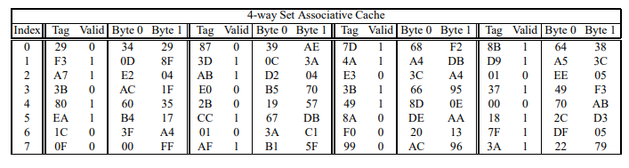
Cache lookup
Assume:
Memory accesses are to 1-byte words (not 4-byte words).
Physical addresses are 12 bits wide.
The cache is 4-way set associative, with a 2-byte block size and 32 total lines
11
10
9
8
7
6
5
4
3
2
1
0
Q1: Lookup 3B6?
What is the data and is there a hit or miss?
0
0
1
1
1
0
1
1
0
1
1
0
CT
CI
CO
Tag = 3B
Q2: What if you have two valid entries with the same tag?
Notes:
Q1. Hit, Answer: 66
Q2. You have a Broken Cache

Slide 29

Virtual Memory
Notes:
I don’t know why I put memes in these slides when they don’t make sense

Slide 30
Multiple Choice Example
When you print the address of a variable from C, what kind of address is that?
Physical Address
Virtual Address
It depends
None of the Above
Notes:
b

Slide 31
Multiple Choice Example
What are some of the benefits of Virtual Memory?
It allows each process’s address space to be larger than the physical address space.
It enables isolation of the address spaces of different processes.
It enables faster memory accesses.
It increases the amount of instruction level parallelism.
It enables DRAM to be a cache for disks.
Notes:
a, b, e

Slide 32
Short Answer
Why would it be difficult to use virtual addresses in caches?
Why might it be beneficial to do so?
Notes:
1. Across two processes, two virtual addresses could be the same, but they refer to different things, because they are mapped to two different physical addresses. Therefore, using virtual addresses in caches is more complicated because you have to distinguish them.
2. Because its faster – don’t have to translate address before requesting some memory

Slide 33
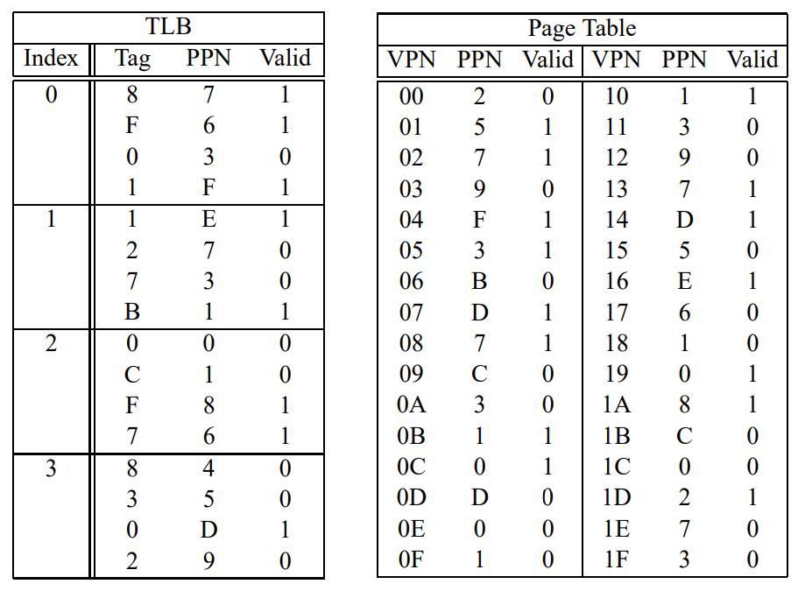
VM Example
Virtual addresses: 16 bits; Physical addresses: 14 bits
The page size is 1024 bytes.
The TLB is 4-way set associative with 16 total entries
Question: Translate 2F09, is there a page fault?
TLBT
TLBI
15
14
13
12
11
10
9
8
7
6
5
4
3
2
1
0
0
0
1
0
1
1
1
1
0
0
0
0
1
0
0
1
VPN
VPO
Virtual Page Number
Virtual Page Offset
0
0
0
1
1
1
0
0
0
0
1
0
0
1
PPN
PPO
Notes:
Phys addr: 0x0709, no page fault

Slide 34
Full VM + Caching Example
Addressing
14-bit virtual addresses
12-bit physical address
Page size = 64 bytes
13
12
11
10
9
8
7
6
5
4
3
2
1
0
VPN
VPO
Virtual Page Number
Virtual Page Offset
11
10
9
8
7
6
5
4
3
2
1
0
PPN
PPO
Physical Page Number
Physical Page Offset

Slide 35
1. Simple Memory System TLB
16 entries
4-way associative
TLBT
TLBI
13
12
11
10
9
8
7
6
5
4
3
2
1
0
VPN
VPO
Set
Tag
PPN
Valid
Tag
PPN
Valid
Tag
PPN
Valid
Tag
PPN
Valid
0
03
–
0
09
0D
1
00
–
0
07
02
1
1
03
2D
1
02
–
0
04
–
0
0A
–
0
2
02
–
0
08
–
0
06
–
0
03
–
0
3
07
–
0
03
0D
1
0A
34
1
02
–
0

Slide 36
2. Simple Memory System Page Table
Only show first 16 entries (out of 256)
VPN
PPN
Valid
VPN
PPN
Valid
00
28
1
08
13
1
01
–
0
09
17
1
02
33
1
0A
09
1
03
02
1
0B
–
0
04
–
0
0C
–
0
05
16
1
0D
2D
1
06
–
0
0E
11
1
07
–
0
0F
0D
1

Slide 37
3. Simple Memory System Cache
16 lines, 4-byte block size
Physically addressed
Direct mapped
CT
CI
CO
11
10
9
8
7
6
5
4
3
2
1
0
PPN
PPO
Idx
Tag
Valid
B0
B1
B2
B3
Idx
Tag
Valid
B0
B1
B2
B3
0
19
1
99
11
23
11
8
24
1
3A
00
51
89
1
15
0
–
–
–
–
9
2D
0
–
–
–
–
2
1B
1
00
02
04
08
A
2D
1
93
15
DA
3B
3
36
0
–
–
–
–
B
0B
0
–
–
–
–
4
32
1
43
6D
8F
09
C
12
0
–
–
–
–
5
0D
1
36
72
F0
1D
D
16
1
04
96
34
15
6
31
0
–
–
–
–
E
13
1
83
77
1B
D3
7
16
1
11
C2
DF
03
F
14
0
–
–
–
–

Slide 38
Address Translation Example #2
Virtual Address: 0x0020
VPN ___ TLBI ___ TLBT ____ TLB Hit? __ Page Fault? __ PPN: ____
Physical Address
CO___ CI___ CT ____ Hit? __ Byte: ____
TLBT
TLBI
13
12
11
10
9
8
7
6
5
4
3
2
1
0
0
0
0
0
0
0
0
0
1
0
0
0
0
0
VPN
VPO
0x00
0
0x00
N
N
0x28
CT
CI
CO
11
10
9
8
7
6
5
4
3
2
1
0
1
0
1
0
0
0
1
0
0
0
0
0
PPN
PPO
0
0x8
0x28
N
Mem

Slide 39

Processes and Threads

Slide 40
Multiple Choice Example
Assuming no errors, which one of the following functions never returns?
fork()
execve()
exit()
wait()
pthread_create()
pthread_join()
Notes:
execve(), exit

Slide 41
Short answer Example
When would sem_wait() (ie. P() operation) have to perform a system call?
Notes:
When the semaphore’s value is 0

Slide 42
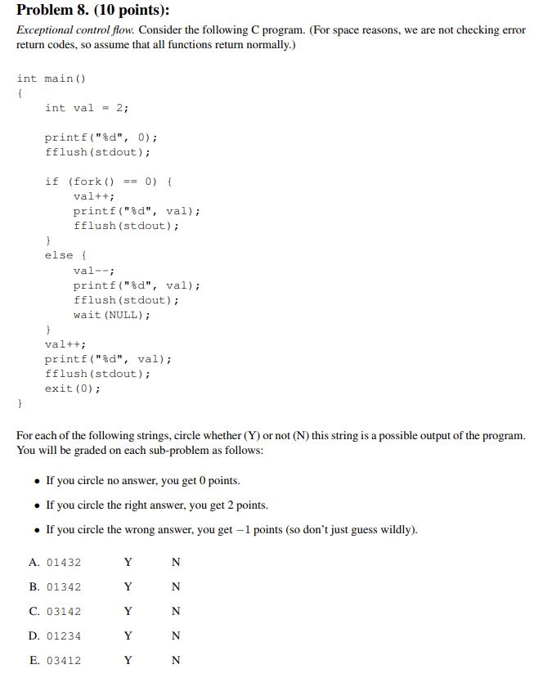
Forking Example
fflush forces the line to be printed.
Which of the following are possible outputs?
Notes:
A. N
B. Y
C. Y
D. N
E. Y

Slide 43
Races and Semaphores
P() -> sem_wait(…)
V() -> sem_post(…)
int a;
sem_t mutex[2];
int main() {
Sem_init(&mutex[0], 0, 0); /* mutex[0] = 0 */
Sem_init(&mutex[1], 0, 1); /* mutex[1] = 1 */
}
Q: Can we add a sem_wait() somewhere to restrict to one answer?
Thread 1
Thread 2
hi
sem_wait(&mutex[0]);
printf(“what’s up?”);
sem_post(&mutex[1]);
printf(“hi”);
sem_post(&mutex[0]);
sem_wait(&mutex[1]);
printf(“not much”);
what’s up
not much
not much
what’s up
Thread 1
Thread 2
hi
sem_wait(&mutex[0]);
printf(“what’s up?”);
sem_post(&mutex[0]);
printf(“hi”);
sem_post(&mutex[0]);
sem_wait(&mutex[0]);
printf(“not much”);
what’s up
not much
not much
[Deadlock]
Thread 1
Thread 2
sem_wait(&mutex[1]);
printf(“what’s up?”);
sem_post(&mutex[1]);
printf(“hi”);
sem_post(&mutex[1]);
sem_wait(&mutex[1]);
printf(“not much”);
hi
not much
what’s up
any
Notes:
Q: if you add sem_post

Slide 44
Thread Forking vs Fork Threading
func1(void*){
…
}
main() {
fork()
pthread_create(func1,…)
…
}
Question: How many threads are created?
Proc 2
thread3,
thread4
thread1,
thread2
Proc 1
Fork Threading
func2(void*){
fork()
…
}
main() {
pthread_create(func2,…)
…
}
thread3
thread1,
thread2
thread1,
thread2
(same, no change)
Thread Forking
Fun fact: fork only copies the thread context of the calling thread! (this is a good decision) (I don’t expect you to know that for the final, but I do think this is really interesting)
Notes:
First Version: 4 threads, cause you fork and each process creates two threads
Second Version: 3 threads,

Slide 45
Fork-mutex-ing vs Thread-mutex-ing
What happens, what gets printed?
func1(){
sem_wait(&mutex);
printf(“I made it!”);
…
}
main() {
sem_init(&mutex, 0, 1);
pthread_create(func1,…);
pthread_create(func1,…);
}
sem_t mutex;
main() {
sem_init(&mutex, 0, 1);
fork()
sem_wait(&mutex);
printf(“I made it!”);
}
Notes:
First case: Both processes print “I made it” and exit (mutex is copied)
Thread case: Random one of the two threads prints “I made it”, other thread is deadlocked until someone unlocks the mutex

Slide 46
Short Answer Question
Give two reasons why parallelizing a code could lead to lower performance. (15 words max each)
Notes:
Need to use locks/semaphores -> too high instruction overhead
Bad Cache behavior slows down code
Not enough work -> thread creation overhead dominates

Slide 47
Other Questions on Concurrency
Race Question
Pthreads / Joining
Forking / Shared Memory
Semaphores
Questions:
Is there non-determinism/race-condition?
Is there deadlock?
What’s the possible ordering?

Slide 48

Linking
Notes:
Ok, you try finding a meme for linking…. Yeah, judge someone else please

Slide 49
Multiple Choice Example
What is the standard order of steps in a compilation flow?
Compile, Preprocess, Assemble, Link
Compile, Assemble, Link, Preprocess
Assemble, Preprocess, Link, Compile
Preprocess, Compile, Assemble, Link
Notes:
Preprocess, Compile, Assemble, Link

Slide 50
Multiple Choice Example
What's the purpose of the linker?
Optimize the code's performance.
Support the abstraction of virtual memory.
Enable separate compilation.
Simplify the contract between hardware and software.
Notes:
Enable separate compilation.

Slide 51
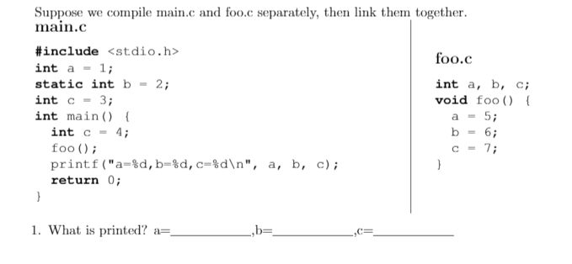
1 Question on Linking
Given a piece of C code, identify where those variables are stored, and other properties (shared, private)
Notes:
a=5 (foo.c modifies the global defined in main.c)
b=2 (“static” keyword means that b is local to main.c; foo.c does not have access to it)
c=4 (variables at a local program scope take precedence, even though foo.c does modify the global value c defined in main.c)

Slide 52
Where’s that Memory? ( in ELF, in Memory)
.data
Stored in
.text
heap (array)
(dyn_array ptr on stack)
main.c
sum.c
int sum(int *a, int n);
int array[2] = {1, 2};
int main()
{
int val1 = sum(array, 2);
int *dyn_arr = (int*) malloc(4*2);
int val2 = sum(array, 2);
return val1 + val2;
}
int sum(int *a, int n)
{
int i, s = 0;
struct_t n;
for (i = 0; i < n; i++) {
s += a[i];
}
return s;
}
Stored on stack
Stored in %rsi,%rdi
Probably a register
%rax

Slide 53

Data Representation and Stacks
Notes:
This is the top image results for “stacks meme” on google, yes that’s why I choose this

Slide 54
Attack Lab Question
Best way to study for this is to do the attack lab.
Concepts:
Stacks (you will draw a stack based on assembly)
Construct / Identify an attack
Test knowledge of datatypes

Slide 55
Stack and Data
int func(int i) {
volatile union U {
char s[16];
int x;
} u;
u.x=0;
u.s[i]=i;
return u.x;
}
What is printed?
func(0)=0x0
func(1)=0x100
func(2)=0x20000
func(3)=0x3000000
What input would crash the program?
0x00000000004005d0 <+0>: movslq %edi,%rax
0x00000000004005d3 <+3>: movl $0x0,-0x18(%rsp)
0x00000000004005db <+11>: mov %dil,-0x18(%rsp,%rax,1)
0x00000000004005e0 <+16>: mov -0x18(%rsp),%eax
0x00000000004005e4 <+20>: retq
Notes:
Interestingly, this program doesn’t even bother to allocate the stack (by modifying the value of rsp) – it doesn’t even need to because it doesn’t call any other functions. Cool huh?
It looks like the union u is being placed at 0x18 (24 bytes) off of rsp. So if you call func(24), that should modify the lowest byte of the return address.

Slide 56
Other Random Questions

Slide 57
Multiple Choice Example
Given the simple implicit-free-list for implementing malloc, which of the following scenarios would cause the most external fragmentation?
Repeatedly calling malloc() on many different sizes.
Repeatedly calling malloc() on many different sizes, while sometimes freeing some memory.
Repeatedly calling malloc() with the same size.
Repeatedly calling malloc() with the same size, while sometimes freeing some memory.
Notes:
b)

Slide 58
Short Answer Question
For a floating point number, what would be an effect of allocating more bits to the exponent part by taking them from the fraction part – ie . How would the representable numbers change (30 words max)
For a floating point number, what would be the effect of disallowing denormalized numbers? (30 words max)
Notes:
1. Larger range of numbers (both bigger and smaller), but with less precision
2. You can’t represent 0, and you also can’t represent many numbers which are closer to zero than is possible with the minimum exponent (EXP field = 1)

Slide 59
Main Course Theme: Abstraction Is Good, but …
These abstractions have limits, understanding these limits is:
Important for correct programs
Abstractions don’t necessarily conform to expectations
Important for Security
Abstractions can often be circumvented
Important for Performance
Abstractions tend to hide performance implications

Slide 60
Getting Cozy with Abstractions
Algorithm
Application
Programming Language
Compiler
Operating System
Architecture (ISA)
Hardware Organization
Component Design
Circuit Design
Devices (Transistors)
Physics/Manufacturing

Slide 61
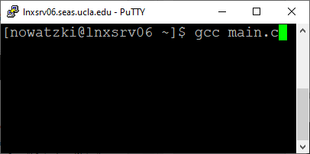
Copy Page Table (mark as copy-on-write)
Copy Registers
Set return value of fork() as zero
Virtual Memory
Virtual Memory
Stack
Stack
Heap
Heap
Data
Data
Code
fork()
Code
Logical Flow
Logical Flow
Registers
mov $57, %eax
syscall
Registers
Child: Duplicate
BASH Shell
Process
BASH Shell
Process

Slide 62
Duplicate BASH’s Virtual Memory
GCC Executable (in ELF format)
0
Kernel virtual memory
(includes page table)
execve(“gcc”,
”main.c”)
Kernel virtual memory
(new page table)
ELF header
User stack for BASH
Stack for GCC Main
Empty User Stack
Program header table
(required for executables)
mov $59, %eax
syscall
%rsp
(stack
pointer)
.init section
.text section
GCC’s Shared Libraries
BASH’s Shared Libraries
.rodata section
.data section
.bss section
brk
BASH’s Heap
(maintained by malloc)
.symtab
Empty Heap
.debug
BASH’s Globals
(read/write)
GCC’s Globals
(read/write)
.line
.strtab
BASH’s Code and Read-only Vars
(read-only)
GCC’s Code and Read-only Vars
(read-only)
Section header table
(required for relocatables)
0

Slide 63
Execute First Instruction of GCC!
0000000000402840 <__libc_start_main@plt>:
CPU Chip
TLB
Read Page
Table
PTE
4028
VPN
no
Cache
Memory
(holds
Page
Table)
MMU
CPU
VA
PTEA
402840
PA
340
Data
(ff 25 d2 79 2b 00 …… )
Read
Data
Notes:
402840: ff 25 d2 79 2b 00 jmpq *0x2b79d2(%rip) # 6ba218 <iconv_open@plt+0x2b7598>

Slide 64
Instruction
Fetch
Address
Memory
Access
(ff 25 d2 79 2b 00 …… )
Inst7
Inst8
PC
Instructions
Instruction
Decode
jmpq *0x2b79d2(%rip)
Inst5
Inst6
Instruction
Dispatch
Register
File
Writeback
Inst3
Inst4
Execute
Branch
Arith
Arith
Arith
Load
Store
Inst2:
Multiply
Operation Results
Addr.
Addr.
Data
Data
Access Memory
Memory
Access

Slide 65
Pipelined Multiply
Binary
Decimal
1 0 1 0
× 1 0 1 1
10
Stage 1
11
Stage 2
1 0 1 0
Stage 3
Stage 1
1 0 1 0
Divide computation into stages
Pass partial computations from stage to stage
Stage 2
0 0 0 0
1 0 1 0
Stage 3
1 1 0 1 1 1 0
110

Slide 66
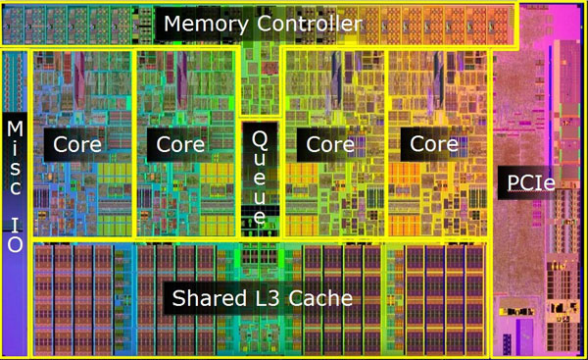
Multiplier

Slide 67
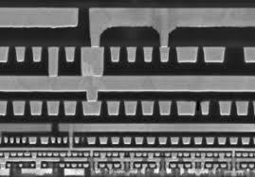

Slide 68
Compilation
main.c
vector.h
Translators
(cpp, cc1, as)
libvector.a
libc.a
Static libraries
Relocatable
object files
main2.o
Linker (ld)
Fully linked
executable object file
a.out

Slide 69
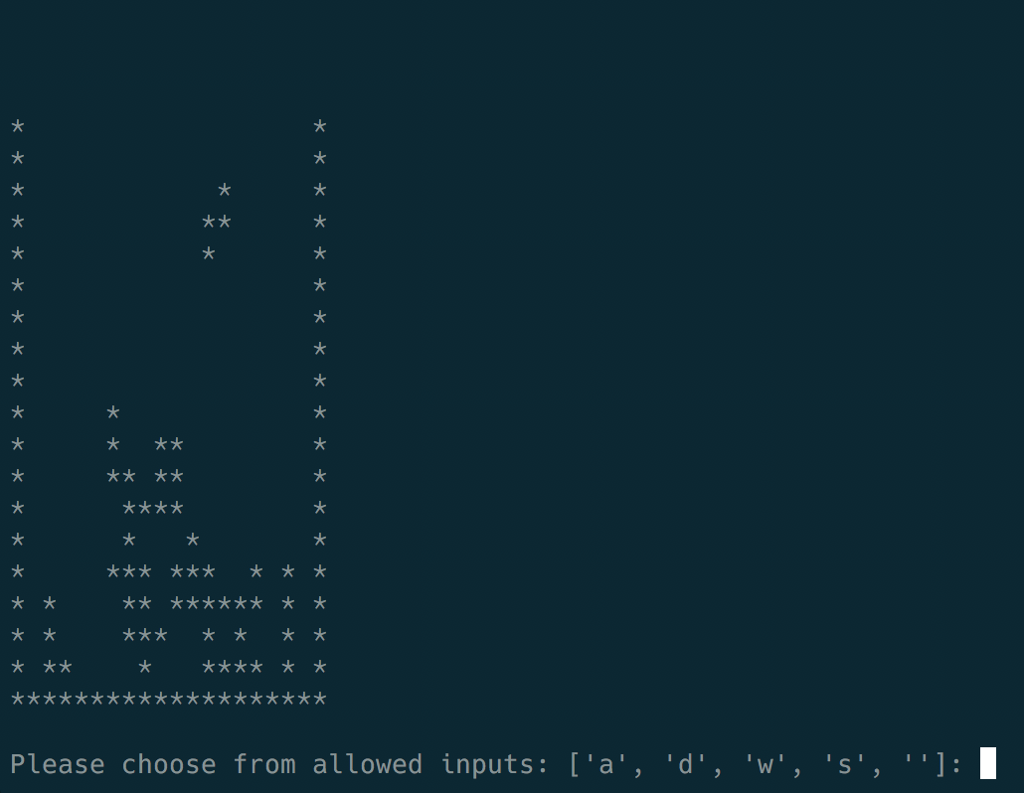

Slide 70
Lesson:
Systems are complex
There’s always another level of complexity!
Even though we don’t understand everything, its still quite useful to know the basics

Slide 71

Conclusions
Its been fun
Good luck studying (and thread lab)
Don’t stress out too much
Have a nice winter break

