Slide 1
CS 33: Intro To Computer Organization
Tony Nowatzki
tjn@cs.ucla.edu

Slide 2
Agenda
Intro Material
Administrative details
Lecture – Bits and Data Types in C (Chapter 2)

Slide 3
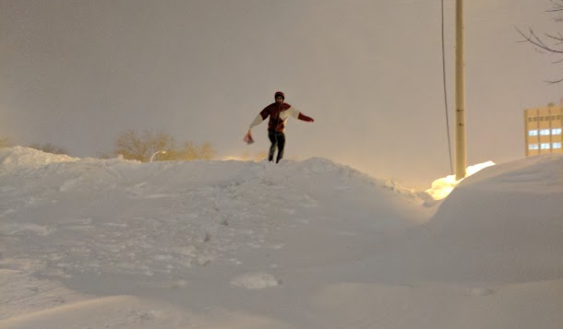

About ME
Graduated from Wisconsin 2016
Joined UCLA January 2017
Love CS33 more each time I teach it!
Lead PolyArch Resesarch Group
Design next-generation processors
Focus on hardware specialization
What about you?
Non-standard time to be teaching this course… (typical one is spring)

Slide 4
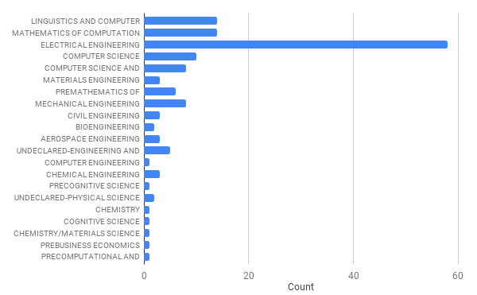
Class Composition (2018)

Slide 5
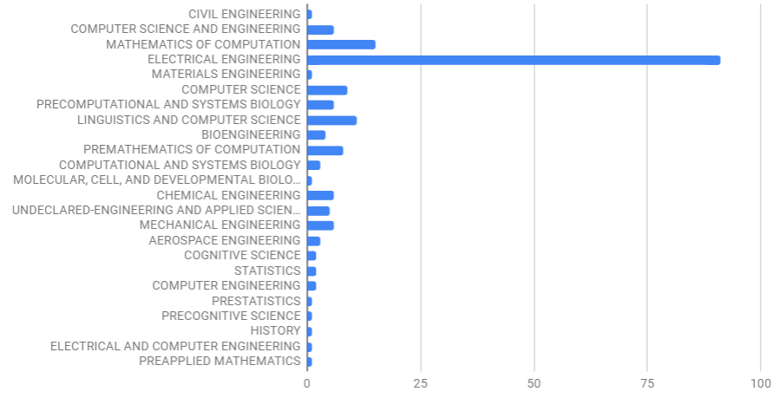
Class Composition (Winter 2019)

Slide 6
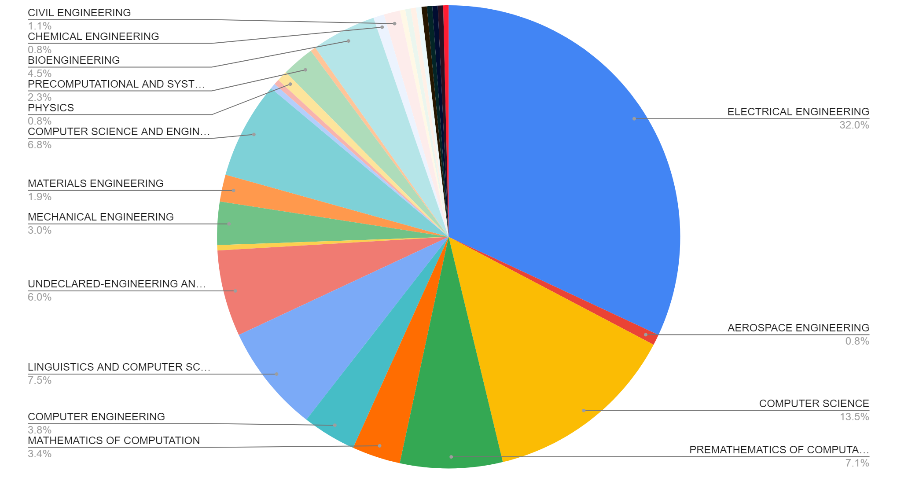
Class Composition (Fall 2019)
1st largest
3rd largest
2nd largest

Slide 7
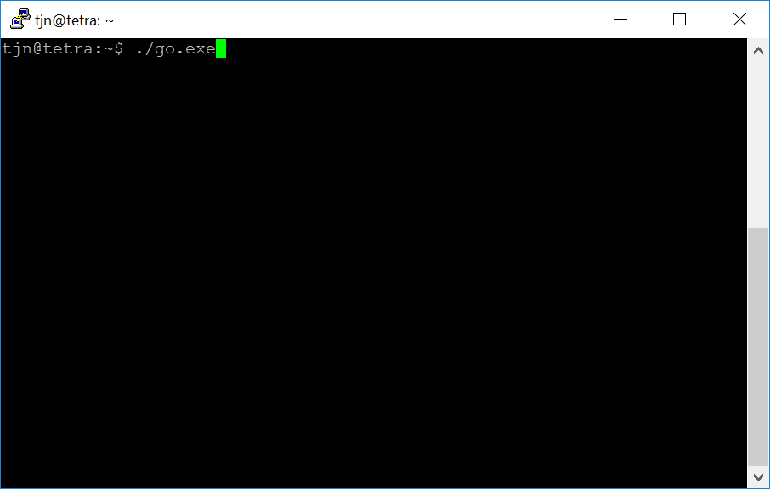
Course in a nutshell:
Demystifying Computers….

Slide 8
Software World
Algorithm
Application
Programming Language
Compiler
Operating System
Instruction Set Architecture (ISA)
Hardware Organization
Component Design
Circuit Design
Devices (Transistors)
Physics/Manufacturing
Hardware World

Slide 9
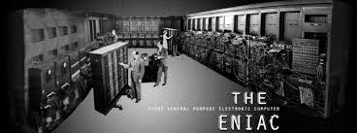
Computers Pre-1964
Each Computer was New
Implemented machine (has mass) → hardware
Instructions for hardware (no mass) → software
Boundary between hardware/software was fuzzy
Software Lagged Hardware
Each new machine design was different
Software needed to be rewritten in assembly/machine language
Unimaginable today
Going forward: Need to separate HW interface from implementation
ENIAC: First machine with abstractions, kindof
John Von Neumann -> popularized the concept of ISA

Slide 10
Software World
Algorithm
Algorithm
Algorithm
Application
Application
Application
Programming Language
Programming Language
Programming Language
Compiler
Compiler
Compiler
Operating System
Operating System
Operating System
Machine 1
Machine 2
Machine 3
Hardware Organization
Hardware Organization
Hardware Organization
Component Design
Component Design
Component Design
Circuit Design
Circuit Design
Circuit Design
Devices (Transistors)
Devices (Transistors)
Devices (Transistors)
Physics/Manufacturing
Physics/Manufacturing
Physics/Manufacturing
Hardware World

Slide 11
Architecture
Algorithm
Application
Programming Language
Compiler
Operating System
Architecture (ISA)
Architecture (ISA)
Architecture (ISA)
Hardware Organization
Hardware Organization
Hardware Organization
Component Design
Component Design
Component Design
Circuit Design
Circuit Design
Circuit Design
Devices (Transistors)
Devices (Transistors)
Devices (Transistors)
Physics/Manufacturing
Physics/Manufacturing
Physics/Manufacturing
Machine 1
Machine 2
Machine 3
Better for big-data workloads
Better for desktop/gaming
Better mobile applications

Slide 12
ISA: The interface that determines the representation of programs to hardware.

Slide 13
What should be in an ISA?
Ingredients:
Memory: a place to put values (state, variables, etc.)
Instructions: moves from one state to the next
Program: set of instructions (lets put it in memory)
Execution model: When do we execute each instruction?
Von Neuman Execution:
Most common model today
Instructions are executed sequentially, defined by a “program counter”
Branch instruction (br)
Time_{n}
Time_{n+1}
Memory
Instruction
Memory
Program
<0>Add mem[0], mem[1]
<1>Mult mem[1], mem[0]
<2>Sub mem[3], 5
<3>Br mem[3]>9, goto <0>
Program Counter
Von Neuman Architectures:
Instruction Set Architecture (ISA)
Notes:
Universal language for software to tell hardware what to do

Slide 14
How does software use the ISA?
func.c
func() in x86 ISA
int func(unsigned n) {
int ret=0;
for(int i=0; i<n; ++i){
if(i & 1) {
ret+=i;
}
}
return ret;
}
<0>: mov $0x0,%eax
<5>: mov $0x0,%edx
<10>: br <22>
<12>: test $0x1,%dl <15>: br <19>
<17>: add %edx,%eax
<19>: add $0x1,%edx
gcc
compiler
<22>: cmp %edi,%edx
<24>: br <12>
a.out
(binary)
objdump
<26>: repz retq

Slide 15
How does hardware use the ISA?
Steps to executing an instruction:
Fetch – Grab instruction from memory
Decode – Interpret instruction
Execute – Perform Computation
Writeback – Update State
1. Fetch
Address
Instruction
(cache)
Program Counter
Instruction
2. Decode
Register
File
Branch
Add
Mult
Load
Store
3. Execute
Operation Results
Addr.
Addr.
Data
Data
4. Writeback
Data Memory
(cache)
Semi-realistic Diagram of CPU

Slide 16
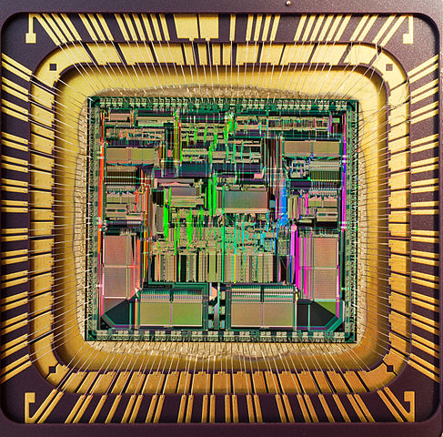
C Program
void main() {
while(1) {…}
}
Compiler
push %rbp
mov %rsp,%rbp
jmp 0x4004bc
binary
Operating System
Software
process
Instruction Set
Architecture (ISA):
X86, ARM, MIPS…
Interface
Hardware
1. Fetch
Instruction
(cache)
pc
2. Decode
Register
File
Branch
Add
Mult
Load
Store
Data Memory
(cache)
Notes:
Computer DOESN’

Slide 17
Trajectory of this course
… very much a bottom up approach:
Week 1: Computer representations of data
Weeks 2-4: In-depth explanation of an ISA: x86 (sneak in floats)
… midterm …
Weeks 5.5-7: Computer Architecture + Performance
Weeks 7.5-8: Operating System Abstractions (Process+Virt. Mem)
Weeks 9-10: Multithreading + Synchronization

Slide 18
Visual Trajectory
Algorithm
Application
Programming Language
Compiler
Operating System
Architecture (ISA)
Hardware Organization
Component Design
Circuit Design
Devices (Transistors)
Physics/Manufacturing

Slide 19
Useful Outcomes of this course!
Introductions to many areas around systems:
Computer Architecture
Operating Systems
Parallel Programming
Tiny bit: security, compilers, storage systems, etc.
Be able to answer basic computer questions:
How are numbers represented in a computer?
What are the basic operations a computer performs?
Where is the parallelism in a computer?
What is the role of the operating system?
Practical Skills:
Get more comfortable with Linux + C programming.
Basic performance optimizations.
You will learn GDB!

Slide 20
Main Course Theme: Abstraction Is Good, but …
Most CS and CE courses emphasize abstraction
Abstract data types
Asymptotic analysis
These abstractions have limits, understanding these limits is:
Important for correct programs
Abstractions don’t necessarily conform to expectations
Important for Security
Abstractions can often be circumvented
Important for Performance
Abstractions tend to hide performance implications

Slide 21
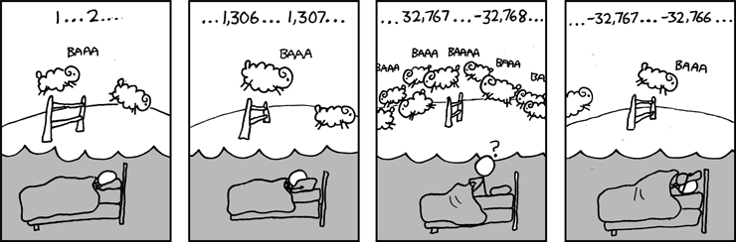
Example 1: int’s are not Integers, float’s are not Reals
Example 1: Is x² ≥ 0?
Float’s: Yes!
Int’s:
40000 * 40000 --> 1600000000
50000 * 50000 --> ??
Example 2: Is (x + y) + z = x + (y + z)?
Unsigned & Signed Int’s: Yes!
Float’s:
(1e20 + -1e20) + 3.14 --> 3.14
1e20 + (-1e20 + 3.14) --> ??
Source: xkcd.com/571
Notes:
Answer 1: -1794967296
Answer 2: 0

Slide 22
Computer Arithmetic
Cannot assume all “usual” mathematical properties
Due to finiteness of representations
Integer operations satisfy “ring” properties
Commutativity, associativity, distributivity
Floating point operations satisfy “ordering” properties
Monotonicity, values of signs
Observation
Need to understand which abstractions apply in which contexts
Important issues for compiler writers and serious application programmers

Slide 23
Example 2: Memory Referencing Bug Example
typedef struct {
int a[2];
double d;
} struct_t;
double fun(int i) {
volatile struct_t s;
s.d = 3.14;
s.a[i] = 1073741824; /* Possibly out of bounds */
return s.d;
}
fun(0) --> 3.14
fun(1) --> 3.14
fun(2) --> 3.1399998664856
fun(3) --> 2.00000061035156
fun(4) --> 3.14
fun(6) --> Segmentation fault

Slide 24

Meltdown and Spectre (highly simplified)
Bugs that plagued high-performance processors (2018)
Algorithm
Application
Program 1
Programming Language
Program 2
Compiler
Operating System
Architecture (ISA)
Speculation +
Caching
Hardware Organization
Component Design
Circuit Design
Devices (Transistors)
Physics/Manufacturing

Slide 25
Example 3: There’s more to performance than asymptotic complexity
Constant factors matter too!
Often see 10:1 performance range depending on how code written, sometimes 100:1
Must optimize at multiple levels: algorithm, data representations, procedures, and loops
Must understand system to optimize performance
How programs compiled and executed
How to measure program performance and identify bottlenecks
How to improve performance without destroying code modularity and generality

Slide 26
Memory System Performance Example
void copyij(int src[2048][2048],
int dst[2048][2048])
{
int i,j;
for (i = 0; i < 2048; i++)
for (j = 0; j < 2048; j++)
dst[i][j] = src[i][j];
}
void copyji(int src[2048][2048],
int dst[2048][2048])
{
int i,j;
for (j = 0; j < 2048; j++)
for (i = 0; i < 2048; i++)
dst[i][j] = src[i][j];
}
4.3ms
81.8ms
2.0 GHz Intel Core i7
Hierarchical memory organization
Performance depends on access patterns
Including how step through multi-dimensional array

Slide 27

When is performance important?
Machine learning
Big Data (databases, webservers, networks etc.)
Notes:
Particle effects, physics simulation, lense flares,

Slide 28
Some Administrative Details

Slide 29
Course Components
Lectures
Teach Concepts, show examples
Discussions
Applied concepts, important tools and skills for labs, clarification of lectures, exam coverage
Worksheets handed out in discussion will serve as “homeworks”
Labs
The heart of the course
Provide in‐depth understanding of an aspect of systems
Programming and measurement

Slide 30
Course Info
Main Web Page:
Syllabus, schedule (slides), homeworks, labs,
Office Hours – will post by tomorrow
https://polyarch.github.io/cs33/
CCLE WebPage:
Only assignments turned in here (labs 1 and 5)
https://ccle.ucla.edu/course/view/19F-COMSCI33-1
Pizza:
Course discussions and random questions
One TA will be in charge from Monday - Friday
Textbook
Randal E. Bryant and David R. O’Hallaron. “Computer Systems: A Programmer’s Perspective”, 3rd Edition, Prentice Hall 2015.

Slide 31
Grading
Exams (50%)
Midterm (20%)
Final (30%)
All exams are open book/open notes.
Labs (40%)
Lab 1: Datalab (5%)
Lab 2: Bomb Lab (10%)
Lab 3: Attack Lab (10%)
Lab 4: Malloc Lab (10%)
Lab 5: Thread Lab (5%)
Participation (10%)
Credit for worksheets in discussion section
A few in-class quizzes
Notes:
You must work alone on all labs

Slide 32
Lab Facilities
SEAS Administered Linux Machine
Remote access only
Use ssh to log in with your SEAS account
Machines: lnxsrv??.seas.ucla.edu
Some labs require a specific machine to work
Please direct any account issues to the SEAS help desk as they are the only ones with root access on this machine
Alternatives (Not Recommended)
You may use other alternatives to develop your code
BUT: We will test on the SEAS machines
Your code must work correctly on these machines for credit

Slide 33
How should you program?
Recommended: Vim + Log In Directly
This is what I will use if you come to my office hours
Emacs is another option if you like misery and pain (just kidding)
Edit locally, run remotely?
Many good editors: Sublime, notepad++, whatever mac has etc.
But somewhat painful to transfer files manually…
Visual Studio your own machine?
Can use it, but please test on a lnxsrv machine so that we are all on the same page.

Slide 34
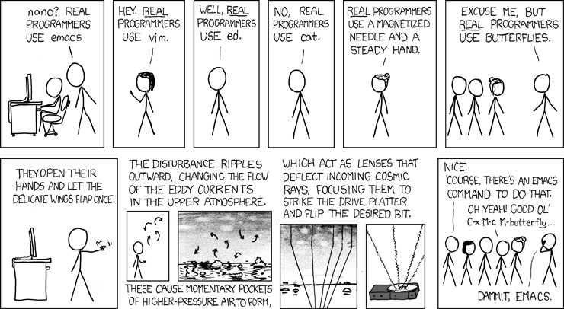

Slide 35
Academic Honesty Policy
Unless stated otherwise, each student must turn in his/her own assignment.
You may discuss solution strategies with others, but you should never read another student’s answers, including answers to assignments from prior years.
You must never show your answers to anyone else and should never post your code in a public place, such as Github, either now or in the future.
You must list the people with whom you interact at the top of your assignment. (You cannot violate the policy by listing extra names, only by omitting names.) Also list any resources used like websites/textbooks.

Slide 36
Academic Honesty Examples
This is not okay:
Sharing code of a solution: either by copying, retyping, looking at, or supplying a copy of a file.
Posting solutions on Piazza
Googling … “youtube datalab solutions”
Googling … “bryant and o’hallaron textbook solutions”
This is okay:
Helping others use systems or tools.
Helping others with high‐level design issues.
Helping others debug their code.

Slide 37
Some emails I’ve gotten…
“I am sorry that my lab code wasn't fully representative of my skills as a student and I believe I deserve a zero because of it.”
“I used github versions of code for the assignment. I understand that I am subject to corresponding penalties for doing wrong and will not put on similar acts in the future. ”
“I confess that I did look at some Github repositories while doing the performance lab and I feel really embarrassed about it. Please accept my apologies and I'll remember this lesson forever.”
“while I was doing the lab, I was searched code for the solution and I used some. So I am writing the email for confess. Sorry about that, and I will learn from it and never do it again. ”
“I am the one who copied codes from some websites. Sorry for this thing…”

Slide 38
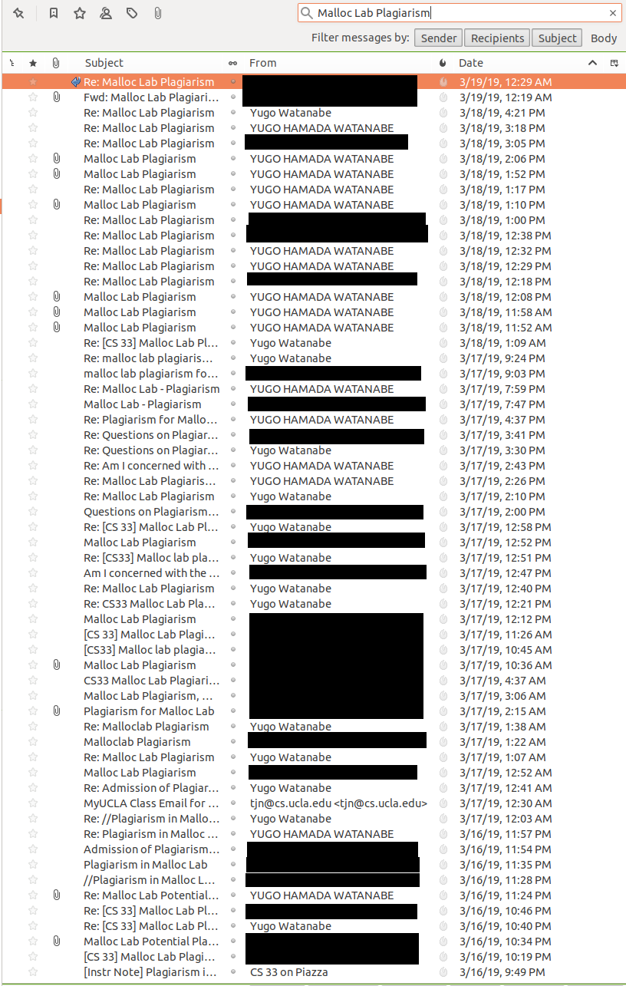

Slide 39


Slide 40


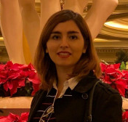


Mathanky Sankaranarayanan
Minhao
Cheng
Atefeh Sohrabizadeh
Yugo
Watanabe
Cibi Pragadeesh

