Slide 1
Machine-Level Programming I: Basics

Slide 2
Review 1
When type casting integers, do I favor types with
smaller size or bigger size?
unsigned or signed?
What happens when you overflow when adding two unsigned numbers?
The result number becomes zero
Result becomes negative
Result is UMAX too low
Result is 2^w too low
What endianness is X86?
Big or little?
What endianness are humans?
Big or little?
Notes:
X86 is little endian

Slide 3
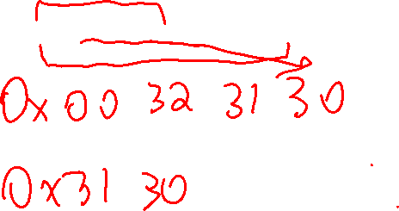
Review 2
How many instances of the “address space” are there on any given computer?
One per program
What defines the size of an address space?
“Word size” of the ISA (X86-64 is 64 bits)
What could these bytes represent (lower addrs. first): 0x30 0x31 0x32 0x00 0x00 0x00 0x00 0x00 0x00 0x00?
Notes:
----------------
int (or unsigned): 0x00323130 (little endian)
long long int: 0x0000000000323130 (little endian)
string: “012”
some other weird thing (floating point, pointer, something else)

Slide 4
Today: Machine Programming I: Basics
C, assembly, machine code
Assembly Basics: Registers, operands, move
Arithmetic & logical operations
History of Intel processors and architectures

Slide 5
ISAs are Awesome
Software
(OS/Libraries/
Applications)
ISA: Instruction
Set Architecture
ISA: Instruction
Set Architecture
ISA: Instruction
Set Architecture
Hardware Organization
Hardware Organization
Hardware Organization
Component Design
Component Design
Component Design
Circuit Design
Circuit Design
Circuit Design
Devices (Transistors)
Devices (Transistors)
Devices (Transistors)
Physics/Manufacturing
Physics/Manufacturing
Physics/Manufacturing

Slide 6
Definitions
Architecture: A specification for how software interacts with hardware.
Instruction Set Architecture (ISA): Specific language understood by the hardware.
Examples: types of operations, registers.
Microarchitecture: Implementation of the architecture.
Examples: cache sizes and core frequency.
Compiled Code Forms:
Machine Code: The byte-level programs that a processor executes
Assembly Code: A text representation of machine code
Example ISAs:
Intel: x86, IA32, Itanium, x86-64
ARM: Used in almost all mobile phones

Slide 7
What should be in an ISA?
Python
import fnmatch
import os
images = ['*.jpg', '*.jpeg', '*.png', '*.tif', '*.tiff']
matches = []
for root, dirnames, filenames in os.walk("C:\"):
for extensions in images:
for filename in fnmatch.filter(filenames, extensions):
matches.append(os.path.join(root, filename))
Enough to run any program in any language…
C Code
#include <stdio.h>
int a[100], b[100];
int main(int argc, char** argv) {
int c;
for(int i = 0; i < 100; ++i) {
c = c + a[i] * b[i];
}
if(c > 5) {
printf("yay!\n");
}
}
<SCRIPT LANGUAGE="JavaScript">
var now = new Date();
var days = new Array('Sunday','Monday','Tuesday','Wednesday','Thursday','Friday','Saturday');
var months = new Array('January','February','March','April','May','June','July','August','September','October','November','December');
var date = ((now.getDate()<10) ? "0" : "")+ now.getDate();
function fourdigits(number) {
return (number < 1000) ? number + 1900 : number;
Javascript
Notes:
Category 1: Where am i?
Category 2: Storage (long lasting, temporary – store instructions and data)
Category 3: Specifying Work (types of instructions, control)

Slide 8
What should be in an architecture?
Time_{n}
Time_{n+1}
Ingredients:
Memory: a place to put values (called address space)
Instructions: moves from one state to the next
Program: set of instructions (lets put it in memory)
Execution model: When do we execute each instruction?
Von Neumann execution: Instructions are executed sequentially, unless otherwise directed
Memory
Instruction
Memory
Program
<0>Add mem[0], mem[1]
<1>Mult mem[1], mem[0]
<2>Sub mem[3], 5
<3>Br mem[3]>9, goto <0>
Instruction Pointer
Notes:
Universal language for software to tell hardware what to do

Slide 9
Computer Organization Viewpoint
CPU
Memory
Register
File
Addresses
Code +
Data +
Stack
PC
Data
Condition
Codes
Instructions
Programmer-Visible State
PC: Program counter
Address of next instruction
Instruction Pointer (IP), or “RIP” (x86-64)
Register file
Heavily used temporary data
Data used closed to where it’s produced
Condition codes (somewhat specific to x86)
Store status information about most recent arithmetic or logical operation
Used for conditional branching
Memory
“Address space” exists here
Byte addressable array
Code and user data
Stack to support procedures

Slide 10
What ISA will we focus on?
Intel x86-64
Why?
Easy for you to play with, because you have x86 processors in your backpack…
Dominate laptop/desktop/server market
Why shouldn’t we do this?
Evolutionary design
Backwards compatible up until 8086, introduced in 1978
Added more features as time goes on
This evolutionary process resulted in *MANY* instructions and instruction types, leading to what we call a “Complex Instruction Set”

Slide 11
Intel x86 Evolution: Milestones
Name Date Transistors MHz
8080 1974 6K 1
Mostly 8-bit datapath, 16bit addresses, 64 Kb Address space
8086 1978 29K 5-10
First intel 16-bit datapath. Basis for IBM PC & DOS
1MB address space (20 bit address width)
386 1985 275K 16-33
First 32 bit Intel processor (Address & data) , referred to as IA32
Added “flat addressing”, capable of running Unix
Pentium 4E 2004 125M 2800-3800
First 64-bit Intel x86 processor, referred to as x86-64
Core 2 2006 291M 1060-3500
First multi-core Intel processor
Skylake XCC 2018 >8 B 1700-3900
28 Cores

Slide 12
How have ISAs changed over time?
Example: X86
Is mostly the same, amazingly
Fully backwards compatible (with OS support)
Run a program that was compiled 40 years ago
But, so tempting to add some ISA Features
Instructions to support multimedia (image, video, VR) operations
Instructions for security/cryptography, etc..
Instructions to support explicit parallelism
Instructions to enable more efficient conditional operations
And much more!
Small ISA + Incremental Change + Time = HUGE ISA
Approach: Just learn a subset of x86 that is simple and commonly used by compilers…

Slide 13
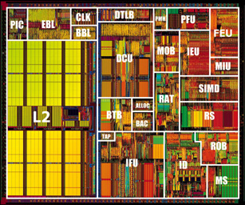
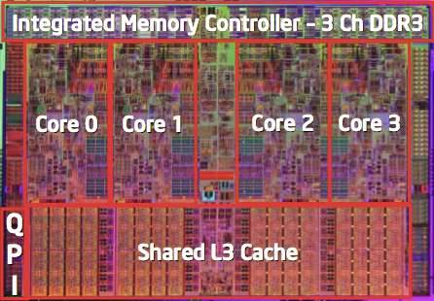
Intel x86 Processors, cont.
Pentium
~2000
Ivy Bridge
~2012
(>1B transistors)

Slide 14
Other Changes besides ISA?
Transition from 32 bits to 64 bits
More cores
Micro-architectural Features (we probably won’t discuss these further…)
Speculation, Multi-threading, Huge Caches, DVFS, OOO Execution
ISAs are related to, but are not the same as hardware!

Slide 15
Historical note: RISCV vs CISC
80s/90s -- Should my ISA have lots of instructions or few instructions?
Lots: Complex Instruction Set Computer (CISC, eg. x86)
Easier to add functionality and support backwards compatibility
Possible to make instructions which do coarse grain work
Few: Reduced Instruction Set Computer (RISC, eg. MIPS)
Easier to implement
Easier to make fast processor with complex features
RISC > CISC?
Hardware Translation

Slide 16
x86 Clones: Advanced Micro Devices (AMD)
Historically
AMD has followed just behind Intel
A little bit slower, a lot cheaper
Then
Recruited top circuit designers from Digital Equipment Corp. and other downward trending companies
Built Opteron: tough competitor to Pentium 4
Developed x86-64, their own extension to 64 bits
Recent Years (10 years)
Intel got its act together
Leads the world in semiconductor technology
AMD has fallen behind
Relies on external semiconductor manufacturer
Very Recently (3 years) -- AMD crushing it again!

Slide 17
Intel’s 64-Bit History
2001: Intel Attempts Radical Shift from IA32 to IA64
Totally different architecture (Itanium)
Executes IA32 code only as legacy
Performance disappointing
2003: AMD Steps in with Evolutionary Solution
x86-64 (now called “AMD64”)
Intel Felt Obligated to Focus on IA64
Hard to admit mistake or that AMD is better
2004: Intel Announces EM64T extension to IA32
Extended Memory 64-bit Technology
Almost identical to x86-64!
All but low-end x86 processors support x86-64
But, lots of code still runs in 32-bit mode

Slide 18
Ie. what do assembly programs look like?
What do programs look like to the computer?

Slide 19

Compiling Into Assembly
C Code (sum.c)
Generated x86-64 Assembly
long plus(long x, long y);
void sumstore(long x, long y,
long *dest)
{
long t = plus(x, y);
*dest = t;
}
sumstore:
pushq %rbx
movq %rdx, %rbx
call plus
movq %rax, (%rbx)
popq %rbx
ret
(example for next few slides)
Obtain with command
gcc –Og –S sum.c
Produces file sum.s
Notes:
Warning: Will get very different results on other machines or compilers (eg. Mac OS-X) due to different versions of gcc and different compiler settings.

Slide 20

Turning C into Object Code
Code in files p1.c p2.c
Compile with command: gcc –Og p1.c p2.c -o p
Use basic optimizations (-Og) [New to recent versions of GCC]
Put resulting binary in file p
text
C program (p1.c p2.c)
Compiler (gcc –Og -S) (optimizations
happen here)
text
Asm program (p1.s p2.s)
Assembler (gcc or as)
binary
Object program (p1.o p2.o)
Static libraries (.a)
Linker (gcc or ld)
binary
Executable program (p)

Slide 21
Object Code
Code for sumstore
Assembler
Translates .s into .o
Binary encoding of each instruction
Nearly-complete image of executable code
Missing linkages between code in different files
Linker
Resolves references between files
Combines with static run-time libraries
E.g., code for malloc, printf
Some libraries are dynamically linked
Linking occurs when program begins execution
0x0400595:
0x53
0x48
0x89
0xd3
0xe8
0xf2
0xff
0xff
0xff
0x48
0x89
0x03
0x5b
0xc3
Total of 14 bytes
Each instruction 1, 3, or 5 bytes
Starts at address 0x0400595

Slide 22
Assembly Characteristics: Data Types
“Integer” data of 1, 2, 4, or 8 bytes
Data values, don’t distinguish signed/unsigned!
Addresses (untyped pointers)
Floating point data of 4, 8 bytes (and 10 bytes, but we won’t use)
Code: Byte sequences encoding series of instructions
No aggregate types such as arrays or structures
Just contiguously allocated bytes in memory

Slide 23
Assembly Characteristics: Operations
Perform arithmetic function on register or memory data
Transfer data between memory and register
Load data from memory into register
Store register data into memory
Transfer control
Unconditional jumps to/from procedures
Conditional branches

Slide 24

Machine Instruction Example
*dest = t;
C Code
Store value t where designated by dest
Assembly
Move 8-byte value to memory
Quad words in x86-64 parlance
Operands:
t: Register %rax
dest: Register %rbx
*dest: Memory M[%rbx]
Object Code
3-byte instruction
Stored at address 0x40059e
movq %rax, (%rbx)
0x40059e: 48 89 03
Notes:
Mov l
Mov w
Mov b

Slide 25
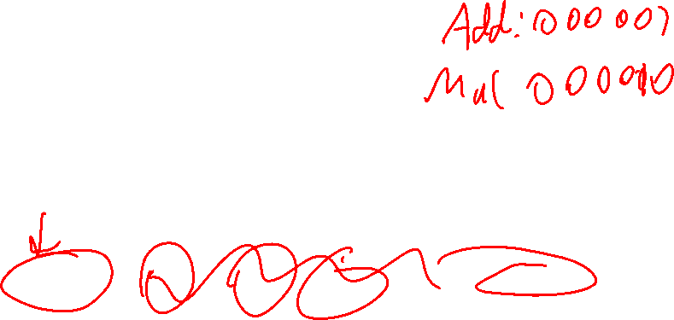
Simple Example: MIPS Format
Length
32-bits
3 Types for different kinds of operations
Op: Opcode, Rs: Source Reg 1, Rt Source reg 2, Rd: Destination reg, Sh: shift, Func: additional opcode bits
R-type
Op(6)
Rs(5)
Rt(5)
Rd(5)
Sh(5)
Func(6)
I-type
Op(6)
Rs(5)
Rt(5)
Immed(16)
J-type
Op(6)
Target(26)

Slide 26
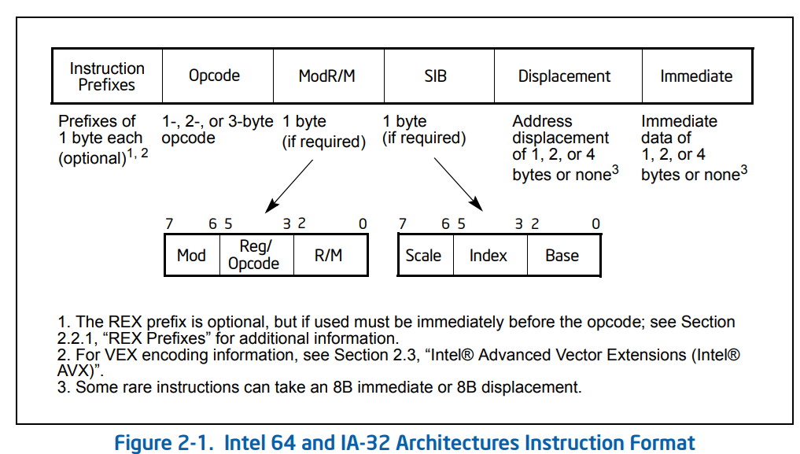

Not Simple Example: X86 Format
Intel® 64 and IA-32 Architectures Software Developer’s Manual

Slide 27

Disassembling Object Code
Disassembled
0000000000400595 <sumstore>:
400595: 53 push %rbx
400596: 48 89 d3 mov %rdx,%rbx
400599: e8 f2 ff ff ff callq 400590 <plus>
40059e: 48 89 03 mov %rax,(%rbx)
4005a1: 5b pop %rbx
4005a2: c3 retq
Disassembler
objdump –d sum
Useful tool for examining object code
Analyzes bit pattern of series of instructions
Produces approximate rendition of assembly code
Can be run on either a.out (complete executable) or .o file

Slide 28
Reading Byte-Reversed Listings
Example Fragment
Deciphering Numbers
Value: 0x12ab
Pad to 32 bits: 0x000012ab
Split into bytes: 00 00 12 ab
Reverse: ab 12 00 00
Address Instruction Code Assembly Rendition
8048365: 5b pop %ebx
8048366: 81 c3 ab 12 00 00 add $0x12ab,%ebx
804836c: 83 bb 28 00 00 00 00 cmpl $0x0,0x28(%ebx)

Slide 29

Alternate Disassembly
Disassembled
Object
0x0400595:
0x53
0x48
0x89
0xd3
0xe8
0xf2
0xff
0xff
0xff
0x48
0x89
0x03
0x5b
0xc3
Dump of assembler code for function sumstore:
0x0000000000400595 <+0>: push %rbx
0x0000000000400596 <+1>: mov %rdx,%rbx
0x0000000000400599 <+4>: callq 0x400590 <plus>
0x000000000040059e <+9>: mov %rax,(%rbx)
0x00000000004005a1 <+12>:pop %rbx
0x00000000004005a2 <+13>:retq
Within gdb Debugger
gdb sum
disassemble sumstore
Disassemble procedure
x/14xb sumstore
Examine the 14 bytes starting at sumstore

Slide 30
What Can be Disassembled?
% objdump -d WINWORD.EXE
WINWORD.EXE: file format pei-i386
No symbols in "WINWORD.EXE".
Disassembly of section .text:
30001000 <.text>:
30001000: 55 push %ebp
30001001: 8b ec mov %esp,%ebp
30001003: 6a ff push $0xffffffff
30001005: 68 90 10 00 30 push $0x30001090
3000100a: 68 91 dc 4c 30 push $0x304cdc91
Reverse engineering forbidden by
Microsoft End User License Agreement
Anything that can be interpreted as executable code
Disassembler examines bytes and reconstructs assembly source

Slide 31
Today: Machine Programming I: Basics
C, assembly, machine code
Assembly Basics: Registers, operands, move
Arithmetic & logical operations
History of Intel processors and architectures

Slide 32
x86-64 Integer Registers
%rax
%r8
%eax
%r8d
%rbx
%r9
%ebx
%r9d
%rcx
%r10
%ecx
%r10d
%rdx
%r11
%edx
%r11d
%rsi
%r12
%esi
%r12d
%rdi
%r13
%edi
%r13d
%rsp
%r14
%esp
%r14d
%rbp
%r15
%ebp
%r15d
64-bits each, names prefixed with “r”
Can reference low-order 4 bytes with “e” prefix
Notes:
“integer” but anything could in principle be stored in them

Slide 33
Some History: IA32 Registers
Origin
(mostly obsolete)
%eax
%ax
%ah
%al
accumulate
%ecx
%cx
%ch
%cl
counter
%edx
%dx
%dh
%dl
data
general purpose
%ebx
%bx
%bh
%bl
base
%esi
source
index
%si
%edi
destination
index
%di
%esp
stack
pointer
%sp
%ebp
base
pointer
%bp
16-bit virtual registers
(backwards compatibility)

Slide 34

Moving Data
%rax
%rcx
Moving Data
movq Source, Dest:
Operand Types
Immediate: Constant integer data
Example: $0x400, $-533
Like C constant, but prefixed with ‘$’
Encoded with 1, 2, or 4 bytes
Register: One of 16 integer registers
Example: %rax, %r13
But %rsp reserved for special use
Others have special uses for particular instructions
Memory: 8 consecutive bytes of memory at address given by register
Simplest example: (%rax)
Various other “address modes”
%rdx
%rbx
%rsi
%rdi
%rsp
%rbp
%rN

Slide 35

movq Operand Combinations
Source
Dest
Src,Dest
C Analog
Reg
movq $0x4,%rax
temp = 0x4;
Imm
Mem
movq $-147,(%rax)
*p = -147;
Reg
movq %rax,%rdx
temp2 = temp1;
movq
Reg
Mem
movq %rax,(%rdx)
*p = temp;
Mem
Reg
movq (%rax),%rdx
temp = *p;
Cannot do memory-memory transfer with a single instruction

Slide 36

Example Program for Move
void swap
(long *xp, long *yp)
{
long t0 = *xp;
long t1 = *yp;
*xp = t1;
*yp = t0;
}
swap:
movq (%rdi), %rax
movq (%rsi), %rdx
movq %rdx, (%rdi)
movq %rax, (%rsi)
ret

Slide 37
Understanding Swap() – initial state
Memory
void swap
(long *xp, long *yp)
{
long t0 = *xp;
long t1 = *yp;
*xp = t1;
*yp = t0;
}
Registers
%rdi
%rsi
%rax
%rdx
Register Value
%rdi xp
%rsi yp
%rax t0
%rdx t1
swap:
movq (%rdi), %rax # t0 = *xp
movq (%rsi), %rdx # t1 = *yp
movq %rdx, (%rdi) # *xp = t1
movq %rax, (%rsi) # *yp = t0
ret

Slide 38
Understanding Swap()
Memory
Registers
Address
123
0x120
%rdi
0x120
0x118
%rsi
0x100
0x110
%rax
0x108
%rdx
456
0x100
swap:
movq (%rdi), %rax # t0 = *xp
movq (%rsi), %rdx # t1 = *yp
movq %rdx, (%rdi) # *xp = t1
movq %rax, (%rsi) # *yp = t0
ret

Slide 39

Understanding Swap()
Memory
Registers
Address
123
0x120
%rdi
0x120
0x118
%rsi
0x100
0x110
%rax
123
0x108
%rdx
456
0x100
swap:
movq (%rdi), %rax # t0 = *xp
movq (%rsi), %rdx # t1 = *yp
movq %rdx, (%rdi) # *xp = t1
movq %rax, (%rsi) # *yp = t0
ret

Slide 40
Understanding Swap()
Memory
Registers
Address
123
0x120
%rdi
0x120
0x118
%rsi
0x100
0x110
%rax
123
0x108
%rdx
456
456
0x100
swap:
movq (%rdi), %rax # t0 = *xp
movq (%rsi), %rdx # t1 = *yp
movq %rdx, (%rdi) # *xp = t1
movq %rax, (%rsi) # *yp = t0
ret

Slide 41
Understanding Swap()
Memory
Registers
Address
456
0x120
%rdi
0x120
0x118
%rsi
0x100
0x110
%rax
123
0x108
%rdx
456
456
0x100
swap:
movq (%rdi), %rax # t0 = *xp
movq (%rsi), %rdx # t1 = *yp
movq %rdx, (%rdi) # *xp = t1
movq %rax, (%rsi) # *yp = t0
ret

Slide 42
Understanding Swap()
Memory
Registers
Address
456
0x120
%rdi
0x120
0x118
%rsi
0x100
0x110
%rax
123
0x108
%rdx
456
123
0x100
swap:
movq (%rdi), %rax # t0 = *xp
movq (%rsi), %rdx # t1 = *yp
movq %rdx, (%rdi) # *xp = t1
movq %rax, (%rsi) # *yp = t0
ret

Slide 43
Simple Memory Addressing Modes
Normal (R) Mem[Reg[R]]
Register R specifies memory address
Aha! Pointer dereferencing in C movq (%rcx),%rax
Displacement D(R) Mem[Reg[R]+D]
Register R specifies start of memory region
Constant displacement D specifies offset movq 8(%rbp),%rdx
Takeaway: Complex addressing allow you to express common memory access patterns within a single instruction.

Slide 44
Full Memory Addressing Modes in X86
Most General Form
D(Rb,Ri,S) Mem[Reg[Rb]+S*Reg[Ri]+ D]
D: Constant “displacement” 1, 2, or 4 bytes
Rb: Base register: Any of 16 integer registers
Ri: Index register: Any, except for %rsp
S: Scale: 1, 2, 4, or 8 (why these numbers?)
Special Cases
(Rb,Ri) Mem[Reg[Rb]+Reg[Ri]]
D(Rb,Ri) Mem[Reg[Rb]+Reg[Ri]+D]
(Rb,Ri,S) Mem[Reg[Rb]+S*Reg[Ri]]
Notes:
Sizes of major datatypes

Slide 45

Address Computation Examples
%rdx | 0xf000
%rcx | 0x0100
D(Rb,Ri,S) Mem[Reg[Rb]+S*Reg[Ri]+ D]
Expression | Address Computation | Address
0x8(%rdx) | 0xf000 + 0x8 | 0xf008
(%rdx,%rcx) | 0xf000 + 0x100 | 0xf100
(%rdx,%rcx,4) | 0xf000 + 4*0x100 | 0xf400
0x80(,%rdx,2) | 2*0xf000 + 0x80 | 0x1e080
Notes:
0xf000 + 0x8 = 0xf008
0xf000 + 0x0100 = 0xf100
0xf000 + 4*0x0100 = 0xf400
2*0xf000 + 0x80 = 0x1d080

Slide 46
Today: Machine Programming I: Basics
C, assembly, machine code
Assembly Basics: Registers, operands, move
Arithmetic & logical operations
History of Intel processors and architectures

Slide 47

Some Arithmetic Operations
Two Operand Instructions:
Format Computation
addq Src,Dest Dest = Dest + Src
subq Src,Dest Dest = Dest − Src
imulq Src,Dest Dest = Dest * Src
salq Src,Dest Dest = Dest << Src (also called shlq)
sarq Src,Dest Dest = Dest >> Src Arithmetic
shrq Src,Dest Dest = Dest >> Src Logical
xorq Src,Dest Dest = Dest ^ Src
andq Src,Dest Dest = Dest & Src
orq Src,Dest Dest = Dest | Src
Watch out for argument order!
No distinction between signed and unsigned int (why?)
DESTINATION
MODIFIED
Shift right

Slide 48
Some Arithmetic Operations
One Operand Instructions
incq Dest Dest = Dest + 1
decq Dest Dest = Dest − 1
negq Dest Dest = − Dest
notq Dest Dest = ~Dest
See book for more instructions

Slide 49
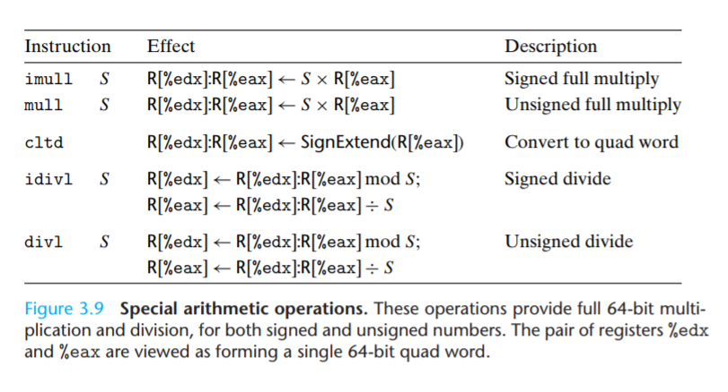
Some instructions use implicit registers…

Slide 50
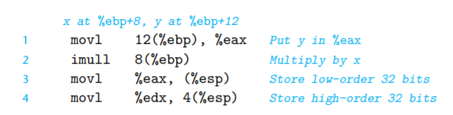
Example in action

Slide 51
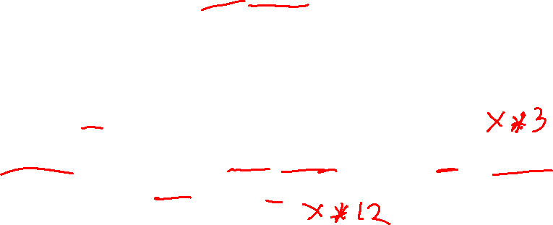
Address Computation Instruction
leaq Src, Dst “Load Effective Address”
Src is address mode expression
Set Dst to address denoted by expression
Uses
Address comp: Computing addresses without a memory reference
E.g., translation of p = &x[i].val;
Sneaky math: Computing arithmetic expressions of the form x + k*y
k = 1, 2, 4, or 8
Example
long m12(long x)
{
return x*12;
}
Converted to ASM by compiler:
leaq (%rdi,%rdi,2), %rax # t <- x+x*2
salq $2, %rax # return t<<2

Slide 52

Arithmetic Expression Example
arith:
leaq (%rdi,%rsi), %rax
addq %rdx, %rax
leaq (%rsi,%rsi,2), %rdx
salq $4, %rdx
leaq 4(%rdi,%rdx), %rcx
imulq %rcx, %rax
ret
long arith
(long x, long y, long z)
{
long t1 = x+y;
long t2 = z+t1;
long t3 = x+4;
long t4 = y * 48;
long t5 = t3 + t4;
long rval = t2 * t5;
return rval;
}
Interesting Instructions
leaq: address computation
salq: shift left
imulq: multiplication
But, only used once

Slide 53
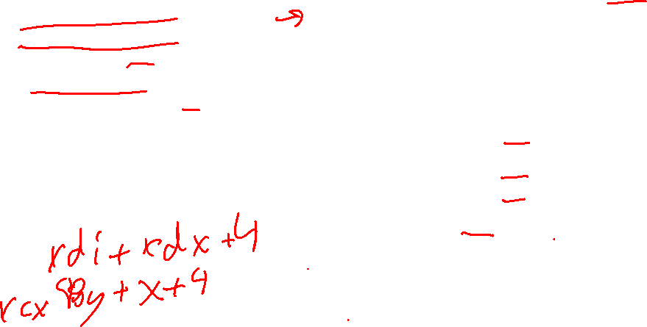
Understanding Arithmetic Expression Example
arith:
leaq (%rdi,%rsi), %rax # t1
addq %rdx, %rax # t2
leaq (%rsi,%rsi,2), %rdx # [temp]
salq $4, %rdx # t4
leaq 4(%rdi,%rdx), %rcx # t5
imulq %rcx, %rax # rval
ret
long arith
(long x, long y, long z)
{
long t1 = x+y;
long t2 = z+t1;
long t3 = x+4;
long t4 = y * 48;
long t5 = t3 + t4;
long rval = t2 * t5;
return rval;
}
Notice there is no t3 : )
Register | Use(s)
%rdi | Argument x
%rsi | Argument y
%rdx | Argument z, [temp],t4
%rax | t1, t2, rval
%rcx | t5

Slide 54
Today: Machine Programming I: Basics
C, assembly, machine code
Assembly Basics: Registers, operands, move
Arithmetic & logical operations
History of Intel processors and architectures

Slide 55
Machine Programming I: Summary
History of Intel processors and architectures
Evolutionary design leads to many quirks and artifacts
C, assembly, machine code
New forms of visible state: program counter, registers, ...
Compiler must transform statements, expressions, procedures into low-level instruction sequences
Assembly Basics: Registers, operands, move
The x86-64 move instructions cover wide range of data movement forms
Arithmetic
C compiler will figure out different instruction combinations to carry out computation

Slide 56
Extra

