Slide 1


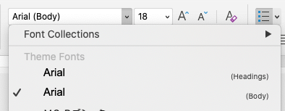
Capitalization and font guidelines
>>>>> Before you begin <<<<<
Capitalization guidelines
  Use title case for presentation titles
    All words are capitalized except for prepositions, conjunctions, and articles
  Use sentence case for slide titles, section titles, and bullets
    Just the first word in a text string is capitalized
  Always capitalize proper nouns, including Esri product names as noted in the Product Naming Guide
Font guidelines
  Always pick Arial [Headings] or [Body] from the top of the font list under Theme Fonts
Esri Corporate Template-Dark v4.7
May 6, 2026
See Change Log for details
Notes:
Esri Corporate Template-Dark v4.7
May 6, 2026
Copyright © 2026 Esri. All rights reserved.

Slide 2


Less is more
>>>>> Before you begin <<<<<
Less is more
Avoid paragraphs and long sentences
Use the 5x5 rule — max of 5 lines, 5 words each
One idea per slide
Presentation structure
Content in longer presentations should be grouped using the following structure: ​
  Sections > Topics > Subtopics​
  Note: A section may include multiple topics

Slide 3

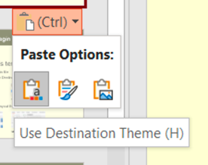
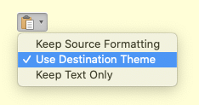
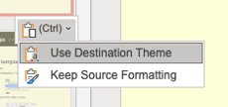
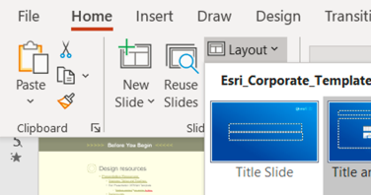
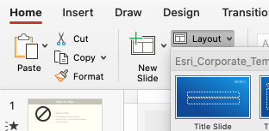
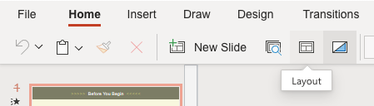
How to apply this template
>>>>> Before you begin <<<<<
How to apply this template
Copy existing slides into this file
When pasting, choose Use Destination Theme
For consistent title placement, you may need to select a layout from the Layout menu
Windows
Mac
Web
Windows
Mac
Web

Slide 4


Design resources
>>>>> Before you begin <<<<<
Design resources
Icons
  From the Home ribbon above, click Esri Icons
Presentation Resources [link]
  Diagrams, Tables and Timelines [link]
  Esri Design Template [link]
  Globes [link]
  Backgrounds [link]
Strategic Presentations [link]
Stock photos
  Adobe Stock images are available. See the details
  Do not use stock images from Microsoft.

Slide 5

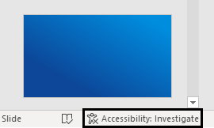
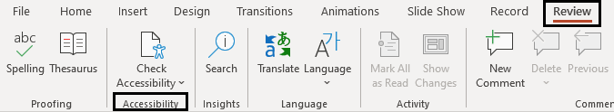
Accessibility
>>>>> Before you begin <<<<<
Accessibility [link]
Check accessibility while designing slides with the Review tab or in the lower left-hand corner
Add alternative text and mark graphical images as decorative
Review slide reading order
Create unique slide titles

Slide 6
Maps that do the talking
Data-driven visualization with MapLibre
George Owen
Notes:
Esri Corporate Template-Dark v4.7
May 6, 2026
Copyright © 2026 Esri. All rights reserved.

Slide 7
Agenda
Goal: Show data-driven visualization in the browser
Open data sources
MapLibre style specification
Maps!
Cartographic techniques

Slide 8
Open data sources

Slide 9
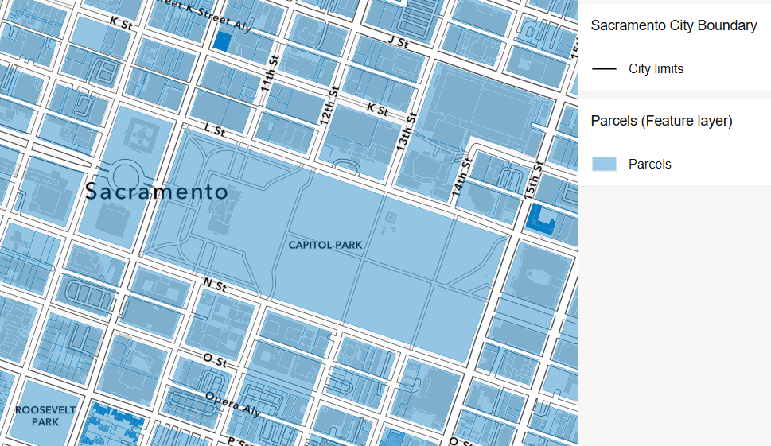
Spatial data fundamentals
Basic context
Features
  Geometry + Attributes
Today: Using Vector Tiles
Many other formats available
Data-driven styles
Notes:
The humble feature
Supported in a million different formats, GeoJSON, JSON-FG, GeoParquet
Today we’re going to be working with features as vector tiles, still a very strong option especially for browsers
Focus is on data-driven styling: styling based on attributes

Slide 10

Data sources
Focus of today’s talk
Today’s study area: City of Sacramento
Data sources used in today’s talk:
  City of Sacramento Open Data Hub
  Sacramento County Open Data Hub
  ArcGIS Living Atlas, Esri Demographics*
Data methodology:
  Started as feature services
  Prepared, clipped, and enriched
  Final rev published as vector tiles
Notes:
Working with municipal data
Sacramento County Open Data Hub is amazing
parcels
City boundaries
Land use
Bunch of other great things
Augmented with data from Esri – ArcGIS Living Atlas, Esri Demographics

Slide 11

Accessing open data with ArcGIS
Use an ArcGIS account
Free and open source
Make a free account: ArcGIS Location Platform
  Online and Enterprise also work
Also gets data hosting, platform services
location.arcgis.com

Slide 12
Style specification

Slide 13

MapLibre Style Specification
An open standard for visualization
Open-source fork of Mapbox v1 style spec
Part of MapLibre project
Published in 2020 (ancient by today’s standards)
Widely supported, de facto interop standard
  *Also note the OGC styles standard
Notes:
Open-source fork of Mapbox style spec v1
Supported by both Esri and AWS
Useful in MapLibre GL JS, MapLibre Native
De facto standard for a while – see https://ogcapi.ogc.org/styles/
Pic: excerpt of a style layer from a layer, here we’re setting the paint property to a fill color that is conditional on the value of a variable called TapestryHouseholds_THHSCODE

Slide 14
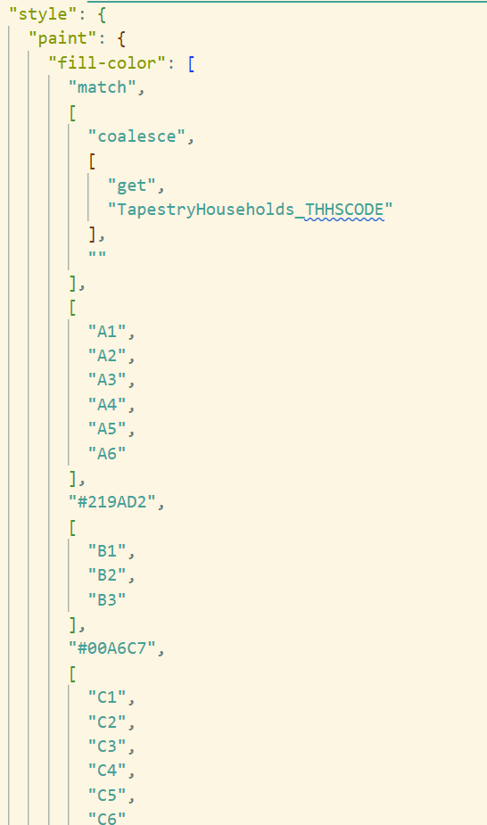
Style document layout
An open standard for visualization
A single JSON document containing:
  Data sources
  Style layers
  Expressions
  Fonts, glyphs, sprites
MapLibre Style Specification
Notes:
Open-source fork of Mapbox style spec v1
Supported by both Esri and AWS
Useful in MapLibre GL JS, MapLibre Native
De facto standard for a while – see https://ogcapi.ogc.org/styles/
Pic: excerpt of a style layer from a layer, here we’re setting the paint property to a fill color that is conditional on the value of a variable called TapestryHouseholds_THHSCODE

Slide 15
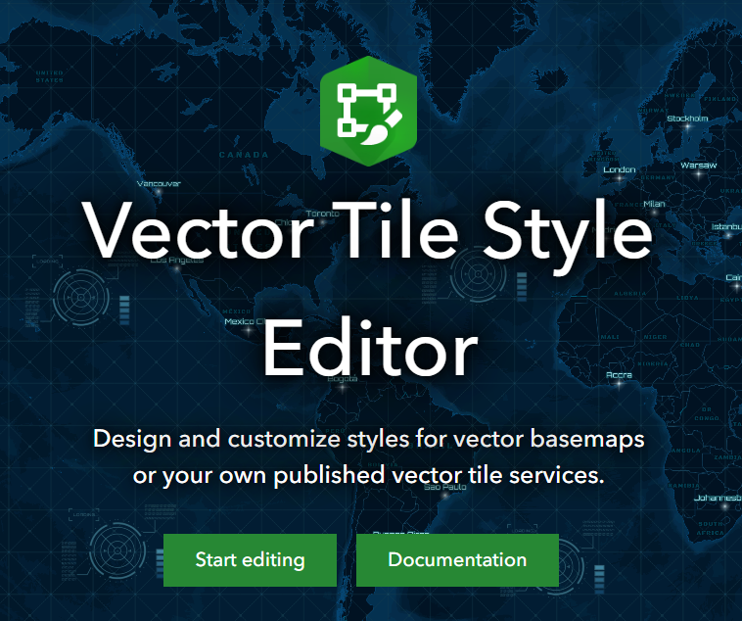
Creating style JSON
MapLibre Style Spec can do anything!
Recommend using web tools for sanity
Vector Tile Style Editor
  GUI-based approach to styling
  Many layers at once
Agentic workflows
  Select colors, symbols, etc
  Agentically generate style document using
  using a custom agent skill

Slide 16
Let’s see some maps!

Slide 17
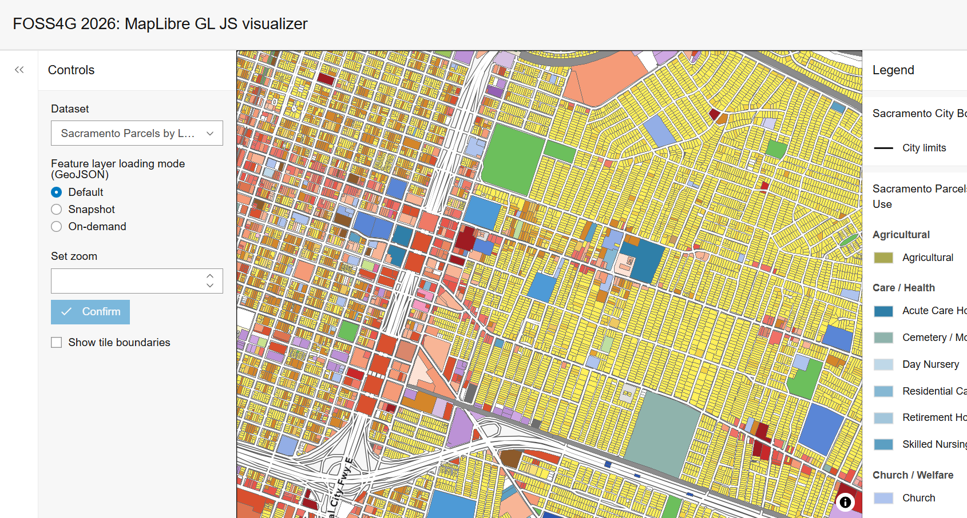
Demo application
Browser application
Browser-based MapLibre app
Framework: Svelte, Typescript, Vite
UI: Calcite Components
Map: MapLibre GL JS
Data:
  Hosting: Vector tile service
  Streaming: MapLibre ArcGIS plugin
LINK
Notes:
Demo app
MapLibre GL JS
MapLibre ArcGIS plugin drawing features, vector tiles hosted in an arcgis vector tile service
Directly consume open data hosted in arcgis hub

Slide 18
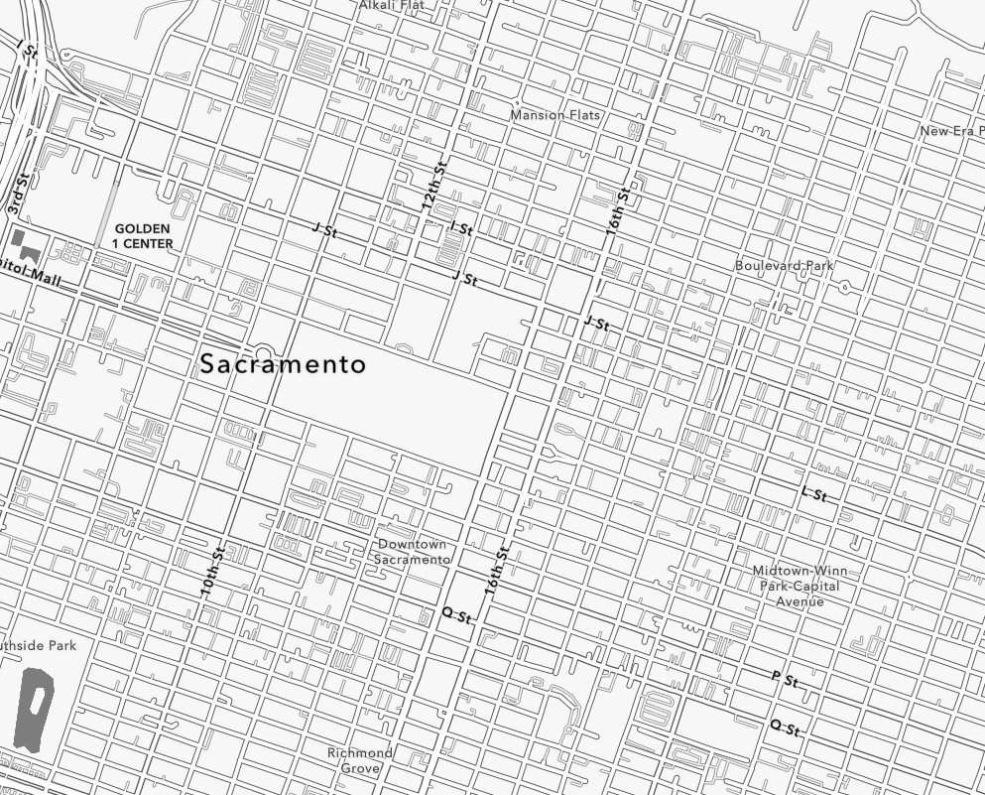
Basemap style
ArcGIS Basemap Styles Service
ArcGIS Human Geography basemap
All ArcGIS basemaps use
MapLibre style JSON
~200 style layers of roads, buildings, etc
50+ other styles available
Custom basemap support
Notes:
APA’s Land Based Classification Standards – linked at the end
APA land based classification standards – linked at the end.
GeoJSON + Parcels is a headache...^

Slide 19
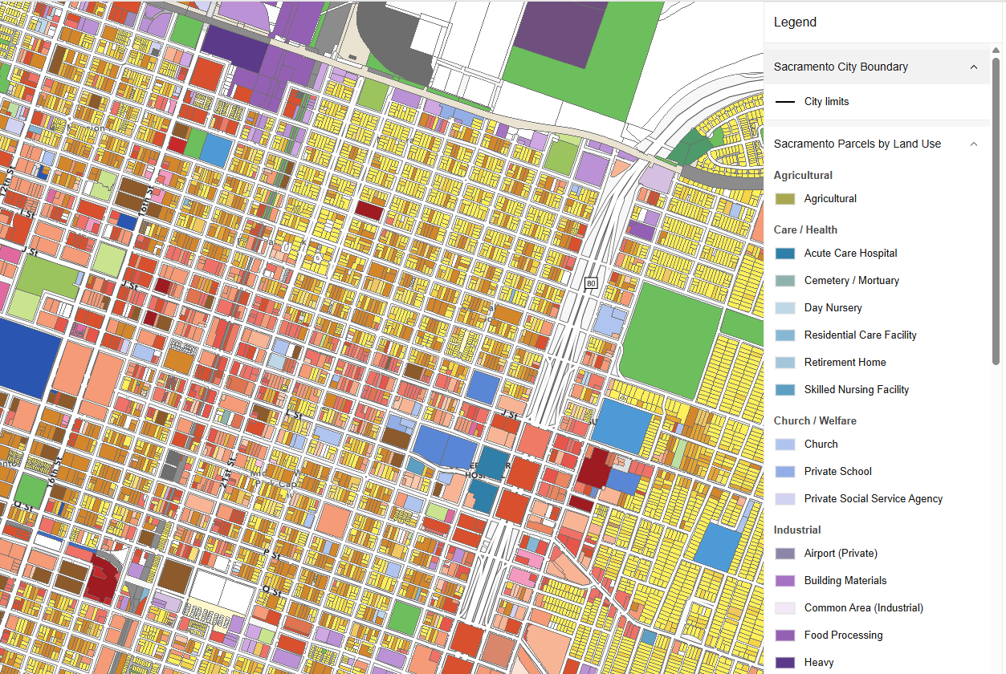
Dataset 1: Parcels by land use
Chorochromatic style
Access LU_SPECIF property through style spec
Conditional parcel colors
  Deep theory behind color choices
Vector Tiles for optimal performance
Legend built using Calcite
Notes:
APA’s Land Based Classification Standards – linked at the end
APA land based classification standards – linked at the end.
GeoJSON + Parcels is a headache...^

Slide 20
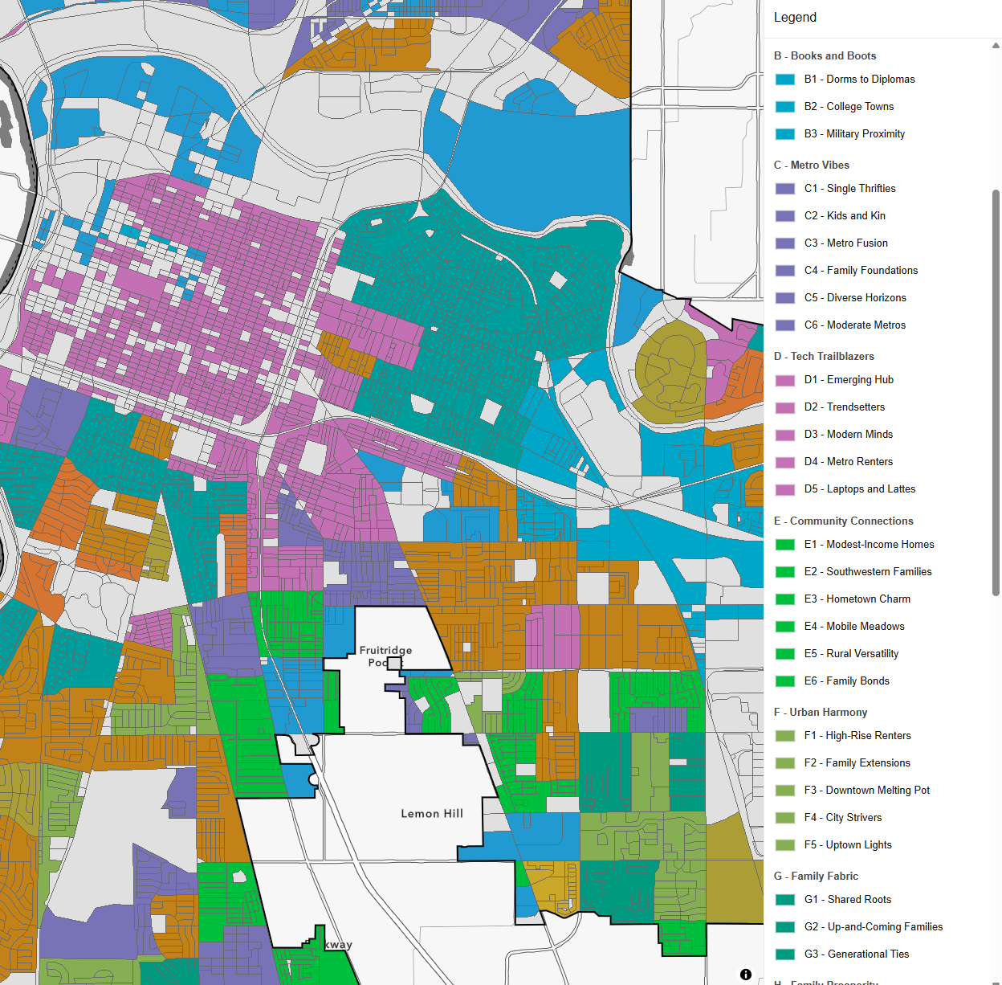
Dataset 2: Esri Tapestry Segments
Chorochromatic style
Neighborhood classification
  Socioeconomics
  Demographics
  Lifestyle characteristics
“LifeMode” groups are supposed to be useful
Census block-level data
Learn more: Tapestry Data

Slide 21
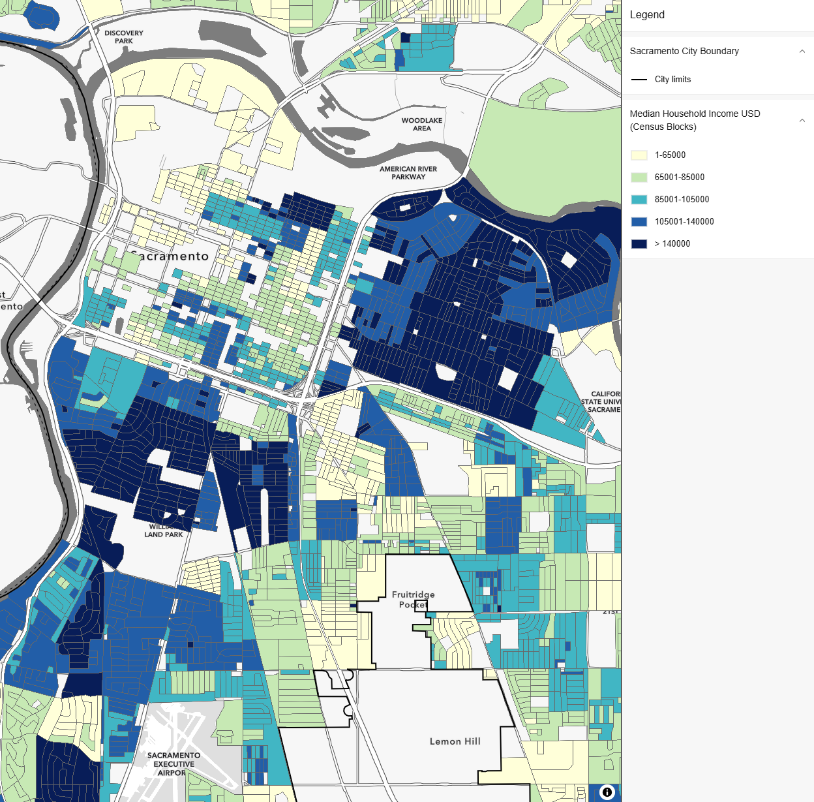
Dataset 3: Median Household Income (USD)
Quintile color ramp
5-class Quantile (equal quantity in each class)
Color has implied meaning
Census block-level data
Layer enrichment
Notes:
Color has implied meaning: Dark, saturated ~= affluent, wealthy

Slide 22
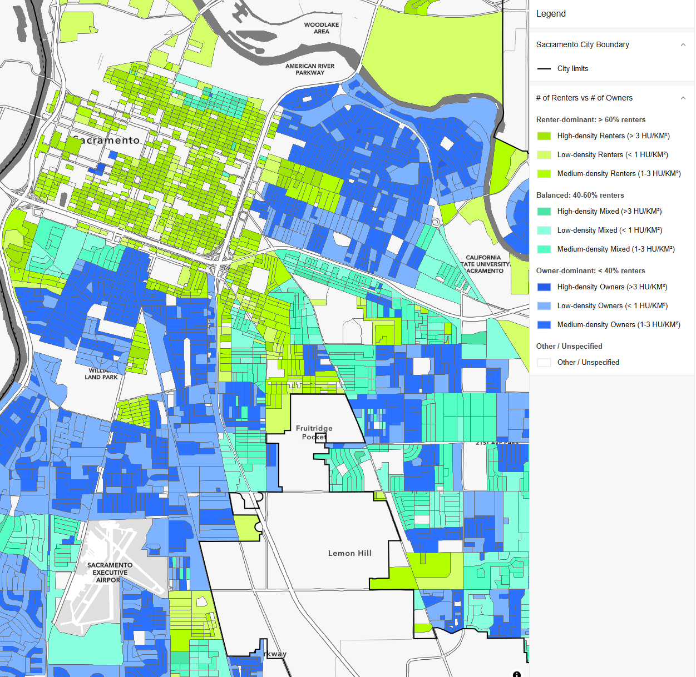
Dataset 4: % of renters vs % of homeowners
Bivariate colors
Actual variables:
  Percent of people that are renters (hue)
  Total household density (saturation)
Source: Esri Demographics
Best practice: pre-classify data using
an additional attribute
Notes:
Style spec works better when modeling a single thing, if you don’t pre-classify data you can hook directly into the R, G, and B of RGB but that’s extremely limiting all things considered

Slide 23
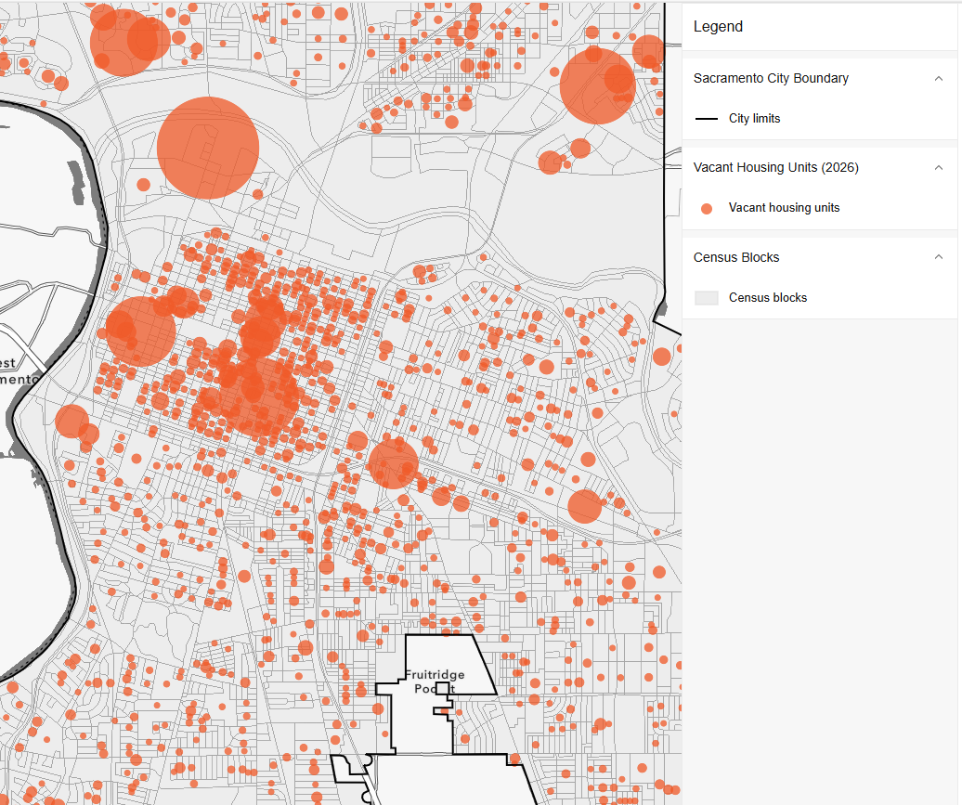
Dataset 5: Number of vacant housing units
Proportional symbols
Points sized by quantity
Source: Esri Demographics
Sacramento Housing Element Hub
Highlights specific buildings of interest
Notes:
Buildings of interest: NAME AND SHAME

Slide 24
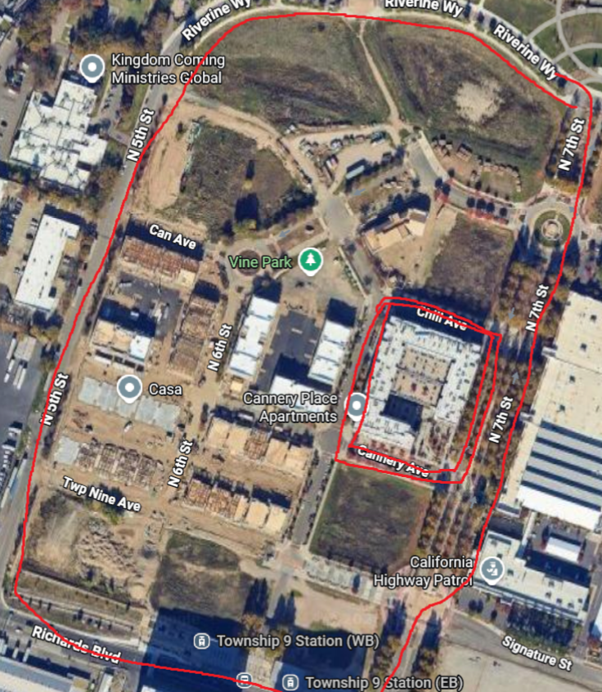
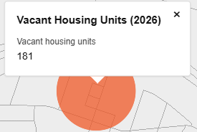

The data speaks...
Yes this is all real data
https://canneryplaceapts.com/index.html
https://capitoltowersapartments.com
“Cheaper to leave it empty”

Slide 25
Conclusion & Resources

Slide 26
Takeaways
MapLibre ecosystem!
Use MapLibre ArcGIS plugin to render open Hub data
MapLibre style specification + Agentic workflows

Slide 27

Resources
MapLibre GL JS
MapLibre ArcGIS plugin
Data enrichment browser
Sacramento County Open Data Hub
Sacramento Housing Element Hub
Styling resources:
Vector tile style editor
Maplibre-agent-skills
gowin20/agent-skills
APA’s Land Based Classification Standards

Slide 28
Data attribution
ArcGIS Living Atlas
Esri Demographics
City of Sacramento Open Data Hub
Sacramento County Open Data Hub

Slide 29
Copyright © 2026 Esri. All rights reserved.

