Slide 1


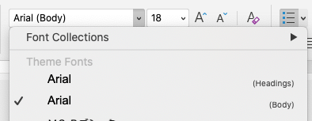
Capitalization and font guidelines
>>>>> Before you begin <<<<<
Capitalization guidelines
  Use title case for presentation titles
    All words are capitalized except for prepositions, conjunctions, and articles
  Use sentence case for slide titles, section titles, and bullets
    Just the first word in a text string is capitalized
  Always capitalize proper nouns, including Esri product names as noted in the Product Naming Guide
Font guidelines
  Always pick Arial [Headings] or [Body] from the top of the font list under Theme Fonts
Esri Corporate Template-Dark v4.7
May 6, 2026
See Change Log for details
Notes:
Esri Corporate Template-Dark v4.7
May 6, 2026
Copyright © 2026 Esri. All rights reserved.

Slide 2


Less is more
>>>>> Before you begin <<<<<
Less is more
Avoid paragraphs and long sentences
Use the 5x5 rule — max of 5 lines, 5 words each
One idea per slide
Presentation structure
Content in longer presentations should be grouped using the following structure: ​
  Sections > Topics > Subtopics​
  Note: A section may include multiple topics

Slide 3

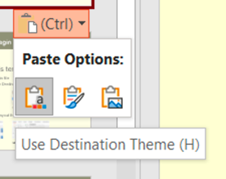
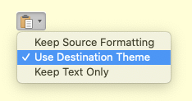
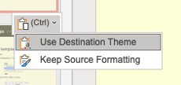
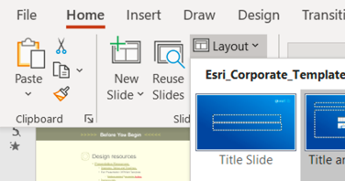
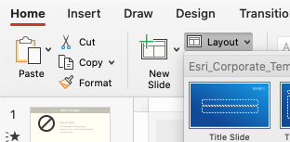
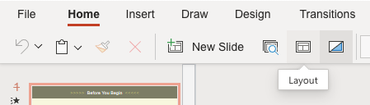
How to apply this template
>>>>> Before you begin <<<<<
How to apply this template
Copy existing slides into this file
When pasting, choose Use Destination Theme
For consistent title placement, you may need to select a layout from the Layout menu
Windows
Mac
Web
Windows
Mac
Web

Slide 4


Design resources
>>>>> Before you begin <<<<<
Design resources
Icons
  From the Home ribbon above, click Esri Icons
Presentation Resources [link]
  Diagrams, Tables and Timelines [link]
  Esri Design Template [link]
  Globes [link]
  Backgrounds [link]
Strategic Presentations [link]
Stock photos
  Adobe Stock images are available. See the details
  Do not use stock images from Microsoft.

Slide 5

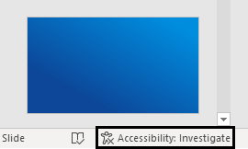
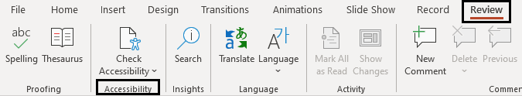
Accessibility
>>>>> Before you begin <<<<<
Accessibility [link]
Check accessibility while designing slides with the Review tab or in the lower left-hand corner
Add alternative text and mark graphical images as decorative
Review slide reading order
Create unique slide titles

Slide 6
Performant maps, Open data
Optimizing large municipal queries with MapLibre
George Owen
Notes:
Esri Corporate Template-Dark v4.7
May 6, 2026
Copyright © 2026 Esri. All rights reserved.

Slide 7
Agenda
Municipal open data
Browser-based data rendering
Optimizing GeoJSON queries

Slide 8
Municipal open data

Slide 9

Finding open data
Focus of today’s talk
ArcGIS Hub: Municipal data, local gov’t
Today’s data: City of Sacramento
Data sources used in today’s talk:
  City of Sacramento Open Data Hub
  Sacramento County Open Data Hub
  ArcGIS Living Atlas, Esri Demographics*
Notes:
Working with municipal data
Sacramento County Open Data Hub is amazing
parcels
City boundaries
Land use
Bunch of other great things
Augmented with data from Esri – ArcGIS Living Atlas, Esri Demographics

Slide 10
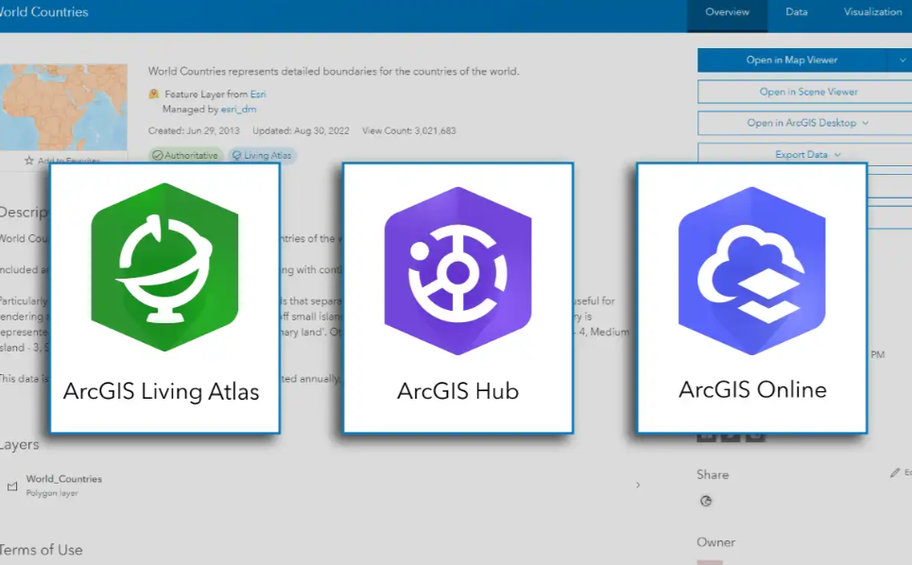
Other open data sources
https://livingatlas.arcgis.com/
https://hub.arcgis.com/
All free
Worth checking your area

Slide 11

Accessing ArcGIS open data
Use ArcGIS Location Platform
Free and open source
Make a free account: ArcGIS Location Platform
Access Hub data, Living Atlas data
Also get data hosting, platform services

Slide 12

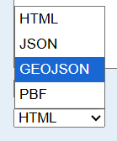
Features: Open data formats
A world of wonderful standards!
JSON-FG, GeoParquet, Vector tiles, GeoPackage, Topo-JSON, PMTiles, KMZ........
Reality: GeoJSON everywhere
Esri feature services return GeoJSON.
  Among other, worse options

Slide 13
Browser-based data rendering

Slide 14

MapLibre GL JS
https://maplibre.org/
Open-source fork of Mapbox v1, 2020
MapLibre ecosystem: Native SDK, tile server, and more
Wonderful alternative to Mapbox
Strong industry support
Active community
Growing in popularity

Slide 15
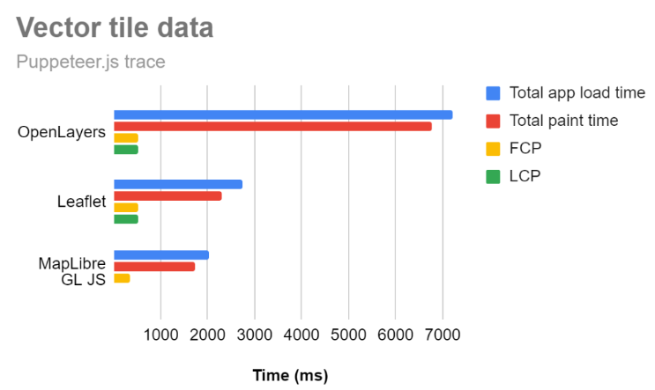
MapLibre GL JS is performant
Source: my 2023 FOSS4G talk

Slide 16
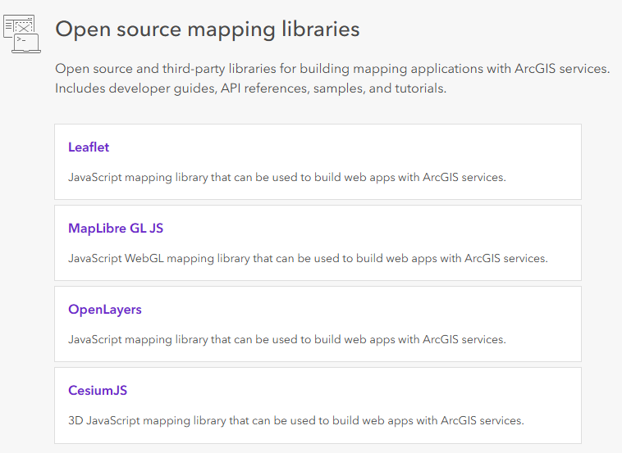
Esri’s open-source ecosystem
Javascript/Typescript npm packages
ArcGIS REST JS
MapLibre ArcGIS plugin
Leaflet ArcGIS plugin (Esri Leaflet)
CesiumJS, OpenLayers support
More plugins coming soon!

Slide 17
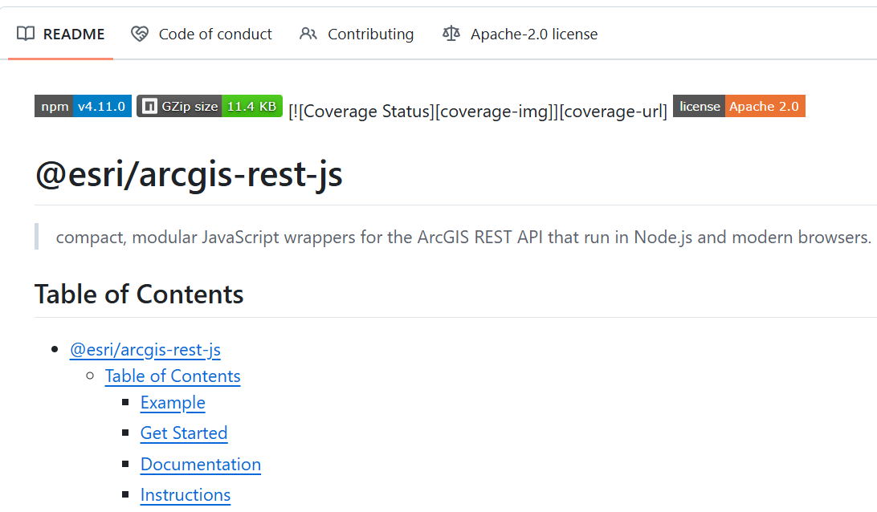
ArcGIS REST JS
@esri/arcgis-rest-js
Typescript monorepo containing 10 packages
REST API helpers – data services, portal authentication, etc
Core re-usable logic for other packages
Also powers ArcGIS Hub!
LINK

Slide 18
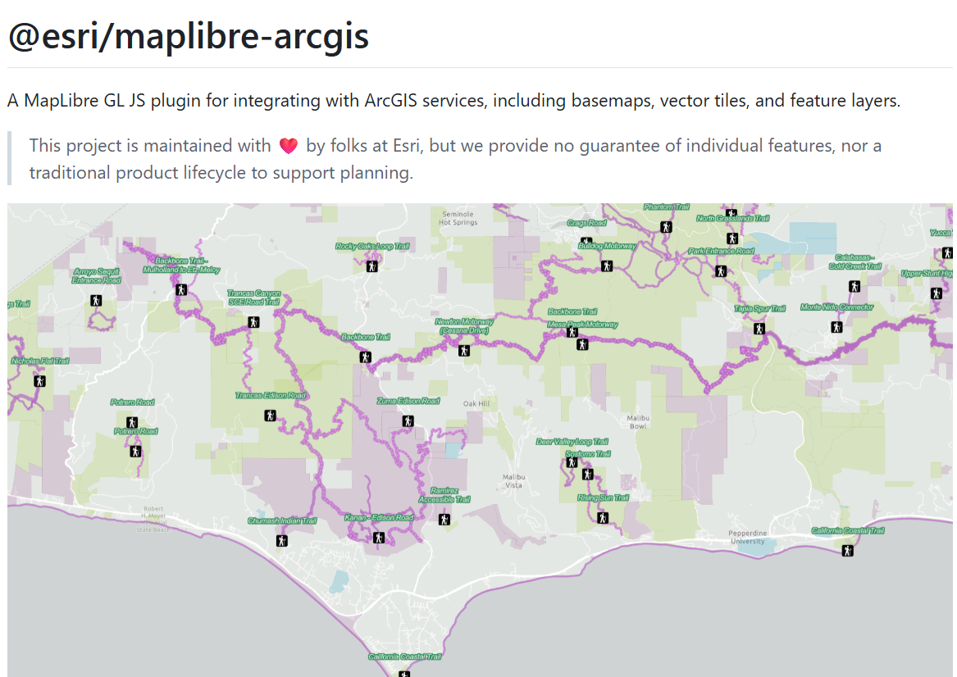
MapLibre ArcGIS plugin
@esri/maplibre-arcgis
Data service integration with MapLibre GL JS
Basemap services
Feature services
Vector tile services
Attribution, authentication, etc
LINK

Slide 19
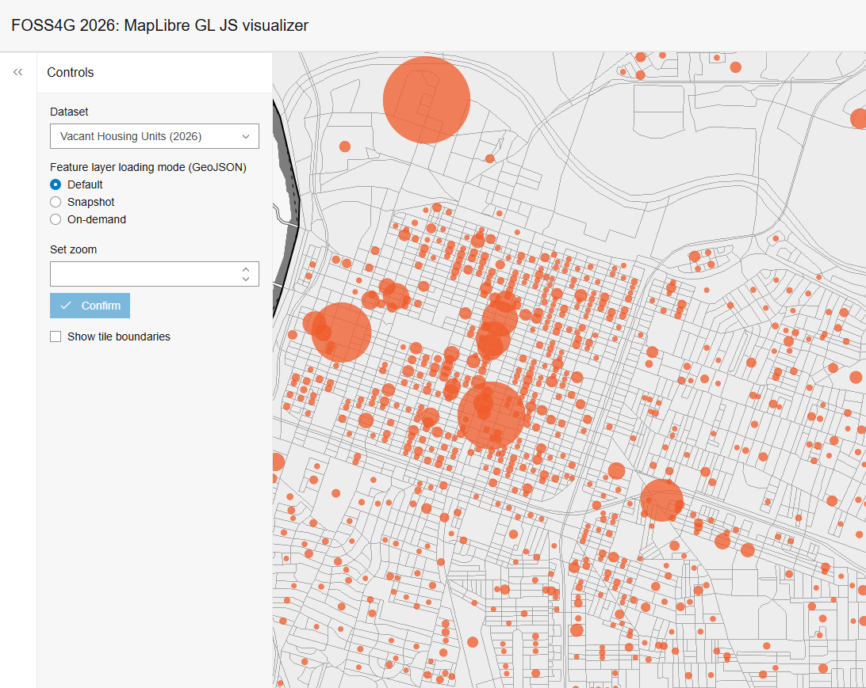
Demo
LINK

Slide 20
Optimizing Feature service queries

Slide 21
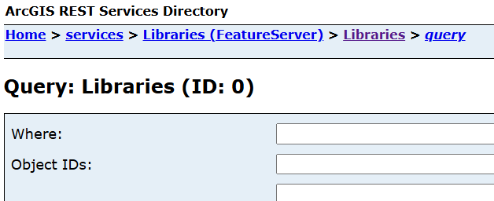
Problem: Esri’s Feature Service
MapLibre ArcGIS
Esri feature services only serve GeoJSON
  *Spatially Optimized Parquet service also available, but distinct from feature services
GeoJSON is unoptimized
  Large file sizes
  Slow loading times
2,000 feature limit per request
GeoJSON is still hugely popular

Slide 22
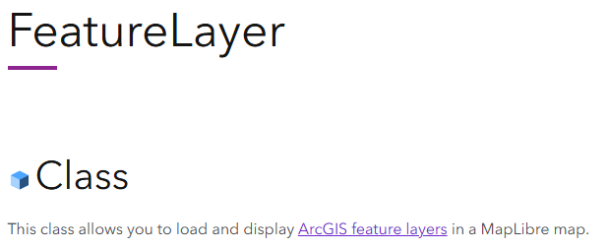

Solution: FeatureLayer class
MapLibre ArcGIS
Load feature services in MapLibre
Lessons learned from ArcGIS Maps SDK for JS
Huge amount of optimizations
  Multiple loading strategies
  Advanced caching strategy
  Network transfer optimizations
  Converts EsriJSON to GeoJSON
“The secret sauce”

Slide 23
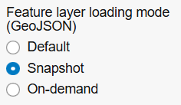
Loading strategy: Snapshot mode
MapLibre ArcGIS
Load everything at once
Triggers on initial render
Paginate requests up to 8,000 features
  Bypasses “2,000 feature limit”
Easy to implement
Real advantages for small datasets

Slide 24

Snapshot mode pros and cons
MapLibre ArcGIS
+ Avoids unnecessary requests
+ Real advantages for small datasets
+ Ideal situation: Get it out of the way early
- Blocks first contentful paint (FCP)
- Parcels:

Slide 25
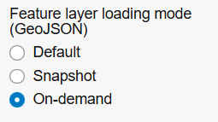
On-demand loading strategy
MapLibre ArcGIS
Load tiles as you pan and zoom
Cache the current view and a bit more
Optimize geometries at different zoom levels
  Quantization
Enables truly large datasets

Slide 26

Quantization parameters
MapLibre ArcGIS
Handled by FeatureServer
Simplify the geometry of features
  Simplified version has fewer vertices, more compact
Tolerance parameter: Request different versions at different zoom levels
API reference

Slide 27
More on-demand optimizations
MapLibre ArcGIS
Client caching strategies
  Lagging window method
  Current zoom and extent
  Extent-based expiration
  Lagging window method
AbortController to deduplicate requests
FeatureService: Server-side cache
Hardcoded overflow prevention: 350,000 features on-screen at once
Dependent on hardware specs

Slide 28
Default FeatureLayer behavior
MapLibre ArcGIS
Get service information
Attempt snapshot mode
  Check if exceeds 8,000 feature limit (higher for points)
  Load everything at once
Fall back to on-demand loading
“loadingMode” parameter can override default behavior

Slide 29
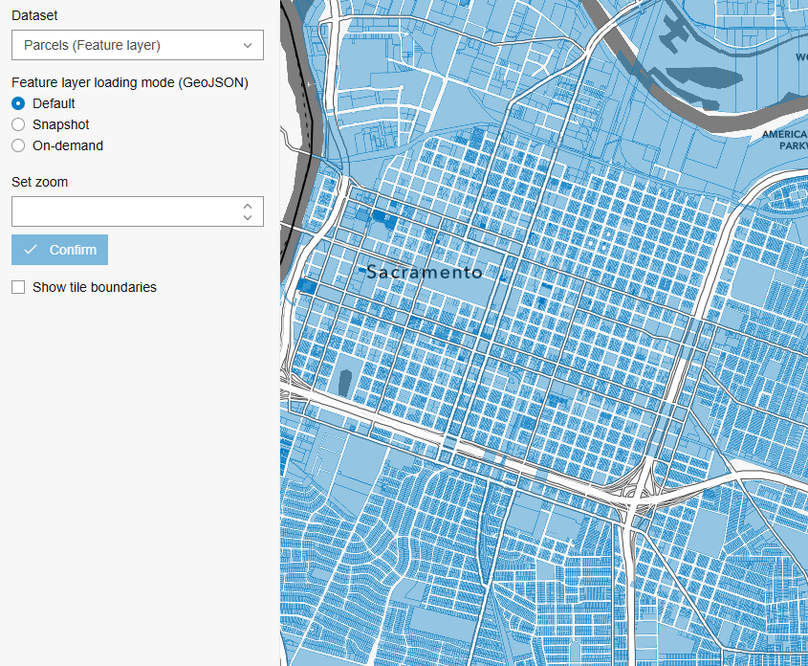
Demo: Snapshot vs On-demand
MapLibre ArcGIS

Slide 30
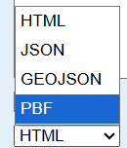
Another optimization: PBF network requests
ArcGIS REST JS
Request all GeoJSON as highly compressed .pbf files
  PBF contains EsriJSON, not MVT
Decode to GeoJSON on client
~10x less bandwidth than GeoJSON
From feature services: PBF containing EsriJSON :\
We wrote our own parser: @esri/arcgis-rest-feature-service
MapLibre ArcGIS workflow:
  Query EsriJSON PBF -> convert EsriJSON to GeoJSON -> render GeoJSON

Slide 31
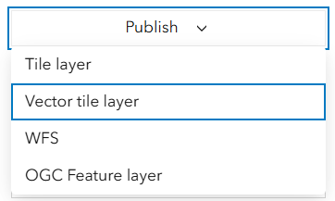
The best optimization?
MapLibre ArcGIS
Stop using GeoJSON...
Publish vector tiles instead.
  Identical attributes and geometry
For existing feature services: Single click
Or, use a Parquet Feature Layer

Slide 32

The road ahead
Esri’s open source ecosystem
Implementing this logic in more environments
  Leaflet
  CesiumJS
What other libraries are you interested in?
What do you want to see in MapLibre ArcGIS?
  Parquet feature layer support
Slides and app: https://github.com/gowin20/foss4g-2026-maplibregl-data-visualization

Slide 33
Copyright © 2026 Esri. All rights reserved.

