Slide 1
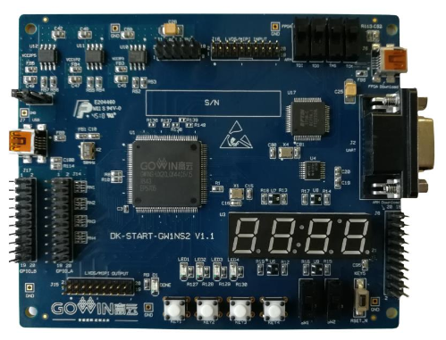
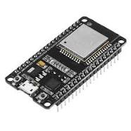
UART
WiFi
AWS
5V/3.3V Translator
//Enter SSID:
//Enter Password:
//Enter HOST_ADDRESS:
//Enter CLIENT_ID:
//Enter TOPIC_NAME:
//Enter RootCA:
//Enter Device Certificate:
//Enter Device Private Key:

