Slide 1
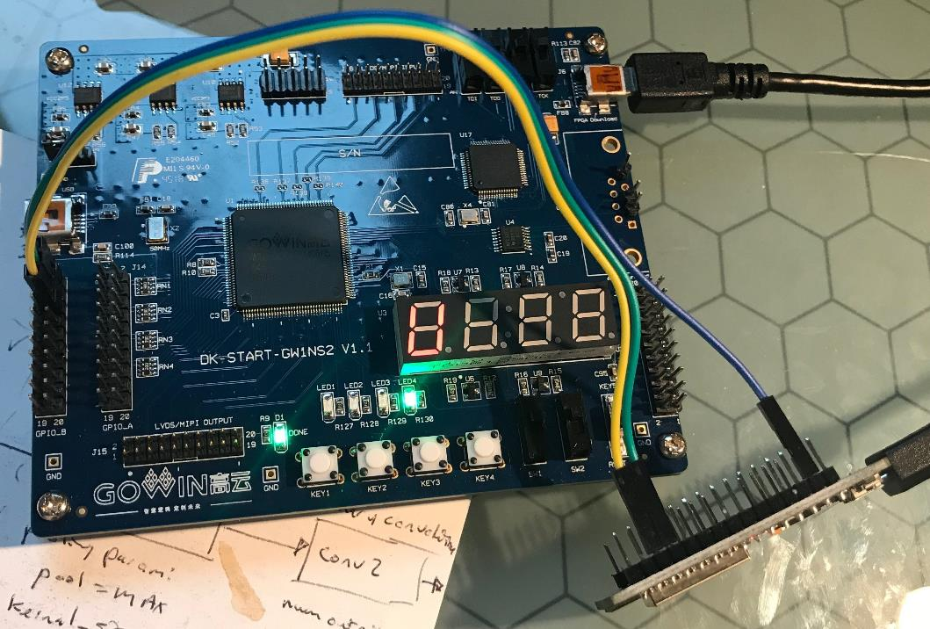
ESP32 HEADER
PIN “GND”: GND
PIN “RX”: UART RX
PIN “TX: UART TX
GPIO_B HEADER
PIN2: GND
PIN4: UART TX
PIN6: UART RX

