Slide 1

















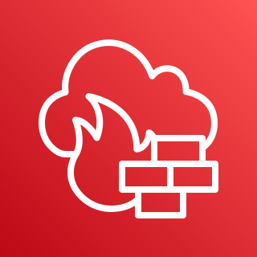








































AWS Cloud
Region
VPC
Availability Zone1
Auto Scaling group
Auto Scaling group
Web1
WAS1
Security group
Security group
Availability Zone2
Web2
WAS2
Security group
Security group
VPC
Monitor Group
Availability Zone1
Availability Zone2
BastionHost
RDS1
RDS2
Security group
Security group
Security group
Storage group

