Slide 1











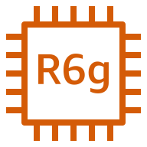
AWS Cloud
Region
VPC
Public subnet
Security group

