Slide 1

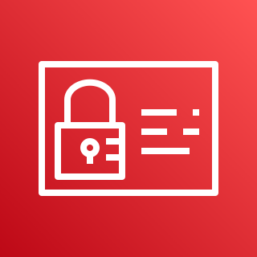

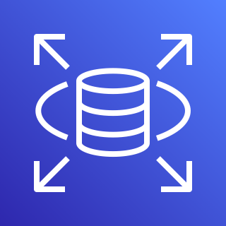
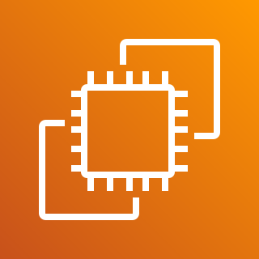
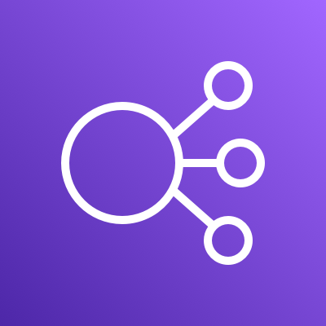







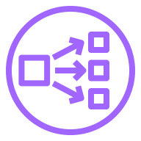


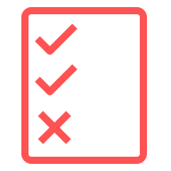




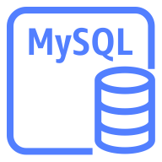
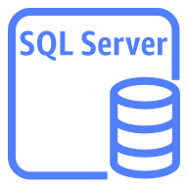

AWS Cloud
Region
VPC
Availability Zone – AZ1
Public subnet
Private subnet
Security group
Security group
Availability Zone – AZ2
Public subnet
Security group
Availability Zone – AZ1
Availability Zone – AZ2
Private subnet
Private subnet
Public subnet
Security group
Security group
Security group

