Slide 1


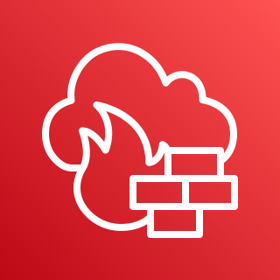
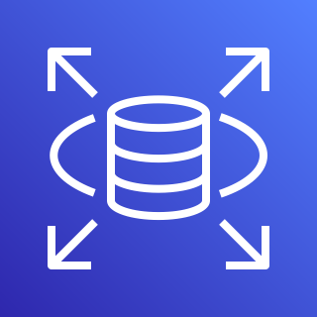







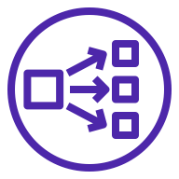

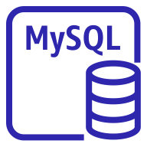






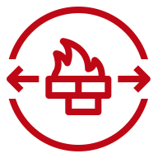
AWS Cloud
Region
VPC
Availability Zone
Private subnet
Auto Scaling group
Auto Scaling group
Security group
Public subnet
Private subnet
Availability Zone
Private subnet
Security group
Security group
Security group

