Slide 1








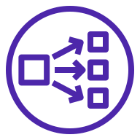


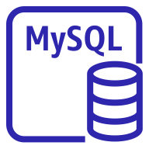






AWS Cloud
Region
VPC
Availability Zone
Private subnet
Security group
Public subnet
Private subnet
Security group
Security group
Availability Zone
Private subnet
Security group

