Slide 1



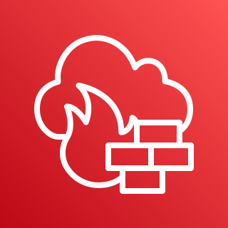




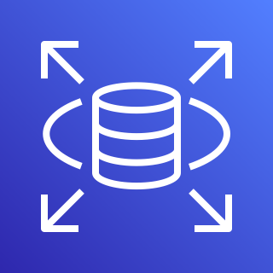

















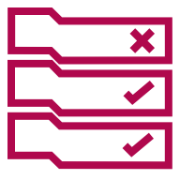



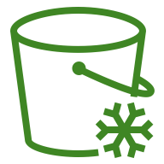
AWS Cloud
Region
VPC
Public subnet
Private subnet
Availability Zone
Security group
Security group
Private subnet
Public subnet
Availability Zone
Private subnet
Monitoring Group
Group name

