Slide 1
Azure Synapse Analytics

Slide 2
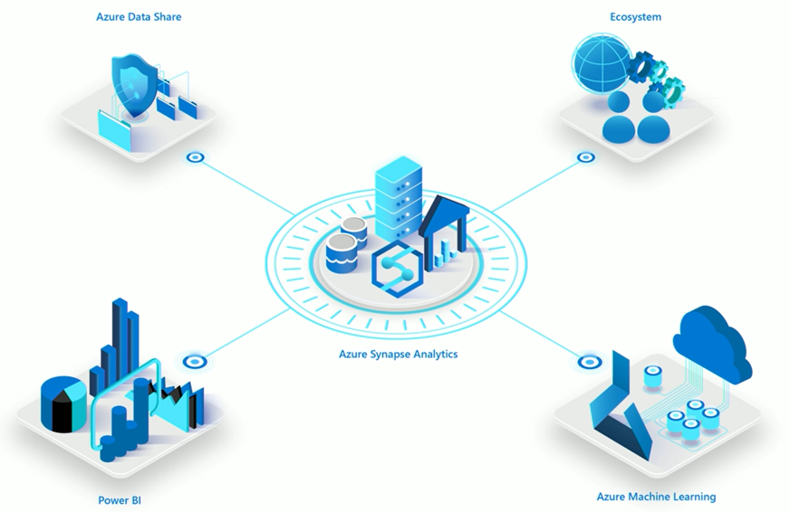
Azure Synapse Analytics SQL Data Warehouse
Azure Synapse Analytics SQL Data Warehouse, formerly known as Azure SQL Data Warehouse, is a cloud-based data warehousing service provided by Microsoft Azure.
It is designed to help organizations efficiently store, manage, and analyze large volumes of data for business intelligence and data analytics purposes.
Azure Synapse Analytics offers a fully managed, scalable, and high-performance data warehouse solution that can handle data of all sizes, from gigabytes to petabytes.

Slide 3
Scalability:
Azure Synapse Analytics is built to scale horizontally and vertically, allowing organizations to adjust their data warehousing resources based on their needs.
You can dynamically allocate more computing power or storage capacity as your data and query demands change.
MPP Architecture:
It employs a Massively Parallel Processing (MPP) architecture, where data is distributed across multiple nodes for parallel processing.
This allows for faster query performance, even with large datasets.

Slide 4
Integration:
Azure Synapse Analytics integrates seamlessly with various Azure data services and tools.
You can ingest data from Azure Data Lake Storage, Azure Blob Storage, Azure SQL Databases, and more.
It also supports integration with popular business intelligence tools like Power BI, Azure Analysis Services, and Azure Machine Learning.
Security:
Microsoft takes data security seriously.
Azure Synapse Analytics provides robust security features, including data encryption at rest and in transit, identity, and access management through Azure Active Directory, and auditing and monitoring capabilities.

Slide 5
SQL-Based Querying:
Users can write SQL queries to extract and analyze data from the data warehouse.
It supports T-SQL, which is compatible with Transact-SQL used in SQL Server, making it easier for users with SQL skills to work with the platform.
Data Loading:
Azure Synapse Analytics supports various data loading methods, including bulk loading, PolyBase for seamless integration with on-premises data, and the Azure Data Factory for ETL (Extract, Transform, Load) processes.

Slide 6
Workload Isolation:
It allows you to create and manage multiple SQL pools (formerly known as SQL Data Warehouse units), each with its own resources and performance characteristics.
This enables workload isolation for different teams or use cases within your organization.
Serverless SQL Pools:
In addition to provisioned SQL pools, Azure Synapse Analytics offers serverless SQL pools, which allow you to query data stored in your data lake without provisioning resources explicitly.
This is useful for on-demand and ad-hoc queries.

Slide 7
Monitoring and Optimization:
Azure Synapse Analytics provides monitoring and optimization tools to help you identify and improve query performance.
You can use features like Query Performance Insights to analyze query execution and make necessary adjustments.
Cost Management:
The service offers cost management features to help you keep track of your data warehousing expenses.
You can pause and resume SQL pools when they are not in use to save on costs.

Slide 8
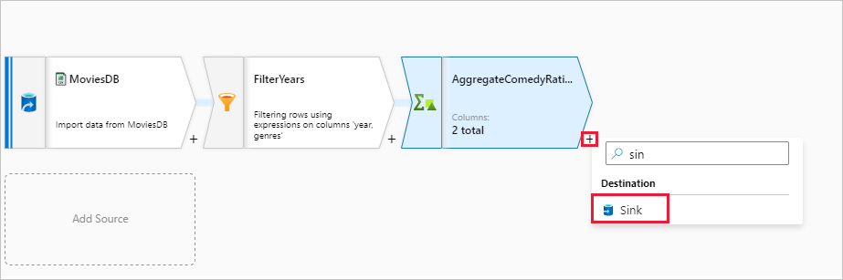
Azure Synapse Mapping Data flow
Azure Synapse Mapping Data Flow is a cloud-based data transformation service provided by Microsoft Azure, which is part of the Azure Synapse Analytics suite.
It allows users to visually design, transform, and cleanse their data without writing code.
This tool is particularly useful for data engineers, data scientists, and data analysts who need to prepare and transform data for analytics and reporting purposes.

Slide 9
Azure Synapse Pipeline
Azure Synapse Pipeline, part of Microsoft's Azure Synapse Analytics suite, is a powerful cloud-based orchestration service that enables users to create, schedule, and manage complex data workflows and data processing tasks.
It provides a flexible and scalable platform for designing and automating data integration, transformation, and analytics processes.
With Azure Synapse Pipelines, organizations can easily move data between various sources and destinations, trigger actions based on events or schedules, and monitor the execution and performance of their data workflows, allowing for efficient and reliable data-driven decision-making.
It seamlessly integrates with other Azure services, enabling the creation of end-to-end data pipelines for data warehousing, data lakes, and advanced analytics scenarios.

Slide 10
Data Ingestion and Preparation
Data Ingestion:
Start by ingesting data from various sources into Azure Synapse Analytics SQL Data Warehouse.
This can be achieved through various methods, such as Azure Data Factory for data movement and Azure Data Factory Data Flows for ETL operations.
You can also use Azure Data Factory's Data Copy activity or PolyBase for bulk loading data.
Data Preparation:
After ingesting the data, perform necessary data preparation tasks.
This includes schema modifications to ensure data consistency and structure alignment with your analytical requirements.
Azure Synapse Mapping Data Flow can be used for visually designing and executing data transformations without writing code.

Slide 11
Data Transformation and Loading
Data Transformation:
As part of data preparation, you may need to perform data transformations to clean, enrich, and format the data for analysis.
Mapping Data Flow within Azure Synapse Analytics provides a visual interface to create complex data transformation logic, or you can write T-SQL scripts for more advanced transformations.
Data Loading:
After data preparation, load the cleaned and transformed data into your SQL Data Warehouse.
Use the appropriate loading techniques, such as bulk insert, PolyBase, or Azure Data Factory, depending on your specific needs and data volume.

Slide 12
Querying and Analyzing Data:
With your data now stored in Azure Synapse Analytics SQL Data Warehouse, you can start querying and analyzing it.
Write SQL queries to extract insights from your data.
You can also use tools like Power BI, and Azure Analysis Services, or even integrate with Azure Machine Learning to perform advanced analytics and generate visual reports and dashboards.
Optimization and Scaling:
Monitor the performance of your SQL Data Warehouse and optimize query execution as needed.
You can scale up or down based on workload demands by adjusting the number of data warehouse units (DWUs) to ensure optimal performance.

Slide 13
Data Governance and Security:
Implement data governance and security measures to protect your data.
Azure Synapse Analytics provides robust security features, including data encryption, role-based access control, and auditing to ensure compliance with data protection regulations.
Automation and Scheduling:
Create and schedule Azure Synapse Pipelines within Azure Data Factory to automate the data ingestion, preparation, and loading processes.
This ensures that your data is regularly updated and ready for analysis.

Slide 14
Query Performance Optimization Techniques
Data Distribution:
SQL DW uses a Massively Parallel Processing (MPP) architecture where data is distributed across multiple nodes.
To optimize query performance, ensure that your data distribution aligns with your query patterns.
Use distribution keys and distribution methods wisely to minimize data shuffling during query execution.
Indexing:
SQL DW supports clustered columnstore indexes, which are highly efficient for analytics workloads.
Ensure that your tables are appropriately indexed to speed up query performance.

Slide 15
Statistics:
Keep statistics up to date on your tables. SQL DW uses statistics to generate optimal query execution plans.
Regularly refresh statistics, especially after data loads or significant data modifications.
Data Compression:
Use data compression to reduce storage costs and improve query performance.
Columnstore indexes, in particular, benefit from data compression.
Partitioning:
Consider partitioning large tables to improve query performance.
Partitioning can limit the amount of data scanned during query execution.

Slide 16
Query Design:
Write efficient SQL queries. Avoid using SELECT * when unnecessary, limit the use of subqueries, and use appropriate indexing columns in your WHERE clauses to minimize data scanning.
Monitoring and Tuning:
Continuously monitor query performance using tools like Query Performance Insights in Azure Synapse Analytics.
Identify slow-running queries and use execution plans to optimize them.
Data Movement:
Minimize data movement by using techniques like staging tables for ETL operations.
Avoid shuffling large amounts of data between distributions.

Slide 17
Resource Scaling:
Azure Synapse Analytics allows you to adjust the number of Data Warehouse Units (DWUs) to allocate more or fewer resources to your SQL DW instance based on workload demands.
Scaling up can improve query performance for resource-intensive operations.
Caching:
Leverage result caching when possible to speed up frequently executed queries.

