Slide 1
Azure Data Factory

Slide 2
Understand ADF components
Azure Data Factory (ADF) is a cloud-based data integration service provided by Microsoft as part of the Azure cloud ecosystem.
It allows you to create, schedule, and manage data pipelines for moving and transforming data from various sources to various destinations.
ADF consists of several components that work together to facilitate data integration processes.
Here are the main components of Azure Data Factory:
Authoring Tools
Data Flow
Linked Services
Datasets
Pipelines
Activities
Triggers
Integration Runtimes
Debugging and Monitoring
Data Movement and Transformation Activities

Slide 3
Authoring Tools
These tools provide a graphical interface for designing and configuring your data pipelines.
The primary authoring tool for ADF is the Azure Data Factory UI in the Azure portal.
It allows you to visually design your data pipelines, set up data movement and transformation activities, and define scheduling and dependencies.
Data Flow
Data Flow is a cloud-based data transformation service within Azure Data Factory.
It allows you to visually design and create ETL (Extract, Transform, Load) processes using a graphical interface.
You can use Data Flow to transform, clean, and manipulate data before it's loaded into your destination.

Slide 4
Linked Services
Linked Services are connections to external data sources or destinations.
They provide the necessary information for ADF to connect to your data sources, such as databases, file storage, or even other cloud services.
Linked Services stores connection strings, credentials, and other settings required to establish a connection.
Datasets
Datasets define the structure of your data, including its schema and location.
They represent the input or output of activities in your data pipelines.
Datasets can be linked to various data sources, and they provide a consistent way to reference and work with data across your pipelines.

Slide 5
Pipelines
Pipelines define the workflow and sequence of activities that need to be executed to move and transform data.
Activities within a pipeline can include data movement, data transformation using Data Flows, data copying, and more.
Pipelines allow you to orchestrate complex data integration tasks.
Activities
Activities are the specific actions that occur within a pipeline.
They can be data movement activities (e.g., copying data from one location to another), data transformation activities (using Data Flows), data analysis, and more.
Each activity performs a specific task as part of the data integration process.

Slide 6
Triggers
Triggers are used to schedule the execution of pipelines.
There are two types of triggers: Time-based triggers allow you to schedule pipelines to run at specific times or intervals, while Event-based triggers allow pipelines to be triggered by specific events, such as the arrival of new data in a storage account.
Integration Runtimes
Integration Runtimes provide the execution environment for your data integration activities.
They define the computing resources and connectivity needed to move and transform data.
Azure Data Factory supports several types of integration runtimes, including Azure, Self-hosted, and Azure-SSIS Integration Runtime.

Slide 7
Debugging and Monitoring
ADF provides tools to monitor and troubleshoot your data pipelines.
You can monitor pipeline runs, view activity logs, track data lineage, and set up alerts for pipeline failures.
Data Movement and Transformation Activities
These activities perform the actual movement and transformation of data.
Examples include copying data from on-premises databases to Azure, transforming data using Data Flows, and executing custom scripts.

Slide 8
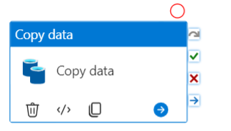
Copy Data Flow activity in ADF
The "Copy Data" activity in Azure Data Factory (ADF) is used to move data from a source to a destination.
It's one of the core activities within ADF and is commonly used to perform data movement tasks.
The "Copy Data" activity allows you to configure data movement settings, transformations, and mapping between source and destination datasets.
This activity is part of the Data Flow component in ADF and enables you to perform ETL (Extract, Transform, Load) operations on the data being moved.

Slide 9
Control Flow Activity
In Azure Data Factory (ADF), the "Control Flow" activity is a fundamental component that allows you to orchestrate and control the execution flow of your data pipelines.
It's used to define the sequence of actions and conditions that determine how your pipeline should behave.
Unlike data movement and transformation tasks that are handled by the Data Flow activities, Control Flow activities manage the overall workflow and dependencies within your pipeline.

Slide 10
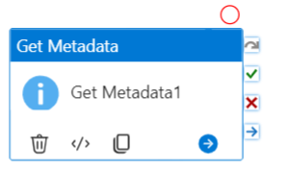
Get Metadata Activity
The "Get Metadata" activity is a powerful component in Azure Data Factory that allows you to retrieve metadata information about files, folders, tables, partitions, and other objects from various data sources.
This information can be used to dynamically configure your data pipelines, making them more flexible and adaptable to changes in the source data.
The "Get Metadata" activity is particularly useful when you want to perform actions based on the characteristics of the data without necessarily moving or transforming it.

Slide 11
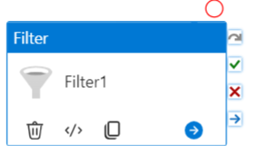
Filter Activity
"Filter" activity in Azure Data Factory, you can achieve filtering functionality using other activities and components within Azure Data Factory.
You can use the Control Flow activities to implement conditional execution based on specific criteria.
For example, you can use the "If Condition" activity to check a condition and then decide whether to proceed with certain tasks or activities.

Slide 12
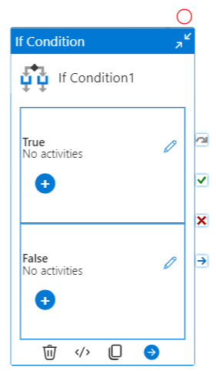
If Activity
The "If Condition" activity in Azure Data Factory is used to introduce conditional logic into your data pipelines.
It allows you to evaluate a condition and then execute different branches of activities based on whether the condition is true or false.
This activity is part of the Control Flow in ADF and is used to direct the flow of execution based on specific criteria.

Slide 13
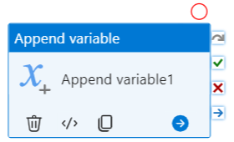
Append Activity
"Append" activity in Azure Data Factory (ADF, you can achieve appending data to a destination using various methods and activities within ADF.
The standard "Copy Data" activity can be used to append data to an existing destination.
When you configure the source and destination datasets within the "Copy Data" activity, you can choose the "Append rows to destination table" option.
This option is particularly useful when you're working with databases and want to add new rows to an existing table

Slide 14
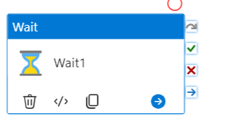
Wait Activity
The "Wait" activity in Azure Data Factory (ADF) is used to introduce a time delay or pause in the execution of your data pipeline.
It allows you to temporarily halt the pipeline's progress for a specified duration before proceeding to the next activity.
This can be useful for scenarios where you need to wait for certain conditions to be met, such as ensuring that data is available or allowing time for external processes to complete.

Slide 15
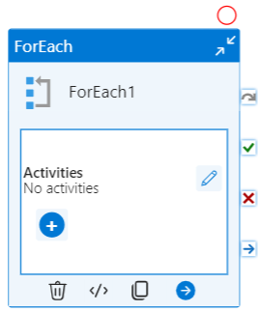
ForEach Loop Activity
The "ForEach" loop activity in Azure Data Factory (ADF) is a control flow activity that enables you to iterate over a collection and perform a set of actions for each item in the collection.
It's a powerful tool for handling repetitive tasks or applying the same set of actions to multiple items, such as files in a folder or tables in a database.
The "ForEach" loop activity is part of the Control Flow component in ADF.

Slide 16
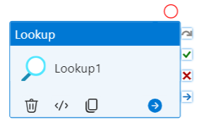
Lookup Activity
The "Lookup" activity in Azure Data Factory is used to retrieve a single value from a specified dataset.
This activity is commonly used in the context of a data transformation process to retrieve a configuration value, a reference data record, or a specific attribute for use in data manipulation or transformation logic.
The "Lookup" activity allows you to fetch data from a source and use that data within your pipeline.

