Slide 1
Azure Data Factory

Slide 2
Mapping Dataflow Transformation
Mapping Data Flow in Azure Data Factory (ADF) is a powerful transformation tool that allows you to visually design and build complex ETL (Extract, Transform, Load) processes within a data integration pipeline.
It provides a flexible and intuitive interface for performing data transformations, aggregations, filtering, joining, and other data manipulation operations on your source data before it's loaded into a destination.

Slide 3
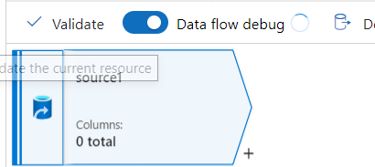
Source Transformation
In the context of Azure Data Factory's Mapping Data Flow, a "Source Transformation" refers to the initial step in a data transformation process where you define the source dataset and its properties.
The source transformation specifies where your data is coming from and how it should be ingested into the Data Flow for further transformations, aggregations, and processing.

Slide 4

Sink Transformation
In Azure Data Factory's Mapping Data Flow, a "Sink Transformation" refers to the final step in a data transformation process where you define the destination dataset and its properties.
The sink transformation specifies where your transformed data will be loaded or written after undergoing various transformations and processing steps within the Data Flow.

Slide 5
Surrogate Key Transformation
A surrogate key transformation is a process used in data integration to replace natural keys with artificial or surrogate keys.
Natural keys are identifiers that have intrinsic meaning within the data (e.g., names, addresses), while surrogate keys are system-generated unique identifiers that have no inherent meaning and are used to maintain data integrity and facilitate efficient data manipulation.
You can implement a surrogate key transformation to replace natural keys with surrogate keys during data transformation.
This is particularly useful when integrating data from multiple sources or when dealing with slowly changing dimensions (SCDs) where natural keys might change over time.

Slide 6
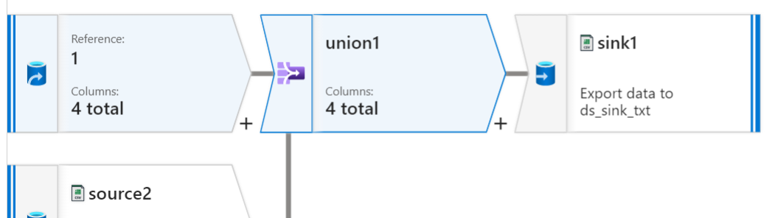
Union Transformation
The "Union" transformation in data integration, including Azure Data Factory's Mapping Data Flow, is used to combine or merge the contents of two or more datasets with the same structure into a single dataset.
This operation is similar to the SQL UNION operation, where duplicate rows are typically removed, and the resulting dataset contains all unique rows from the input datasets.

Slide 7
Conditional Split Transformation
The "Conditional Split" transformation is used in data integration to route data rows based on specific conditions.
It allows you to divide incoming data into multiple output paths or branches depending on the conditions you define.
This transformation is particularly useful when you need to apply different processing logic to different subsets of your data.
While the "Conditional Split" transformation is not a native feature of Azure Data Factory's Mapping Data Flow, you can achieve similar functionality using other components and techniques available in Mapping Data Flow.

Slide 8
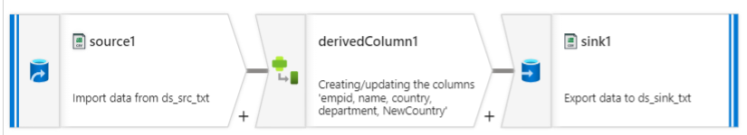
Derived Column Transformation
The "Derived Column" transformation in data integration, including Azure Data Factory's Mapping Data Flow, allows you to create new columns or modify existing columns by applying expressions to each row of your dataset.
This transformation is a versatile tool for adding calculated values, performing data transformations, or applying conditional logic to your data.

Slide 9
API-based Integration
API-based integration plays a pivotal role in modern software development, enabling different applications, services, and systems to communicate and interact seamlessly.
APIs (Application Programming Interfaces) provide a standardized way for developers to access the functionalities and data of other software components, whether they are internal or external to their own application.
This integration approach is crucial for building interconnected, efficient, and scalable software ecosystems.

Slide 10
Role of APIs in Modern Software Development
Modularity and Reusability
APIs enable developers to break down complex applications into smaller, modular components.
These components can then be reused across different projects, improving development efficiency and reducing redundancy.
Interoperability
APIs facilitate communication between diverse software systems, regardless of the programming languages, platforms, or technologies they use.
This interoperability fosters collaboration and integration among various applications.

Slide 11
Ecosystem Building
APIs allow organizations to create ecosystems of interconnected services and products.
This is particularly valuable in enabling third-party developers to build on top of existing platforms, leading to innovation and rapid expansion of functionality.
Microservices Architecture
In a microservices architecture, applications are composed of small, independently deployable services.
APIs play a crucial role in enabling these services to communicate and collaborate while maintaining isolation.

Slide 12
Flexibility and Scalability
APIs enable applications to scale horizontally by adding more instances of a particular service.
New instances can be integrated seamlessly using APIs without disrupting the overall application.
Security and Access Control
APIs provide a controlled way to expose specific functionalities and data.
Properly designed APIs allow developers to manage access, authenticate users, and implement security measures effectively.

Slide 13
Mobile and Web Integration
APIs are the foundation for building mobile apps and web applications that interact with backend services.
They enable a seamless user experience by allowing these front-end applications to communicate with back-end systems.
Data Integration
APIs are used to connect different data sources and systems, enabling real-time data synchronization, data extraction, and data transformation between disparate systems.

Slide 14
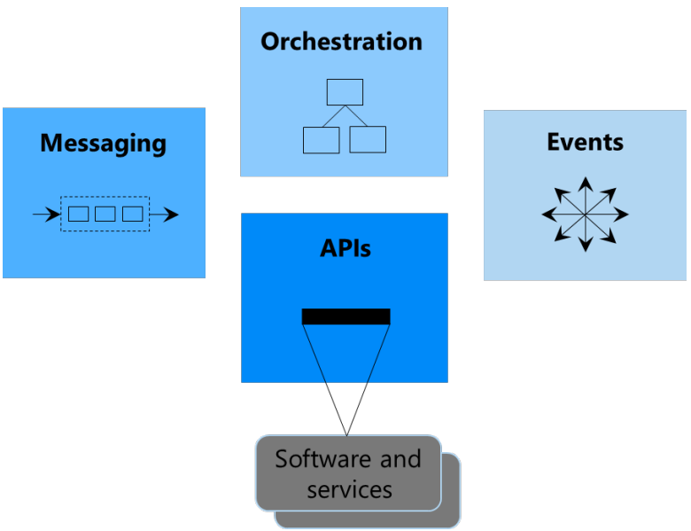
API-based integration Architecture
API-based integration architecture is the systematic design and structure that governs how different software systems, services, and applications communicate and interact with each other using APIs (Application Programming Interfaces).
The architecture defines the patterns, components, protocols, and principles for achieving seamless and efficient integration across various systems.

Slide 15
Best practices for designing and building APIs
Clear and Consistent Naming: Use descriptive and intuitive names for endpoints, resources, and parameters to make APIs easy to understand.
Versioning: Include version numbers in your APIs to ensure backward compatibility and allow for gradual changes.
Documentation: Provide comprehensive documentation that includes usage examples, request/response samples, and error codes.
RESTful Principles: If using REST, adhere to RESTful principles like statelessness, using proper HTTP methods, and using resource-based URLs.
Security: Implement strong authentication and authorization mechanisms, such as OAuth, API keys, or JWT tokens. Use HTTPS for secure communication.

Slide 16
API Consumption and Integration Techniques
API consumption and integration techniques involve various methods and approaches to interact with and utilize external APIs effectively.
When integrating with external APIs, developers need to understand the API documentation, authentication methods, request-response formats, error handling, and data transformation.
Most APIs are accessed over HTTP(S).
Developers use HTTP methods like GET, POST, PUT, and DELETE to send requests to the API's endpoints.
Responses are received in the form of HTTP status codes and data in JSON or XML formats.

Slide 17
Authentication
Authentication is the process of verifying the identity of a user, application, or system trying to access an API.
It answers the question: "Who are you?" By requiring authentication, APIs ensure that only legitimate and authorized users or applications can access their resources.
Common methods of API authentication include:
API Keys
Basic Authentication
Bearer Token (OAuth 2.0)
API Gateway Authentication
Client Certificates

Slide 18
API Keys:
API keys are unique strings generated by the API provider and provided to the client.
The client includes the API key in the request headers, and the API validates the key to grant access.
Basic Authentication:
Basic authentication involves sending a username and password encoded in the request headers.
This method is simple but not very secure, as credentials are transmitted in base64 encoding.

Slide 19
Bearer Token (OAuth 2.0):
Bearer tokens, often used in conjunction with OAuth 2.0, are short-lived tokens that the client includes in the request headers.
The API validates the token to grant access.
API Gateway Authentication:
An API gateway can handle authentication on behalf of multiple APIs.
It might use various methods such as API keys, OAuth, or custom authentication mechanisms.
Client Certificates:
Some APIs require the client to present a digital certificate to prove its identity.
The server validates the certificate to grant access.

Slide 20
Authorization
Authorization, often referred to as "access control," comes into play after authentication.
It defines what actions or resources an authenticated user or application is allowed to access.
It answers the question: "What are you allowed to do?"
Common methods of API authorization include:
Role-Based Access Control (RBAC)
Scope-Based Access (OAuth 2.0)
Attribute-Based Access Control (ABAC)
Policy-Based Access Control
Fine-Grained Access Control

Slide 21
Role-Based Access Control (RBAC):
Users or applications are assigned specific roles, and each role has predefined permissions.
RBAC ensures that access is based on the roles assigned to the user.
Scope-Based Access (OAuth 2.0):
OAuth 2.0 introduces scopes that define the specific actions or resources a token can access.
The client specifies the desired scopes when requesting a token.
Attribute-Based Access Control (ABAC):
ABAC considers attributes about the user, resource, and context to make access decisions.
For example, a user might be allowed to access a resource only during specific times.

Slide 22
Policy-Based Access Control:
Policies define access rules based on conditions, roles, or attributes.
These policies dictate which users or applications are allowed to perform specific actions.
Fine-Grained Access Control:
This approach allows specifying access control down to individual data items or fields within a resource.
It's useful when certain parts of a resource need different levels of access.

Slide 23
Change Data Capture
Change Data Capture (CDC) is a technique used in database management and data integration to identify and track changes made to a database.
CDC captures and records modifications to data, including inserts, updates, and deletes, so that these changes can be efficiently replicated or synchronized with other systems, databases, or data warehouses.
CDC plays a significant role in ensuring data consistency, accuracy, and synchronization across various data sources and destinations.

Slide 24
Significance of Change Data Capture (CDC) in Data Synchronization
Real-time Data Updates:
CDC captures changes as they occur, allowing for near-real-time data synchronization.
This is crucial for scenarios where up-to-date information is required across different systems.
Minimized Data Transfer:
Instead of transferring entire datasets, CDC identifies and transmits only the changes made to the data.
This reduces network bandwidth consumption and improves efficiency.

Slide 25
Data Integrity:
By tracking changes, CDC ensures that data consistency is maintained between source and target systems.
It prevents conflicts, duplication, and data loss during synchronization.
Reduced Latency:
Traditional batch-based data synchronization may introduce delays.
CDC minimizes latency by capturing changes as they happen, enabling timely updates in target systems.

Slide 26
Support for BI and Analytics:
CDC is essential for creating accurate and up-to-date data warehouses used for reporting, business intelligence, and analytics purposes.
Easier Migration:
During database migrations or upgrades, CDC helps ensure that no data changes are lost.
It simplifies the transition from one database version to another.
Decoupling Systems:
CDC allows systems to remain loosely coupled. Changes in one system are detected and propagated to others, even if they use different technologies or databases.

Slide 27
Understanding CDC in the context of databases and systems
Change Data Capture (CDC) in the context of databases and systems refers to the process of identifying and capturing changes made to data within a database or system.
It involves tracking modifications to records, such as inserts, updates, and deletes, and making these changes available for replication, synchronization, reporting, or analysis in near-real-time.
CDC is a valuable technique in scenarios where data consistency, integration, and synchronization are crucial.

Slide 28
CDC Process:
CDC involves monitoring the database's transaction logs or using triggers to identify changes to data records.
These changes are captured and transformed into a format suitable for replication or synchronization purposes.
Database CDC:
Within databases, CDC tracks changes made to individual rows or tables.
When a data modification occurs, CDC mechanisms record the change details, such as the changed values, timestamp, and the type of operation.

Slide 29
Use cases for CDC and its benefits in integration scenarios
Use Cases for CDC | Benefits in Integration Scenarios
Real-time Data Synchronization | - Ensures consistent and up-to-date data across multiple systems.
 | - Supports real-time reporting, analytics, and decision-making.
 | - Reduces data discrepancies and improves overall data quality.
Data Warehousing | - Populates data warehouses with accurate and current data.
 | - Enhances business intelligence and reporting capabilities.
 | - Enables historical data analysis and trend identification.
Cloud and On-Premises Integration | - Facilitates integration between hybrid architectures.
 | - Supports data synchronization between cloud and on-premises systems.
ETL Processes | - Feeds Extract, Transform, Load (ETL) processes with changed data.
 | - Reduces the need for full data extraction and processing.
 | - Improves ETL efficiency and minimizes processing times.
Real-time Event Processing | - Supports event-driven architectures by reacting to data changes.
 | - Enables immediate responses to critical business events.
 | - Enhances system scalability and responsiveness.
Application Integration | - Integrates data and functionality across applications in real time.
 | - Enables seamless interactions and communication between systems.
 | - Supports the creation of unified user experiences.
Data Migration and Upgrades | - Facilitates smooth database migrations without data loss.
 | - Ensures data integrity during system upgrades or transitions.
 | - Minimizes disruption and downtime during migration processes.

