Slide 2
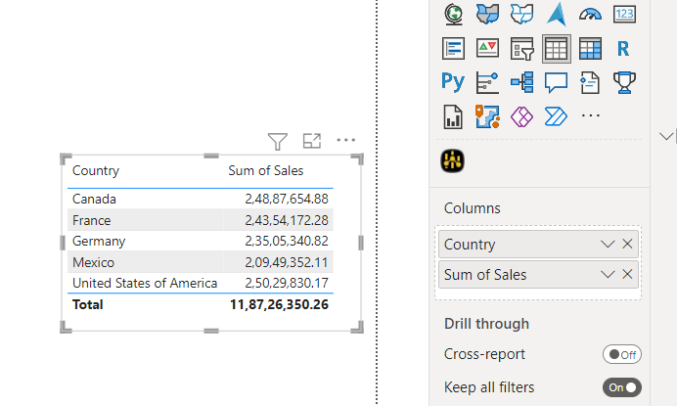
Tables
Let me show you how to create a Table in Power BI with an example.
If you drag and drop any dimension field, then the desktop automatically creates a table for you.
Let me drag and drop the Country and Sales from the Fields section to Canvas.
As you can see from the screenshot below, the desktop automatically creates a table for you.

Slide 3
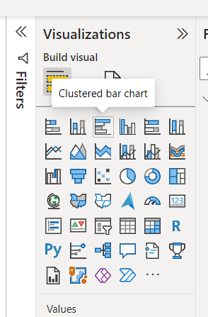
Bar Chart
Power BI Bar Chart or Horizontal Bar Chart is useful for the data comparison.
For example, you can compare Sales by Color, Region, Product Group, etc.
Let me show you how to create a Bar Chart with an example.
Click on the Clustered Bar Chart under the Visualization section.
It automatically creates a Clustered Bar Chart with dummy data.

Slide 4
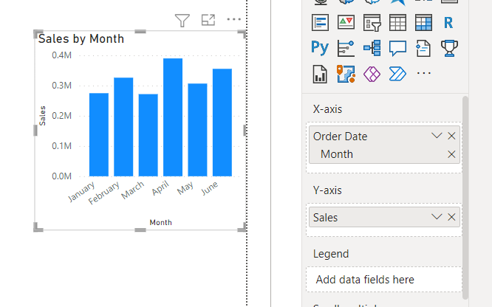
Drag and Drop the Month from Fields section to Y-axis field
And Drag and Drop the Sales values from Fields section to X-axis field

Slide 5
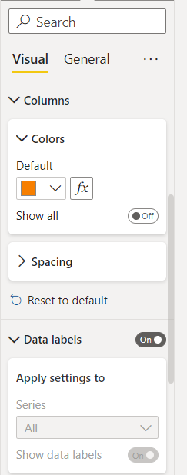
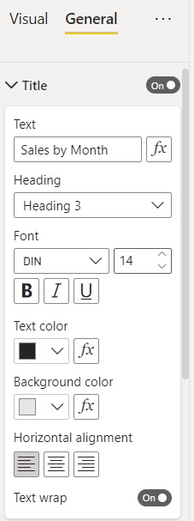
Please click on the Format button to see the list of formatting options that are available for this Bar Chart.
Here we are giving a color to the bars and On the Data labels.
For the Title go to General and Give title name as shown.

Slide 6
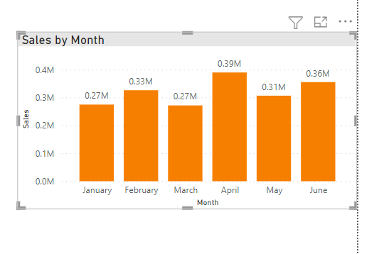
After changing the format the chart will look like this

Slide 7
Clustered Bar Chart
Click on the Clustered Bar Chart under the Visualization section.
It automatically creates a Clustered Bar Chart with dummy data.

Slide 8
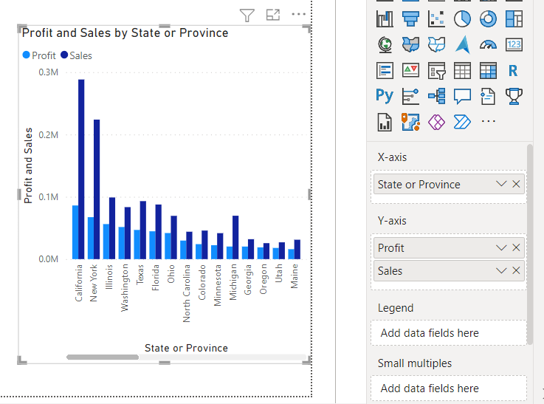
Drag and Drop the State or Province from Fields section to Y-axis field
And Drag and Drop the Sales and Profit values from Fields section to X-axis field

Slide 9
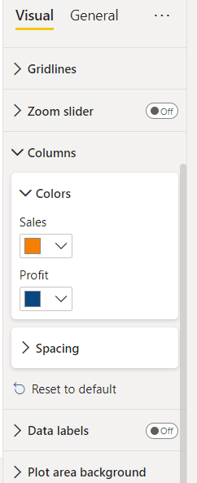
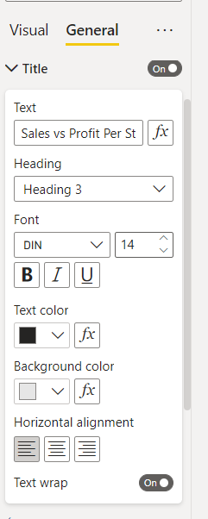
Please click on the Format button to see the list of formatting options that are available for this Bar Chart.
Here we are giving a color to the bars and On the Data labels.
For the Title go to General and Give title name as shown.

Slide 10
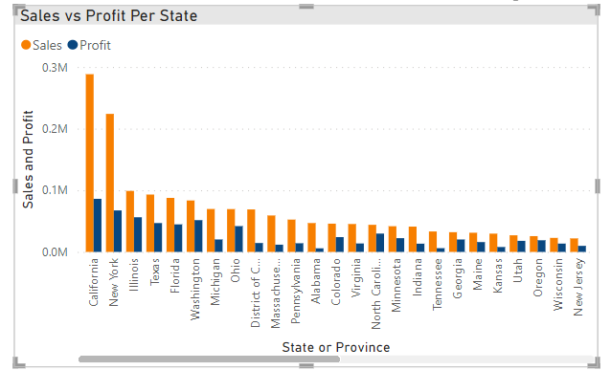
After changing the format the chart will look like this

Slide 11
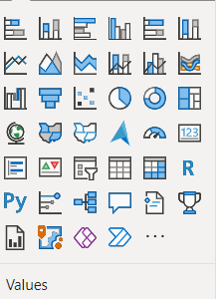
Column Chart
Click on the Column Chart under the Visualization section.
It automatically creates a Column Chart with dummy data.

Slide 12
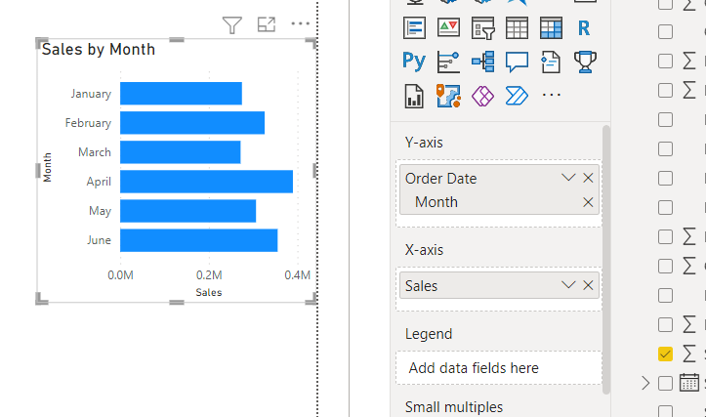
Drag and Drop the Month from Fields section to Y-axis field
And Drag and Drop the Sales values from Fields section to X-axis field

Slide 13
Clustered Column Chart
Click on the Clustered Column Chart under the Visualization section.
It automatically creates a Clustered Column Chart with dummy data.

Slide 14
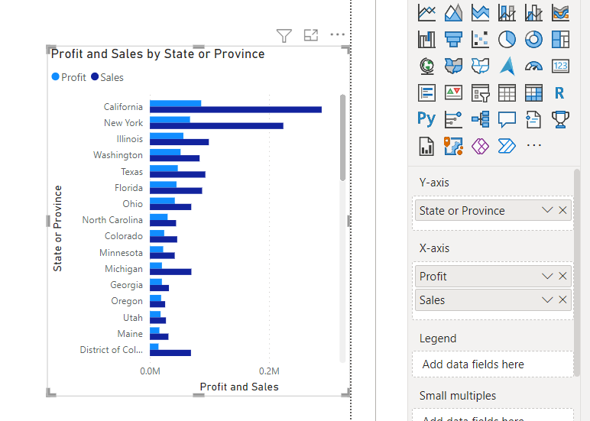
Drag and Drop the State or Province from Fields section to Y-axis field
And Drag and Drop the Sales and Profit values from Fields section to X-axis field

Slide 15
Pie Charts
Power BI Pie Charts are very useful to visualize the High-level data.
For example, Sales by Continent or region, Orders by Country, Customers by region, Sales by Main product Group, etc.
When you click on the Pie Chart under the Visualization section, automatically create a Dummy Pie Chart

Slide 16
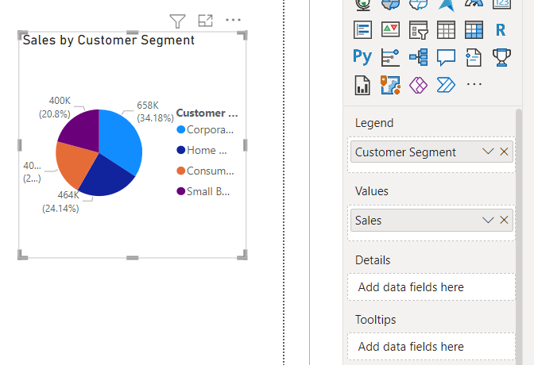
Drag and drop Customer Segment field to the Legend section.
Drag and drop Sales field to the Values section.

Slide 17
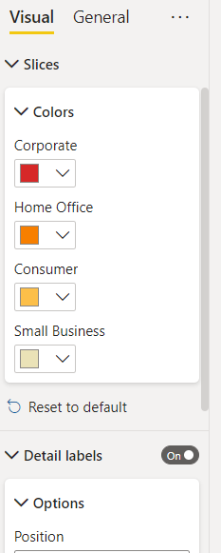
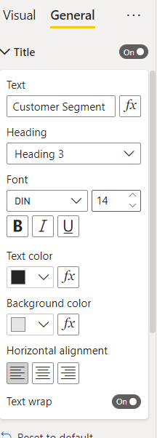
Please click on the Format button to see the list of formatting options that are available for this Bar Chart.
Here we are giving a color to the Slicers and On the Data labels.
For the Title go to General and Give title name as shown.

Slide 18
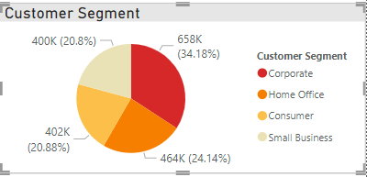
After changing the format the chart will look like this

Slide 19
Donut Chart
Power BI Donut Chart is similar to Pie, which is useful to visualize the higher-level data.
When you click on this under the Visualization section, it automatically creates a Donut Chart with dummy data.

Slide 20
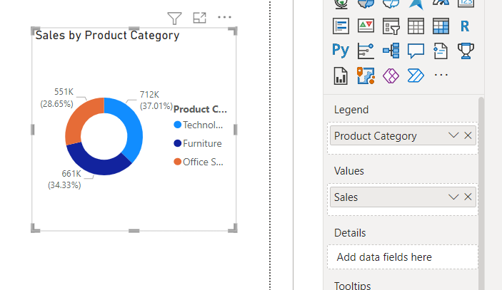
Drag and Drop the Product Category from Fields section to Legend field.
And Drag and Drop the Sales values from Fields section to Values field as shown below.

Slide 21
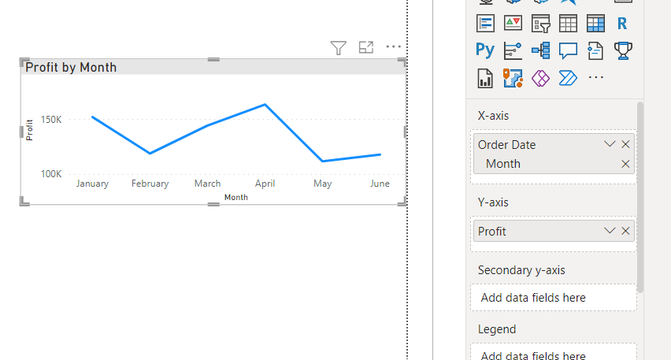
Line Chart
Click on the Line Chart under the Visualization section. It will automatically create a Line Chart with dummy data.
Drag and drop the Sales from Fields section to Y-axis field
Drag and drop the Order Date from fields section to X-axis and keep only month as shown below.

Slide 22
Scatter Chart
Power BI Scatter Chart or Scatter plot is very useful to visualize the relationship between two sets of data.
Click on the Scatter Chart under the Visualization section. It automatically creates a Scatter Chart with dummy data.

Slide 23
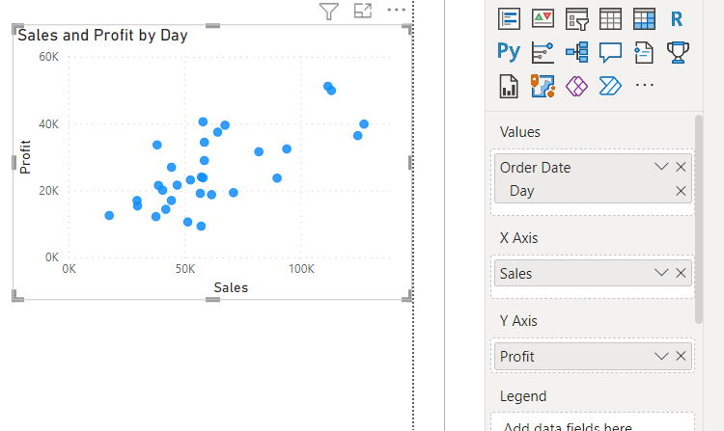
Drag and drop Order Date field to the Values section and keep only day as shown below.
Drag and drop Sales field to the X-axis section.
Drag and drop Profit field to the Y-axis section.

Slide 24
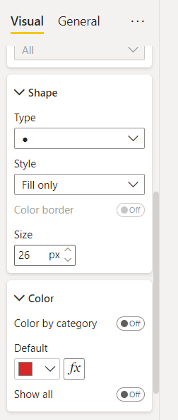
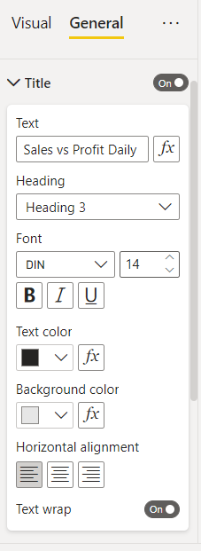
Please click on the Format button to see the list of formatting options that are available for this Bar Chart.
Here we are giving a color and Size of the Bubble and On the Data labels.
For the Title go to General and Give title name as shown.

Slide 25
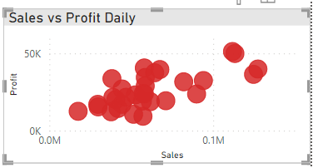
After changing the format the chart will look like this

Slide 26
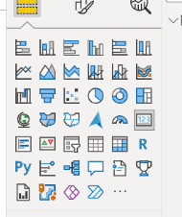
Cards
A card is useful to display a single number (or metric value).
For example, If we want to track the total orders, total sales value, or total quotations we sent, then we can use this Card visualization.
In order to create one, first, click on the Card present in the Visualization section.
It will create a Card with dummy data, as shown in the screenshot below.

Slide 27
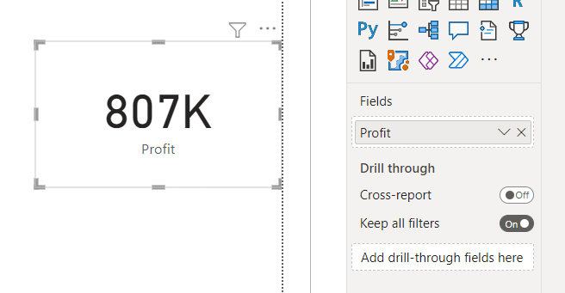
Let me drag the Profit into the Fields section as shown below.

Slide 28
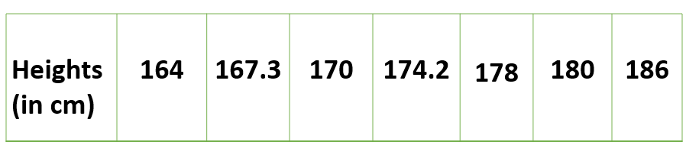
Univariate analysis
This type of data consists of only one variable.
The analysis of univariate data is thus the simplest form of analysis since the information deals with only one quantity that changes.
The example of a univariate data can be height.

Slide 29
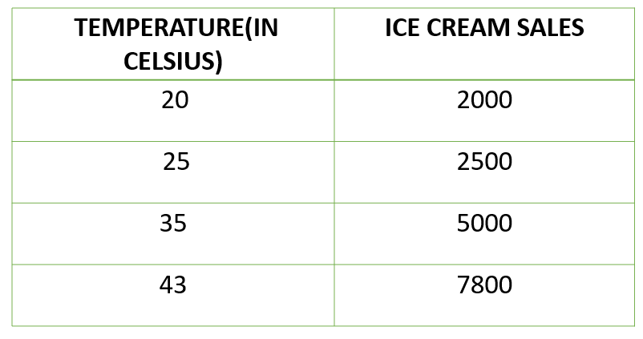
Bivariate analysis
This type of data involves two different variables.
The analysis of this type of data deals with causes and relationships and the analysis is done to find out the relationship among the two variables.
Example of bivariate data can be temperature and ice cream sales in summer season.

Slide 30
Reports in Power BI
Reports in Power BI are interactive and visually appealing data presentations that enable users to analyze and interpret data to make informed decisions.
These reports are created by designing visualizations such as charts, tables, and graphs that represent data from various sources.
Reports allow users to drill down into data, apply filters, and explore insights dynamically.
They serve as a central hub for data analysis and storytelling, where data can be organized into meaningful narratives to convey insights effectively.
Reports in Power BI can be shared securely with colleagues, clients, or stakeholders, either through the Power BI service, embedded in applications, or exported for offline viewing, ensuring that data-driven insights are accessible to the right people at the right time.

Slide 31
Dashboards in Power BI
Dashboards in Power BI are interactive, visual displays of key insights and metrics that provide a consolidated view of data from various sources.
They serve as a centralized hub for data analysis and decision-making by presenting data in the form of charts, graphs, tables, and other visual elements.
Dashboards allow users to monitor performance, track trends, and gain quick insights into their data.
These dashboards are highly customizable, enabling users to arrange and format visuals according to their needs, and they can be shared with others, either within the organization or externally.
Power BI dashboards empower users to interact with data in real time, drill down into details, and make data-driven decisions to drive business growth and efficiency.

Slide 32
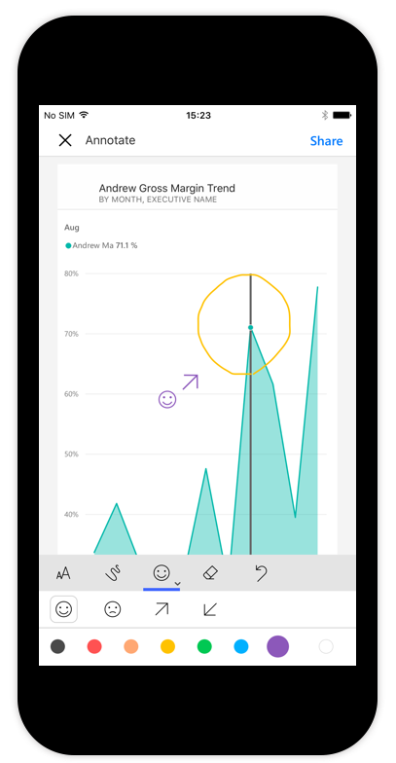
Power BI Mobile
Power BI Mobile is a mobile application designed to extend the capabilities of Microsoft Power BI, a powerful business intelligence and data visualization tool.
With Power BI Mobile, users can access their Power BI reports and dashboards on smartphones and tablets, allowing them to stay connected to their data and insights while on the go.
The mobile app provides a responsive and intuitive interface, enabling users to interact with data visualizations, explore reports, and share insights with colleagues in real time.
It supports both online and offline access, ensuring that users can access critical business information even when they are not connected to the internet.

