Slide 1
Power BI

Slide 2
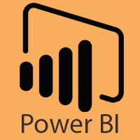
Introduction to Power BI
Power BI is one of the most popular Data Visualization and Business Intelligence tool.
The Power BI tool is the collection of apps, data connectors, and software services which are used to get the data from different data sources, transforms data, and produces useful reports.

Slide 3
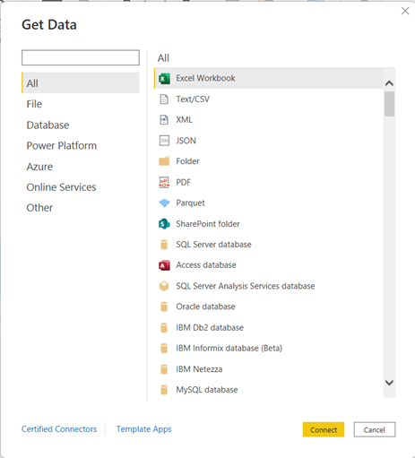
Power BI Data Sources
Power BI Desktop and Power BI Services support a large range of data sources.
Click on the Get Data button, and it shows you all the available data connections.
You can connect to different Flat files, Azure cloud, SQL database, and Web platforms, also such as Google Analytics, Facebook, and Salesforce objects.

Slide 4
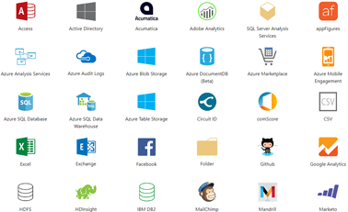
Here are the available data sources in Power BI, as shown below:
SQL Database
Flat Files
Blank Query
OData Feed
Azure Cloud Platform
Online Services
Oracle database
IBM Db2 database
IBM Netezza
IBM Informix database (Beta)
Other data sources such as Exchange, Hadoop, or active directory

Slide 5
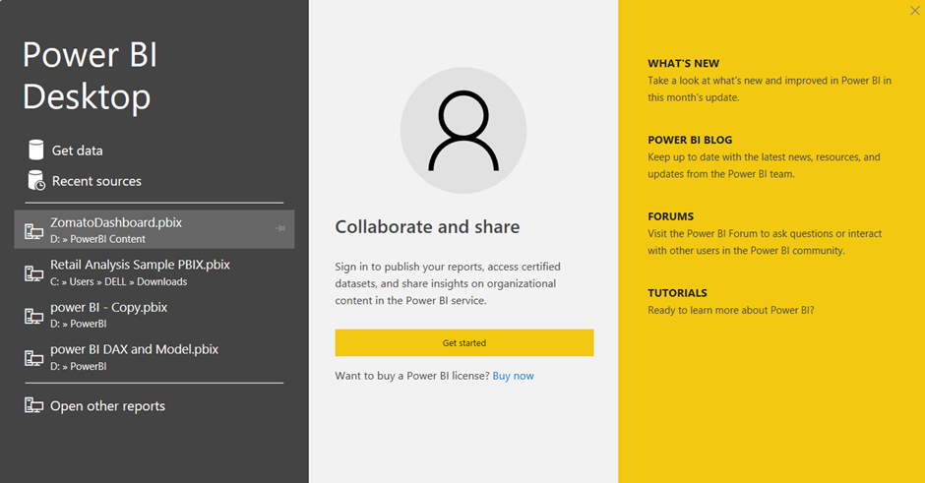
Connecting to Excel
When you open the Power BI Desktop app you will see a window as below click Get Data option.

Slide 6
As this is an Excel file, select the Excel Workbook option from the drop-down list.
Because our file is in Excel file format. And click connect.

Slide 7
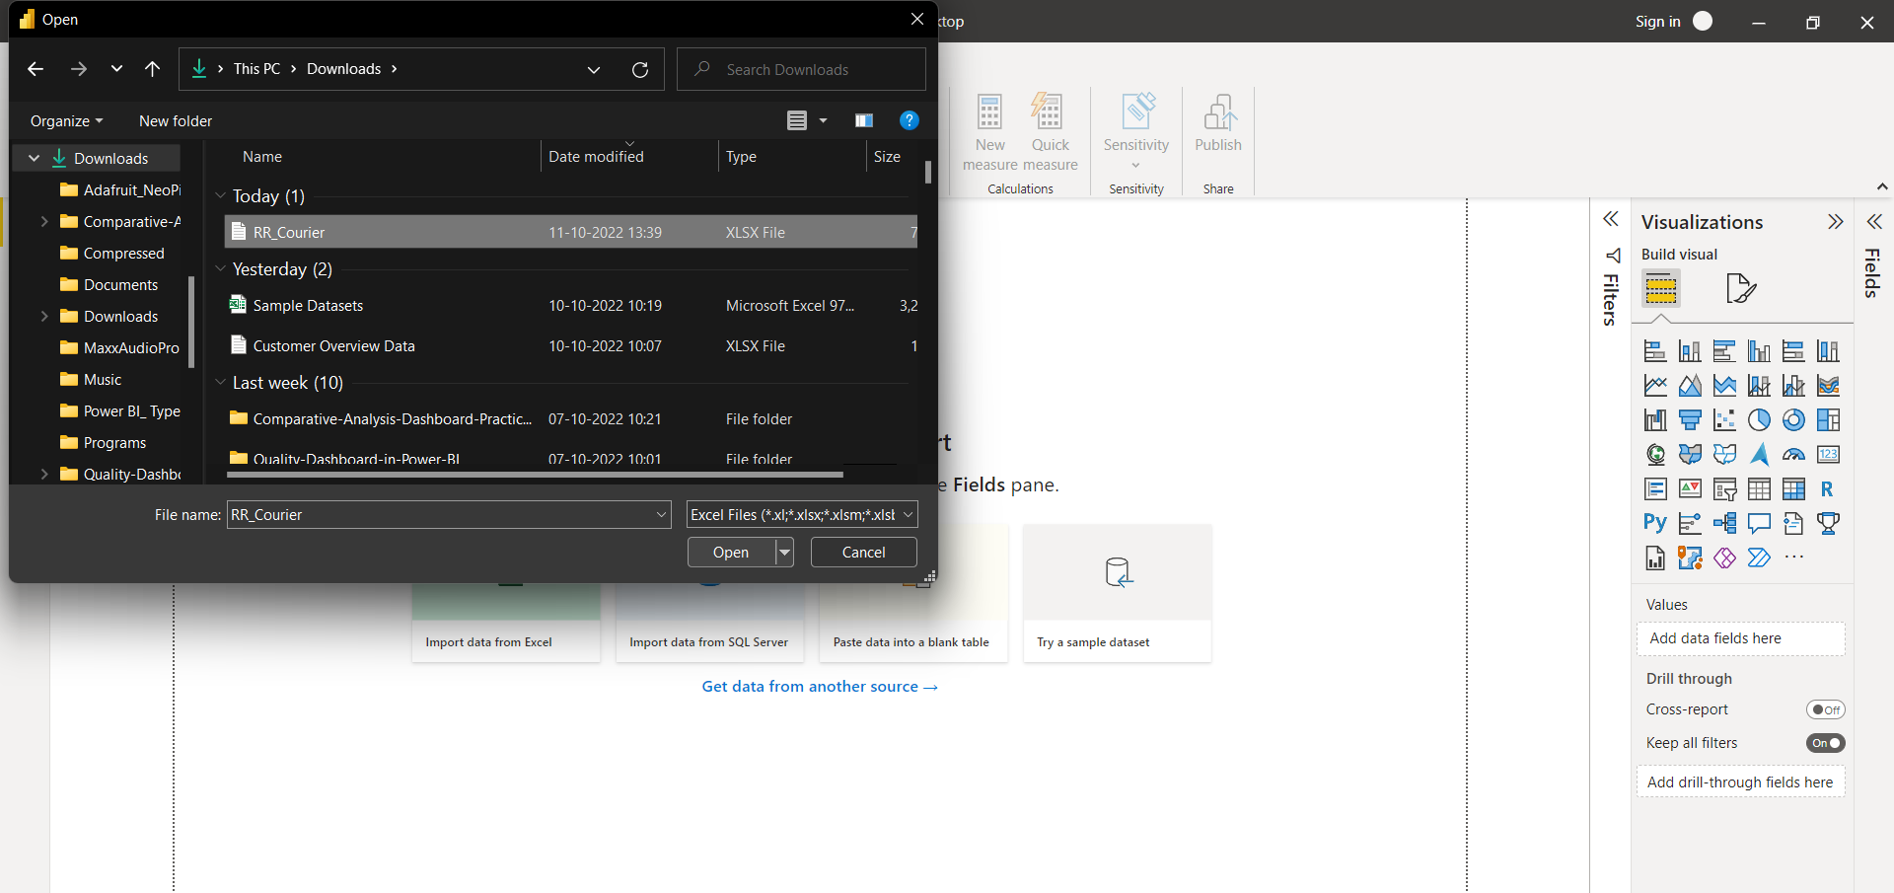
Select the file named RR_Courier file and click open.

Slide 8
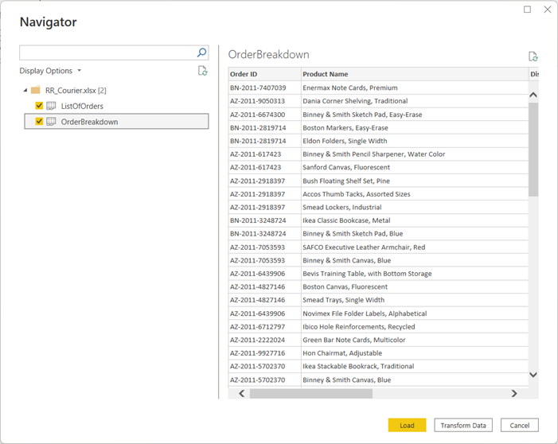
After selecting the file and select tables in the file, data will be displayed in the below format.
Click on Load.

Slide 9
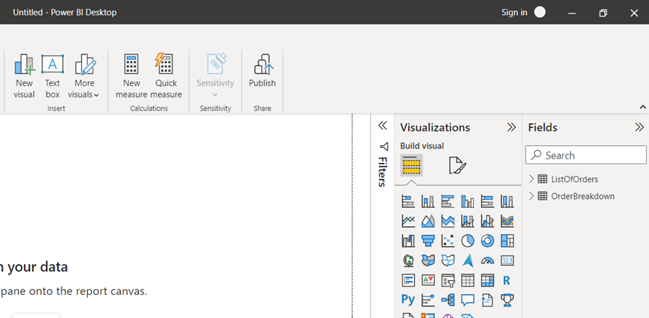
In the power bi desktop right side in the Fields section, it will show your three tables as shown below.

Slide 10
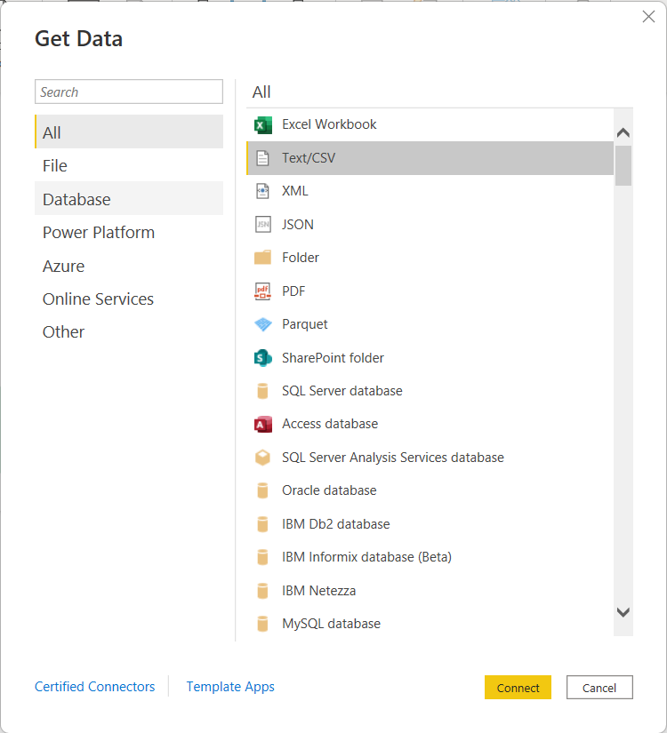
Connecting to CSV/Text
As this is an Text file, select the Text/CSV option from the drop-down list.
Because our file is in Text file format. And click connect.

Slide 11
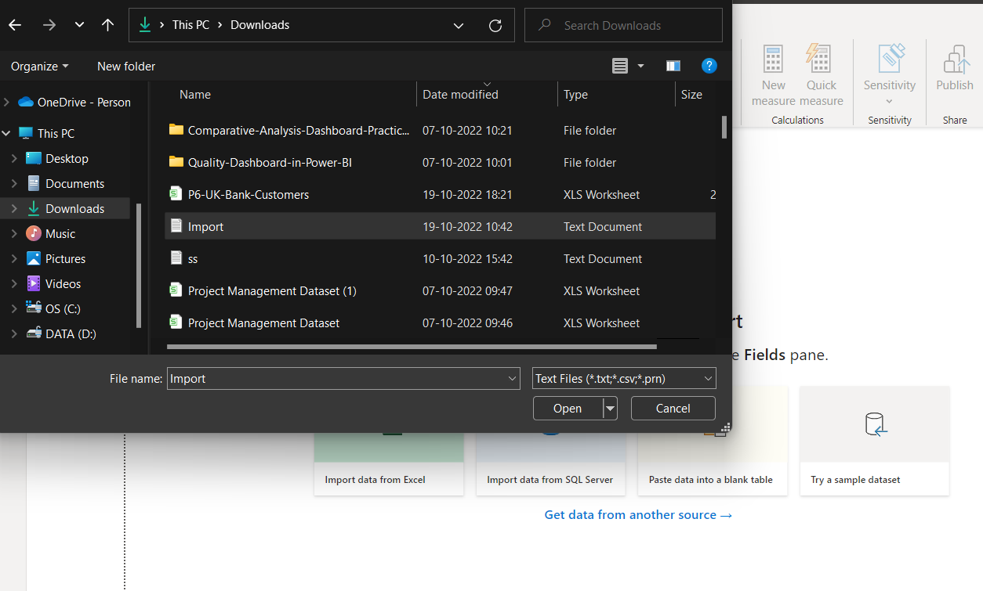
Select the file named Import file and click open.

Slide 12
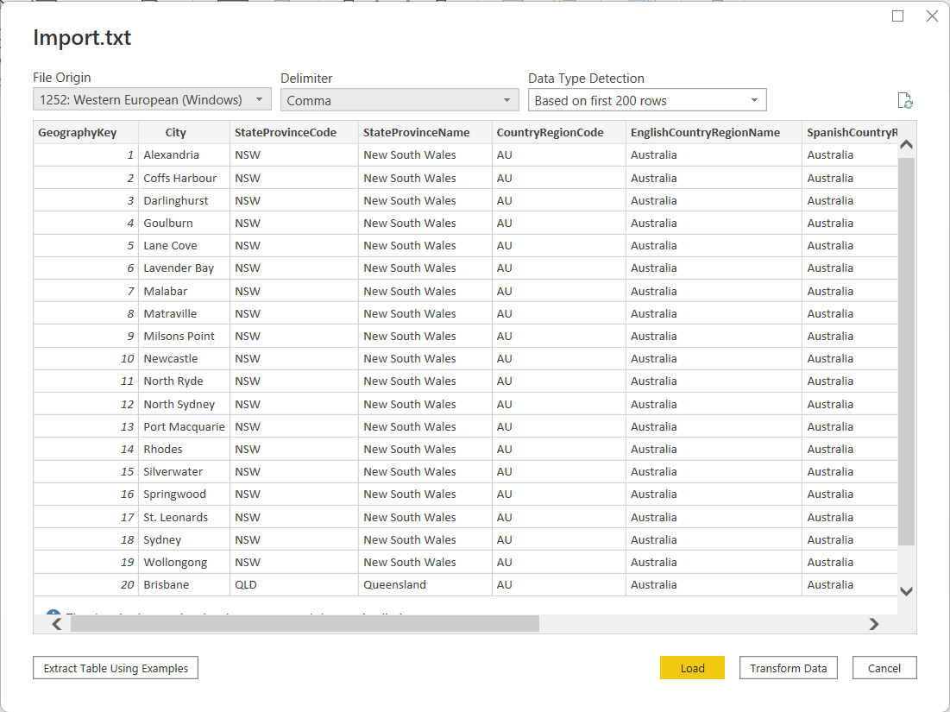
After selecting the file and select tables in the file, data will be displayed in the below format.
Click on Load.

Slide 13
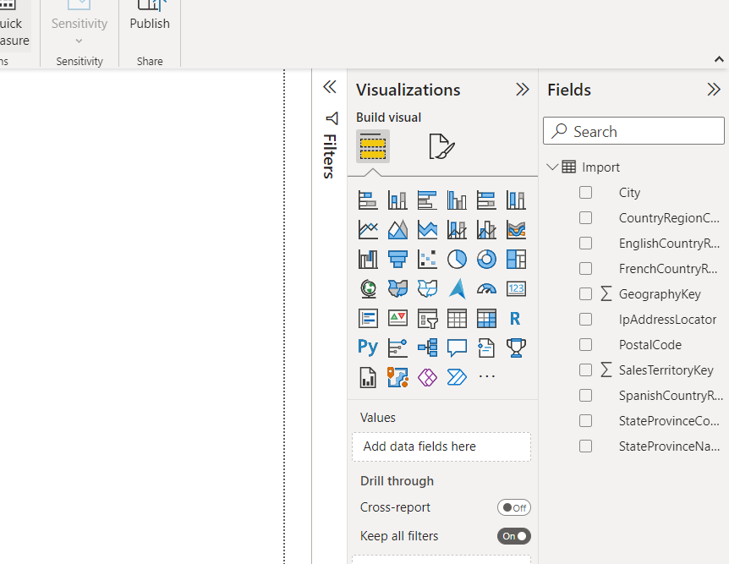
In the power bi desktop right side in the Fields section, it will show your three tables as shown below.

Slide 14
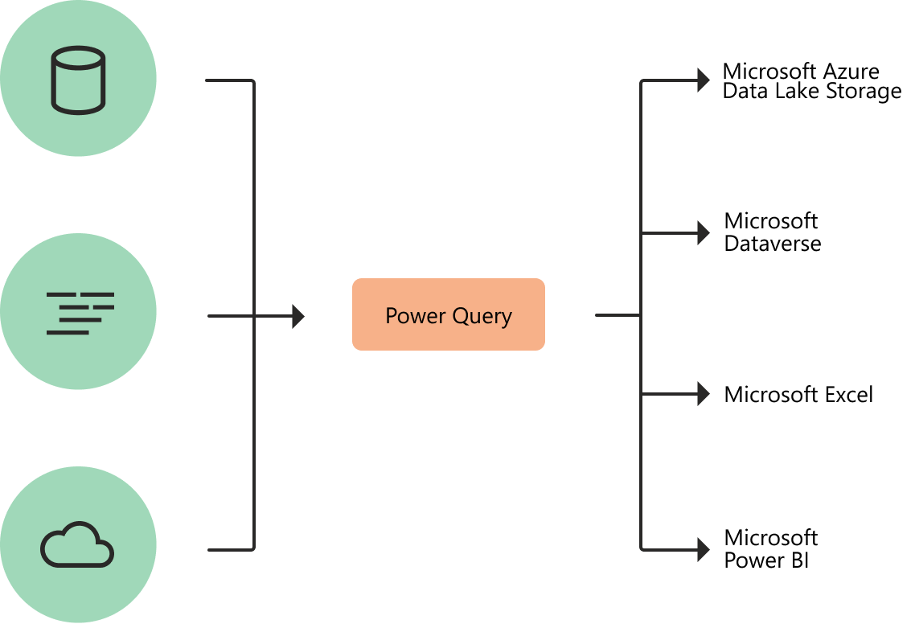
Introduction to Power Query
Power Query is a Data Transformation and Data Preparation tool included with Microsoft Excel and Microsoft Power BI.
Power Query streamlines the process of importing data from a variety of file types including Excel tables, CSV files, Database tables, Webpages, and so on, and allows you to transform your data into the proper shape and condition for better analysis.

Slide 15
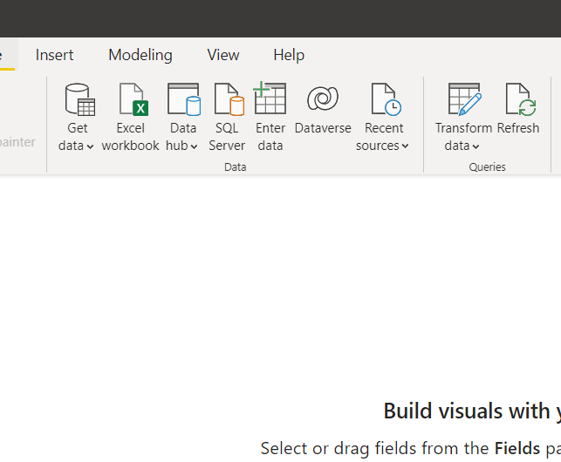
Power Query Power BI: Power Query Editor
To access Power Query Editor, go to the Home tab of Power BI Desktop and click Transform data.

Slide 16
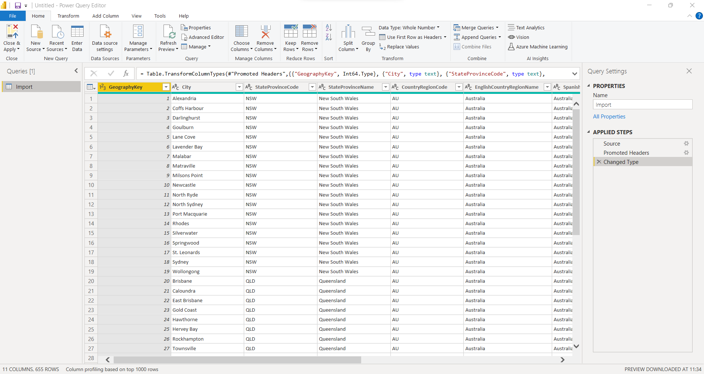
Here’s how Power Query Editor looks once you’ve made a data connection:
Many buttons in the ribbon are now active to interact with the data in the query.
Queries are listed in the left pane and can be selected, viewed, and shaped.
The data from the selected query is shown and ready for shaping in the center pane.
The Query Settings window displays, listing the query’s properties and steps that have been applied.

Slide 17
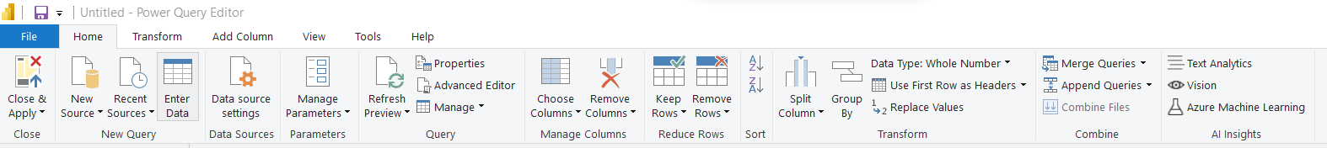
Power Query Power BI: The Query Tab
Power Query Editor’s ribbon is divided into four Tabs: Home, Transform, Add Column, View, Tools, and Help.
The common query tasks are located on the Home tab.

Slide 18
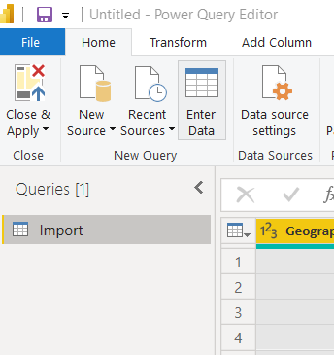
Power Query Power BI: The Inquiries Pane on the Left
The left pane, or Inquiries Pane, shows the number of ongoing queries as well as the query name.
When you select a query from the left pane, the data for that query is displayed in the center pane, where you may shape and change it to match your needs.
The image below depicts the left pane with a query.

Slide 19
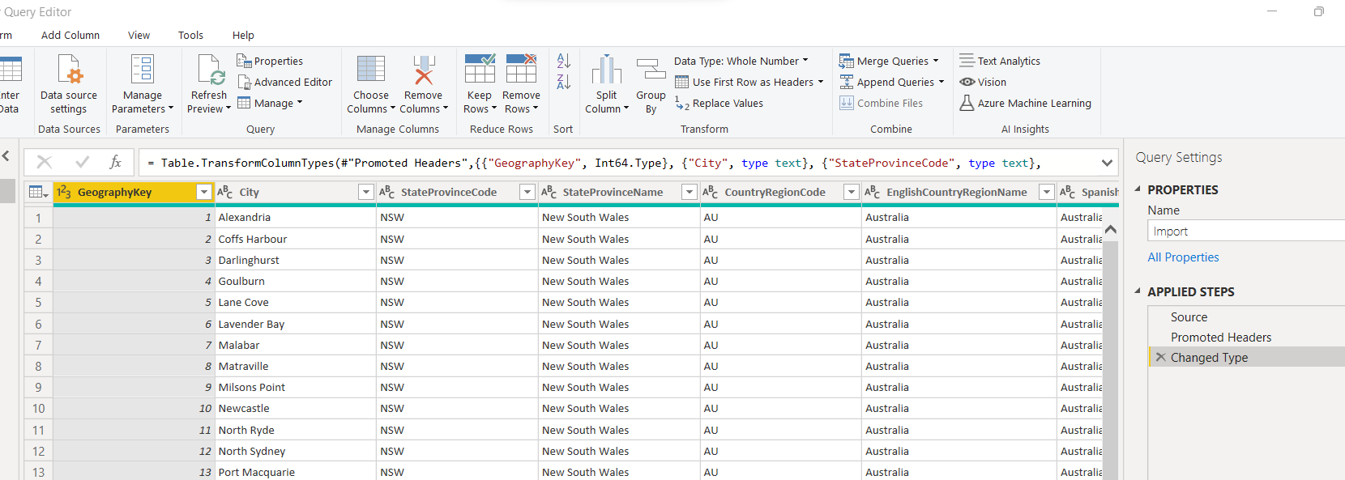
Power Query Power BI: The Data Pane in the Center
The Data from the selected query is displayed in the center pane, also known as the Data Pane.
This Pane is where the Query view does the most of its work.

Slide 20
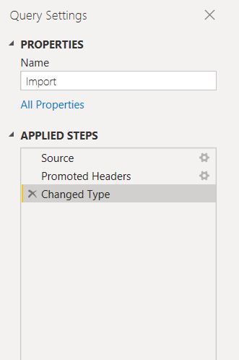
Power Query Power BI: The Query Settings Pane on the Right
The Right Pane, also known as the Query Settings Pane, displays all steps related to a query.
For example, the Applied Steps area of the Query Settings pane in the accompanying image shows the fact that we just modified the type of the Overall score column.

Slide 21
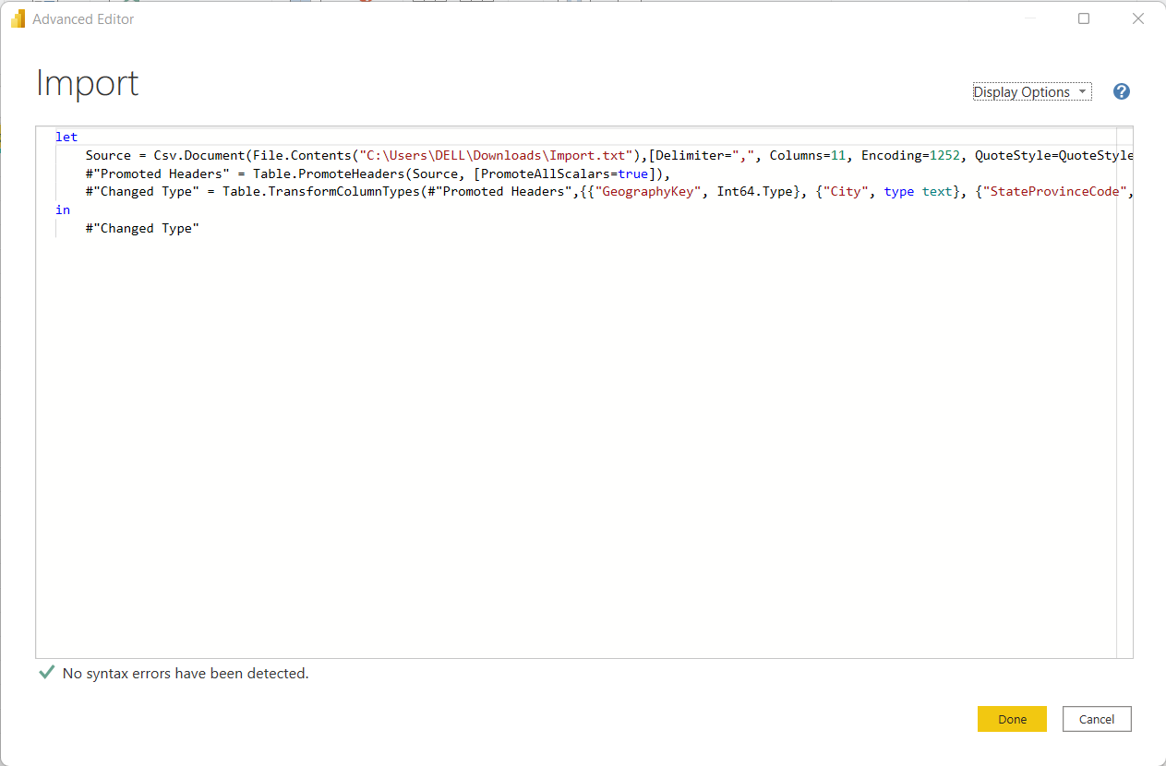
Power Query Power BI: Advanced Editor
The Advanced Editor displays the code that Power Query Editor generates at each step.
You can also write your own shaping code.
To access the advanced editor, choose View from the ribbon, then Advanced Editor.
A popup appears, displaying the current inquiry code.

Slide 22
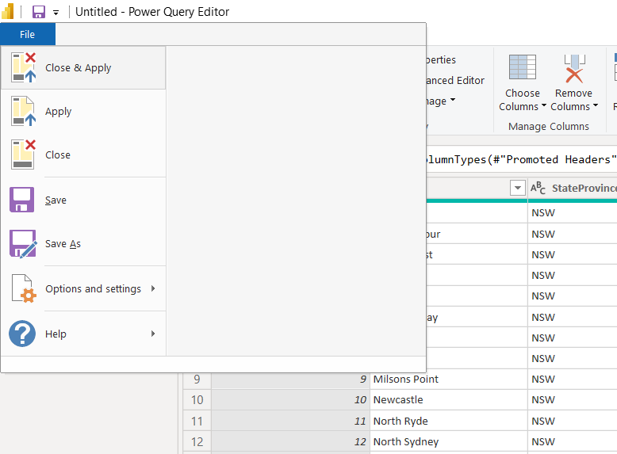
Power Query Power BI: Saving your Work
When your query is where you want it, choose Close & Apply from the File menu in Power Query Editor.
This action saves your changes and exits the editor.
As progress is achieved, Power BI Desktop displays a status dialogue.

Slide 23
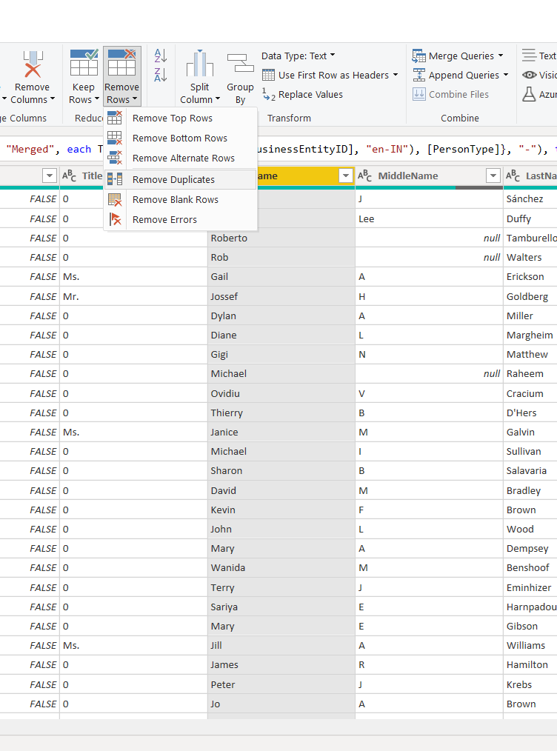
Eliminating Duplicates
Select the Column you want to remove Duplicate rows.
In the Home tab click on the Remove Rows drop down and select Remove Duplicate rows.
It will automatically remove the duplicate rows that are present in your column.

Slide 24
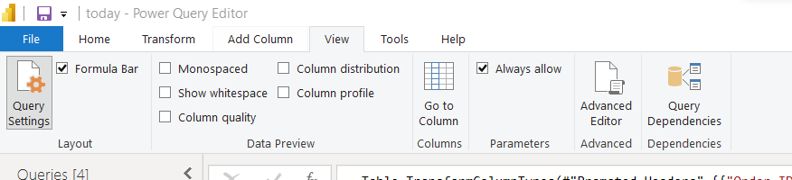
Data Profiling
In Power Query Editor, Under View tab in Data Preview Section we can see the following data profiling functionalities-
Column quality
Column distribution
Column profile

Slide 25
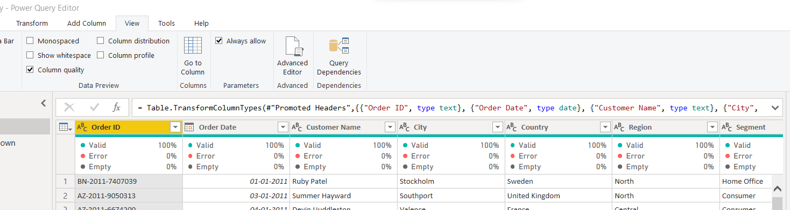
Column quality:
In this section, we can easily see valid, Error and Empty percentage of data values associated with the Selected table.
As you are able to see data is 100 % valid.
In some cases, if data is not valid, you can see a different percentage value for selected column.

Slide 26
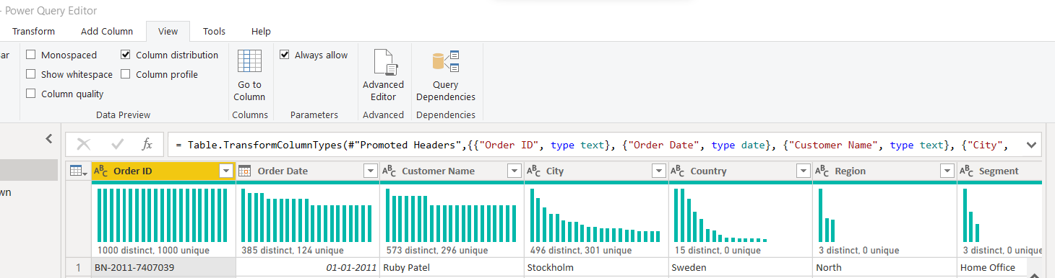
2. Column Distribution
In this section we can easily see the inline value distribution histogram.
For example, # distinct records, # unique records.
Once you hover on distributed histogram, you can also see the percentage associated with distinct and unique data for the selected column

Slide 27
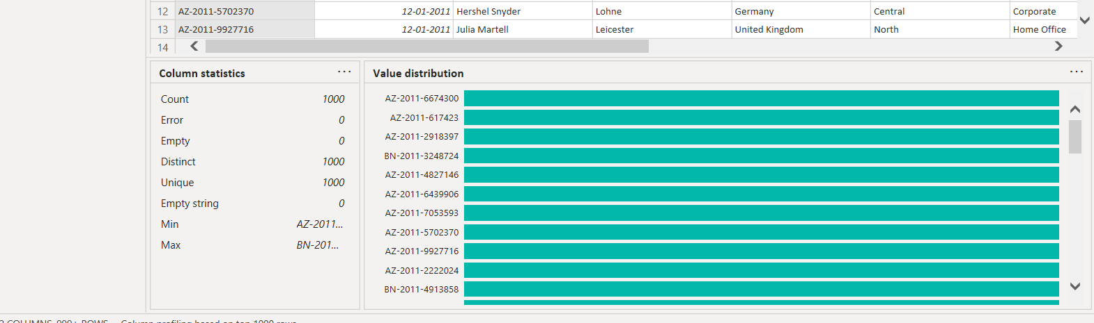
3. Column Profile
This is one of the most important features.
As you can see for the selected column, you can see Column statistics which includes distribution measures like #Count, #error, #empty, #distinct, #Unique, #Empty string, Min, Max

Slide 28
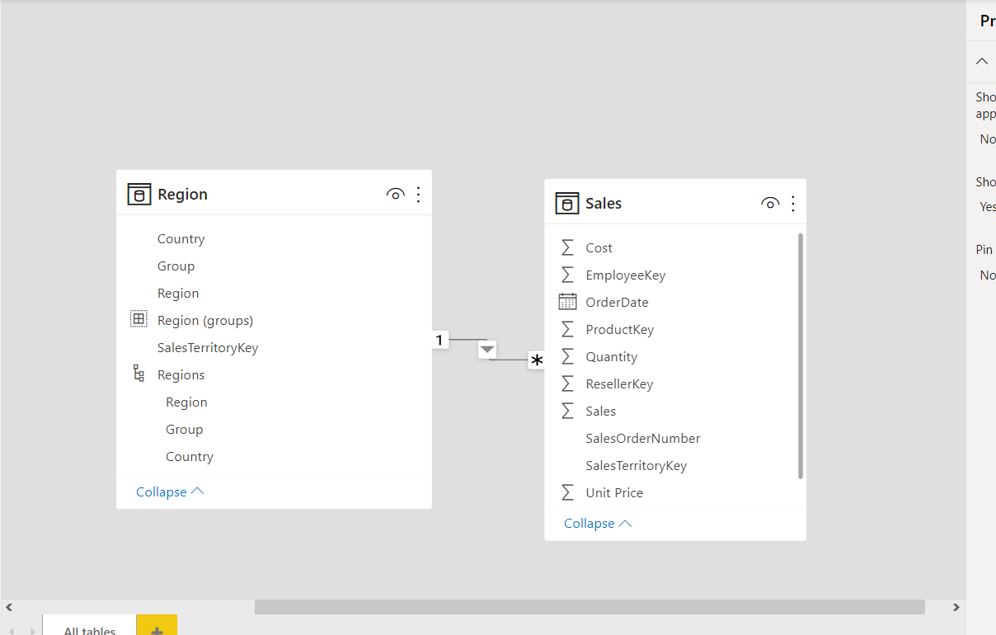
PowerBI Data Modelling
Data Modeling is one of the features used to connect multiple data sources in BI tool using a relationship.
A relationship defines how data sources are connected with each other and you can create interesting data visualizations on multiple data sources.

Slide 29
DAX EXPRESSIONS

Slide 30

Introduction to DAX
To do the basic calculation and data analysis on data in Power pivot, we use DAX.
It is a formula-based language to compute calculated columns and calculated fields.
Help to create new information in form of calculated columns and measures, table from data that is already existing in your table.

Slide 31
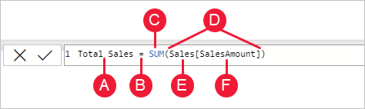
Syntax
The measure name, Total Sales.
The equals sign operator (=), which indicates the beginning of the formula. When calculated, it will return a result.
The DAX function SUM, which adds up all the numbers in the Sales[SalesAmount] column. You’ll learn more about functions later.
Parenthesis (), which surround an expression that contains one or more arguments. Most functions require at least one argument. An argument passes a value to a function.
The referenced table, Sales.
The referenced column, [SalesAmount], in the Sales table. With this argument, the SUM function knows on which column to aggregate a SUM.

Slide 32
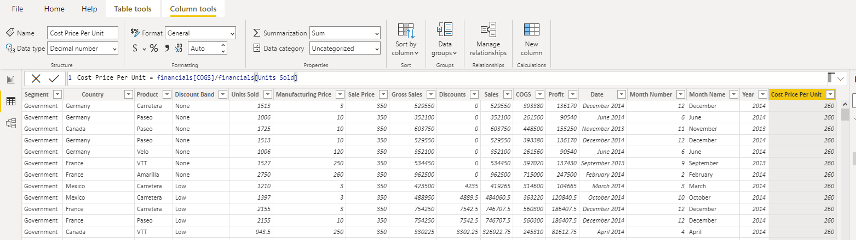
Row Context
This refers to just “the current row” across all columns of a table and extends to all columns in related tables too.
This type of context lets the DAX formula know which rows to use for a specific formula.

Slide 33
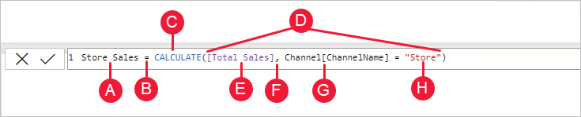
Filter context
Filter context is a little more difficult to understand than row context.
You can most easily think of filter context as: One or more filters applied in a calculation that determines a result or value.

Slide 34
The measure name, Store Sales.
The equals sign operator (=), which indicates the beginning of the formula.
The CALCULATE function, which evaluates an expression, as an argument, in a context that is modified by the specified filters.
Parenthesis (), which surround an expression containing one or more arguments.
A measure [Total Sales] in the same table as an expression. The Total Sales measure has the formula: =SUM(Sales[SalesAmount]).
A comma (,), which separates the first expression argument from the filter argument.
The fully qualified referenced column, Channel[ChannelName]. This is our row context. Each row in this column specifies a channel, such as Store or Online.
The value, Store, as a filter. This is our filter context.

Slide 35
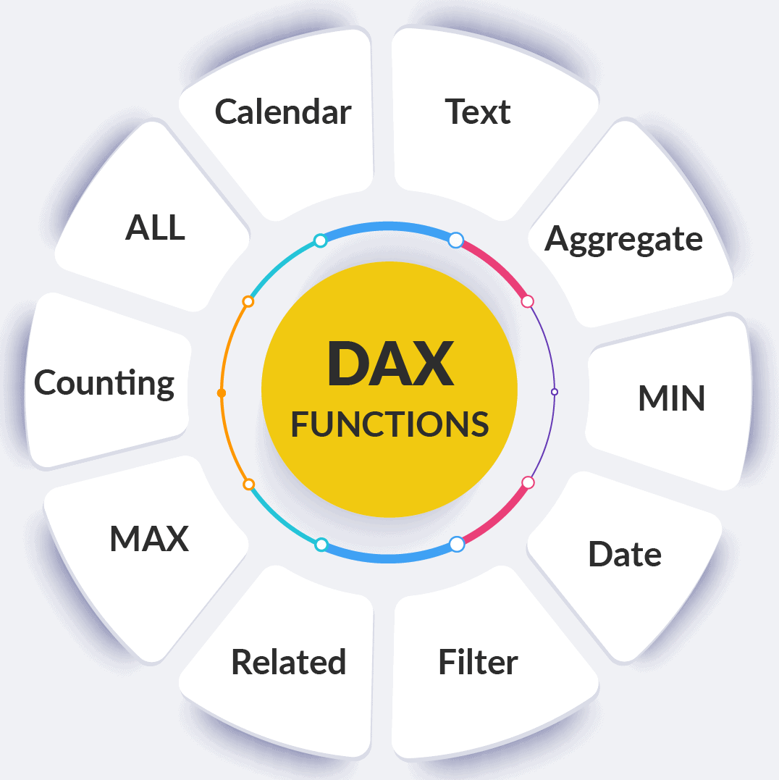
Functions
DAX includes the following categories of functions: Date and Time, Time Intelligence, Information, Logical, Mathematical, Statistical, Text, Parent/Child, and Other functions.

Slide 36
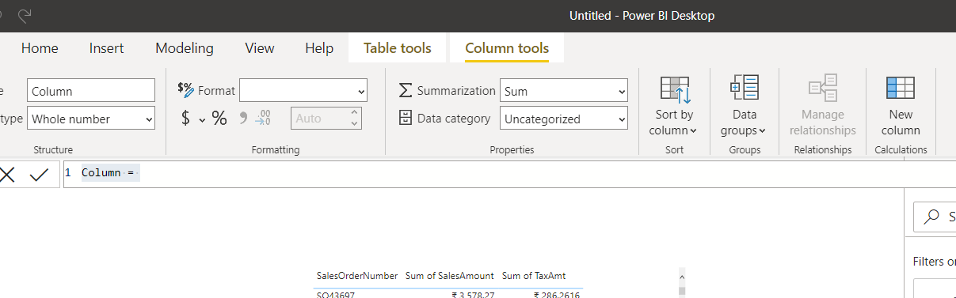
Calculated Columns
Microsoft Power BI allows you to create custom or calculated columns from existing ones.
In order to create it, please click on the New Column option under the Modeling tab.
Clicking the New tab opens the Power BI DAX formula bar, as shown below.

Slide 37
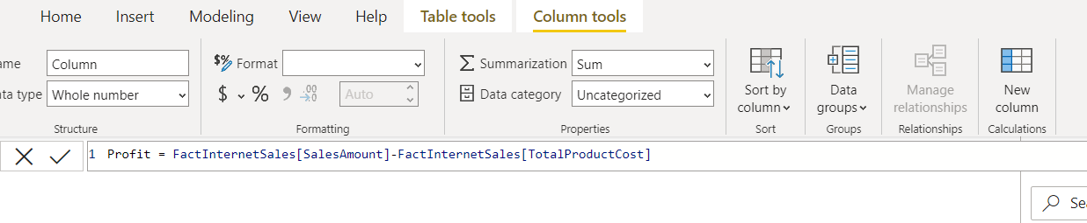
For this Calculated Columns demo purpose, we select Sales Amount and Total Product Cost from the Fact Internet Sales table.
From the screenshot below, you can see that we are calculating the Profit by removing the Total Product Cost from Sales Amount.
Next, a new col called profit is created by clicking the enter.

Slide 38
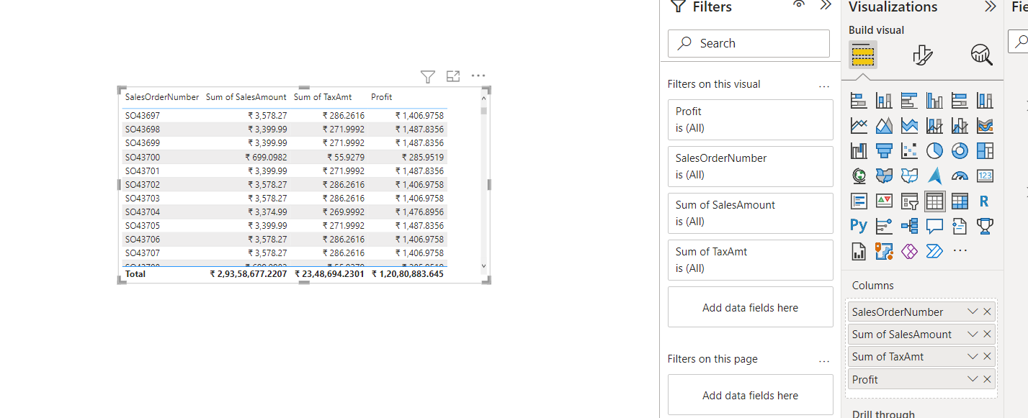
Let me add the calculated col we created to the table.

Slide 39
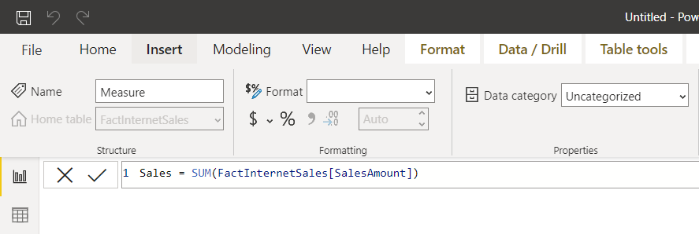
Explicit Measure
If I want to show the sum of sales in my report, I can create a measure with a simple calculation below;

Slide 40
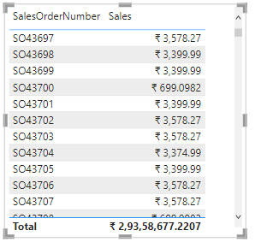
The measure will show the sum of sales aggregated by whatever filtering the FactInternetSales table.
In the below, I have the Sales measure filtered by the SalesOrderNumber field from FactInternetSales.
Sales measure displayed in a visual.
Whenever you create a measure yourself in Power BI, that is called Explicit measure.

Slide 41
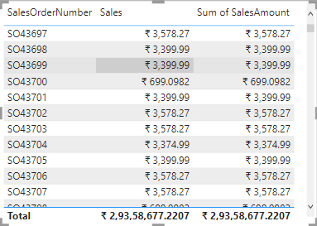
Implicit Measure
The measure above shows the sales value, however, there is another and more popular way of getting the sales value.
That is by dragging and dropping the SalesAmount column (from the FactInternetSales table) directly into the report’s visual.

Slide 42
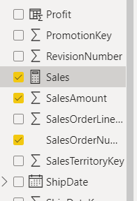
If you notice, you will see a Sigma (or sum) icon beside the SalesAmount column.
This is an icon you will see beside every numeric column (not columns participating in relationships) that are by default set in Power BI as auto-sumarizable.
This means whenever you visualize that column in the Power BI, Power BI shows you the aggregation (the summarization in this case) instead of individual values.

Slide 43
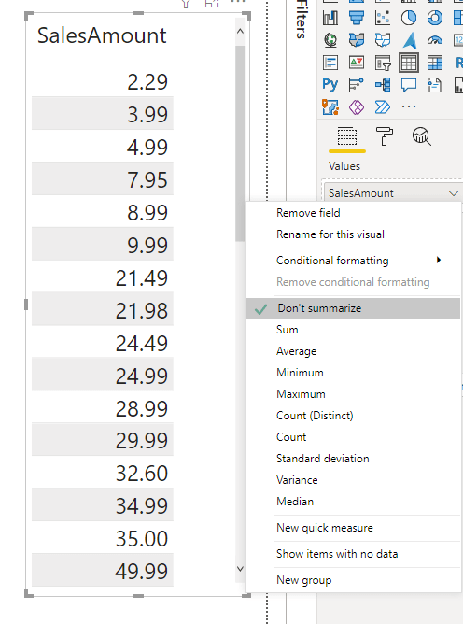
If Power BI didn’t summarize the values of SalesAmount, then we would have seen below: the list of values in the SalesAmount column;

Slide 44
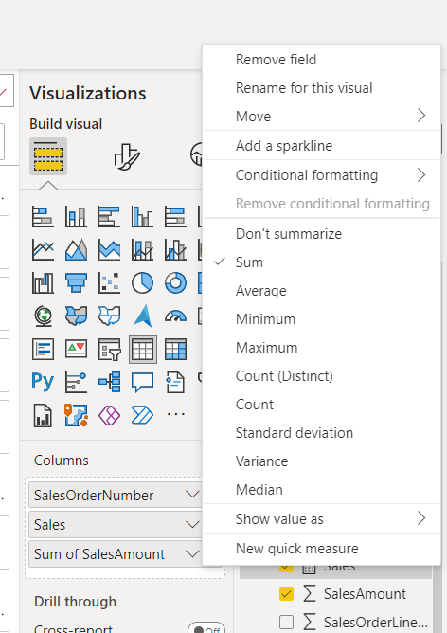
The auto-summarization that Power BI automatically applies on the numeric columns is called an Implicit Measure.
An implicit measure is not only in the form of Sum.
you can change that in the visual by changing the aggregation;

Slide 45
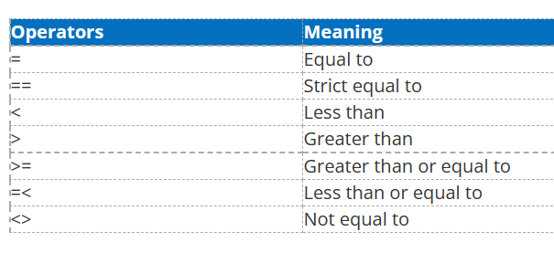
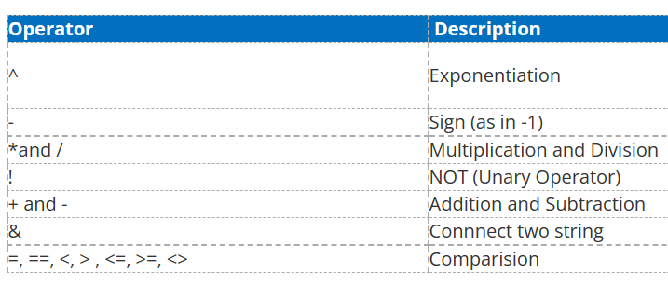
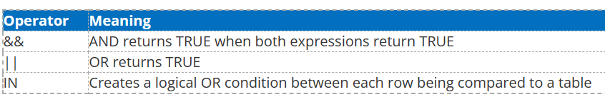
Comparison Operators

Slide 46
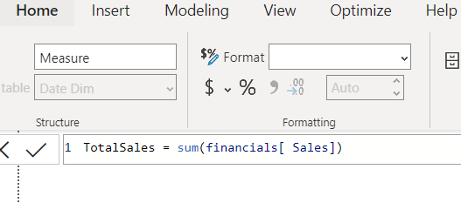
Most Important DAX functions
SUM ()
The sum function adds the values in a column of the table. Following syntax is used for SUM functions
Click on New Measure under the Modeling tab.
Type TotalSales and type SUM formula on the right side of the equal sign.

Slide 47
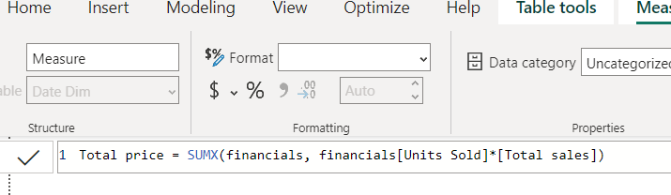
SUMX ()
In our example to calculate total price, we use SUMX (shown below).
Inside the bracket, financial shows the table which will be evaluated.
The expression after comma states the formula to be computed row by row.

Slide 48
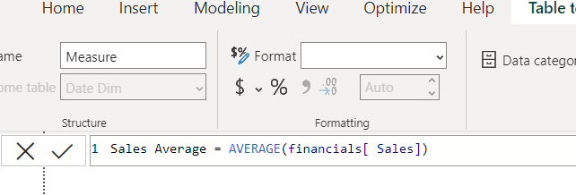
AVERAGE ()
The average function returns the average (arithmetic mean) of all the numbers in a column.
Following is the syntax for Average ()
For example, if we want to know the average sales for each product category

Slide 49
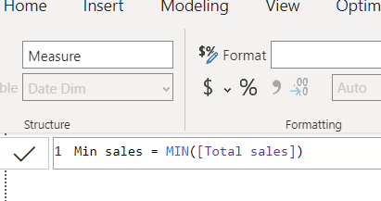
MI­­­­­N ()
The MIN function returns the smallest value in a column, or between two scalar expressions.
The syntax for MIN is as follows.
MIN (Column Name) or MIN (expression1, Expression2)

Slide 50
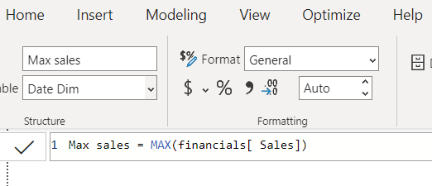
MAX()
In order to extract maximum value from a column, we use MAX function which is the opposite of MIN function i.e., it gives the maximum value in a column, or between two scalar expressions.
The syntax for MAX function is
MAX(<column>) or MAX(<expression1>, <expression2>)

Slide 51
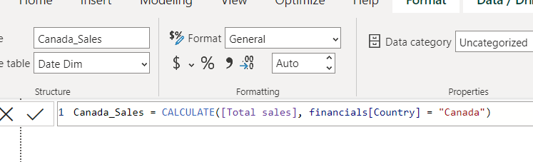
CALCULATE ()
The CALCULATE function is a very important function in Power BI as it is used to apply your own filters to data, that can add to existing filters or even replace them.
The following syntax is followed to write a CALCULATE function.
CALCULATE(<expression>, <filter1>, <filter2>…)

Slide 52
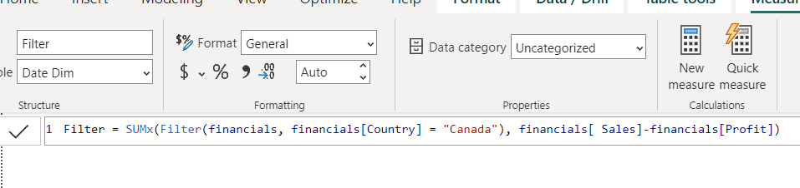
Filter ()
FILTER is an expression that can be used in unison with an existing function such as CALCULATE the SUMX, we have used Filter to FILTER the unit price which is greater than 300 to calculate sales of the product which are expensive (greater than 300)
Following syntax is followed to write a Filter function
(<expression>,<filter1>,<filter2>…)

Slide 53
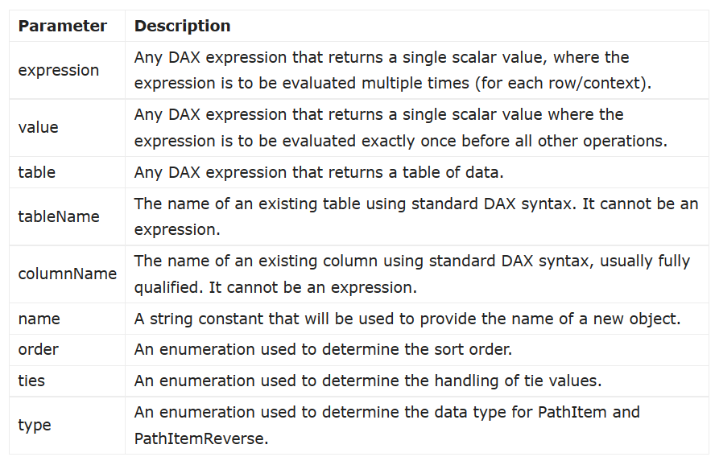
Parameter-Naming Conventions

Slide 54

TOPN
TOPN is a tabular function in DAX, and the table it returns is a subset of the input table but only the top (or bottom) items of that table based on evaluation of an expression.

Slide 55

SAMPLE
Returns a sample of N rows from the specified table.
SAMPLE (<n_value>, <table>, <orderBy_expression>, [<order>], [<orderBy_expression>, [<order>]] …)

Slide 56

COUNT
The DAX COUNT function is used to count the total number of cells that contain value entities such as integer, whole number, string, and character.

Slide 57

DISTINCTCOUNT
The DISTINCTCOUNT function only returns the number of unique values ​​that exist in a column.
DISTINCTCOUNT(<column>)

Slide 58

COUNTROWS
The COUNTROWS function returns the count of rows in the specified table or table defined by the expression.
COUNTROWS(<table>)

Slide 59
Row-level security
Row-level security in Power BI is a crucial security feature that allows organizations to control access to data at a granular level.
With row-level security, you can define rules that determine which rows of data within a dataset or table are visible to different users or user groups.
This means that individuals or groups only see the data that is relevant to them, while sensitive or restricted information remains hidden.
Row-level security is particularly valuable in scenarios where you need to share a single dataset with multiple stakeholders, such as different departments or customers while ensuring that each user can only access the data they are authorized to view.
It enhances data privacy, compliance, and confidentiality within Power BI reports and dashboards.

