Slide 1
Azure Storage Types

Slide 2
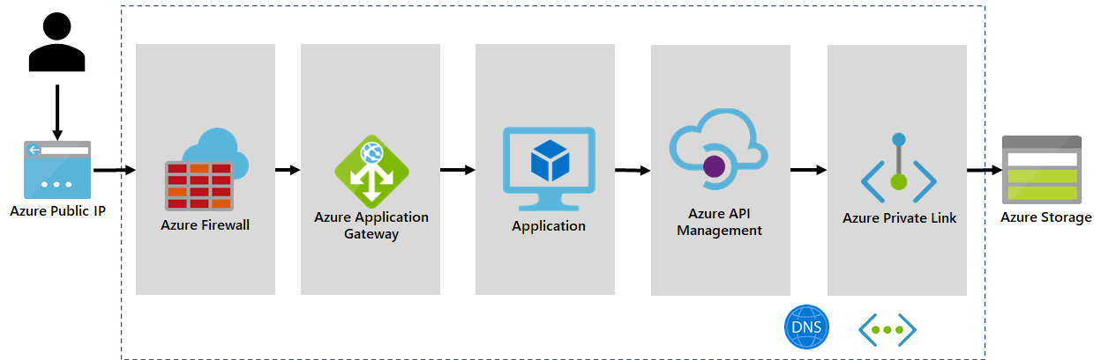
Access and Authentication
Access and authentication mechanisms play a crucial role in ensuring the secure access of Azure Storage services like Data Lake Storage Gen2 and Blob Storage.
Azure provides several features and tools to control who can access your storage resources and how they can interact with them.

Slide 3
Azure Active Directory (Azure AD) Integration:
Azure AD integration allows you to use Azure AD identities for authentication and authorization.
It provides centralized identity management and enables fine-grained access control using Azure AD roles.
Shared Access Signatures (SAS):
SAS tokens allow you to grant limited and specific permissions to users or applications without sharing your account keys.
You can generate SAS tokens for specific resources and define permissions, access duration, and more.

Slide 4
Role-Based Access Control (RBAC):
RBAC allows you to assign specific roles (e.g., owner, contributor, reader) to users, groups, or service principals at different levels (account, container, blob).
Roles define what actions users can perform, such as read, write, delete, etc.
Access Control Lists (ACLs):
ACLs provide more granular control over permissions by specifying access rights for individual blobs or containers.
They are used in conjunction with shared key authentication or SAS tokens.

Slide 5
Virtual Network Service Endpoints:
Virtual Network Service Endpoints allow you to secure your storage resources by limiting access to only specified virtual networks.
Traffic between the virtual network and the storage service remains on the Microsoft Azure backbone network.
Private Endpoints (Preview):
Private Endpoints provide a private IP address within your virtual network that is used to access the storage account.
This keeps data traffic within the Azure network and enhances security for accessing storage resources.

Slide 6
Azure Data Factory

Slide 7
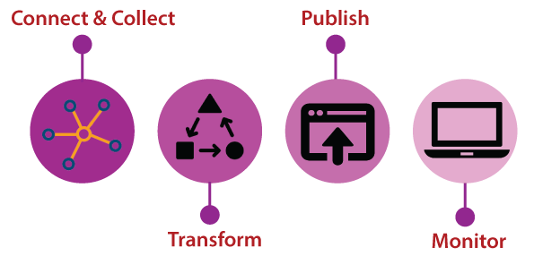
Azure Data Factory
Azure Data Factory is a data-integration service based on the Cloud that allows us to create data-driven workflows in the cloud for orchestrating and automating data movement and data transformation.
Data Factory is a perfect ETL tool on Cloud. Data Factory is designed to deliver extraction, transformation, and loading processes within the cloud.
The ETL process generally involves four steps:

Slide 8
Connect & Collect: We can use the copy activity in a data pipeline to move data from both on-premises and cloud source data stores.
Transform: Once the data is present in a centralized data store in the cloud, process or transform the collected data by using compute services such as HDInsight Hadoop, Spark, Data Lake Analytics, and Machine Learning.
Publish: After the raw data is refined into a business-ready consumable form, it loads the data into Azure Data Warehouse, Azure SQL Database, and Azure Cosmos DB, etc.
Monitor: Azure Data Factory has built-in support for pipeline monitoring via Azure Monitor, API, PowerShell, Log Analytics, and health panels on the Azure portal.

Slide 9
Benefits
Scalability: Azure Data Factory can handle large volumes of data and scales automatically based on demand, accommodating varying workloads efficiently.
Integration: It seamlessly connects with diverse data sources, both on-premises and in the cloud, enabling smooth integration of data from various platforms.
Efficient Data Movement: ADF efficiently moves data between data stores, supporting parallel data transfer and ensuring fast and reliable data movement.
Flexibility: With pipelines and activities, ADF offers flexibility in designing complex data workflows, incorporating control flow activities and conditional branching.
Cost-Effective: As a fully managed service, you only pay for resources used during pipeline execution, making it cost-effective for data integration and orchestration tasks.

Slide 10
Use cases for ETL
Cloud Data Migration: ADF simplifies moving data from on-premises databases to the cloud, ensuring a seamless transition without data loss.
Data Warehousing: ETL in Azure Data Factory facilitates extracting, transforming, and loading data into data warehouses, creating a centralized repository for analytical processing.
Data Integration: ADF handles data integration from diverse sources, harmonizing data formats and structures to provide a unified view for analysis.
Real-time Data Ingestion: ADF ingests and transforms real-time streaming data, enabling near real-time analytics and insights for dynamic business needs.

Slide 11
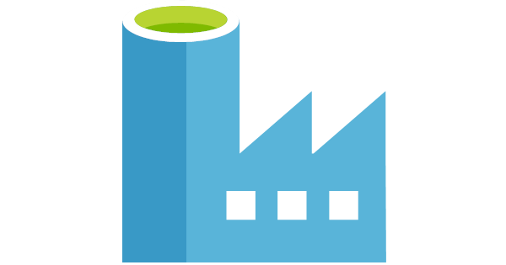
Why We Need It
Azure Data Factory is a powerful cloud-based data integration service provided by Microsoft Azure.
It's designed to help organizations efficiently collect, transform, and move data from various sources to different destinations, enabling data-driven insights and analytics.

Slide 12
ETL vs. ELT:
ETL (Extract, Transform, Load):
In traditional ETL, data is extracted from source systems, transformed to meet the target schema, and then loaded into the destination data store.
ELT (Extract, Load, Transform):
In ELT, data is first extracted from source systems and loaded into the destination data store.
Transformations are then applied within the destination data store.

Slide 13
Data Sets:
Data sets define the data structures and schema of the source and destination data.
They include information about the data format, schema, and location.
Data sets are used as inputs and outputs in data pipelines.
Integration Runtime:
Integration Runtime (IR) is the compute infrastructure that Data Factory uses to execute data integration tasks.
There are two types of integration runtimes: Azure Integration Runtime and Self-hosted Integration Runtime. The former is used for cloud data integration, and the latter is used for on-premises or private network scenarios.

Slide 14
Parameters:
Parameters are values that you can pass into your Data Factory pipelines to make them dynamic and reusable.
They allow you to customize pipeline behavior without modifying the pipeline definition.
System Variables:
System variables are predefined variables provided by Data Factory that you can use within your pipelines.
They provide metadata about the current run, such as run ID, pipeline name, and more.

Slide 15
Data Flows:
Data Flows are visual representations of data transformations within a Data Factory.
They provide a way to design complex data transformations using a visual interface.
Linked Services:
Linked Services define the connection details to external data sources or destinations.
They include connection strings, authentication credentials, and other settings required to access the data.

Slide 16
Triggers:
Triggers define when and how often a pipeline should be executed.
They can be time-based or event-based, allowing you to automate data integration workflows.
Activities:
Activities are the building blocks of data pipelines.
They represent a single action in a pipeline, such as copying data, transforming data, or executing a script.
Debugging and Monitoring:
Data Factory provides debugging capabilities and monitoring tools to troubleshoot and monitor pipeline executions.

Slide 17
Pipeline
A pipeline is a sequence of activities arranged in a specific order.
Each activity represents a single action, such as copying data, transforming data, executing a script, or calling a stored procedure.
Pipelines can include data movement activities, data transformation activities, and control flow activities.
Data Factory provides a visual designer for creating and managing pipelines using a drag-and-drop interface.
You can define parameters for pipelines to make them dynamic and reusable.

Slide 18
Pipeline Chaining
Pipeline chaining involves connecting multiple pipelines together to form a more complex workflow.
Each pipeline can be responsible for a specific subset of tasks, and by chaining pipelines, you can create an end-to-end data integration process.
Pipelines can be triggered sequentially, ensuring that the output of one pipeline becomes the input for the next pipeline.
Chaining allows you to modularize your workflows, making them easier to design, manage, and troubleshoot.
It enables you to break down complex processes into smaller, more manageable pieces.
You can use control flow activities to manage pipeline execution dependencies and branching logic.

