Slide 1
Knowledge Representation Models

Slide 2
Knowledge Representation
Knowledge Representation is a field of artificial intelligence that is concerned with presenting real-world information in a form that the computer can ‘understand’ and use to ‘solve’ real-life problems or ‘handle’ real-life tasks.
The ability of machines to think and act like humans such as understanding, interpreting and reasoning constitute knowledge representation. It is related to designing agents that can think and ensure that such thinking can constructively contribute to the agent’s behavior.
knowledge representation allows machines to behave like humans by empowering an AI machine to learn from available information, experience or experts. However, it is important to choose the right type of knowledge representation if you want to ensure business success with AI.

Slide 3
Knowledge Representation
Represented in AI include:
Objects
Events
Performance
Facts
Meta-Knowledge
Knowledge-base

Slide 4
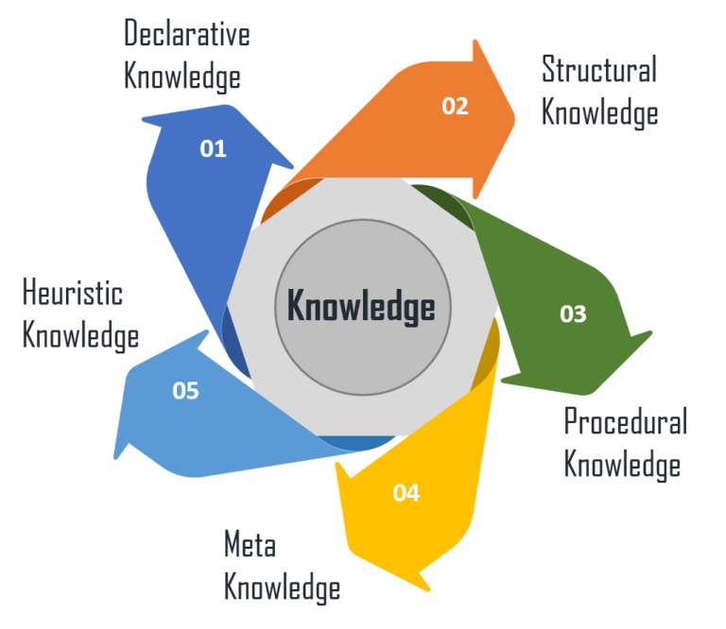
Types of knowledge

Slide 5
Knowledge types
Declarative Knowledge – It includes concepts, facts, and objects and expressed in a declarative sentence.
Structural Knowledge – It is a basic problem-solving knowledge that describes the relationship between concepts and objects.
Procedural Knowledge – This is responsible for knowing how to do something and includes rules, strategies, procedures, etc.
Meta Knowledge – Meta Knowledge defines knowledge about other types of Knowledge.
Heuristic Knowledge – This represents some expert knowledge in the field or subject.

Slide 6
Cycle of Knowledge Representation in AI
Artificial Intelligent Systems usually consist of various components to display their intelligent behavior. Some of these components include:
Perception
Learning
Knowledge Representation & Reasoning
Planning
Execution

Slide 7
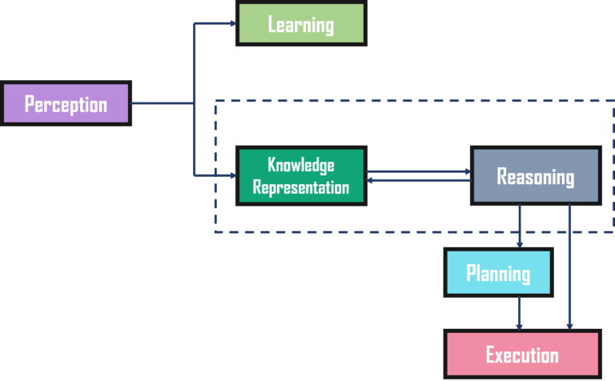
Knowledge Representation Cycle

Slide 8
Knowledge Representation Cycle
The Perception component retrieves data or information from the environment. with the help of this component, you can retrieve data from the environment, find out the source of noises and check if the AI was damaged by anything. Also, it defines how to respond when any sense has been detected.
Then, there is the Learning Component that learns from the captured data by the perception component. The goal is to build computers that can be taught instead of programming them. Learning focuses on the process of self-improvement. In order to learn new things, the system requires knowledge acquisition, inference, acquisition of heuristics, faster searches, etc.
The main component in the cycle is Knowledge Representation and Reasoning which shows the human-like intelligence in the machines. Knowledge representation is all about understanding intelligence. Instead of trying to understand or build brains from the bottom up, its goal is to understand and build intelligent behavior from the top-down and focus on what an agent needs to know in order to behave intelligently. Also, it defines how automated reasoning procedures can make this knowledge available as needed.
The Planning and Execution components depend on the analysis of knowledge representation and reasoning. Here, planning includes giving an initial state, finding their preconditions and effects, and a sequence of actions to achieve a state in which a particular goal holds. Now once the planning is completed, the final stage is the execution of the entire process.

Slide 9
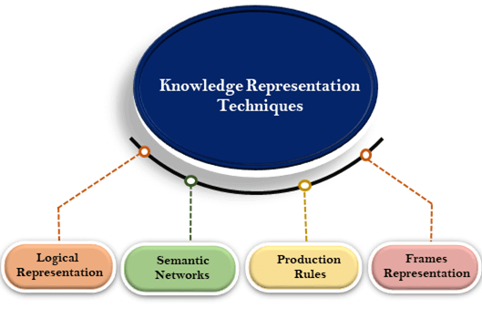
Four Fundamental Types of Knowledge Representation
In artificial intelligence, knowledge can be represented in various ways depending on the structure of the knowledge or the perspective of the designer or even the type of internal structure used. An effective knowledge representation should be rich enough to include the knowledge required to solve the problem. It should be natural, compact and maintainable.

Slide 10
Logical Representation
Formal logic - is a language with unambiguous representation guided by certain concrete rules.
working with logical representation is challenging, it forms the basis for programming languages and enables you to construct logical reasoning.
It allows designers to lay down certain vital communication rules to give and acquire information from agents with minimum errors in communication. Different rules of logic allow you to represent different things resulting in an efficient inference. Hence, the knowledge acquired by logical agents will be definite which means it will either be true or false.

Slide 11
Logical Representation
Logical representation is a language with some concrete rules which deals with propositions and has no ambiguity in representation. Logical representation means drawing a conclusion based on various conditions. This representation lays down some important communication rules. It consists of precisely defined syntax and semantics which supports the sound inference. Each sentence can be translated into logics using syntax and semantics.
Syntax:
Syntaxes are the rules which decide how we can construct legal sentences in the logic.
It determines which symbol we can use in knowledge representation.
How to write those symbols.

Slide 12
Logical Representation
Semantics:
Semantics are the rules by which we can interpret the sentence in the logic.
Semantic also involves assigning a meaning to each sentence.
Logical representation can be categorised into mainly two logics:
Propositional Logics
Predicate logics

Slide 13
Logical Representation
An example of formal logic, consider the following clauses with
nonsense words squeeg and moof
Premise: All squeegs are moofs
Premise: John is a squeeg
Conclusion: John is a moof
■ The argument is valid no matter what words are used
Premise: All X are Y
Premise: Z is a X
Conclusion: Z is a Y
is valid no matter what is substituted for X, Y, and Z

Slide 14
Logical Representation
The conditional is analogous to the arrow of production rules in that
it is expressed as an IF-THEN form. For example:
if it is raining then carry an umbrella
p → q
where
p = it is raining
q = carry an umbrella

Slide 15
Logical Representation
In logic, the conditional is defined by its truth table,
◻ e.g. p → q
where p and q are any statements, this can be translated as:
■ p implies q
■ if p then q
■ p, only if
■ q if p
■ p is necessary for p
■ For example, let p represent “you are 18 or older” and q represents
“you can vote”
you are 18 or older implies you can vote
if you are 18 or older then you can vote
you are 18 or older, only if you can vote
you are 18 or older is sufficient for you can vote
you can vote if you are 18 or older
you can vote is necessary for you are 18 or older

Slide 16
Logical Representation
Advantages of logical representation:
Logical representation enables us to do logical reasoning.
Logical representation is the basis for the programming languages.
Disadvantages of logical Representation:
Logical representations have some restrictions and are challenging to work with.
Logical representation technique may not be very natural, and inference may not be so efficient.

Slide 17
Semantic Network
A semantic network allows you to store knowledge in the form of a graphic network with nodes and arcs representing objects and their relationships. It could represent physical objects or concepts or even situations. A semantic network is gener
A semantic network is simple and easy to implement and understand. It is more natural than logical representation. It allows you to categorize objects in various forms and then link those objects. It also has greater expressiveness than logic representation. ally used to represent data or reveal structure.

Slide 18
Semantic Network
Semantic networks are alternative of predicate logic for knowledge representation. In Semantic networks, we can represent our knowledge in the form of graphical networks. This network consists of nodes representing objects and arcs which describe the relationship between those objects. Semantic networks can categorize the object in different forms and can also link those objects. Semantic networks are easy to understand and can be easily extended.
This representation consist of mainly two types of relations:
IS-A relation (Inheritance)
Kind-of-relation

Slide 19
Semantic Network
Example: Following are some statements which we need to represent in the form of nodes and arcs.
Statements:
Jerry is a cat.
Jerry is a mammal
Jerry is owned by Priya.
Jerry is brown colored.
All Mammals are animal.
In the above diagram, we have represented the different type of knowledge in the form of nodes and arcs. Each object is connected with another object by some relation.

Slide 20
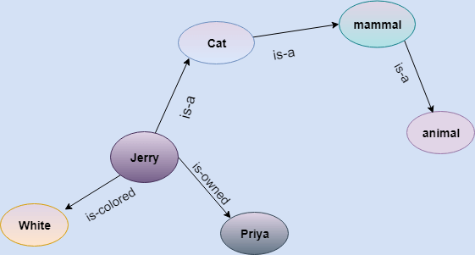
Semantic Network

Slide 21
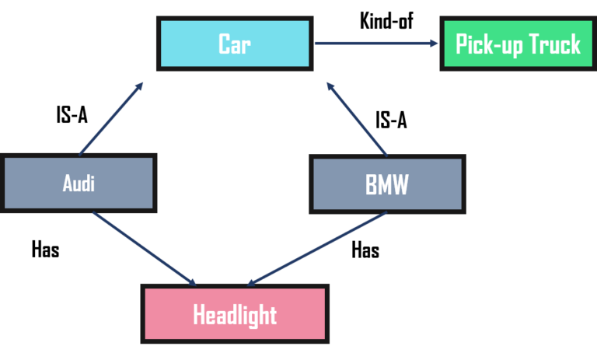
Semantic Network

Slide 22
Drawbacks in Semantic representation:
Semantic networks take more computational time at runtime as we need to traverse the complete network tree to answer some questions. It might be possible in the worst case scenario that after traversing the entire tree, we find that the solution does not exist in this network.
Semantic networks try to model human-like memory (Which has 1015 neurons and links) to store the information, but in practice, it is not possible to build such a vast semantic network.
These types of representations are inadequate as they do not have any equivalent quantifier, e.g., for all, for some, none, etc.
Semantic networks do not have any standard definition for the link names.
These networks are not intelligent and depend on the creator of the system.

Slide 23
Advantages of Semantic network:
Semantic networks are a natural representation of knowledge.
Semantic networks convey meaning in a transparent manner.
These networks are simple and easily understandable.

Slide 24
Frame Representation
A frame is a collection of attributes and its associated values, which describes an entity in the real world. It is a record like structure consisting of slots and its values.
Slots could be of varying sizes and types. These slots have names and values. Or they could have subfields named as facets. They allow you to put constraints on the frames.
There is no restraint or limit on the value of facets a slot could have, or the number of facets a slot could have or the number of slots a frame could have. Since a single frame is not very useful, building a frame system by collecting frames that are connected to each other will be more beneficial. It is flexible and can be used by various AI applications.

Slide 25
Frame Representation
A frame is a record like structure which consists of a collection of attributes and its values to describe an entity in the world. Frames are the AI data structure which divides knowledge into substructures by representing stereotypes situations. It consists of a collection of slots and slot values. These slots may be of any type and sizes. Slots have names and values which are called facets.

Slide 26
Frame Representation
Facets: The various aspects of a slot is known as Facets. Facets are features of frames which enable us to put constraints on the frames. Example: IF-NEEDED facts are called when data of any particular slot is needed. A frame may consist of any number of slots, and a slot may include any number of facets and facets may have any number of values. A frame is also known as slot-filter knowledge representation in artificial intelligence.
Frames are derived from semantic networks and later evolved into our modern-day classes and objects. A single frame is not much useful. Frames system consist of a collection of frames which are connected. In the frame, knowledge about an object or event can be stored together in the knowledge base. The frame is a type of technology which is widely used in various applications including Natural language processing and machine visions.

Slide 27
Example of a frame for a book
Slots | Filters
Title | Artificial Intelligence
Genre | Computer Science
Author | Peter Norvig
Edition | Third Edition
Year | 1996
Page | 1152

Slide 28
Example 2:
Let's suppose we are taking an entity, Peter. Peter is an engineer as a profession, and his age is 25, he lives in city London, and the country is England. So following is the frame representation for this:
Slots | Filter
Name | Peter
Profession | Doctor
Age | 25
Marital status | Single
Weight | 78

Slide 29
Advantages of frame representation:
The frame knowledge representation makes the programming easier by grouping the related data.
The frame representation is comparably flexible and used by many applications in AI.
It is very easy to add slots for new attribute and relations.
It is easy to include default data and to search for missing values.
Frame representation is easy to understand and visualize.

Slide 30
Disadvantages of frame representation:
In frame system inference mechanism is not be easily processed.
Inference mechanism cannot be smoothly proceeded by frame representation.
Frame representation has a much generalized approach.

Slide 31
Production Rules
Production rule-based representation has many properties essential for knowledge representation. It consists of production rules, working memory, and recognize-act-cycle. It is also called condition-action rules. According to the current database, if the condition of a rule is true, the action associated with the rule is performed.
Although production rules lack precise semantics for the rules and are not always efficient, the rules lead to a higher degree of modularity. And it is the most expressive knowledge representation system.

Slide 32
Production System
Rules
An unordered set of user-defined "if-then" rules of the form:
If P1 ^ ... ^ Pm then Action_1, ..., Action_n
where the Pis are facts that determine the conditions when this rule is applicable. Each Action adds or deletes a fact from the Working Memory.
Working Memory (WM)
A set of "facts" consisting of positive literals defining what's known to be true about the world
Inference Engine
Procedure for inferring changes (additions and deletions) to Working Memory.

Slide 33
Production Rules
Production rules system consist of (condition, action) pairs which mean, "If condition then action". It has mainly three parts:
The set of production rules
Working Memory
The recognize-act-cycle
In production rules agent checks for the condition and if the condition exists then production rule fires and corresponding action is carried out. The condition part of the rule determines which rule may be applied to a problem. And the action part carries out the associated problem-solving steps. This complete process is called a recognize-act cycle.
The working memory contains the description of the current state of problems-solving and rule can write knowledge to the working memory. This knowledge match and may fire other rules.
If there is a new situation (state) generates, then multiple production rules will be fired together, this is called conflict set. In this situation, the agent needs to select a rule from these sets, and it is called a conflict resolution.

Slide 34
Production Rules
Example:
IF (at bus stop AND bus arrives) THEN action (get into the bus)
IF (on the bus AND paid AND empty seat) THEN action (sit down).
IF (on bus AND unpaid) THEN action (pay charges).
IF (bus arrives at destination) THEN action (get down from the bus).

Slide 35
Production Rules
1. If the pH of the spill is less than 6,
Then the spill material is an acid.
2. If the spill material is an acid
And the spill smells like vinegar,
3. If a flammable liquid was spilled,
Then call the fire department.

Slide 36

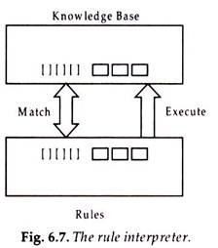
Production Rules
Rules are sometimes written with arrows (→) to indicate the IF and THEN portions of the rules.
For example, rule 1 in this notation would look like:

Slide 37
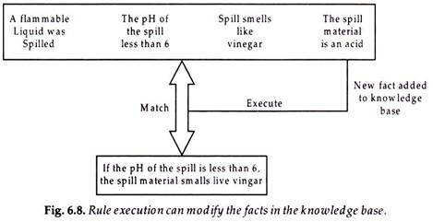
Production Rules
The rule’s action part may modify the set of facts in the knowledge base by adding the then portion
of the rule fired in the data base added as new fact as shown in Fig. 6.8.

Slide 38
Production Rules
Advantages of Production rule:
The production rules are expressed in natural language.
The production rules are highly modular, so we can easily remove, add or modify an individual rule.
Disadvantages of Production rule:
Production rule system does not exhibit any learning capabilities, as it does not store the result of the problem for the future uses.
During the execution of the program, many rules may be active hence rule-based production systems are inefficient.

Slide 39
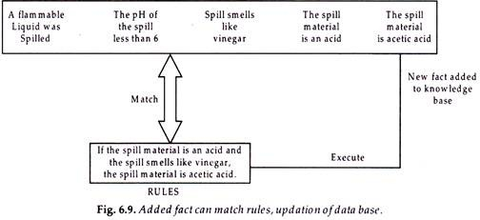
Production Rules
The new facts added to the data (knowledge) base can themselves be used for forming matches with the IF portion of rules

Slide 40
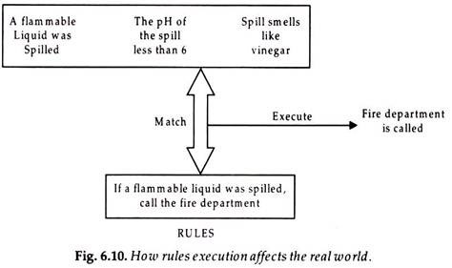
Production Rules
The action taken when the rule fires may directly affect the real world

Slide 41
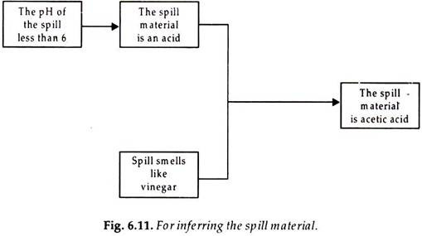
Production Rules
This matching of rule IF portions of rule, to the facts in the data base can produce what are called inference chains. The inference chain formed from successive execution of rules 1 and 2 is shown in Fig. 6.11. The inference chain indicates how the system used the rules to infer the identity of the spill material. An expert system’s inference chains can be displayed to the user to help explain how the system reached its conclusions.

Slide 42
Representation Requirements
A good knowledge representation system must have properties such as:
Representational Accuracy: It should represent all kinds of required knowledge.
Inferential Adequacy: It should be able to manipulate the representational structures to produce new knowledge corresponding to the existing structure.
Inferential Efficiency: The ability to direct the inferential knowledge mechanism into the most productive directions by storing appropriate guides.
Acquisitional efficiency: The ability to acquire new knowledge easily using automatic methods.

Slide 43
QUESTIONS ???

Slide 44
Requirements for knowledge Representation system
1. Representational Accuracy: KR system should have the ability to represent all kind of required knowledge.
2. Inferential Adequacy: KR system should have ability to manipulate the representational structures to produce new knowledge corresponding to existing structure.

Slide 45
Requirements for knowledge Representation system
3. Inferential Efficiency: The ability to direct the inferential knowledge mechanism into the most productive directions by storing appropriate guides.
4. Acquisitional efficiency- The ability to acquire the new knowledge easily using automatic methods.

