Slide 1
Knowledge Representation Models

Slide 2
What is knowledge representation?
KR / KRR is concerned with how AI agents think and how thinking contributes to intelligent behavior of agents.
Represents information about the real world so that a computer (an agent) can understand and utilizes this knowledge to solve the complex real world problems.
Its not just storing data in a database, but it enables an intelligent machine to learn from that knowledge and experiences. It can behave intelligently like a human.

Slide 3
KRR
The ability of machines to think and act like humans such as understanding, interpreting and reasoning constitute knowledge representation.
It is related to designing agents that can think and ensure that such thinking can constructively contribute to the agent’s behaviour in acting like humans.

Slide 4
What to Represent?
Object: All the facts about objects in our world domain.
Events: Events are the actions which occur in our world.
Performance: Describes the behavior of an agent which involves knowledge about how to do things.
Meta-knowledge: It is knowledge about what we know.
Facts: Facts are the truths about the real world and what we represent.

Slide 5
Contd
Knowledge-Base: The central component of the knowledge-based agents is the knowledge base. It is represented as KB.
The Knowledgebase is a group of the Sentences.
knowledge: Knowledge is awareness or familiarity gained by experiences of facts, data, and situations.

Slide 6
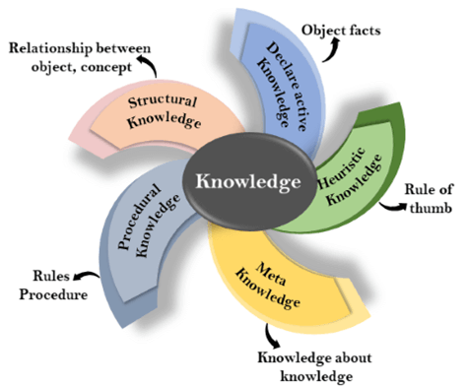
Types of knowledge

Slide 7
1. Declarative Knowledge
Declarative knowledge is to know about something.
It includes concepts, facts, and objects.
It is also called descriptive knowledge and expressed in declarative sentences.
It is simpler than procedural language.

Slide 8
2. Procedural Knowledge
Procedural knowledge is a type of knowledge which is responsible for knowing how to do something. Also known as imperative knowledge. It can be directly applied to any task. Depends on the task on which it can be applied.
It includes rules, strategies, procedures, agendas, etc.

Slide 9
3. Meta-knowledge
Knowledge about the other types of knowledge is called Meta-knowledge.
4. Heuristic knowledge
Heuristic knowledge is representing knowledge of some experts in a domain.
Heuristic knowledge is based on previous experiences, awareness of approaches, and which are good to work but not guaranteed.

Slide 10
5. Structural knowledge
Structural knowledge is basic knowledge to problem-solving.It describes relationships between various concepts such as kind of, part of, and grouping of something.
It describes the relationship that exists between concepts or objects.

Slide 11
AI knowledge cycle
AI agent consists of various components to display their intelligent behavior
Perception
Learning
Knowledge Representation and Reasoning
Planning
Execution

Slide 12
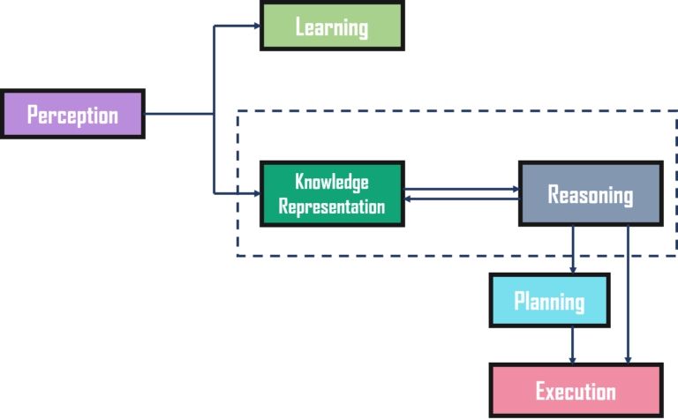
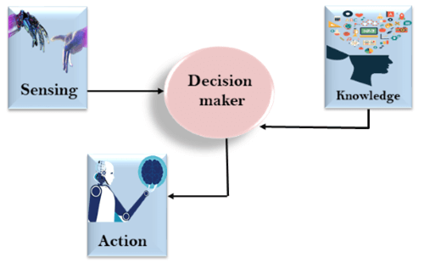
AI knowledge cycle

Slide 13
Approaches to KR
1. Simple relational knowledge
Simplest way of storing facts which uses the relational method
Used in database systems where the relationship between different entities is represented.
Has little opportunity
for inference.
Player | Weight | age
1 | 65 | 23
2 | 58 | 18
3 | 75 | 24

Slide 14
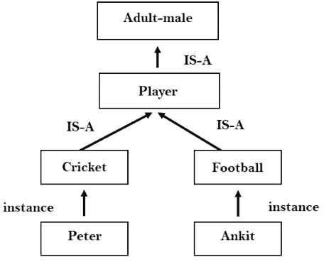
2. Inheritable knowledge:
All data stored into a hierarchy of classes.
Application of inheritance property - Elements inherit values from other members of a class.
Inheritable knowledge shows a relation between instance and class
Every individual frame can represent the collection of attributes and its value.

Slide 15
3. Inferential knowledge
Represents knowledge in the form of formal logics. Can be used to derive more facts.
It guarantees correctness.
Example:
  Marcus is a man man(Marcus)
  All men are mortal ∀x man (x) ---> mortal (x)

Slide 16
4. Procedural knowledge
Uses small programs and codes which describes how to do specific things and how to proceed.
Use of If-Then rule.
Use of coding languages like LISP and Prolog
Can represent heuristic or domain-specific knowledge.

Slide 17
Requirements for knowledge Representation system
1. Representational Accuracy:
KR system should have the ability to represent all kind of required knowledge.
2. Inferential Adequacy:
KR system should have ability to manipulate the representational structures to produce new knowledge corresponding to existing structure.

Slide 18
Requirements for knowledge Representation system
3. Inferential Efficiency:
The ability to direct the inferential knowledge mechanism into the most productive directions by storing appropriate guides.
4. Acquisitional efficiency- The ability to acquire the new knowledge easily using automatic methods.

Slide 19
Fundamental types of Knowledge
Representation
Logical Representation
Production Rules
Semantic Network Representation
Frame Representation

Slide 20
Logical representation
Logical representation is a language with some concrete rules which deals with propositions and has no ambiguity in representation
Logical representation means drawing a conclusion based on various conditions.
It consists of precisely defined syntax and semantics which supports the sound inference. Each sentence can be translated into logics using syntax and semantics.

Slide 21
Syntax & Semantics
Syntaxes are the rules which decide how we can construct legal sentences in the logic.
It determines which symbol can be used in knowledge representation.
How to write those symbols.
Semantics are the rules by which we can interpret the sentence in the logic.
Semantic also involves assigning a meaning to each sentence.

Slide 22
Contd
Logical representation consists of two logics:
  Propositional Logics
  Predicate logics
Advantages of logical representation:
Enables us to do logical reasoning.
Basis for the programming languages.
Disadvantages of logical Representation:
Have restrictions, Not very natural, inference not be so efficient.

Slide 23

Propositional Logic
Syntax
  Propositions, e.g. “it is wet”
  Connectives: and, or, not, implies, iff (equivalent)
  Brackets, T (true) and F (false)
Semantics (Classical AKA Boolean)
  Define how connectives affect truth
    “P and Q” is true if and only if P is true and Q is true
  Use truth tables to work out the truth of statements

Slide 24
Predicate Logic
Propositional logic combines atoms
  An atom contains no propositional connectives
  Have no structure (today_is_wet, john_likes_apples)
Predicates allow us to talk about objects
  Properties: is_wet(today)
  Relations: likes(john, apples)
  True or false
In predicate logic each atom is a predicate
  e.g. first order logic, higher-order logic

Slide 25
First Order Logic
More expressive logic than propositional
  Used in this course (Lecture 6 on representation in FOL)
Constants are objects: john, apples
Predicates are properties and relations:
  likes(john, apples)
Functions transform objects:
  likes(john, fruit_of(apple_tree))
Variables represent any object: likes(X, apples)
Quantifiers qualify values of variables
  True for all objects (Universal): ∀X. likes(X, apples)
  Exists at least one object (Existential): ∃X. likes(X, apples)

Slide 26
Example: FOL Sentence
“Every rose has a thorn”
For all X
  if (X is a rose)
  then there exists Y
    (X has Y) and (Y is a thorn)

Slide 27
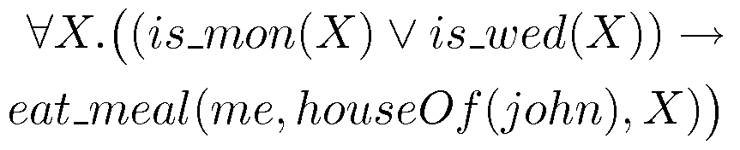
Example: FOL Sentence
“On Mondays and Wednesdays I go to John’s house for dinner”
Note the change from “and” to “or”
  Translating is problematic

Slide 28

Higher Order Logic
More expressive than first order
Functions and predicates are also objects
  Described by predicates: binary(addition)
  Transformed by functions: differentiate(square)
  Can quantify over both
E.g. define red functions as having zero at 17
Much harder to reason with

Slide 29
Beyond True and False
Multi-valued logics
  More than two truth values
  e.g., true, false & unknown
  Fuzzy logic uses probabilities, truth value in [0,1]
Modal logics
  Modal operators define mode for propositions
  Epistemic logics (belief)
    e.g. p (necessarily p), p (possibly p), …
  Temporal logics (time)
    e.g. p (always p), p (eventually p), …

Slide 30
Logic is a Good Representation
Fairly easy to do the translation when possible
Branches of mathematics devoted to it
It enables us to do logical reasoning
  Tools and techniques come for free
Basis for programming languages
  Prolog uses logic programs (a subset of FOL)
  λProlog based on HOL

Slide 31
Fundamental types of Knowledge
Representation
Logical Representation
Production Rules
Semantic Network Representation
Frame Representation

Slide 32
Non-Logical Representations?
Production rules
Semantic networks
  Conceptual graphs
  Frames
Logic representations have restricitions and can be hard to work with
  Many AI researchers searched for better representations

Slide 33
Semantic Network Representation
Alternative of predicate logic for knowledge representation.Knowledge represented in the form of graphical networks.
This network consists of nodes representing objects and arcs which describe the relationship between those objects.
Semantic networks can categorize the object in different forms and can also link those objects. Semantic networks are easy to understand and can be easily extended.

Slide 34
Contd
consist of two types of relations:
IS-A relation (Inheritance)
Kind-of-relation
Example: Statements:
Jerry is a cat.
Jerry is a mammal
Jerry is owned by Priya.
Jerry is brown colored.
All Mammals are animal.

Slide 35
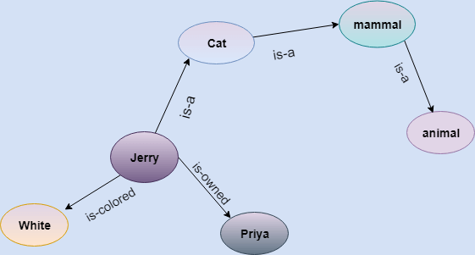

Slide 36
In the above diagram, represent the different type of knowledge in the form of nodes and arcs. Each object is connected with another object by some relation.

Slide 37
Drawbacks in Semantic representation
Semantic networks take more computational time at runtime as we need to traverse the complete network tree to answer some questions. It might be possible in the worst case scenario that after traversing the entire tree, we find that the solution does not exist in this network.
Semantic networks try to model human-like memory (Which has 1015 neurons and links) to store the information, but in practice, it is not possible to build such a vast semantic network.
These types of representations are inadequate as they do not have any equivalent quantifier, e.g., for all, for some, none, etc.
Semantic networks do not have any standard definition for the link names.
These networks are not intelligent and depend on the creator of the system.

Slide 38
Drawbacks in Semantic representation
Semantic networks try to model human-like memory (Which has 1015 neurons and links) to store the information, but in practice, it is not possible to build such a vast semantic network.
These types of representations are inadequate as they do not have any equivalent quantifier, e.g., for all, for some, none, etc.
Semantic networks do not have any standard definition for the link names.
These networks are not intelligent and depend on the creator of the system.

Slide 39
Advantages of Semantic network
Semantic networks are a natural representation of knowledge.
Semantic networks convey meaning in a transparent manner.
These networks are simple and easily understandable.
A semantic network allows you to store knowledge in the form of a graphic network with nodes and arcs representing objects and their relationships.

Slide 40
It could represent physical objects or concepts or even situations. A semantic network is generally used to represent data or reveal structure. It is also used to support conceptual editing and navigation.
A semantic network is simple and easy to implement and understand. It is more natural than logical representation. It allows you to categorize objects in various forms and then link those objects. It also has greater expressiveness than logic representation.

Slide 41
Frame Representation
A frame is a record like structure which consists of a collection of attributes and its values to describe an entity in the world. Frames are the AI data structure which divides knowledge into substructures by representing stereotypes situations. It consists of a collection of slots and slot values. These slots may be of any type and sizes. Slots have names and values which are called facets.

Slide 42
Facets: The various aspects of a slot is known as Facets. Facets are features of frames which enable us to put constraints on the frames. Example: IF-NEEDED facts are called when data of any particular slot is needed. A frame may consist of any number of slots, and a slot may include any number of facets and facets may have any number of values. A frame is also known as slot-filter knowledge representation in artificial intelligence.

Slide 43
Frames are derived from semantic networks and later evolved into our modern-day classes and objects. A single frame is not much useful. Frames system consist of a collection of frames which are connected. In the frame, knowledge about an object or event can be stored together in the knowledge base. The frame is a type of technology which is widely used in various applications including Natural language processing and machine visions.

Slide 44
Example: 1
Let's take an example of a frame for a book
Slots | Filters
Title | Artificial Intelligence
Genre | Computer Science
Author | Peter Norvig
Edition | Third Edition
Year | 1996
Page | 1152

Slide 45
Example 2:
Let's suppose we are taking an entity, Peter. Peter is an engineer as a profession, and his age is 25, he lives in city London, and the country is England. So following is the frame representation for this:

Slide 46
Slots | Filter
Name | Peter
Profession | Doctor
Age | 25
Marital status | Single
Weight | 78

Slide 47
Advantages of frame representation:
The frame knowledge representation makes the programming easier by grouping the related data.
The frame representation is comparably flexible and used by many applications in AI.
It is very easy to add slots for new attribute and relations.
It is easy to include default data and to search for missing values.
Frame representation is easy to understand and visualize.
Disadvantages of frame representation:
In frame system inference mechanism is not be easily processed.
Inference mechanism cannot be smoothly proceeded by frame representation.
Frame representation has a much generalized approach.

Slide 48
A frame is a collection of attributes and its associated values, which describes an entity in the real world. It is a record like structure consisting of slots and its values. Slots could be of varying sizes and types. These slots have names and values. Or they could have subfields named as facets. They allow you to put constraints on the frames.
There is no restraint or limit on the value of facets a slot could have, or the number of facets a slot could have or the number of slots a frame could have. Since a single frame is not very useful, building a frame system by collecting frames that are connected to each other will be more beneficial. It is flexible and can be used by various AI applications.

Slide 49
Production rules
Production rules system consist of (condition, action) pairs which mean, "If condition then action". It has mainly three parts:
The set of production rules
Working Memory
The recognize-act-cycle
In production rules agent checks for the condition and if the condition exists then production rule fires and corresponding action is carried out. The condition part of the rule determines which rule may be applied to a problem. And the action part carries out the associated problem-solving steps. This complete process is called a recognize-act cycle.

Slide 50
The working memory contains the description of the current state of problems-solving and rule can write knowledge to the working memory. This knowledge match and may fire other rules.
If there is a new situation (state) generates, then multiple production rules will be fired together, this is called conflict set. In this situation, the agent needs to select a rule from these sets, and it is called a conflict resolution.

Slide 51
Example:
IF (at bus stop AND bus arrives) THEN action (get into the bus)
IF (on the bus AND paid AND empty seat) THEN action (sit down).
IF (on bus AND unpaid) THEN action (pay charges).
IF (bus arrives at destination) THEN action (get down from the bus).
Advantages of Production rule:
The production rules are expressed in natural language.
The production rules are highly modular, so we can easily remove, add or modify an individual rule.
Disadvantages of Production rule:
Production rule system does not exhibit any learning capabilities, as it does not store the result of the problem for the future uses.
During the execution of the program, many rules may be active hence rule-based production systems are inefficient.

Slide 52
Production rule-based representation has many properties essential for knowledge representation. It consists of production rules, working memory, and recognize-act-cycle. It is also called condition-action rules. According to the current database, if the condition of a rule is true, the action associated with the rule is performed.
Although production rules lack precise semantics for the rules and are not always efficient, the rules lead to a higher degree of modularity. And it is the most expressive knowledge representation system.

Slide 53
Production Rules
Rule set of <condition,action> pairs
  “if condition then action”
Match-resolve-act cycle
  Match: Agent checks if each rule’s condition holds
  Resolve:
    Multiple production rules may fire at once (conflict set)
    Agent must choose rule from set (conflict resolution)
  Act: If so, rule “fires” and the action is carried out
Working memory:
  rule can write knowledge to working memory
  knowledge may match and fire other rules

Slide 54
Production Rules Example
IF (at bus stop AND bus arrives) THEN action(get on the bus)
IF (on bus AND not paid AND have oyster card) THEN action(pay with oyster) AND add(paid)
IF (on bus AND paid AND empty seat) THEN sit down
conditions and actions must be clearly defined
  can easily be expressed in first order logic!

Slide 55
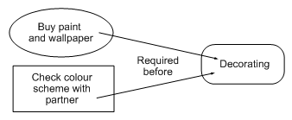

Graphical Representation
Humans draw diagrams all the time, e.g.
  Causal relationships
  And relationships between ideas

Slide 56
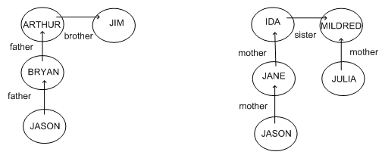
Graphical Representation
Graphs easy to store in a computer
To be of any use must impose a formalism
  Jason is 15, Bryan is 40, Arthur is 70, Jim is 74
  How old is Julia?

Slide 57
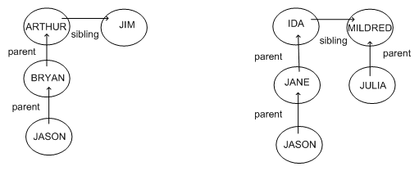
Semantic Networks
Because the syntax is the same
  We can guess that Julia’s age is similar to Bryan’s
Formalism imposes restricted syntax

Slide 58
Semantic Networks
Graphical representation (a graph)
  Links indicate subset, member, relation, ...
Equivalent to logical statements (usually FOL)
  Easier to understand than FOL?
  Specialised SN reasoning algorithms can be faster
Example: natural language understanding
  Sentences with same meaning have same graphs
  e.g. Conceptual Dependency Theory (Schank)

Slide 59
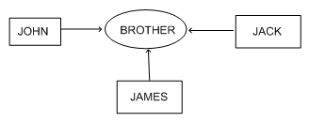
Conceptual Graphs
Semantic network where each graph represents a single proposition
Concept nodes can be
  Concrete (visualisable) such as restaurant, my dog Spot
  Abstract (not easily visualisable) such as anger
Edges do not have labels
  Instead, conceptual relation nodes
  Easy to represent relations between multiple objects

Slide 60
Frame Representations
Semantic networks where nodes have structure
  Frame with a number of slots (age, height, ...)
  Each slot stores specific item of information
When agent faces a new situation
  Slots can be filled in (value may be another frame)
  Filling in may trigger actions
  May trigger retrieval of other frames
Inheritance of properties between frames
  Very similar to objects in OOP

Slide 61
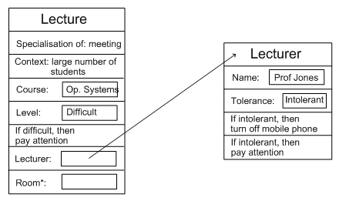
Example: Frame Representation

Slide 62
Flexibility in Frames
Slots in a frame can contain
  Information for choosing a frame in a situation
  Relationships between this and other frames
  Procedures to carry out after various slots filled
  Default information to use where input is missing
  Blank slots: left blank unless required for a task
  Other frames, which gives a hierarchy
Can also be expressed in first order logic

