Slide 1
PROJECT TITLE
FARMER GOVERNMENT AIDED SCHEMES
BY
Name: Gowri R
UNID: UMID02122572656

Slide 2
Contents Outline
Abstract
Introduction
Proposed Methodology
Flow Diagram
Software Tools Used
Expected Output
Conclusion

Slide 3
Abstract
This project focuses on the design and development of a real-time web-based chat application using HTML, CSS, and JavaScript. The primary objective is to provide users with a smooth and interactive communication platform where they can join chat rooms and exchange messages instantly. The application implements WebSocket technology to enable real-time message delivery without page refreshes. Users are required to authenticate themselves by selecting a unique username before entering a chat room, ensuring secure and identifiable communication. The system allows users to create new chat rooms or join existing ones dynamically. Each chat room displays messages with sender identification and timestamps to maintain clarity and context. Basic text formatting features such as bold, italics, and clickable links enhance message readability. The user interface is designed to be intuitive, visually appealing, and responsive across various screen sizes. Additional features like automatic message scrolling and new message notifications improve user experience. The application also handles edge cases such as empty messages, invalid usernames, and user disconnections. Security and data validation measures are applied to prevent impersonation and misuse.

Slide 4
Introduction
Real-time communication has become an essential feature of modern web applications, enabling users to interact instantly across different locations. Chat applications play a significant role in social networking, online collaboration, and customer support systems by providing fast and efficient message exchange. With the growth of web technologies, real-time chat platforms can now be developed using standard front-end tools such as HTML, CSS, and JavaScript. This project aims to design and develop a web-based real-time chat application that allows users to communicate within multiple chat rooms seamlessly. The system uses WebSocket technology to ensure instant message delivery without the need for page refreshes. Users must authenticate themselves by choosing a unique username before joining a chat room, which helps maintain secure and identifiable communication. The application supports features such as message timestamps, sender identification, and basic text formatting to enhance usability. A responsive and user-friendly interface ensures smooth interaction across various devices. The system also manages chat room creation, user joining, and disconnection handling effectively.

Slide 5
Proposed Method
The proposed system follows a modular and client-server based architecture to implement a real-time chat application. Initially, the user accesses the web application through a browser and is prompted to enter a unique username for authentication. The system validates the username to prevent duplication and impersonation before allowing the user to proceed. Once authenticated, the user can view a list of available chat rooms or create a new room as required. When a user joins a chat room, a WebSocket connection is established between the client and the server to enable real-time communication. Messages typed by the user are validated to avoid empty or malicious inputs and then transmitted instantly to all connected users within the same room. Each message is displayed along with the sender’s username and timestamp to maintain message clarity. Basic text formatting features are applied using client-side scripting for enhanced readability. The system automatically handles scrolling to display new messages and notifies users of new activity. User join and disconnect events are monitored to update room participants dynamically. Security measures such as input sanitization and session handling are implemented to protect user data.

Slide 6
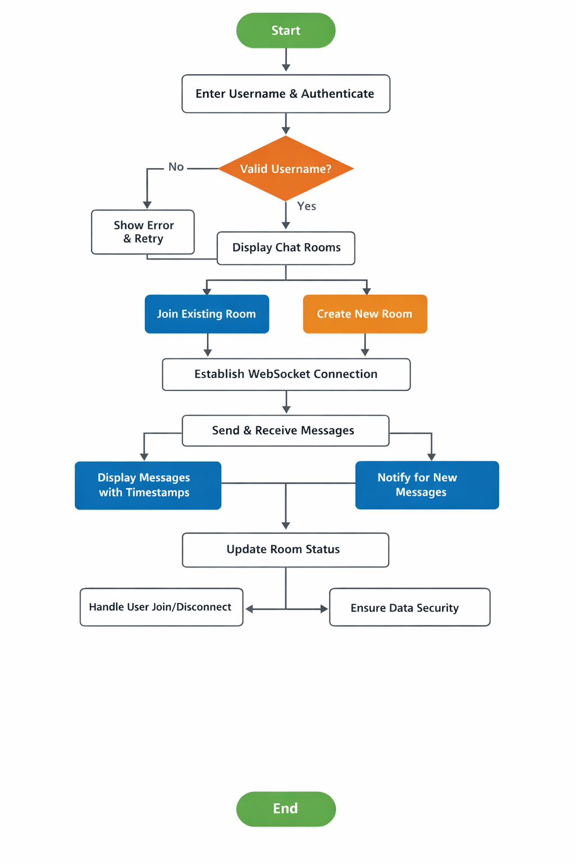
Flow Diagram

Slide 7
Tools Used
Software Tools
Programming Languages:
HTML, CSS, JavaScript
Backend & Database:
Firebase Authentication, Firebase Firestore
Development Tools:
Visual Studio Code, Web Browser (Chrome/Firefox)
Version Control:
GitHub
Operating System:
Windows / Linux
Hardware Tools
Processor: AMD Ryzen 5
RAM: 8GB
Storage: 477GB

Slide 8
Expected Output
The expected output of the real-time chat application is a fully functional web-based platform that allows users to communicate instantly within chat rooms. When the application is launched, users will be prompted to enter a unique username before accessing the chat interface. After successful authentication, users can view a list of available chat rooms and create new rooms if required. Upon joining a chat room, users will be able to send and receive text messages in real time without refreshing the page. Each message will be displayed with the sender’s username and timestamp for better clarity. The chat interface will automatically scroll to show the latest messages. Basic text formatting such as bold, italics, and clickable links will be supported within messages. Notifications will appear when new users join or leave a chat room. The system will prevent empty messages and duplicate usernames. The user interface will be responsive and visually appealing across different devices.

Slide 9
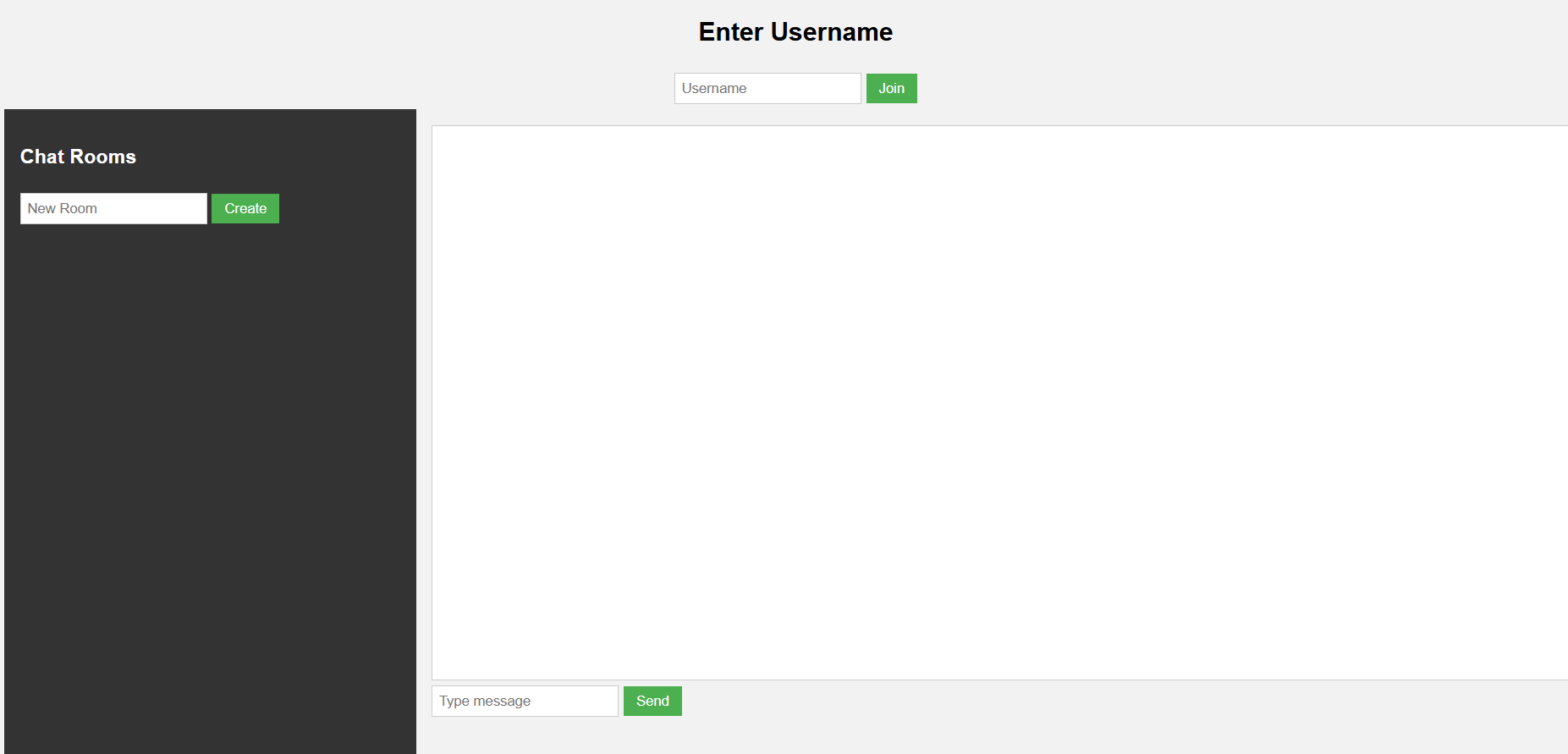
Output Screenshots

Slide 10
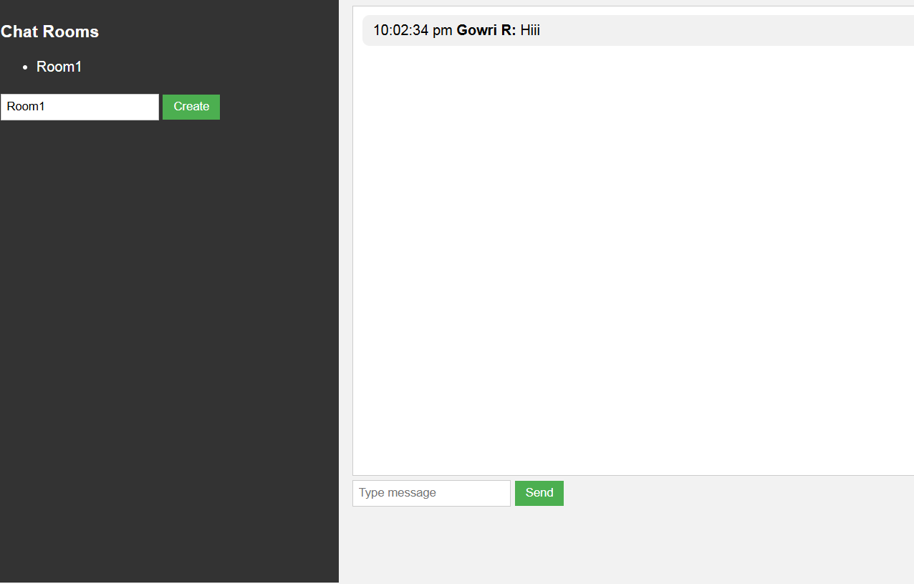
Output Screenshot

Slide 11
Conclusion
The real-time chat application successfully demonstrates the implementation of instant communication using modern web technologies. By integrating HTML, CSS, and JavaScript with WebSocket communication, the system enables users to exchange messages without page refreshes. The application provides secure user authentication by enforcing unique usernames, preventing impersonation. Features such as chat room creation, room selection, and real-time message updates enhance user interaction. Message timestamps and sender identification improve clarity and communication transparency. Basic text formatting options increase message readability and usability. The responsive and intuitive user interface ensures accessibility across different devices and screen sizes. The system efficiently handles user joining and disconnection events. Edge cases like empty messages and invalid inputs are managed effectively. Security and data validation measures help protect user information.

Slide 12
THANK YOU

