Slide 1
PROJECT TITLE
WHEATHER APP
BY
Name: Gowri R
UNID: UMID02122572656

Slide 2
Contents Outline
Abstract
Introduction
Proposed Methodology
Flow Diagram
Software Tools Used
Expected Output
Conclusion

Slide 3
Abstract
This project focuses on the development of a web-based Weather Application that provides real-time weather information for user-specified locations. The application allows users to enter the name of a city or place and retrieve current weather conditions instantly. It fetches live data from a public weather API, ensuring accuracy and reliability of information. The system displays essential weather details such as temperature in Celsius, weather description, and a visual weather icon. HTML is used to structure the application interface, while CSS enhances visual appeal and responsiveness across devices. JavaScript handles user interactions, API communication, and dynamic content updates. The application follows an asynchronous programming approach to ensure smooth data fetching without page reloads. Error handling mechanisms are implemented to manage invalid location inputs and API failures gracefully. User-friendly messages guide users whenever incorrect data is entered. The design prioritizes simplicity, readability, and ease of use. Responsive design techniques ensure compatibility with mobile, tablet, and desktop screens. The project demonstrates effective integration of front-end technologies with external APIs. It enhances practical understanding of web development concepts. The application is scalable and can be extended with additional features like forecasts or unit conversion.

Slide 4
Introduction
Weather information is an essential part of everyday decision-making, influencing activities such as travel, agriculture, outdoor events, and daily planning. With the advancement of web technologies, accessing real-time weather data has become faster and more convenient. A web-based weather application provides users with instant and accurate information without depending on traditional media sources. This project aims to design and develop a user-friendly weather application that allows users to check current weather conditions for any location. The system enables users to enter a city name and retrieve live weather details instantly. The application is built using HTML for structure, CSS for styling, and JavaScript for functionality and interactivity. A public weather API is integrated to fetch real-time data efficiently. The app displays key weather information such as temperature in Celsius, weather description, and visual weather icons. Asynchronous programming techniques are used to ensure smooth data retrieval without page refresh. The interface is designed to be visually appealing and easy to navigate. Responsive design principles are applied to support different screen sizes and devices. Proper error handling is implemented to manage invalid inputs and API failures. Informative messages guide users when incorrect data is entered. The project enhances understanding of API integration and front-end development. It demonstrates real-world use of JavaScript in dynamic web applications. The application is scalable and can be enhanced with additional features. Overall, the project delivers an efficient and interactive weather information system.

Slide 5
Proposed Method
The proposed methodology outlines the systematic approach used to design and develop the web-based weather application. Initially, the requirements of the system are analyzed to identify essential features such as user input, weather data display, and error handling. The application structure is created using HTML to define input fields, buttons, and display sections. CSS is then applied to enhance the visual layout, responsiveness, and overall user experience. JavaScript is used to handle user interactions and application logic. When a user enters a city name and clicks the submit button, an event listener triggers the weather data retrieval process. The application sends an asynchronous request to a public weather API using the Fetch API or async/await. The API response is processed and relevant data such as temperature, weather description, and icons are extracted. The extracted information is dynamically displayed on the user interface. Error handling mechanisms are implemented to detect invalid city names or network issues. Appropriate error messages are shown to guide the user. Responsive design techniques ensure compatibility across devices. Input validation improves reliability and usability. Testing is performed to verify accuracy and functionality. The system is optimized for performance and clarity. This methodology ensures a reliable, efficient, and user-friendly weather application.

Slide 6
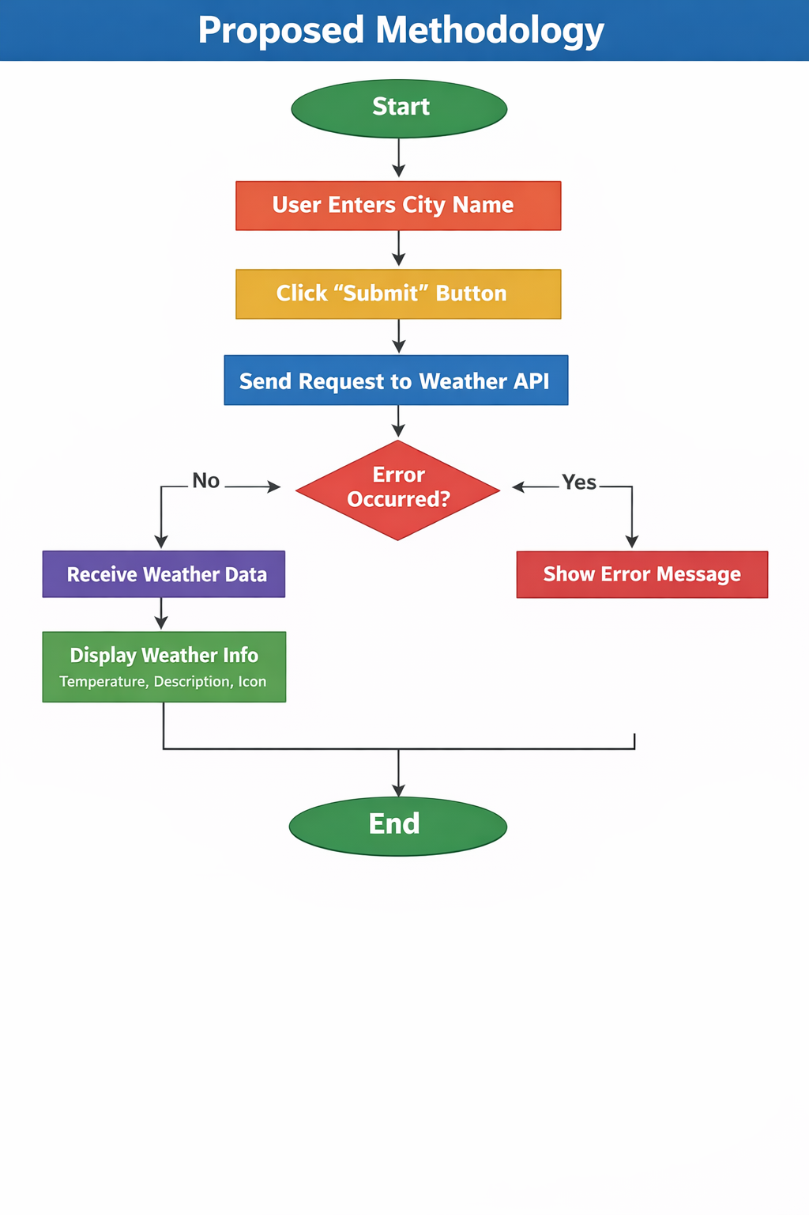
Flow Diagram

Slide 7
Tools Used
Software Tools
Programming Languages:
HTML, CSS, JavaScript
Backend & Database:
Firebase Authentication, Firebase Firestore
Development Tools:
Visual Studio Code, Web Browser (Chrome/Firefox)
Version Control:
GitHub
Operating System:
Windows / Linux
Hardware Tools
Processor: AMD Ryzen 5
RAM: 8GB
Storage: 477GB

Slide 8
Expected Output
The expected output of the weather application is a responsive and user-friendly web interface that displays real-time weather information based on user input. When the user enters a valid city name and clicks the submit button, the application successfully retrieves weather data from the public weather API. The system displays the current temperature in Celsius along with a clear weather description. A corresponding weather icon is shown to visually represent the current weather condition. The application updates the results dynamically without reloading the page. If an invalid location is entered, an appropriate error message is displayed. Network or API-related issues are handled gracefully with informative alerts. The interface remains clean and easy to understand. The application adapts smoothly to different screen sizes and devices. Loading delays are minimal due to asynchronous data handling. The displayed data is accurate and up to date. User interaction is smooth and intuitive.

Slide 9
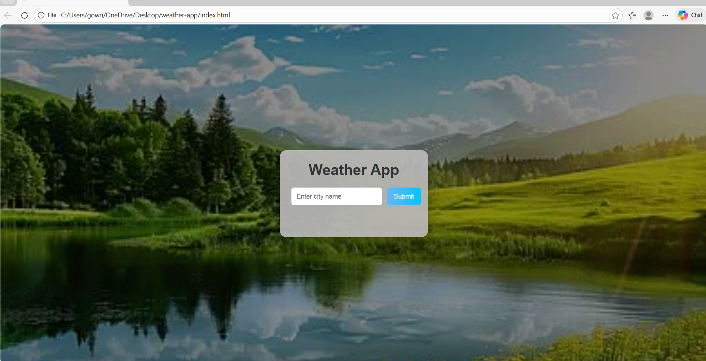
Output Screenshots

Slide 10
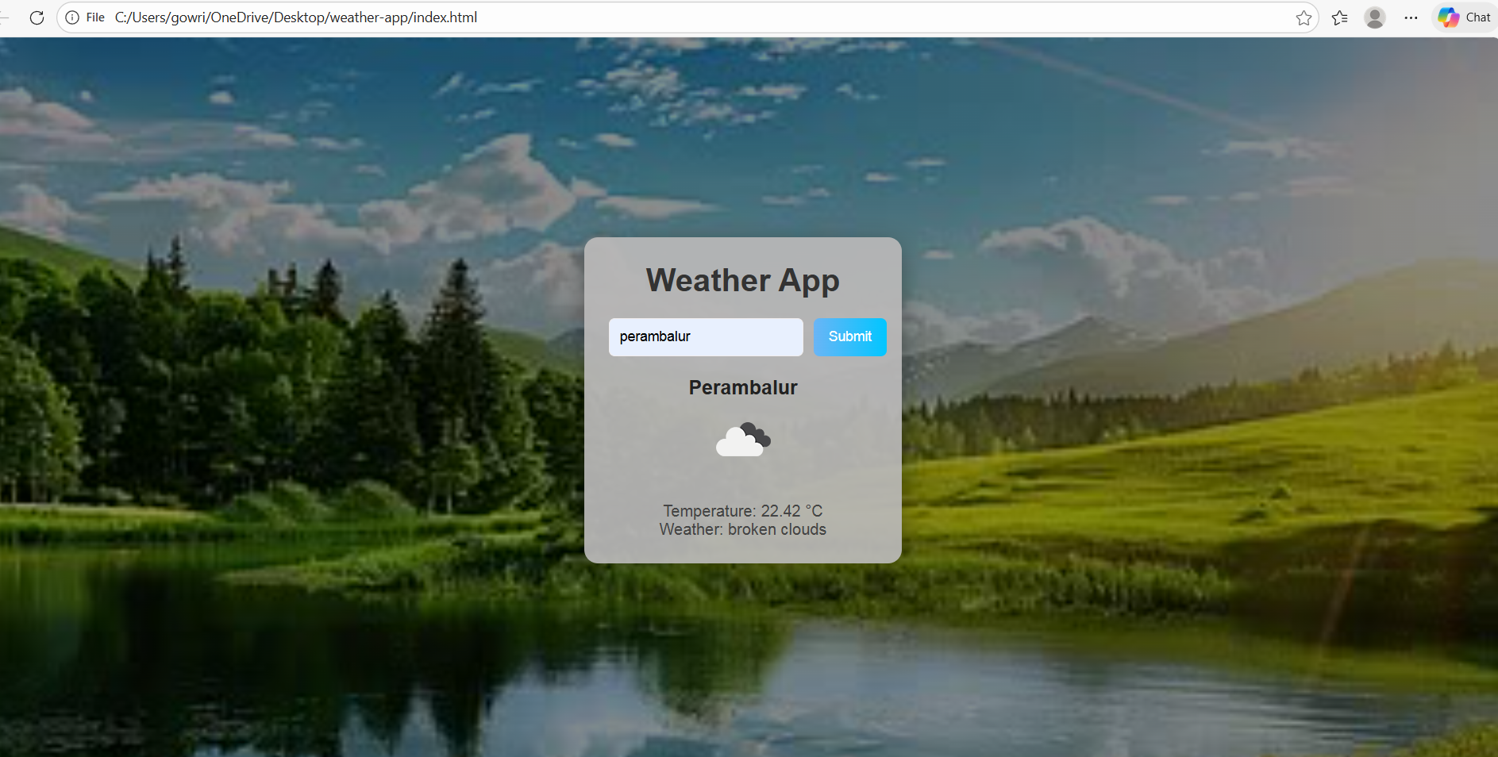
Output Screenshot

Slide 11
Conclusion
The weather application project successfully demonstrates the development of a real-time web-based system using modern front-end technologies. By integrating HTML, CSS, and JavaScript, the application provides a smooth and interactive user experience. The use of a public weather API ensures accurate and up-to-date weather information for user-specified locations. The application effectively displays temperature, weather conditions, and visual icons in a clear format. Error handling mechanisms improve reliability by managing invalid inputs and network issues gracefully. Responsive design techniques allow the application to function efficiently across different devices and screen sizes. Asynchronous data fetching enhances performance and reduces loading time. The project strengthens practical knowledge of API integration and client-side scripting. It follows clean coding practices and structured design principles. The application is easy to use and visually appealing. It meets all specified project requirements successfully. The system is scalable and can be enhanced with additional features.

Slide 12
THANK YOU

