Slide 1

CREDIT SCORING
Gowri ABINESH

Slide 2
Background
  In today’s dynamic financial environment, accurately assessing creditworthiness is more critical than ever. Traditional credit evaluation methods often fall short in predicting default risk effectively.
  This project aims to strengthen credit scoring practices by analyzing demographic, financial and behavioral data to uncover key risk indicators. By integrating machine learning with statistical modeling, it explores innovative ways to build data-driven scorecards that better identify default risks.
  Additionally, customer feedback from Net Promoter Score (NPS) surveys is analyzed to understand customer sentiments and identify areas for service improvement around the loan and credit process.

Slide 3
Project Objectives
Analyze defaulters and associated factors
Develop a credit scorecard using Binary logistic regression
Compare model performance with ML methods
Analyze customer feedback using text mining

Slide 4
Data Source
This analysis is based on four datasets:
Customer Credit Details
Customer Info
Customer Profile
Customer feedback in text format

Slide 5
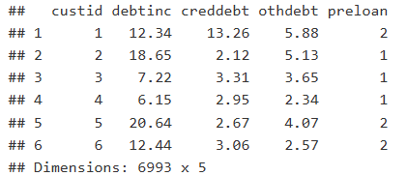
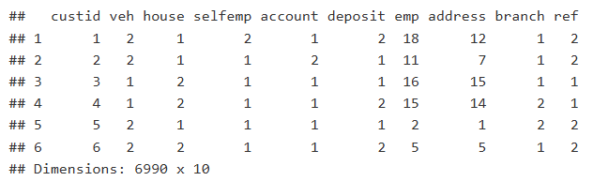
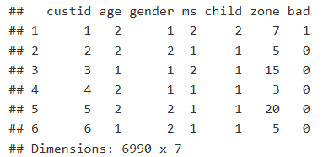
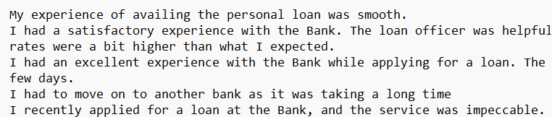
Data Snapshots
Customer Credit Details
Customer Info
Customer Profile
Customer feedback in text format

Slide 6
Project Phases Overview
Phase 1
Data Management
Phase 2
Exploratory Data Analysis (EDA)
Phase 3
Binary Logistic Regression Modeling
Phase 4
Machine Learning Comparison
Phase 5
Text Mining Analysis

Slide 7
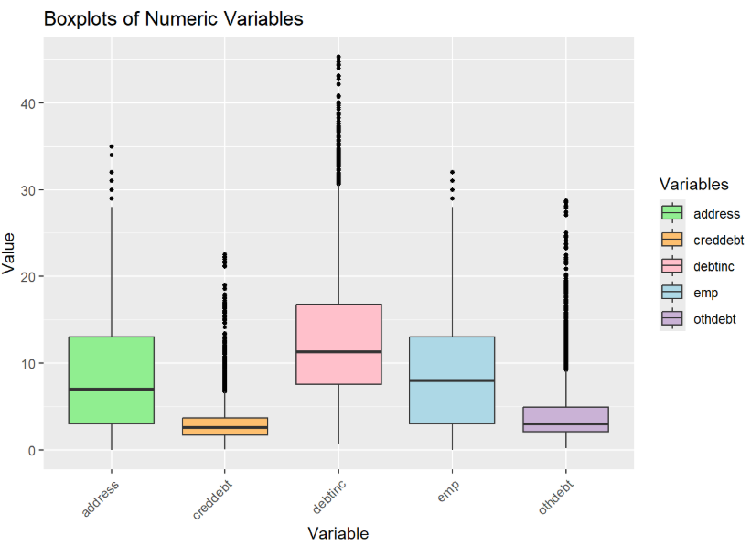
Phase 1 - Data Management
1. Imported and merged structured datasets into master data
2. Cleaned missing values and duplicates
3. Recoded numerical variables into categories
4. Calculated overall Bad Rate
The cleaned dataset revealed notable outliers in debt-related variables and an overall defaulter rate of 13.2%, providing the preliminary understanding of default risk.

Slide 8
Phase 2 - Exploratory Data Analysis
4. Highlighted regional and gender-based risks
5. Mapped employment and debt categories against bad rate
3. Compared average behaviors of numeric variables
2. Identified bad rates across categorical groups
1. Analyzed distribution of numeric variables by default status
6. Explored how age and credit card debt relate to risk
Box plot
Grouped Bar chart
Radial Bar chart
Heatmap
Bubble Matrix
Ridgeline Plot

Slide 9
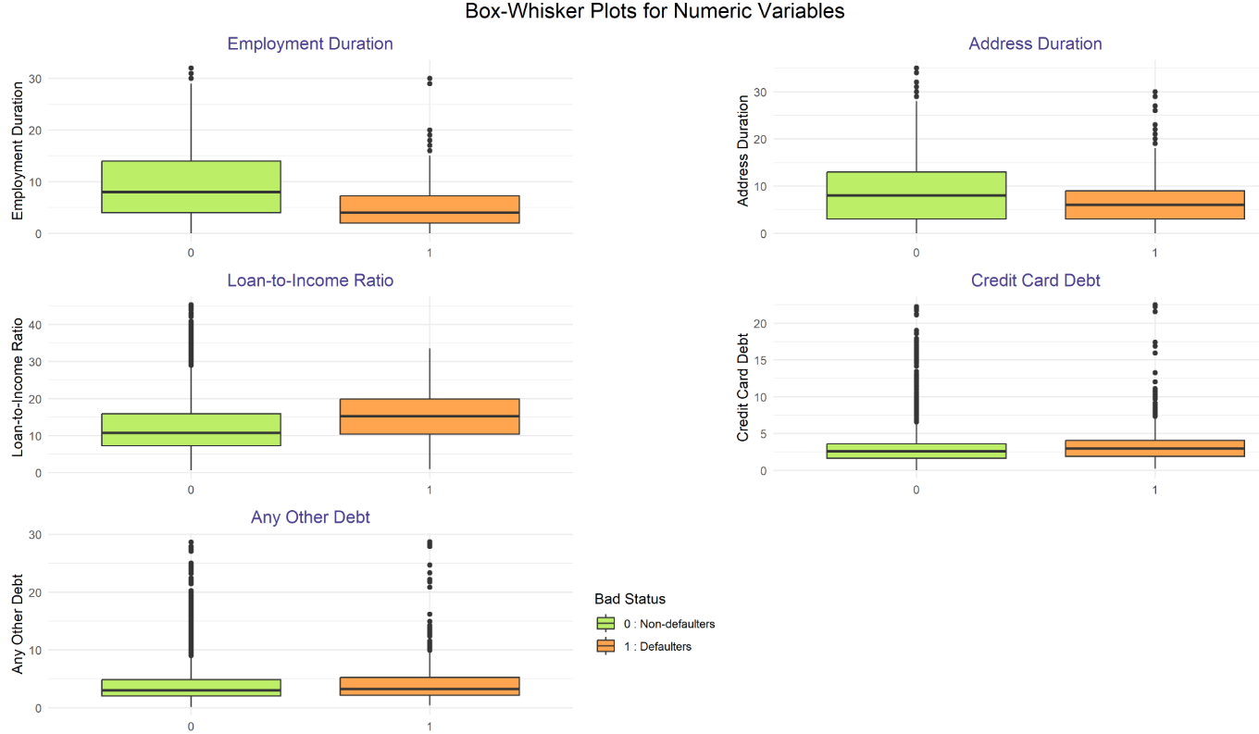
1. Distribution of Numeric Risk Indicators
Defaulters tend to have shorter employment and address histories and carried slightly higher levels of debt and loan-to-income ratios, compared to non-defaulters.

Slide 10
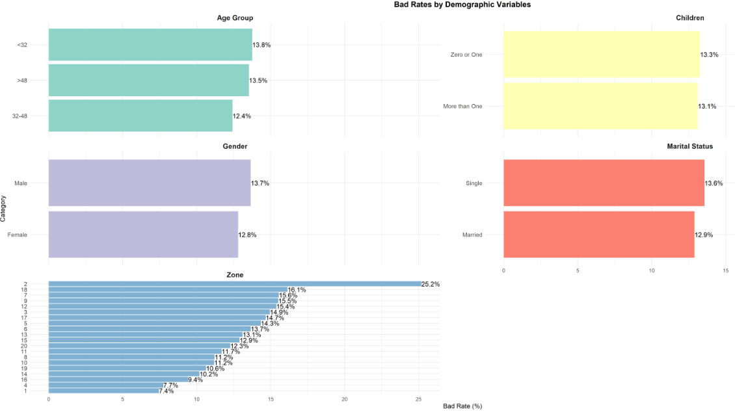
2. Bad Rates Across Demographic Segments
Slightly higher default rates were observed among younger individuals, males, singles and certain zones, suggesting subtle demographic influences on credit risk.

Slide 11
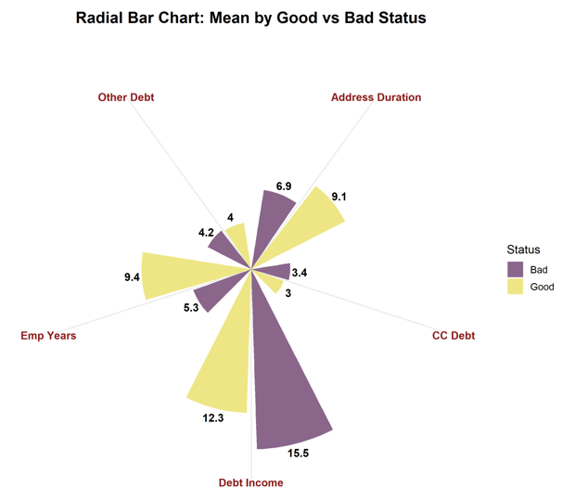
3. Mean Comparison: Good vs Bad Customers
Radial bar chart shows that the defaulters have noticeably higher average values in debt related variables and shorter durations in employment and address history.

Slide 12
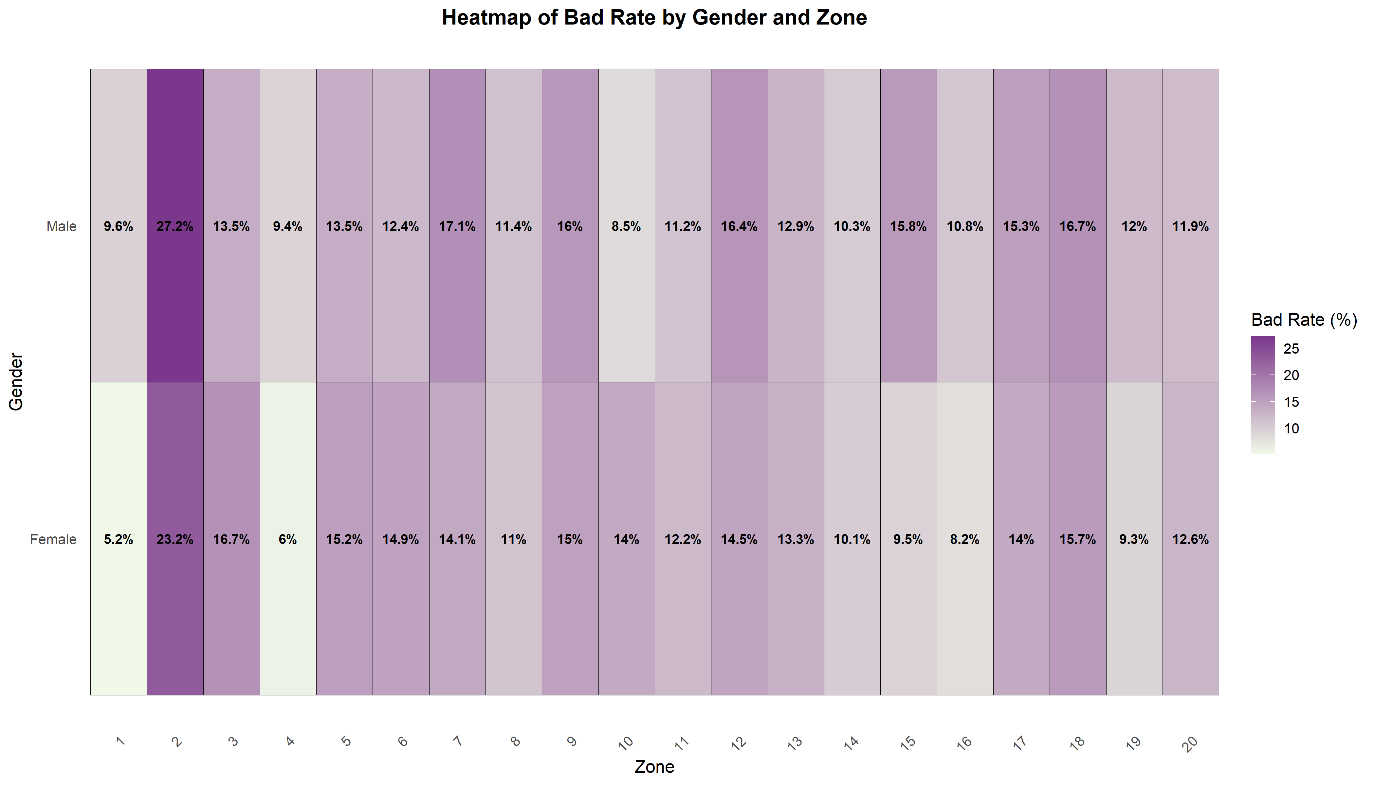
4. Risk Variation by Gender and Zone
Gender-Zone heatmap revealed concentrated default risk among males in certain zones, particularly in Zone 2 and Zone 7.

Slide 13
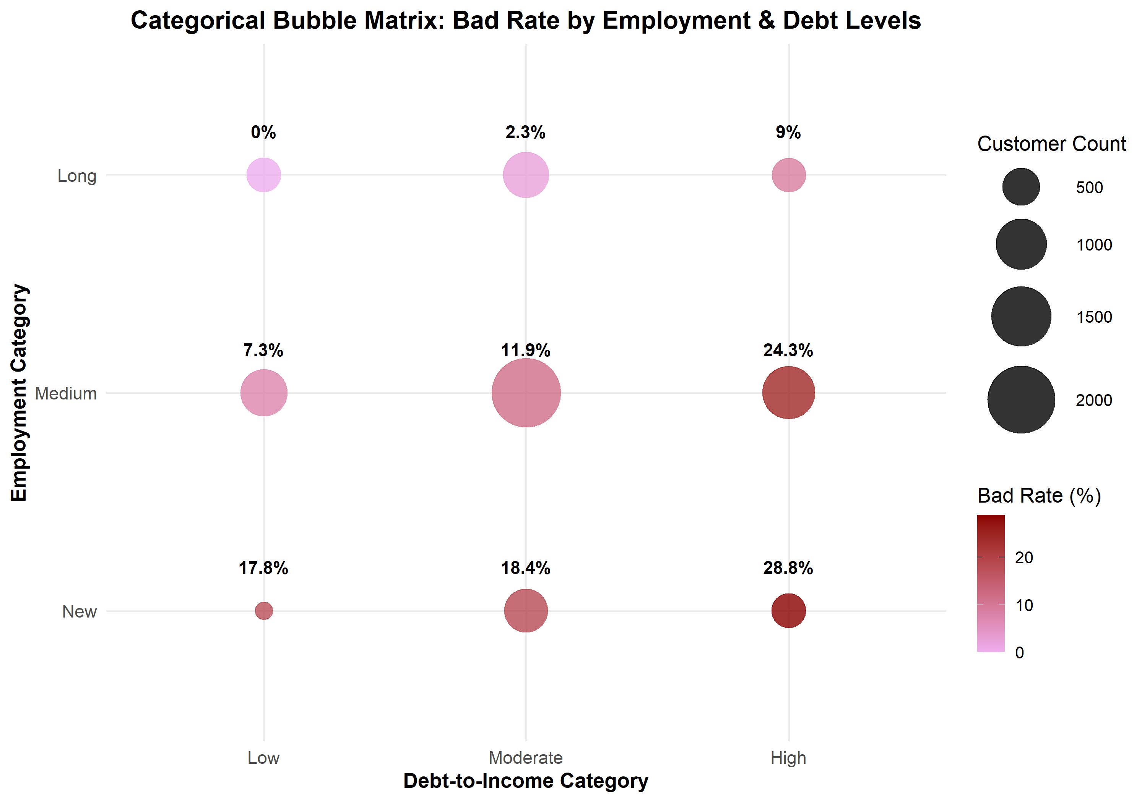
5. Risk Profile by Employment Category & Debt Level
From the Categorical Bubble Matrix, default rates are highest among newly employed individuals with high debt-to-income ratios.

Slide 14
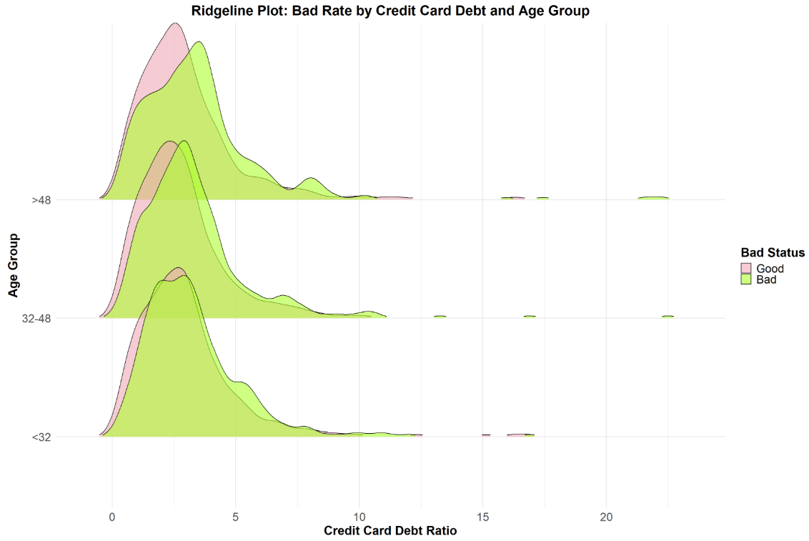
6. Age wise Credit Card Debt Risk Patterns
The Ridgeline Plot reveals that younger age group has a wider spread of credit card debt among defaulters.

Slide 15
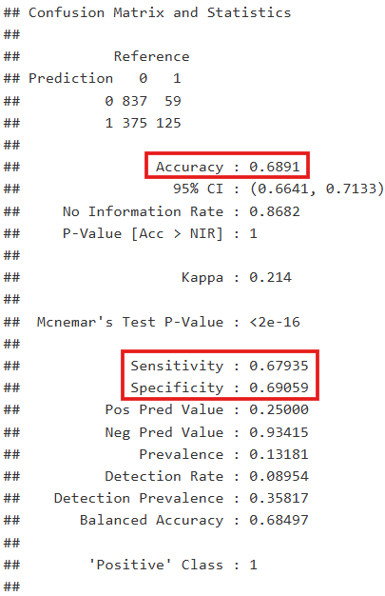
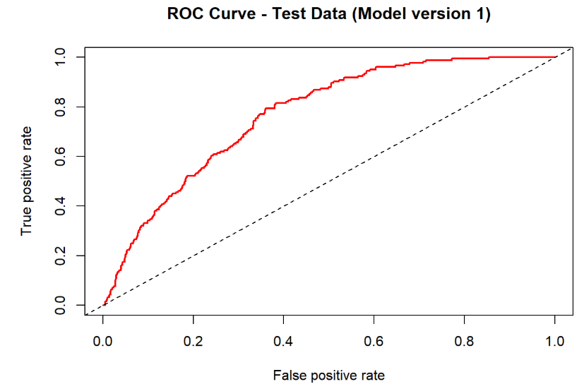
Phase 3 - Binary Logistic Regression Model
Confusion matrix
Model 1 Performance - Numeric Variables
Used original numeric variables to build the binary logistic regression model.
The ROC curve of model 1 test data indicated reliable separation between defaulters and non-defaulters.
Model Version 1 achieved a test AUC of 0.77, showing strong discriminatory power.
At the optimal threshold of 0.147, the confusion matrix showed strong balance between true positive and true negative rates.

Slide 16
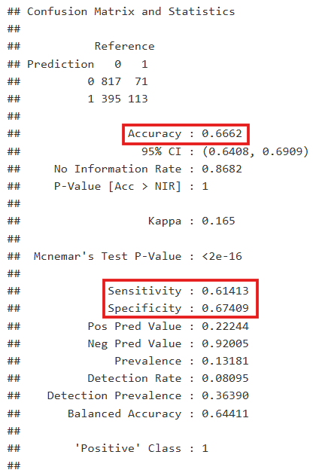
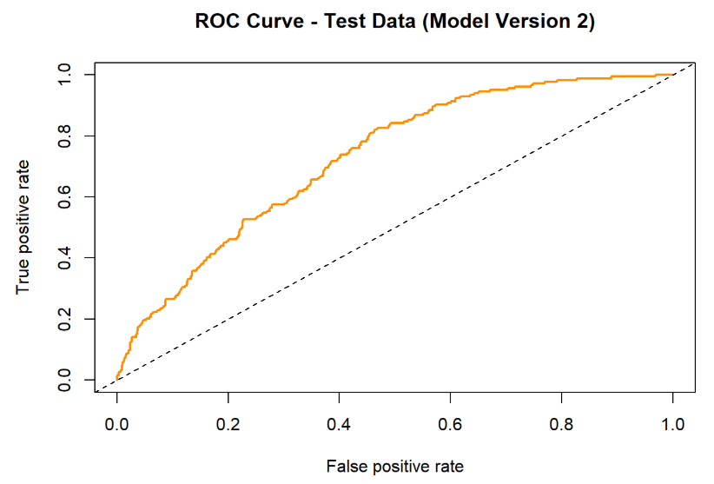
Model 2 Performance - Categorical Variables
Confusion matrix
Used recoded categorical versions of the same variables for comparison.
The ROC curve of model 2 test data showed moderate class separation.
Model Version 2 recorded a test AUC of 0.7281, indicating slightly lower performance compared to model 1.
Using the optimal threshold of 0.139, the test confusion matrix showed reasonable classification balance.

Slide 17
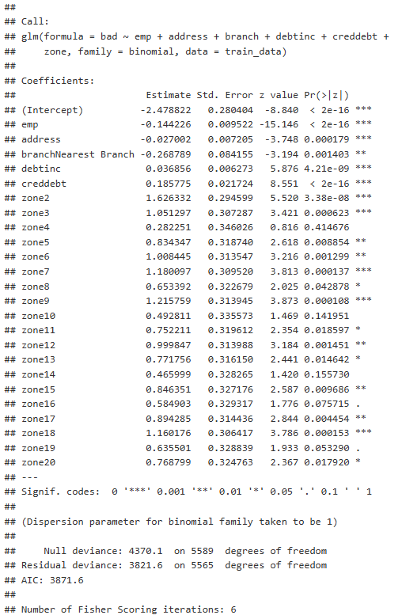
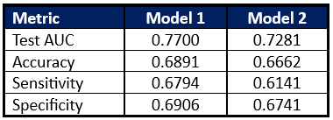
Model Summary
Comparison with EDA Findings
High bad rate zones and high debt ratios observed in EDA were confirmed as significant predictors in modeling.
Variables like age, gender and house ownership had minor differences in EDA but were not statistically significant in the model.
Insights from Logistic Regression Modeling
Two logistic regression models were built and evaluated using test data, with Model 1 (numeric predictors) outperforming Model 2 (categorical predictors) in terms of AUC and classification accuracy.
ROC curves and confusion matrices confirmed that Model version 1 provides better separation and balance at the optimal threshold, indicating its potential as a baseline for comparison with machine learning models.

Slide 18
Phase 4 - Machine Learning Models
Built four machine learning models to improve prediction accuracy of loan defaults.
Models Applied:
- Naive Bayes
- Support Vector Machine (SVM)
- Decision Tree
- Random Forest
Goal: Compare ML models with logistic regression from Phase 3.
Evaluated using ROC curve, AUC values and Confusion Matrices on train and test data.

Slide 19
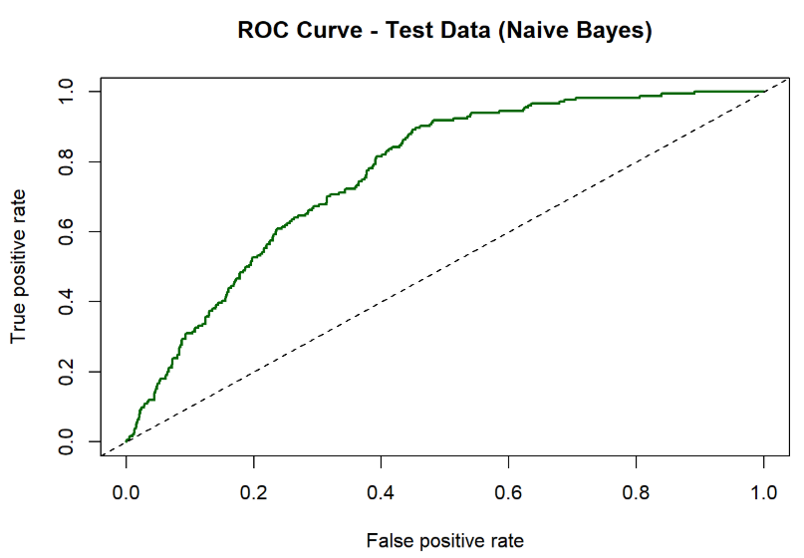
1. Naive Bayes
A simple model that uses probabilities assuming features are unrelated.
Test AUC: 0.7665
Accuracy: 0.8596
High specificity 98.02%, but low sensitivity 6.52%

Slide 20
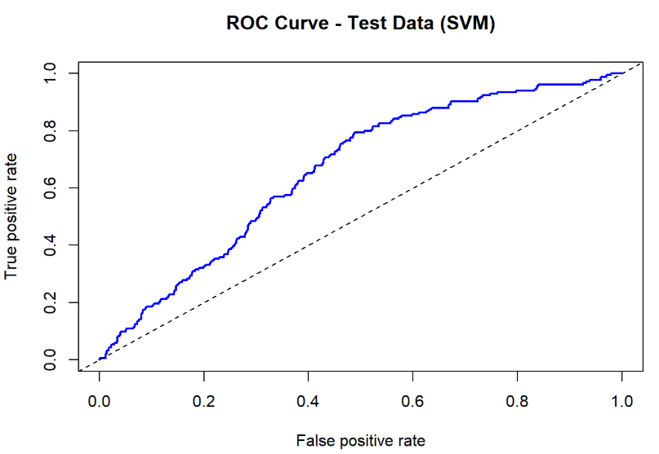
2. Support Vector Machine (SVM)
A linear SVM model was applied to separate defaulters and non-defaulters.
Test AUC: 0.662
Accuracy: 0.8682
Perfect specificity (100%) but no ability to detect actual defaulters (0% sensitivity)

Slide 21
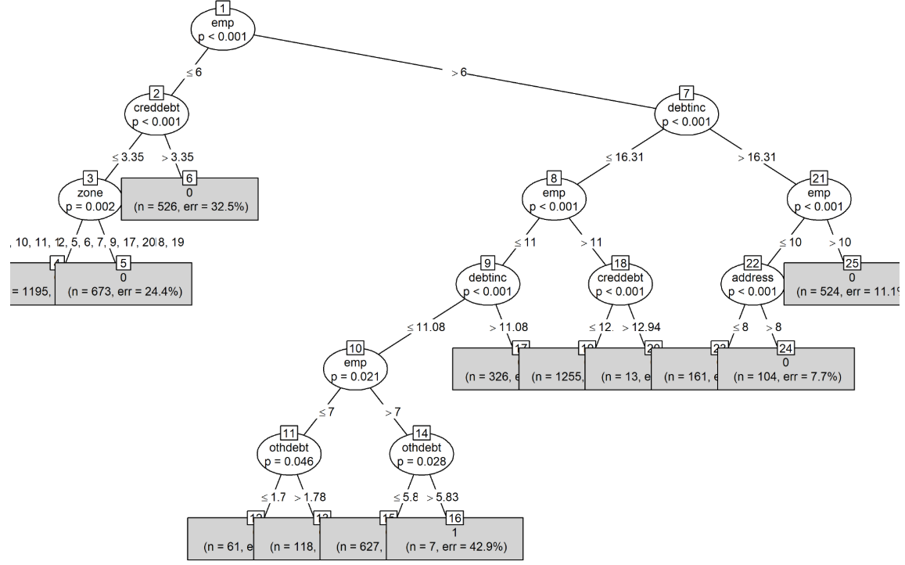
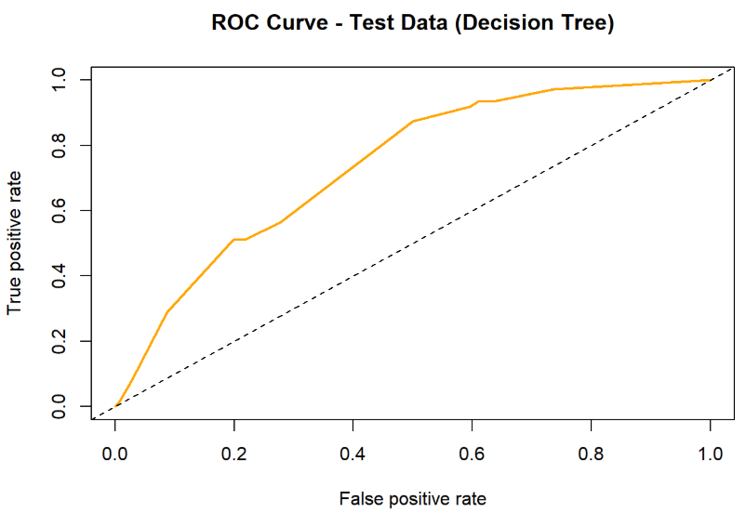
3. Decision Tree
Easy to interpret with clear decision rules.
Captured important patterns like debt ratio and zones.
Test AUC: 0.7381
Accuracy: 0.8646
High specificity (99.42%) but extremely low sensitivity (1.09%)

Slide 22
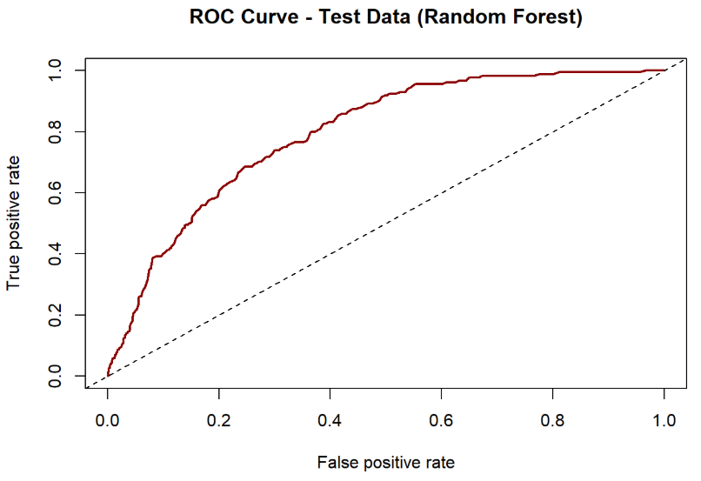
4. Random Forest
Combines multiple decision trees to improve accuracy and reduce overfitting.
Test AUC: 0.7953
Accuracy: 0.8689
High specificity (99.59%), but low sensitivity (3.26%)

Slide 23
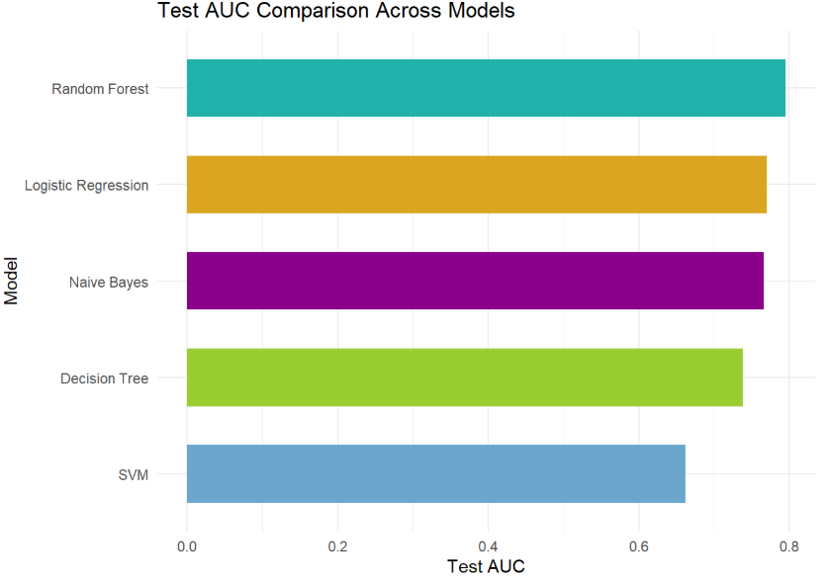
Model Comparison & Decision
Random Forest outperformed all other models in overall predictive performance.
Achieved the highest test AUC of 0.7953 among all models.
Final model selected: Random Forest, based on highest AUC score on test data.

Slide 24

Phase 5 - Customer Feedback Analysis
Analyzed customer feedback data from NPS survey responses.
Text was cleaned by removing punctuation, numbers, stop words and irrelevant terms.
Created a word cloud to visualize frequently mentioned words.
Common themes included service quality, speed, staff support and loan process clarity.

Slide 25
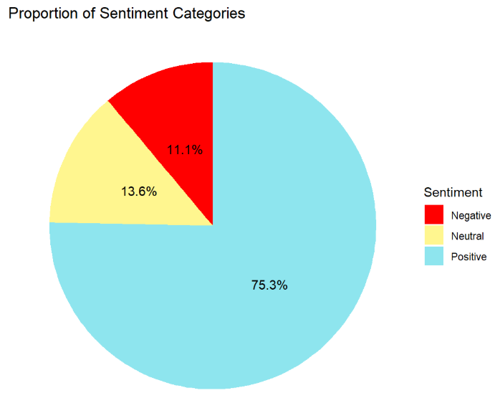
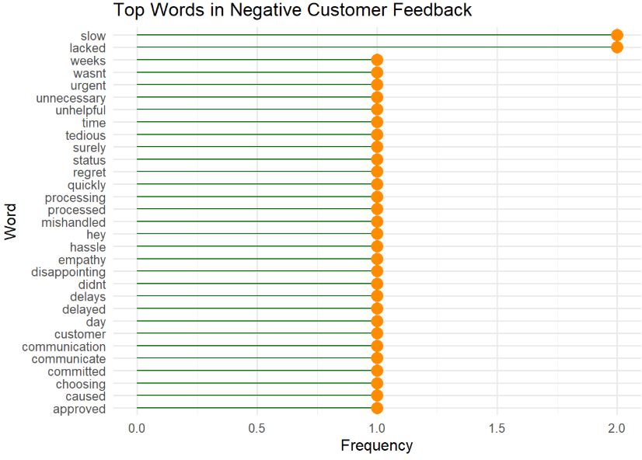
Sentiment Analysis & Insights
Sentiment scores were calculated using sentence-level analysis and averaged per feedback entry.
Feedback classified into Positive, Neutral and Negative categories.
Majority of the responses were positive, showing overall satisfaction.
Negative sentiments pointed to delays and lack of proactive support.
These insights help highlight areas for improving customer experience.

Slide 26
Summary
Explored credit risk patterns using customer demographic, financial and behavioral data to understand critical factors of loan default.
Performed in depth EDA using bad rate tables, boxplots and heat maps to identify high-risk customer segments.
Built predictive models using binary logistic regression and four machine learning techniques. Random Forest achieved the best test AUC.
Validated findings by comparing model outcomes with EDA insights, ensuring consistency and meaningful interpretations.
Analyzed customer feedback using sentiment analysis, revealing mostly positive perceptions, with key improvement areas identified.

Slide 27

Thank you!

