Slide 1
DETECTING ANOMALIES IN CREDIT CARD TRANSACTIONS
Fall 2018 - Predictive Analytics

Slide 2
PROJECT DESCRIPTION
Credit cards are used by many customers of various financial institutions to perform various online, ATM transactions.
These transactions can sometimes be fraudulent done by people who aim to gain monetary benefit without authorization.
This leads to financial losses for the banks and creates a sense of mistrust between the bank and customer and could be a major source for banks losing their customers and trust.
Hence, it becomes necessary for financial institutions to identify and hold such transactions accountable for security purposes.

Slide 3
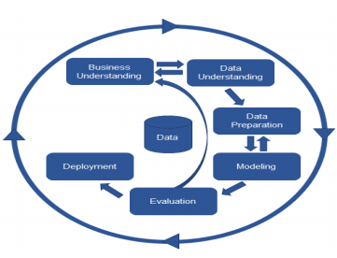
PROJECT WORKFLOW – CRISP DM
Business Understanding: Build a model using the credit card transactional data that can help a financial institution predict fraudulent transactions.
Data Understanding: 492 fake credit card transactions out 284,807 transactions so need to perform Data balancing.
Data Preparation: Data is cleaned, processed and prepared using ETL and EDA.
Modelling: Feature selection and iterating over models to select machine learning algorithms that are a good fit to give a predictive power.
Model evaluation: Select which model suits the business requirement the best using various mathematical measures like Accuracy, AUC etc.
Model deployment : Deployed in the Anaconda Ipython Notebook
https://en.wikipedia.org/wiki/Cross-industry_standard_process_for_data_mining

Slide 4
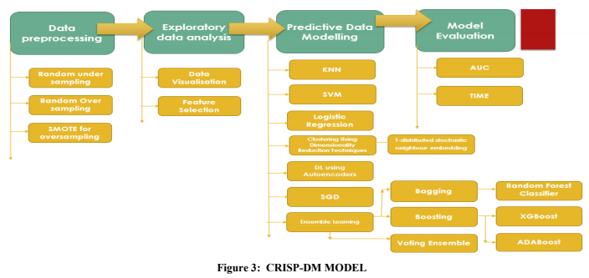
PROJECT WORKFLOW – CRISP DM

Slide 5
1.BUSINESS UNDERSTANDING
Analyzing the credit card transaction data can help banks find patterns that do not conform to normal transactional patterns.
Predictive modelling helps us build a statistical model made up of number of predictive variables that can help us predict whether the future transactions are fraud or not.
PROBLEM STATEMENT: This project thus proposes to build such a model using the credit card transactional data that can help a financial institution
identify 100% of fraudulent transactions or anomalous transactions using various data mining and machine learning techniques
minimise the incorrect number of fraud classifications.

Slide 6
2. DATA UNDERSTANDING
Dataset: https://www.kaggle.com/mlg-ulb/creditcardfraud
COLUMNS
Time - Number of seconds elapsed between this transaction and the first transaction in the dataset.
Amount - Transaction amount. (Not Transformed Data)
V1, V2, V3…V28 – PRINCIPAL COMPONENTS obtained through PCA (Renamed for security).
Class1 for fraudulent transactions, 0 otherwise
It’s a classification model.

Slide 7
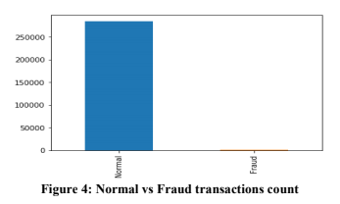
2. DATA UNDERSTANDING
A. DATA IMBALANCE
We can see that the dataset contains 31 columns and 284,407 rows out of which 492 transactions are only fraudulent which accounts for 0.172% and hence data imbalance.

Slide 8
2. DATA UNDERSTANDING
B. FEATURE SCALING
As the other columns are transformed into a standard normal form using PCA we need to transform the columns Time and Amount too into standard normal form.
Given the distribution of the data, each value in the dataset will have the sample mean value subtracted, and then divided by the standard deviation of the whole dataset so that all features are on the same scale.

Slide 9
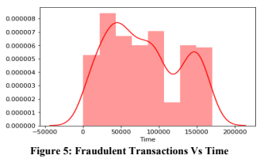
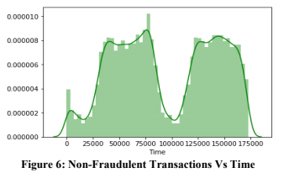
2. DATA UNDERSTANDING
C. EXPLORATORY DATA ANALYSIS
There are no null values in the dataset. So, there is no need to handle such missing values.
There are 284315 normal transactions and 492 fraudulent transactions.
Time is not a significant factor in distinguishing fraudulent from non-fraudulent (not significant at 1st glance).

Slide 10
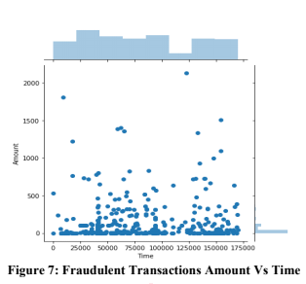
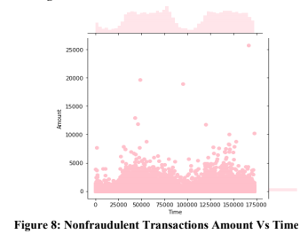
2. DATA UNDERSTANDING
C. EXPLORATORY DATA ANALYSIS
Amount is also not a significant factor in distinguishing fraudulent from non-fraudulent.

Slide 11
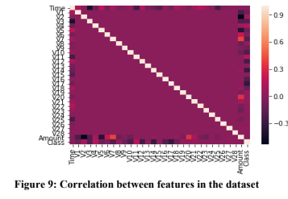
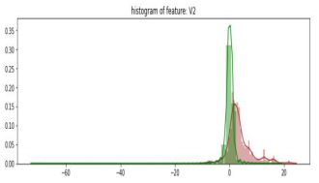
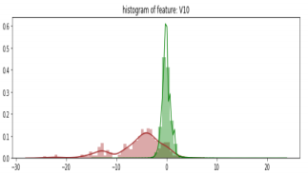
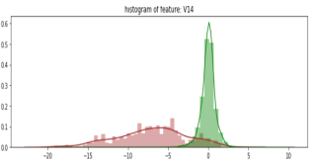
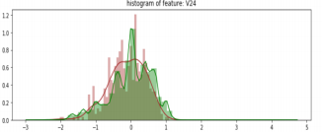
2. DATA UNDERSTANDING
Correlation Analysis
Heatmap that shows the correlation between the features in the dataset.
Feature wise correlation to find features distinguishing between fraudulent and non-fraudulent classes. V1-V7, V9, V10, V11, V12, V14, V16- V19 V21 are distinguishing.

Slide 12
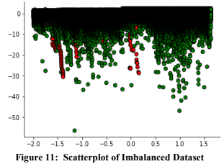
3. DATA PREPARATION
DATA BALANCING STRATEGIES
IMBALANCED DATASET
Imbalanced data needs to balanced as:
1. It causes overfitting of the data and assume the major class as the output for the testing set.
2. We can fail to understand the correlations between the features due to these anomalies as they are in insignificant amount compared to the major class.

Slide 13
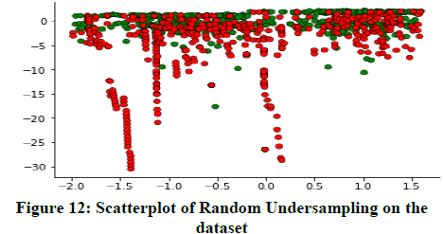
3. DATA PREPARATION
DATA BALANCING STRATEGIES
RANDOM UNDERSAMPLING
Sampling shifts the data around to increase the "numerical stability" of the resulting models.
Removes samples from the majority class to equal the minority class.
ADVANTAGES: Reduces Storage Space and Runtime.
DISADVANTAGES: Loss of Important Data.

Slide 14
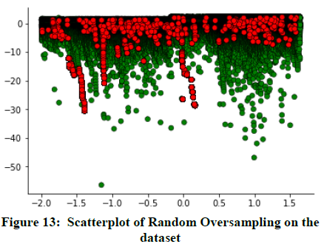
3. DATA PREPARATION
DATA BALANCING STRATEGIES
RANDOM OVERSAMPLING
It is a technique to add samples to the minority class to equal the majority class.
ADVANTAGES: Doesn’t lead to information loss and hence better than random Under sampling.
DISADVANTAGES: Can lead to overfitting as only minor class samples are replicated.

Slide 15
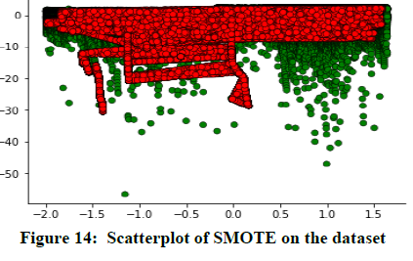
3. DATA PREPARATION
DATA BALANCING STRATEGIES
Random Oversampling using SMOTE (Synthetic Minority Over-sampling Technique):
Takes a subset of minority class and generates synthetic samples like them and added to the original dataset.
ADVANTAGES: Removes the issue of overfitting.

Slide 16
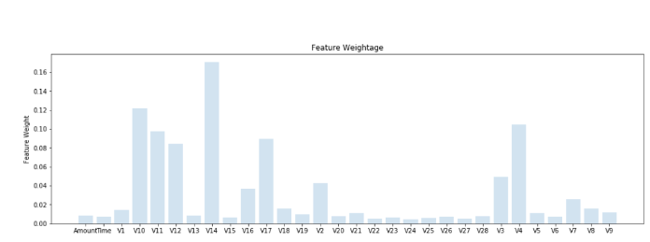
4. MODELLING
FEATURE SELECTION
Used Random Forest Classifier, to score the features according to certain weight to get the highly predictive features.
V10, V14, V4 have highest weightage.

Slide 17
4. PREDICTIVE MODELLING FOR CLASSIFICATION
Logistic Regression
Logistic regression models the probability of a class where these values must be transformed to 0 or 1 to make it a binary classifier.
K Nearest Neighbour
It uses the majority of the classes of K nearest neighbours as the output for the prediction.
Support Vector Machine
Ensures that examples of different classes can be separated by a hyperplane and are at the maximum distance and hence the predicted variables must be mapped accordingly.
Stochastic Gradient Descent (SGD CLASSIFIER)
Iterative optimizing technique used to minimize the objective function.
Samples are randomly selected and the gradient of the loss is estimated each time with a decreasing learning rate.

Slide 18
4. PREDICTIVE MODELLING FOR CLASSIFICATION
Clustering Using t-distributed Stochastic Neighbour Embedding
t-Distributed Stochastic Neighbor Embedding (t-SNE) is a (prize-winning) technique for dimensionality reduction that is particularly well suited for the visualization of high-dimensional datasets.
It models each high-dimensional object by a two- or three-dimensional point in a way that where dissimilar objects are modeled by distant points with high probability and similar objects are modeled by nearby points.
Is a dimensionality reduction algorithm that clusters fraud and non-fraud samples very clearly after performing dimensionality reduction.
Good indicator at the start to see if predictive models will be able to perform classification better or not as it clearly gives clear distinction between the clusters.

Slide 19

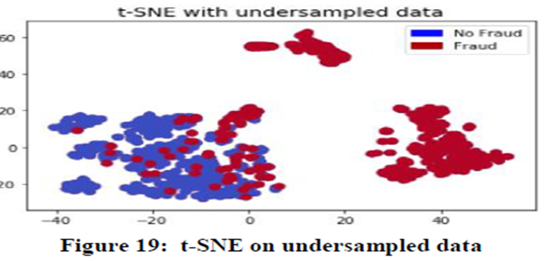

Slide 20
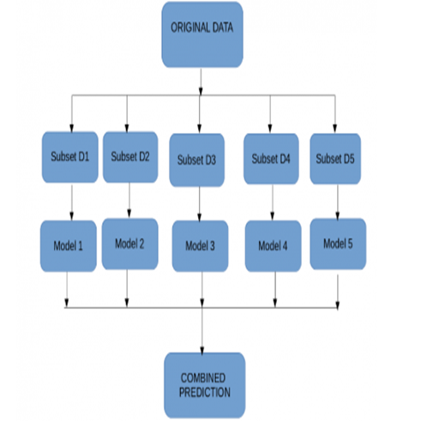
4. ENSEMBLE MODELLING
Ensemble Modelling is a technique where many predictive models are used together to make a better decision rather than a single model.
Bagging with Random Forest Classifier.
Bagging is known as Bootstrap Aggregating.
Instead of applying different models to the same set of data which has a high probability to give the same output
It vies for creating multiple subsets from the original data and applying the predictive model on all of them in parallel to combine them in the end to give a strong combined prediction.
In our project we used Random Forest for Bagging which internally uses decision trees.
https://zhuanlan.zhihu.com/p/40485758

Slide 21
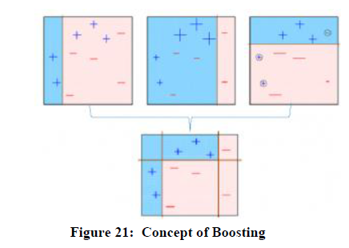
4. BOOSTING
It is a sequential process where the model is applied to subset and the predictions are made on the entire dataset.
The error value is calculated on the predictions and the wrong values are given more weightage.
Then the process of creating subsets and predicting on the whole dataset is repeated and multiple models are created that try to minimize the error of the previous model and combines them all in a weighted mean manner to give the final output.
https://www.analyticsvidhya.com/blog/2015/09/questions-ensemble-modeling/

Slide 22
4. BOOSTING
XGBoost (Xtreme Gradient Boosting)
It can be used for supervised learning tasks such as Regression, Classification, and Ranking. It is built on the principles of gradient boosting framework and designed to “push the extreme computation limits of machines to provide a portable, scalable and accurate library.”
Take a weak learner and add to it another weak learner at every step to build a strong learner and increase the performance.
The new weak learners are added to concentrate on the areas where the existing learners are performing poorly.
AdaBoost
Adaptive boosting also known as AdaBoost is the simplest boosting algorithm that works on improving the areas where the base learner fails.
The base learner is a machine learning algorithm which is a weak learner and upon which the boosting method is applied to turn it into a strong learner by applying it over and over.
we exaggerate the weights of these misclassified samples so that that they have a better chance of being selected when sampled again.

Slide 23
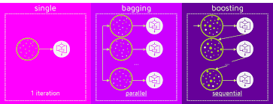
https://medium.com/greyatom/a-quick-guide-to-boosting-in-ml-acf7c1585cb5

Slide 24
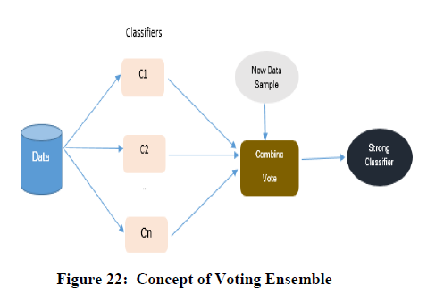
4. VOTING ENSEMBLE
In this multiple independent machine learning models are run on the training data and as per the weighted (optional) output is taken into consideration as the number of votes or average of all the classifiers.
In our project we tried to create a voting ensemble of Logistic regression, K Nearest Neighbour, Stochastic Gradient Descent classifier and SVM classifier.
http://ai.51cto.com/art/201703/535077.htm

Slide 25
5. MODEL EVALUATION
Model evaluation done with oversampled data with SMOTE.
Choosing performance metric as accuracy isn't the correct measure and gives the great feeling of your model being good as it majorly predicts the major class as the predicted value.
We choose area under the ROC curve (AUC) as the performance metric for the imbalanced dataset which can test the correct number of classifications for a model.
A model that has 100% correct classification has an AUC of 1.0 while 0.0 if all are wrong.

Slide 26
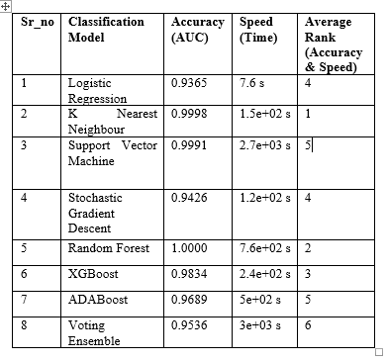
5. MODEL EVALUATION
Accuracy
1. Random Forest
2. K Nearest Neighbour
3. Support Vector Machine
4. XGBoost
5. AdaBoost
6. Voting Ensemble
7. Stochastic Gradient Descent
8. Logistic Regression.
Speed
1. Logistic Regression
2. Stochastic Gradient Descent
3. K Nearest Neighbour
4. XGBoost
5. AdaBoost
6. Random Forest
7. Support Vector Machine
8. Voting Ensemble
Speed and Accuracy
1.K Nearest Neighbour 5. Stochastic gradient descent
2. Random Forest 6. Support Vector Machine
3. XGBoost 7. AdaBoost
4. Logistic Regression 8. Voting Ensemble.

Slide 27
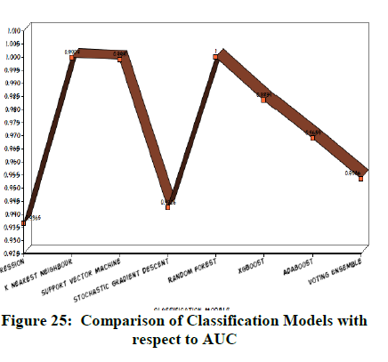
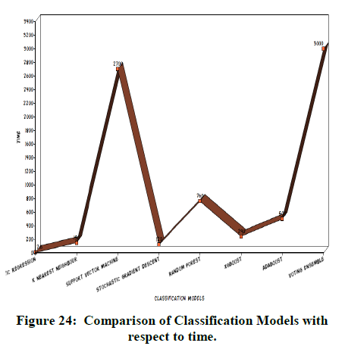
5. MODEL EVALUATION - RESULTS
It can be seen ensemble models are not always the best predictive models in terms of speed mostly as they take time to build though they give good accuracy.
It's useful when you don't care about speed, and want the best classification performance possible. If you use N models in the ensemble, it will be roughly N times slower to both train and evaluate.
They are best to be used in certain cases where they give large improvement in accuracy than single classifier (Weak learners).
The model that is closest to the true data generating process will always be best and will beat most ensemble methods.
From the above table we can see that K nearest Neighbour has the best accuracy and speed of detection.

Slide 28
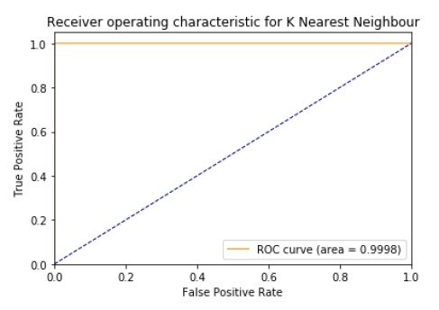
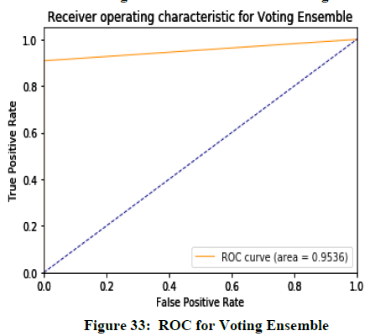
5. MODEL EVALUATION - RESULTS

Slide 29
An ROC curve plots false positive rate (on the X axis) against true positive rate (on the Y axis). false positive rate = FP / (FP + TN) true positive rate = TP / (TP + FN)
It's clear that these rates are irrespective of the actual positive/negative balance on the test set.
Increasing the number of positive samples in the test set by 2x would increase both TP and FN by 2x, which would not change the true positive rate at any threshold.
Similarly, increasing the number of negative samples in the test set by 2x would increase both TN and FP by 2x, which would not change the false positive rate at any threshold.
The shape of the AUC and ROC curve and are not sensitive to the distribution of the class.
Accuracy = (TP+TN)/(TP+TN+FP+FN) is sensitive to the class distribution.

Slide 30
6. MODEL DEPLOYMENT
The project has been developed using python 3.6 and deployed on Jupyter Notebook.
Libraries like :
Pandas for data manipulation
imblearn for data balancing
Scikit- Learn for predictive modelling for machine learning algorithms and evaluation
NumPy for data manipulation
Matplotlib and Seaborn for Data Visualization.

Slide 31
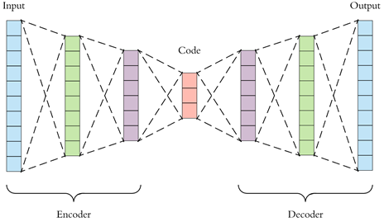
CONCLUSION AND FURTHER WORK
So, when a dataset is imbalanced, we need to convert it into a balanced dataset and use area under the curve as the evaluation metric.
Detecting fraudulent credit card transactions is a tedious process which is subjected to change with varying patterns of the fraudsters and building a 100% accurate fraud detection system is in research.
Various state of art and more powerful approaches are coming into picture like deep learning like autoencoders which has the ability to detect features or changes in the data using deep neural networks in the run rather than it being provided features unlike machine learning models.
So, the future work can be how to improvise the model with deep learning and build a model that adapts the changes in the data on the go which then can be useful for building a more powerful credit card fraud detector system.
https://towardsdatascience.com/applied-deep-learning-part-3-autoencoders-1c083af4d798

Slide 32
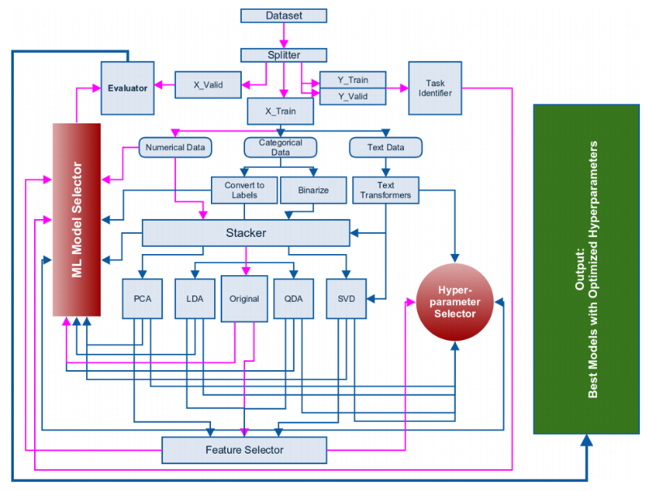
ML FRAMEWORK FOR SOLVING ANY PROBLEM
http://blog.kaggle.com/2016/07/21/approaching-almost-any-machine-learning-problem-abhishek-thakur/

Slide 33
THANKYOU
SREE GOWRI ADDEPALLI (N11837176) [sga297@nyu.edu]
SREE LAKSHMI ADDEPALLI (N12311918) [sla410@nyu.edu]

