Slide 1
AGRIMITRA : AI-Powered Smart Farming Assistant
Student Details : C.Niranjan Reddy (2362321), Gowri Chandana P Nair (2362330)
Guided By : Prof.Vigneshwaran T

Slide 2
Agenda
Abstract
Introduction
Literature Review
Gap identified
Problem statement
Proposed model
Design
Implementation
Result and discussion
Conclusion
Future scope
Reference

Slide 3
Abstract
AgriMitra is an AI-powered smart farming assistant designed to provide personalized agricultural support to farmers. The platform integrates IoT-based environmental monitoring, weather data, intelligent irrigation recommendations, machine learning-based crop recommendation and rotation planning, crop price prediction, and an AI-powered agricultural assistant. Real-time farm context such as soil moisture, temperature, humidity, crop growth stage, weather conditions, and irrigation status is used to generate personalized recommendations. The platform also supports multilingual AI interaction through voice input and output, making agricultural guidance more accessible to farmers.

Slide 4
Introduction
Agriculture remains the primary livelihood for a large share of India’s rural population, yet most smallholder farmers still rely on manual observation rather than real-time data for irrigation, crop selection, and market decisions.
Existing smart-irrigation systems, reviewed in the next section, automate watering but stop short of combining sensor data with AI-driven crop guidance, price forecasting, and natural-language interaction.
AgriMitra is proposed as an AI-powered, multilingual farming assistant that unifies IoT-based environmental monitoring, machine-learning crop and irrigation recommendations, image-based price prediction, and a voice-enabled conversational assistant into a single platform.

Slide 5
Literature Review
Darshana et al. (2025) – Smart Irrigation System
  Uses soil moisture sensors, temperature sensor, relay, and Arduino/Node-based automatic pump control.
  Advantage: Reduces water wastage and enables irrigation.
  Limitation: No IoT connectivity, no remote monitoring, no AI support.
El Mezouari et al. (2022) – Smart Irrigation System
  Uses Arduino UNO, soil moisture sensor, temperature sensor, water-level sensor, and relay for automatic irrigation.
  Advantage: Efficient water usage and automatic monitoring.
  Limitation: Relies on serial communication and lacks cloud connectivity/intelligent decision-making.
Badreideen et al. (2022) – IoT-Based Smart Irrigation System
  Uses soil moisture, temperature, humidity, rain sensors, along with IoT connectivity/mobile application.
  Advantage: Real-time monitoring, remote control, and weather-related information.
  Limitation: No AI assistant or multilingual voice interaction.

Slide 6
Gap Identified
Sensor-and-relay-based systems (Darshna et al., 2025) automate irrigation but provide no IoT connectivity, remote monitoring, or AI support.
Arduino-based systems with local sensing (El Mezouari et al., 2022) rely on serial communication only, lacking cloud connectivity and intelligent decision-making.
IoT-enabled systems (Badreideen et al., 2022) add real-time monitoring and remote control but still offer no AI assistant or multilingual voice interaction for farmers.
No reviewed system combines IoT sensing, ML-based crop and irrigation intelligence, image-based price prediction, and multilingual voice assistance in one accessible platform — the AgriMitra system is designed to close this gap.

Slide 7
Problem Statement
Farmers often lack intelligent tools to plan suitable crop rotations and farming activities based on soil conditions, previous crops, and seasonal factors.
Farmers face difficulty in identifying crops from images and obtaining reliable estimates of their current and future market prices.
Farmers need an accessible system for real-time farm monitoring and personalized agricultural guidance through simple voice-based interaction.

Slide 8
Proposed Model
Crop Planning & Recommendation: Uses soil conditions, previous crop history, and seasonal factors to recommend suitable crops and farming activities through ML and rule-based decision-making.
Crop Identification & Price Prediction: Uses MobileNetV2 to identify crops from images and ML-based market analysis to estimate current and future prices.
IoT-Based Farm Monitoring: Collects real-time environmental data such as soil and weather conditions using IoT sensors.
Multilingual AI Assistant: A Gemini-powered voice assistant provides farmers with real-time farm information, recommendations, and personalized guidance in multiple languages.
Integrated Architecture: Combines IoT sensing, ML models, crop identification, price prediction, weather information, and conversational AI into a single platform for intelligent agricultural decision-making.

Slide 9
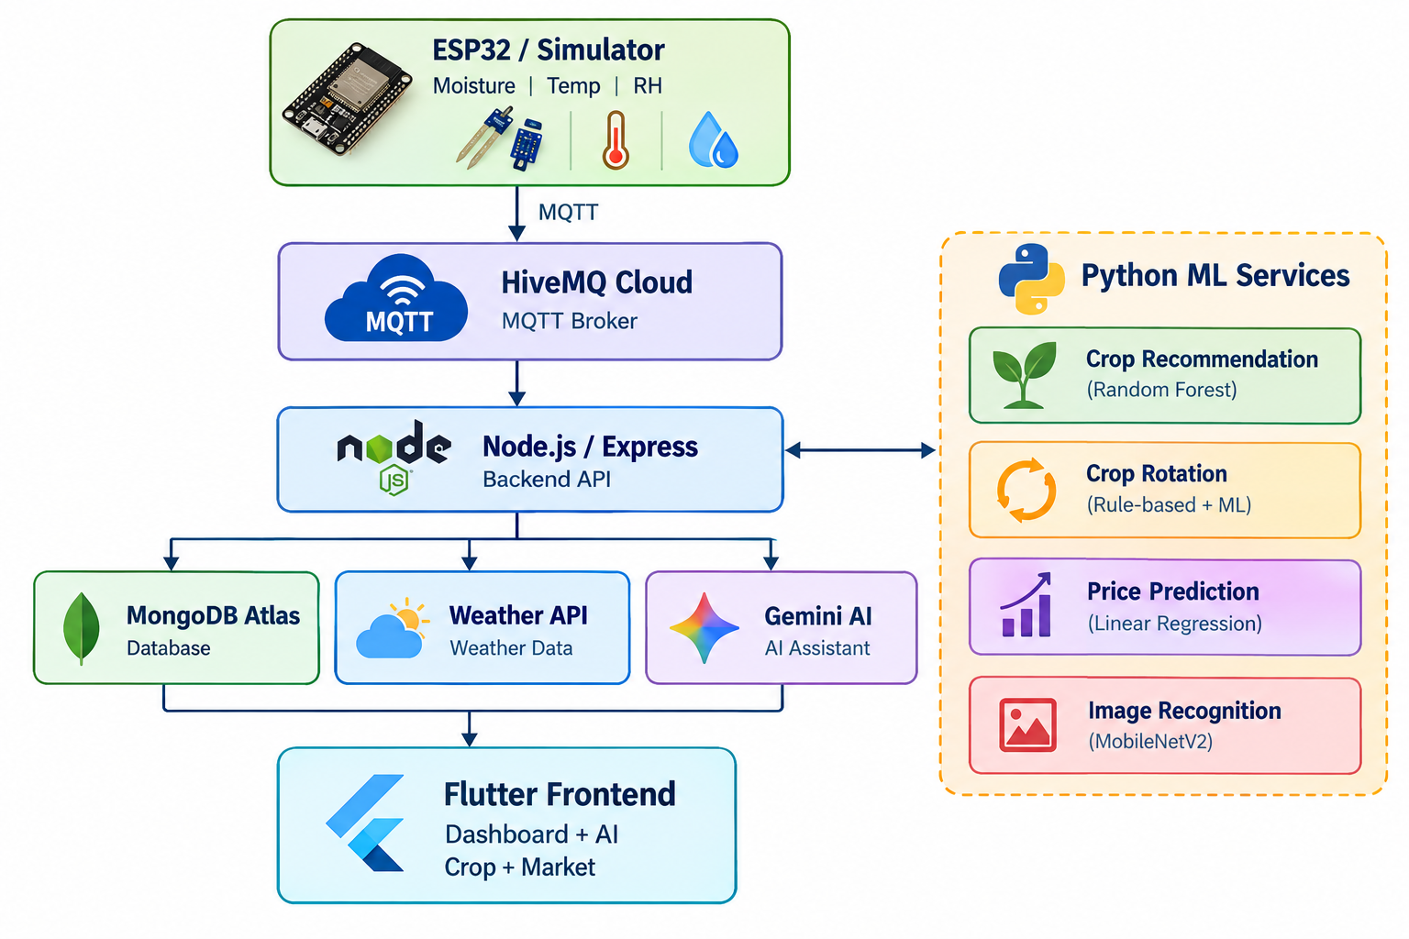
Design - System Architecture

Slide 10
Design - Modules
Crop Rotation & Scheduling
Recommends suitable crop sequences based on soil conditions and previous crops.
Suggests appropriate farming activities and schedules.
Uses machine learning and rule-based analysis for crop planning.
Image-Based Crop Price Prediction
Identifies the crop from an uploaded image using MobileNetV2.
Retrieves relevant market price data.
Predicts current and future crop price trends using historical data.

Slide 11
Implementation -Hardware and Software Requirements
Component | Purpose
ESP32 | IoT sensor connectivity
Capacitive Soil Moisture Sensor | Soil moisture monitoring
DHT22 | Temperature & humidity
Relay Module | Planned pump switching
12V DC Pump | Proposed irrigation actuator
Water Level Sensor | Planned dry-run protection
Power Supply | Development/testing

Slide 12
Implementation - Software Stack
Layer | Technology
Frontend | Flutter / Dart
Backend | Node.js / Express
Database | MongoDB Atlas
IoT Communication | MQTT / HiveMQ Cloud
AI | Google Gemini 2.5 Flash
Crop ML | Python / Flask / Random Forest
Price ML | Python / Flask
Image Recognition | MobileNetV2
Weather | OpenWeatherMap
Market Data | AGMARKNET / data.gov.in
Authentication | JWT + bcrypt
Voice | speech_to_text + flutter_tts

Slide 13
Implementation - AI & ML Components
AI Component
Gemini 2.5 Flash
Uses real-time farm context, weather information, crop details, and Irrigation information to provide personalized agricultural assistance.
Voice Assistance
Speech-to-text and text-to-speech enable multilingual voice interaction.
ML Components
Application | Model / Algorithm
Crop Recommendation | Random Forest Classifier
Crop Rotation | Hybrid ML + Rule-based Approach
Crop Image Recognition | MobileNetV2
Price Prediction | Linear Regression / Trend Forecasting
Irrigation | Hargreaves ET₀ + Kc + Rule-based Decision Logic

Slide 14
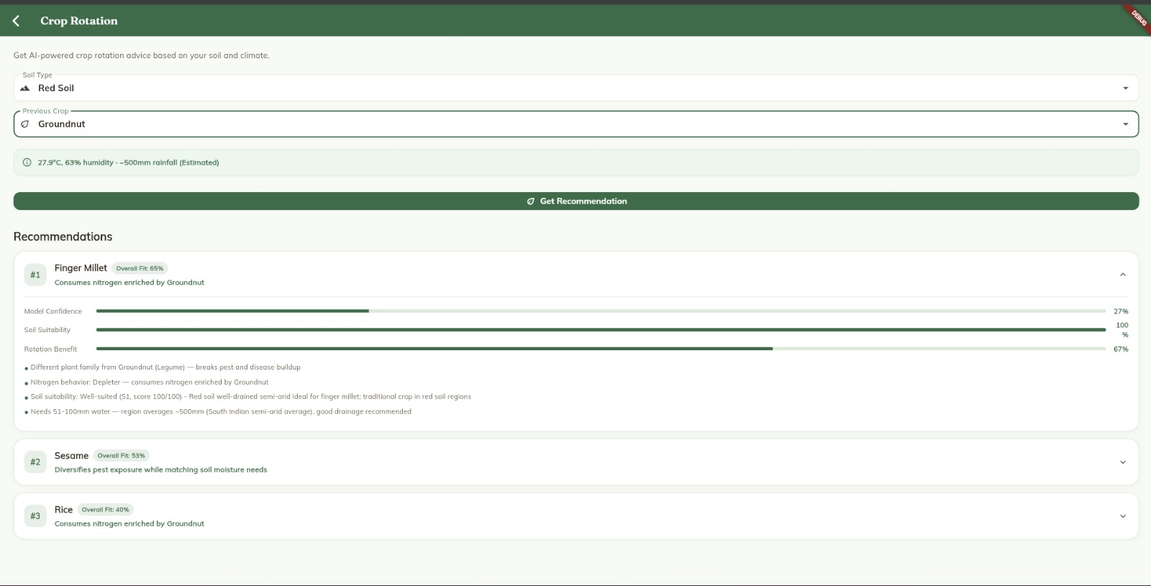
Implementation - Screenshots

Slide 15
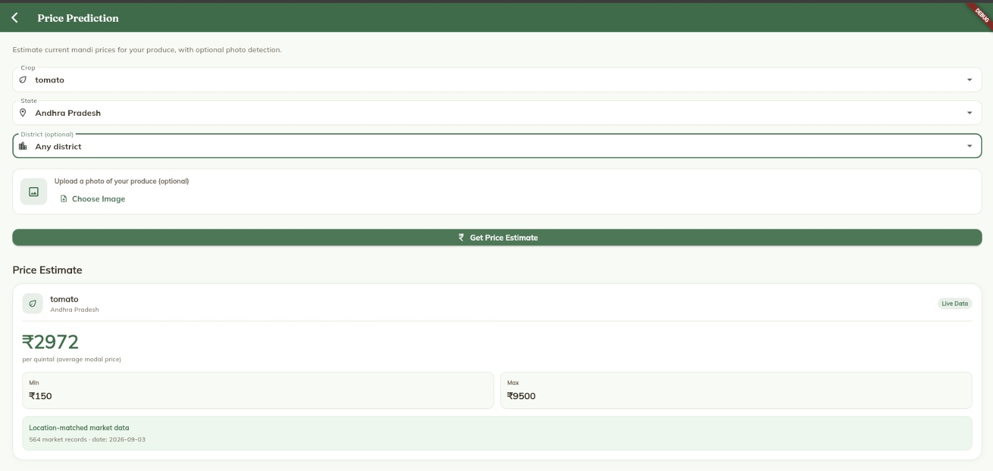
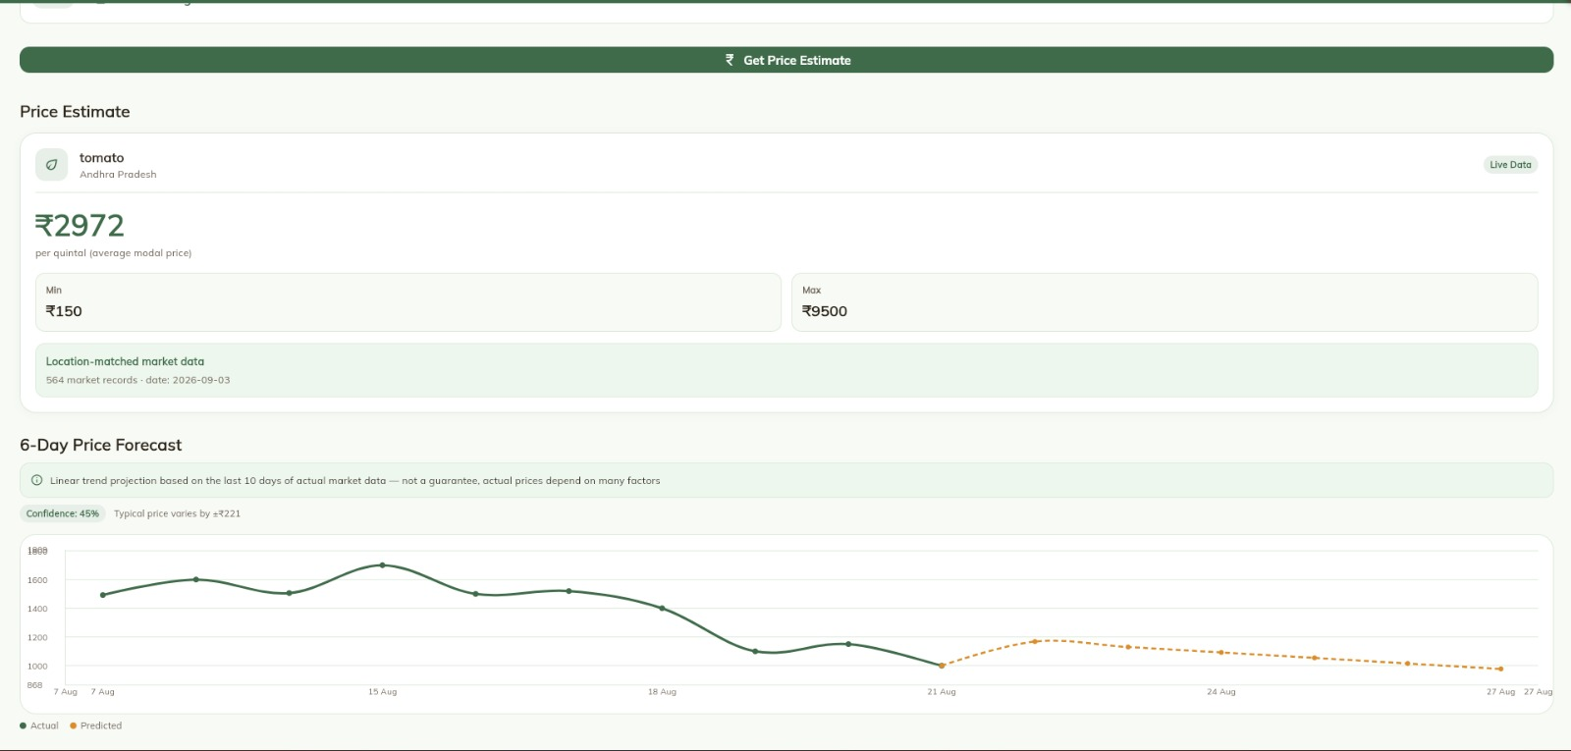

Slide 16
Result and Discussion
The backend (Node.js/Express, MongoDB Atlas, JWT/bcrypt authentication) and the MQTT-based IoT pipeline are functional; sensor data is currently simulated pending real ESP32 hardware integration.
The Random Forest crop-recommendation model achieves close to 99.55% test accuracy on Kaggle dataset, and Hargreaves ET₀-based irrigation engine produces weather-grounded scheduling recommendations.
The Flutter web and mobile frontend is wired to live backend data, with a working dashboard, an auto-generated farm calendar, and a throttled smart-alert system.
The Gemini 2.5 Flash-powered AI assistant maintains multi-turn conversation history and responds using real-time farm context; voice input/output work in English , Tamil , Telugu ,Malayalam and Hindi.

Slide 17
Conclusion
AgriMitra demonstrates that IoT-based monitoring, ML-driven crop and irrigation recommendations, image-based crop prediction, and multilingual voice interaction can be combined into a single platform for Indian farmers.
Testing so far shows high-accuracy crop-recommendation model, a working weather-grounded irrigation engine, and a functional multilingual conversational assistant, directly addressing the gaps found in the reviewed prior systems.
The project validates that combining rule-based and machine-learning approaches — chosen for viable-feasibility — is a practical strategy where data constraints limit purely ML-based solutions.

Slide 18
Future Scope
Complete real ESP32 hardware integration to replace the currently simulated sensor data.
Extend voice support to Kannada through the Bhashini API, and verify Tamil text-to-speech output across devices.
Strengthen ML/DS credibility with a confusion matrix, multi-model comparison (XGBoost, SVM) for crop recommendation, and add Isolation Forest anomaly detection for sensor data.
Optionally extend into crop disease detection, evaluated on PlantVillage and PlantDoc datasets to address the known lab-to-field generalization gap.

Slide 19
Future Scope – Project Roadmap
Phase | Duration | Deliverable
Requirement analysis & literature review | Week 1–2 | Finalized scope, reviewed prior work
Hardware setup & sensor integration | Week 3–4 | ESP32 + sensors + relay + pump
Backend & database architecture | Week 5–6 | MQTT pipeline, MongoDB, REST APIs
Irrigation logic (ET₀ engine) | Week 7–8 | Weather-grounded irrigation logic
Crop recommendation ML model | Week 9 | Trained and saved model (99.55% accuracy)
Conversational AI + voice assistant | Week 10–12 | Gemini-based, multilingual voice IO
Authentication, alerts, farm calendar | Week 13–14 | Secure authentication system, sensor alerts, scheduling
Hardware-software full integration | Week 15–16 | Real ESP32 replacing simulated sensor data
Testing, refinement, documentation | Week 17–18 | End-to-end testing, report writing
Final review & viva preparation | Week 19+ | Presentation, demo readiness

Slide 20
Proposed Solution
The platform provides machine learning-based crop recommendations and crop rotation plans by considering soil suitability, previous crops, and relevant agricultural factors.
The system identifies crops from images and provides crop price estimates and future price trends using market data from AGMARKNET.
AgriMitra monitors real-time soil moisture, temperature, humidity, and weather conditions to provide farmers with up-to-date information about their farm environment.
The system determines irrigation requirements using Hargreaves ET₀, crop coefficient (Kc), crop growth stage, soil moisture, and rainfall probability.
A Gemini 2.5 Flash-powered AI assistant uses real-time farm data to provide personalized agricultural guidance through multilingual text and voice interaction.

Slide 21
References
El Mezouari, A. E., Fazziki, A. E., and Sadgal, M., “Smart Irrigation System,” IFAC-PapersOnLine, vol. 55, no. 10, pp. 3298–3303, 2022. DOI: 10.1016/j.ifacol.2022.10.125.
Badreleen et al., “Smart irrigation system based on IoT and machine learning,” Smart Agricultural Technology, vol. 3, 2022. DOI: 10.1016/j.s.2022.100147.
AI4Bharat — IndicTrans: Open-source speech models for Indian languages, IIT Madras.
Kaggle Crop Recommendation Dataset — N-P-K, temperature, humidity, pH, rainfall crop label dataset.

Slide 22
THANK YOU

