Slide 1
AGRIMITRA : AI-Powered Smart Farming Assistant
Student Details : C.Niranjan Reddy (2362321), Gowri Chandana P Nair(2362330)
Guided By : Prof.Vigneshwaran T

Slide 2
Agenda
Abstract
Problem Statement
Objectives
Hardware & Software Requirements
AI & ML Components
Literature and Background Study
System Architecture
Modules
Screenshots
Project Timeline
References

Slide 3
Abstract
AgriMitra is an AI-powered smart farming assistant designed to provide personalized agricultural support to farmers. The platform integrates IoT-based environmental monitoring, weather data, intelligent irrigation recommendations, machine learning-based crop recommendation and rotation planning, crop price prediction, and an AI-powered agricultural assistant. Real-time farm context such as soil moisture, temperature, humidity, crop growth stage, weather conditions, and irrigation status is used to generate personalized recommendations. The platform also supports multilingual AI interaction through voice input and output, making agricultural guidance more accessible to farmers.

Slide 4
Problem Statement
Farmers often lack intelligent tools to plan suitable crop rotations and farming activities based on soil conditions, previous crops, and seasonal factors.
Farmers face difficulty in identifying crops from images and obtaining reliable estimates of their current and future market prices.
Farmers need an accessible system for real-time farm monitoring and personalized agricultural guidance through simple voice-based interaction.

Slide 5
Objectives
To develop a machine learning and rule-based crop rotation and scheduling system that recommends suitable crops and farming activities based on soil conditions, previous crop history, crop suitability, and seasonal factors. (phase1)
To develop an image-based crop price prediction system that uses MobileNetV2 for crop identification and machine learning-based analysis of historical market data to estimate crop prices and future price trends. (phase 1)
To develop an IoT-based farm monitoring prototype integrated with a multilingual AI voice assistant to provide real-time farm information and personalized agricultural guidance to users. (phase 2)

Slide 6
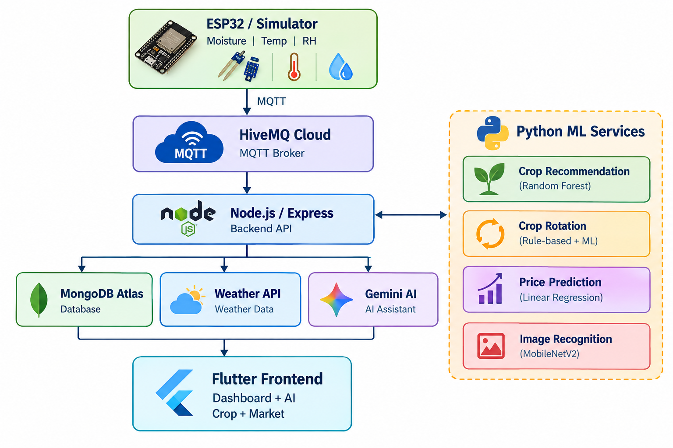
System Architecture

Slide 7
Hardware and Software Requirements
Component | Purpose
ESP32 | IoT sensor connectivity
Capacitive Soil Moisture Sensor | Soil moisture monitoring
DHT22 | Temperature & humidity
Relay Module | Planned pump switching
12V DC Pump | Proposed irrigation actuator
Water Level Sensor | Planned dry-run protection
Power Supply | Development/testing

Slide 8
Software Stack
Layer | Technology
Frontend | Flutter / Dart
Backend | Node.js / Express
Database | MongoDB Atlas
IoT Communication | MQTT / HiveMQ Cloud
AI | Google Gemini 2.5 Flash
Crop ML | Python / Flask / Random Forest
Price ML | Python / Flask
Image Recognition | MobileNetV2
Weather | OpenWeatherMap
Market Data | AGMARKNET / data.gov.in
Authentication | JWT + bcrypt
Voice | speech_to_text + flutter_tts

Slide 9
AI & ML Components
AI Component
Gemini 2.5 Flash
Uses real-time farm context, weather information, crop details, and Irrigation information to provide personalized agricultural assistance.
Voice Assistance
Speech-to-text and text-to-speech enable multilingual voice interaction.
ML Components
Application | Model / Algorithm
Crop Recommendation | Random Forest Classifier
Crop Rotation | Hybrid ML + Rule-based Approach
Crop Image Recognition | MobileNetV2
Price Prediction | Linear Regression / Trend Forecasting
Irrigation | Hargreaves ET₀ + Kc + Rule-based Decision Logic

Slide 10
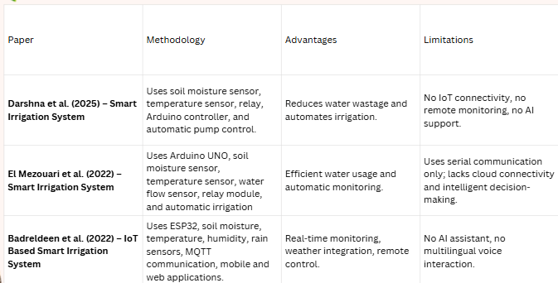
Literature Review / Background Study

Slide 11
Proposed Solution
The platform provides machine learning-based crop recommendations and crop rotation plans by considering soil suitability, previous crops, and relevant agricultural factors.
The system identifies crops from images and provides crop price estimates and future price trends using market data from AGMARKNET.
AgriMitra monitors real-time soil moisture, temperature, humidity, and weather conditions to provide farmers with up-to-date information about their farm environment.
The system determines irrigation requirements using Hargreaves ET₀, crop coefficient (Kc), crop growth stage, soil moisture, and rainfall probability.
A Gemini 2.5 Flash-powered AI assistant uses real-time farm data to provide personalized agricultural guidance through multilingual text and voice interaction.

Slide 12
Modules
Crop Rotation & Scheduling
Recommends suitable crop sequences based on soil conditions and previous crops.
Suggests appropriate farming activities and schedules.
Uses machine learning and rule-based analysis for crop planning.
Image-Based Crop Price Prediction
Identifies the crop from an uploaded image using MobileNetV2.
Retrieves relevant market price data.
Predicts current and future crop price trends using historical data.

Slide 13
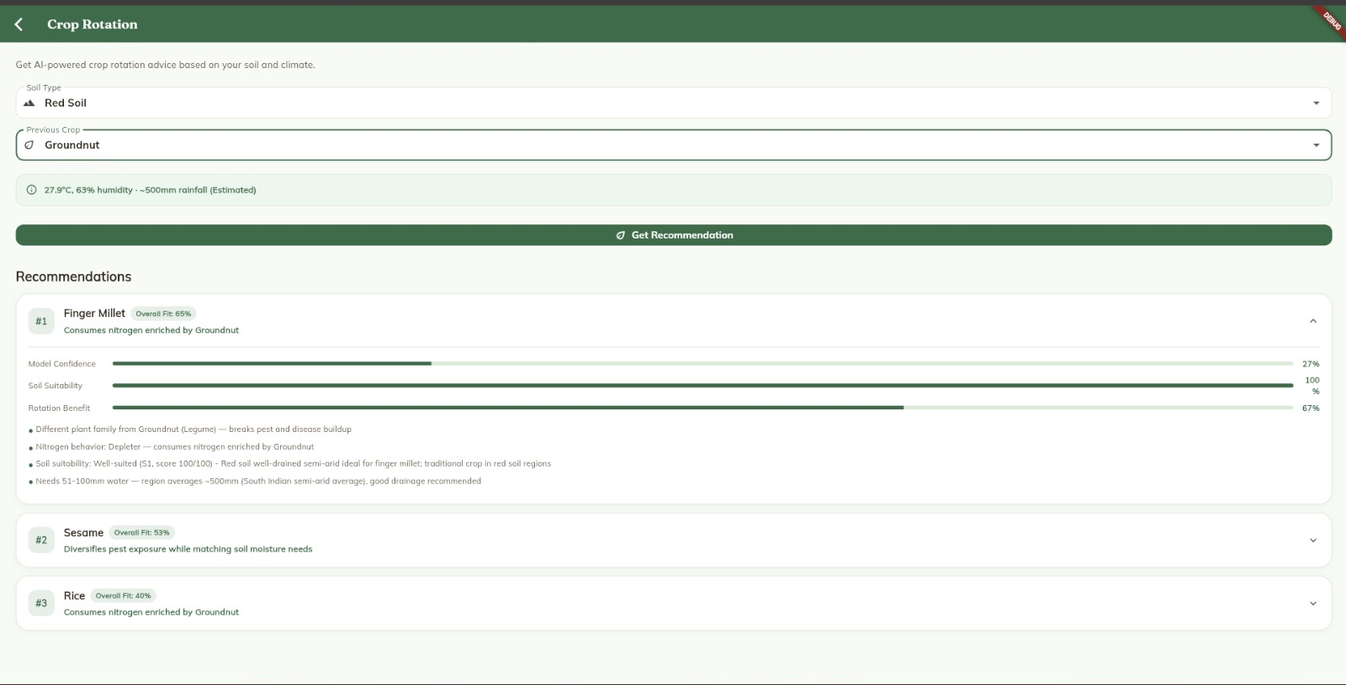
Screenshots

Slide 14
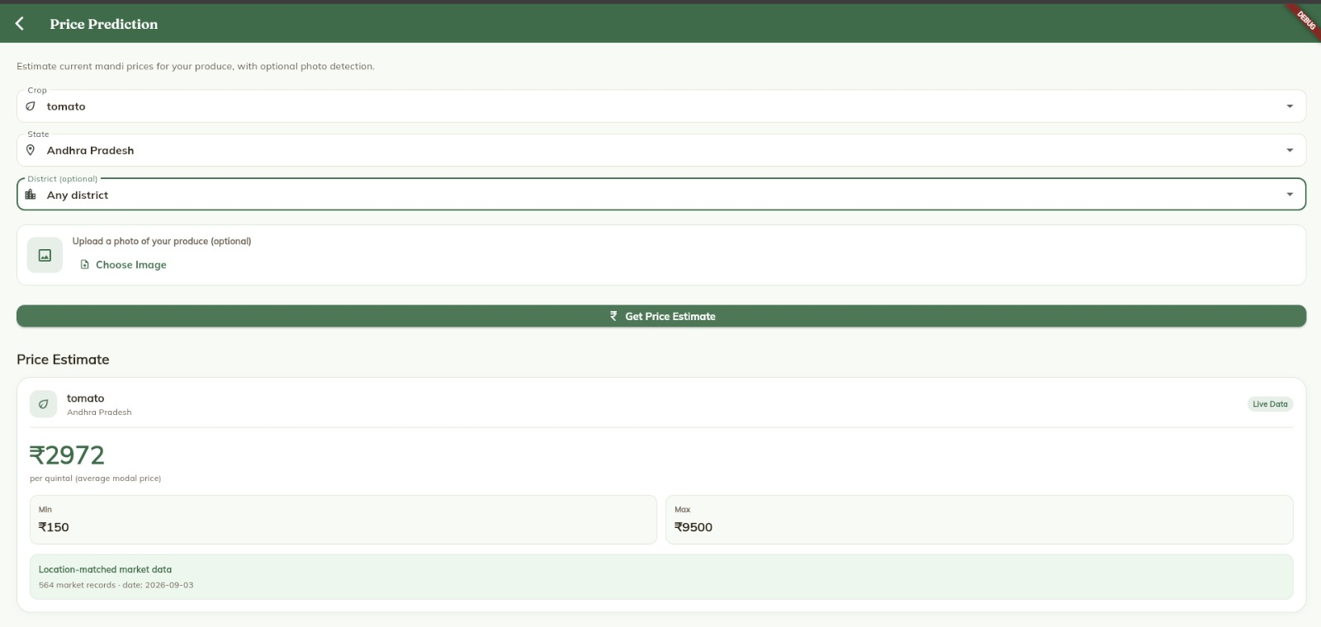
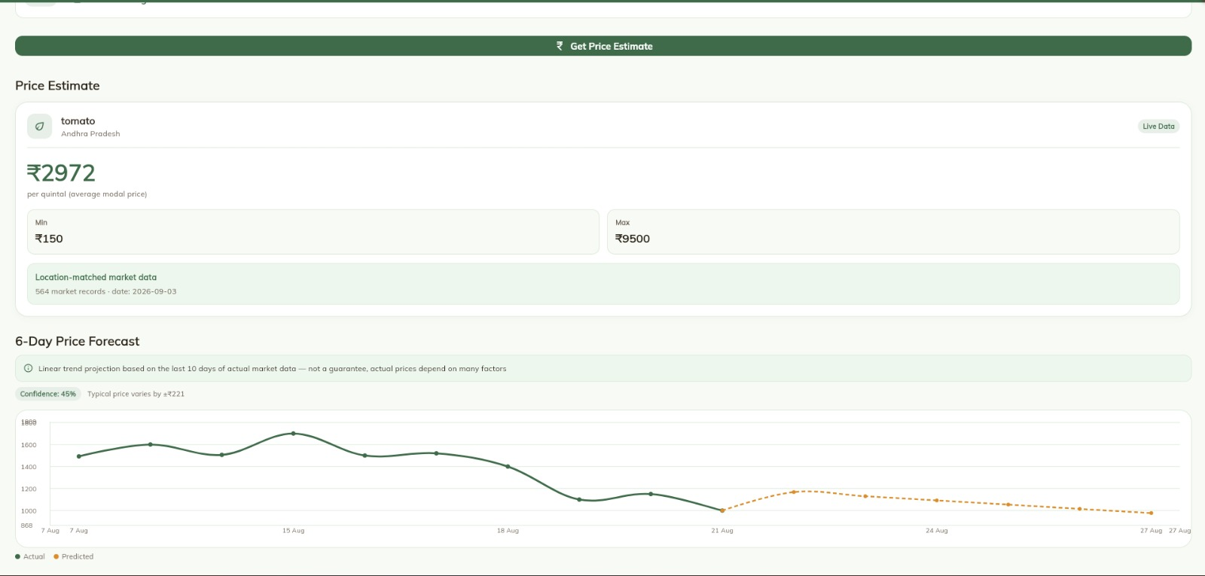

Slide 15
Timeline
Phase | Duration | Deliverable
Requirement analysis & literature review | Weeks 1–2 | Finalized scope, reviewed prior work
Hardware setup & sensor integration | Weeks 3–4 | ESP32 + sensors + relay + pump functional
Backend & database architecture | Weeks 5–6 | MQTT pipeline, MongoDB, REST APIs
Irrigation logic (ET₀ engine) | Weeks 7–8 | Weather-grounded irrigation scheduling
Crop recommendation ML model | Week 9 | Trained and served model (99.55% accuracy)
Conversational AI + voice assistant | Weeks 10–12 | Grounded chatbot, multilingual voice I/O
Authentication, alerts, farm calendar | Weeks 13–14 | Secure login, notification system, auto-calendar
Hardware-software full integration | Weeks 15–16 | Real ESP32 replacing simulated sensor data
Testing, refinement, documentation | Weeks 17–18 | End-to-end testing, report writing
Final review & viva preparation | Week 19+ | Presentation, demo readiness

Slide 16
References
1. El Mezouari, A. E., Fazziki, A. E., and Sadgal, M., "Smart Irrigation System," IFAC-PapersOnLine, vol. 55, no. 10, pp. 3298–3303, 2022. DOI: 10.1016/j.ifacol.2022.10.125.
2. Badreldeen et al., "Smart irrigation system based on IoT and machine learning," Smart Agricultural Technology, vol. 3, 2022. DOI: 10.1016/j.ssaho.2022.100147.
3.AI4Bharat — IndicASR / IndicTTS: Open-source speech models for Indian languages, IIT Madras
4. Kaggle Crop Recommendation Dataset — N-P-K, temperature, humidity, pH, rainfall to crop label dataset

