Slide 1


Role Based
Task Tracking System (RBTTS)
Tracking Made Simple,
Results Made Powerful.
NANDINI KAMEPALLI
Presenter

Slide 2



Learning Journey
Training Highlights | Project Learnings
FastAPI & Pydantic for backend development | Project & Task management workflow implementation
Async programming & API performance optimization | Role-based access control (Admin, Manager, Team Member)
JWT authentication, password security, and account locking | REST API development & modular code structuring
GPT, FAISS, LangChain for AI/ML applications | Logging, security handling, and debugging

Slide 3

Problem Statement
Image
Managing projects and tasks across different roles such as Admin, Manager, Developer, and Tester often becomes inefficient without a centralized system.
Teams face difficulties in tracking task assignments, monitoring progress, and ensuring accountability, which leads to delays and miscommunication.
Additionally, role-based access control and secure collaboration are often lacking, making it challenging to enforce permissions effectively.
Without clear visibility into project and task workflows, organizations struggle with bottlenecks in development and testing, reducing overall productivity.

Slide 4

Proposed Solution
Image
To address these challenges, we propose a Role-Based Task Tracking System (RBTTS) that provides a centralized platform for managing projects, tasks, and workflows.
The system ensures clear assignment of responsibilities, status tracking, and transparent communication across all roles, reducing delays and mismanagement.
By implementing role-based access control, secure authentication, and detailed activity logging, the system maintains accountability while protecting sensitive data.
With structured workflows for Admins, Managers, Developers, and Testers, RBTTS streamlines collaboration, improves productivity, and enhances project visibility.

Slide 5

Project Overview
Image
RBTTS is a mini-Jira–like task tracking system designed to simplify project management and enhance team productivity. It enables users to create, assign, and monitor tasks efficiently, while offering clear visibility into progress and deadlines. With its streamlined approach, RBTTS promotes transparency, accountability, and effective collaboration across all roles within an organization.
Built for teams of all sizes, the system helps managers and team members stay organized, aligned, and focused on project goals by providing structured task workflows and timelines. Planned future enhancements, such as intelligent automation and bot assistance, will further optimize task handling and make project management smarter and more efficient.

Slide 6
Features
Implement role-based access control
Enable project-based task tracking
Support full CRUD operations
Track task progress with status updates
Ensure strong authentication and security
Enable efficient task tracking by user roles and assignments
Ensure robust backend with authentication and logging
Provide secure, role-based access to data

Slide 7

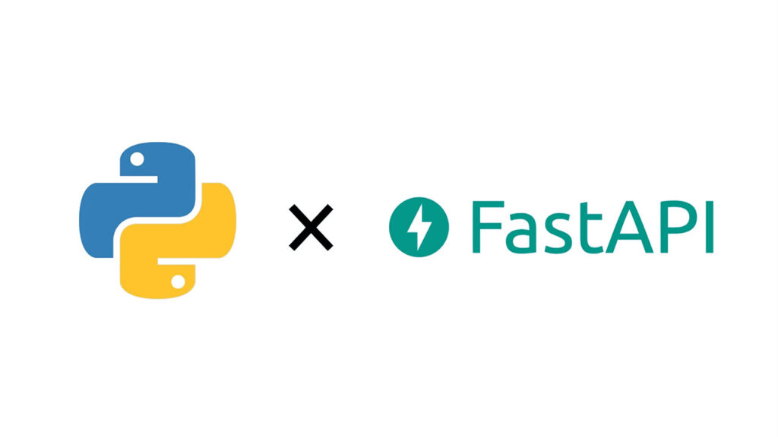

TECH STACK
Backend:
Python + FastAPI
Database: MongoDB
Security: JWT,
and login tracking
A modern, high-performance Python framework powering all APIs, business logic, and user management for seamless backend operations.
A flexible, scalable NoSQL database that stores users, projects, tasks, and login activity, enabling efficient data management and retrieval.
Robust authentication and session management using JWT tokens, password hashing, and login tracking to ensure secure and controlled access.

Slide 8



Authentication & Security
Use Jwt
Authentication with password hashing
Monitor login attempts with logging
Enforce permissions through Role-Based Access Control
Implement JSON Web Tokens to provide secure, stateless authentication for API access, ensuring efficient and scalable user validation.
Track and record login activities to support auditing and detect anomalies, helping to identify unauthorized access attempts.
Apply strict access controls at both API and data layers to restrict user actions based on assigned roles, ensuring appropriate authorization.

Slide 9

User Roles &
Permissions
Overview of system roles, their permissions, and responsibilities
Role | Permissions & Responsibilities
Admin | Full system access; manage users and settings
Manager | Oversee projects; assign tasks; monitor progress
Developer | Work on assigned tasks; update task statuses
Tester | Test tasks; report issues and status updates

Slide 10


CRUD Operations
Project Management
Create, Read, Update, and Delete projects efficiently while ensuring data security and integrity via robust APIs.
Manage detailed project metadata:
Track essential project information including project name, description, status, and start and end dates to ensure transparency and organization.
Easily update and maintain project details to keep all team members informed.
Assign user roles for controlled access
Link projects to specific users based on their roles to maintain proper access control and role-based permissions.
Oversee complete project lifecycle:
Efficiently manage projects through different stages such as active, completed, and archived for streamlined workflow.
Monitor progress at every stage to ensure timely delivery and accountability

Slide 11
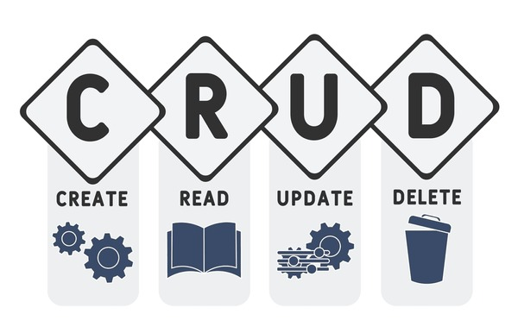

CRUD Operations
Task Management
Create, read, update, and delete tasks efficiently to maintain an organized task list and workflow..
Assign tasks based on user role and project involvement:
Ensure relevant users receive tasks aligned with their roles and projects to optimize productivity and accountability.
Include detailed task information
Link projects to specific users based on their roles to maintain proper access control and role-based permissions.
Track task progress via status updates:
Add task descriptions, deadlines, priority levels, and related project information for comprehensive task tracking
.Monitor progress at every stage to ensure timely delivery and accountability

Slide 12

Development
Workflow
Admin / Manager
Creates a new project and tasks.
Assigns tasks to Developers and Testers.
Developer
Works on assigned tasks.
Updates task status (e.g., in-progress → completed).
Adds remarks or notes if needed.
Tester
Receives completed tasks from Developers.
Tests functionality, reports bugs, or marks as verified.
Updates tester status and adds testing remarks or bugs.
Completion
Once approved by the Tester, the task is marked as Done.
Ensures accountability, traceability, and smooth handover.

Slide 13
API Endpoint Overview
User & Authentication | Project Management | Task Management
Endpoints: GET /health-check – System health check POST /users/register – Register a new user POST /users/login – User login POST /users/request-password-reset – Request password reset POST /users/change-password – Change password POST /users/logout – Logout user | Endpoints: POST /projects/ – Create project GET /projects/ – List projects PUT /projects/{project_id} – Update project GET /projects/{project_id} – Get project details DELETE /projects/{project_id} – Delete project | Endpoints: POST /tasks/ – Create task GET /tasks/ – List all tasks GET /tasks/{task_id} – Get task details PUT /tasks/{task_id} – Update task (Admin) DELETE /tasks/{task_id} – Delete task PUT /tasks/{task_id}/assign – Assign task GET /tasks/my – Get my tasks (Developer) PUT /tasks/{task_id}/status – Update dev status PUT /tasks/{task_id}/remarks – Append dev remarks GET /tasks/my-testing – Get my testing tasks PUT /tasks/{task_id}/test-status – Update test status PUT /tasks/{task_id}/test-remarks – Append test remarks

Slide 14
Challenges & Solutions
Challenges | Solutions
Secure role-based access control | Implemented strict permission checks at API layer
Managing task status consistency | Used atomic updates and validation on status changes
Authentication security | Adopted JWT with strong password hashing and login logging
Efficient project-task mapping | Designed normalized database schema with clear relationships

Slide 15
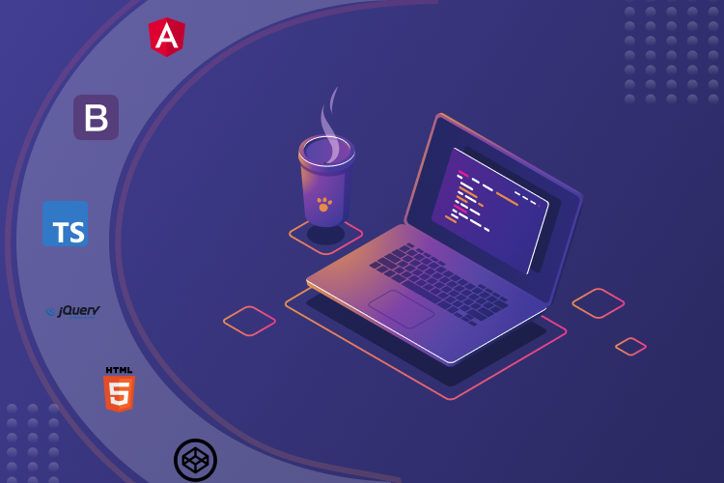

Add Frontend
Future Enhancement
Develop a user-friendly frontend to simplify interactions and improve accessibility for all users.
Integrate advanced reporting and analytics dashboards:
Incorporate comprehensive dashboards to analyze data and generate actionable insights.
Real Time Notifications for Task
Extend role hierarchy and customizable permissions:
Enhance the system’s security and flexibility by expanding role definitions and permission settings.
Provide instant alerts to keep users informed about changes and progress in their tasks.
Automate testing and deployment pipelines:
Streamline development by automating quality assurance and deployment processes for faster releases.

Slide 16



