Slide 1
A Kernel Extreme Learning Machines Algorithm for Node Localization in Wireless Sensor Networks
Team Guide
Ms. R. Janani
Team Members
Anu Ranjana
Deepak Raj
Dhanish Ahmed
Gowri Prasanth

Slide 2
OBJECTIVE
To compute the locations of unknown nodes by the trained KELM.
To improve the accuracy of node localization and it outperforms state-of-the-arts localization methods

Slide 3
PROBLEM DEFINITION
Localization problem based on the existing method.
Previous demonstration that the localization problem of the previously node localization.

Slide 4
EXISTING SYSTEM
Most of the localization algorithms apply integer hop-count values which result in poor localization accuracy in practical applications.
Transform the integer hop-count into the real number hop count.
The fast-SVM algorithm suffers larger localization error

Slide 5
DISADVANTAGES OF EXISTING SYSTEM
The fast-SVM algorithm reduces computation time, but the localization error is not reduced.
The existing algorithm is to compute unknown node coordinates by using the restrained population feasible region, but it produces lower localization accuracy.
The limitations of the number of anchors and the small training samples in WSNs result in low localization accuracy

Slide 6
PROPOSED SYSTEM
To improve the accuracy of unknown node localization, the integer hop-count has to be transformed into the real number hop-count.
This is made possible by partitioning a node’s one-hop neighbour set into three disjoint subsets and estimating the distance between nodes by calculating the areas of intersection regions.
The real number hop-counts between anchors and unknown nodes and the real number hop-counts between unknown nodes need to be estimated.

Slide 7
ADVANTAGES OF PROPOSED SYSTEM
The real number hop-counts between anchors and unknown nodes
The real number hop-counts between unknown nodes need to be estimated.
Denotes the true and estimated node location
They can identify larger localization error

Slide 8
LITERATURE SURVEY
Low-Complexity Message-Passing Cooperative Localization in Wireless Sensor Networks
S.C. WANG ET AL a low-complexity message-passing cooperative localizer for wireless sensor networks with (un-)quantized time-of-arrival (TOA) measurements.
The collaborative positioning problem is first converted as a generalized nonlinear mixing problem, and then resolved by our developed extended generalized approximate message passing (EGAMP) algorithm. The EGAMP localizer iterates between Taylor expanding the nonlinear mixing problem as a linear mixing one, and recovering positions by one-step GAMP.
It successfully handles the quantization losses of quantized TOAs. Its computational complexity is three orders lower than that of belief propagation localizers. Based on our experimental results, the EGAMP localizer gives the state-of-the-art positioning performances, and is robust to quantization losses

Slide 9
LITERATURE SURVEY
RLAN: range‐free localisation based on anisotropy of nodes for WSNs
L.Y. Chen et al Node localisation for wireless sensor networks (WSNs) is applied in various fields, and is an indispensable core to promote the development of WSNs.
Since the previous localisation algorithms did not fully utilize the anisotropy of nodes, according to the actual radiation model of the node's communication, a novel range‐free localisation algorithm called range‐free localisation based on the anisotropy of nodes (RLAN) is proposed.
RLAN not only uses the information of multi‐hop neighbors, but also considers fully the anisotropy of nodes in real networks, which influences the hop relationship and average hop distance, so as to improve the accuracy of node localisation.

Slide 10
LITERATURE SURVEY
Localization algorithm for large-scale wireless sensor networks based on FCMTSR-support vector machine
F. Zhu and J. Wei et .al Sensor node localization is one of research hotspots in the applications of wireless sensor network field. A localization algorithm is proposed in this article which is based on improved support vector machine for large-scale wireless sensor networks.
For a large-scale wireless sensor network, localization algorithm based on support vector machine faces to the problem of the large-scale learning samples. The large-scale training samples will lead to high burden of the training calculation, over learning, and low classification accuracy. In order to solve these problems, this article proposed a novel scale of training sample reduction method (FCMTSR).
FCMTSR takes the training sample as point set, get the potential support vectors, and remove the non-boundary outlier data immixed by analyzing relationships between points and set.

Slide 11
LITERATURE SURVEY
An improved self-localization algorithm for Ad hoc network based on extreme learning machine
Xiaohui Chang et .al Wireless sensor network (WSN) is a typical application of Ad hoc network in autonomous system (AS). It has attracted considerable attention in the past.
Recent years have witnessed a growing interest in the study of localization algorithm for WSN. Self-localization of nodes is one of the key technologies for application of WSN.
The localization accuracy is a significant criterion to evaluate the practical utility of localization algorithm. In most of the localization algorithms, increasing the density of anchor nodes is one of the main strategies to improve the localization accuracy.
But the number of anchor nodes is always limited due to the hardware limitations, such as energy consumption, cost, and so on.

Slide 12
SYSTEM SPECIFICATION
HARDWARE CONFIGURATION
Processor : i3 processor and above
RAM : 4 GB RAM
Hard Disk : 400 GB
Key Board : Standard 105 Keys
Monitor : LG 14” TFT Monitor
SOFTWARE REQUIREMENTS
Operating System : Microsoft Windows 7 and above
Front End : Java

Slide 13
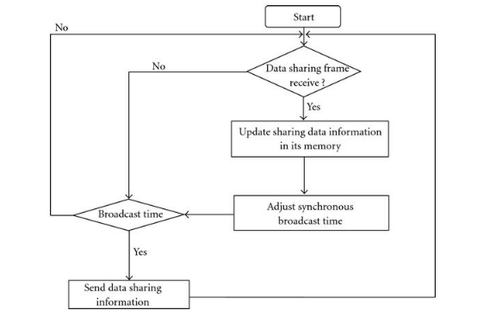
FLOW DIAGRAM

Slide 14
MODULES
Network Construction
Main Route Discovery
Backup Node Localization and Route Construction
Data Transfer

Slide 15
NETWORK CONSTRUCTION
In this module we can construct a topology to provide communication paths for wireless sensor network.
Here the node will give the own details such as Node ID and port number through which the transmission is done and similarly give the known nodes details such as Node ID, IP address and port number which are neighbors to given node

Slide 16
Main Route Discovery
In this module we find the main route for transferring the data from source to destination. When a source has data to transmit to an unknown destination, it broadcasts a Route Request (RREQ) for that destination.
At each intermediate node, when a RREQ is received a reverse route to the source is created. If the receiving node has not received this RREQ before, is not the destination and does not have a “fresh enough” route to the destination, it rebroadcasts the RREQ.
If the receiving node is the destination or has a “fresh enough” to the destination, it generates a Route Reply (RREP). The RREP is uni-casted in a hop-by-hop fashion to the source. As the RREP propagates, each intermediate node creates a main route to the destination

Slide 17
Backup Node Localization and Route Construction
The backup route to the destination is established during the route reply phase. We slightly modify the AODV protocol in this procedure.
During route reply phase, nodes along the main route (including the source node) which receive the RREP create the backup route towards the destination (run a “Backup Route Discovery” procedure) by broadcasting a route request packet with “Backup flag” set (backup RREQ).
The TTL of the packet is initially fixed at three to guarantee that the packet is not forwarded beyond three nodes.

Slide 18
DATA TRANSFER
In this module we transfer the data from source node to destination node.
First it searches the main route.
The data is transfer via the main route. If the any nodes in the main route are failed, it constructs the backup route

Slide 19
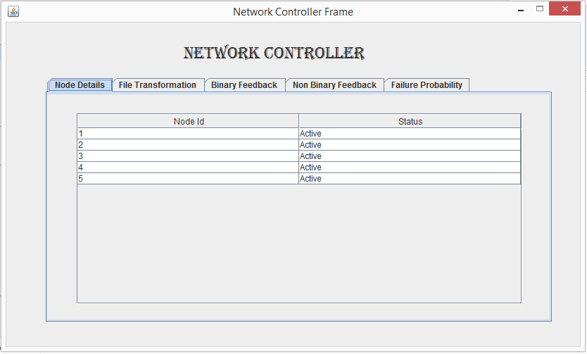
NETWORK CONTROLLER

Slide 20
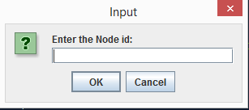
NODE CREATION

Slide 21
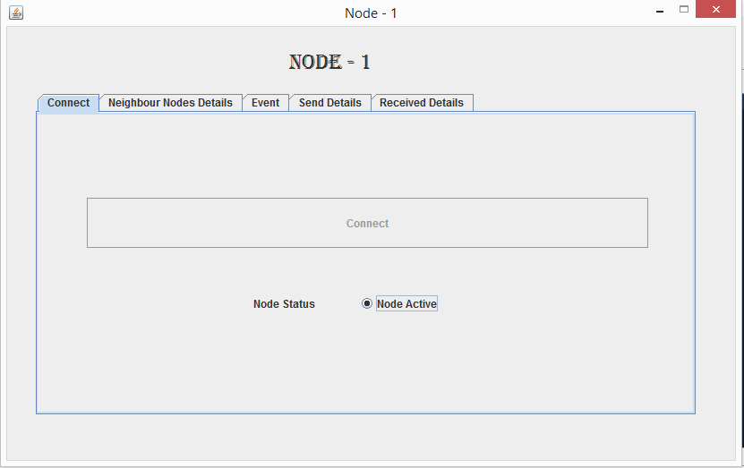
NODE CONNECTION

Slide 22
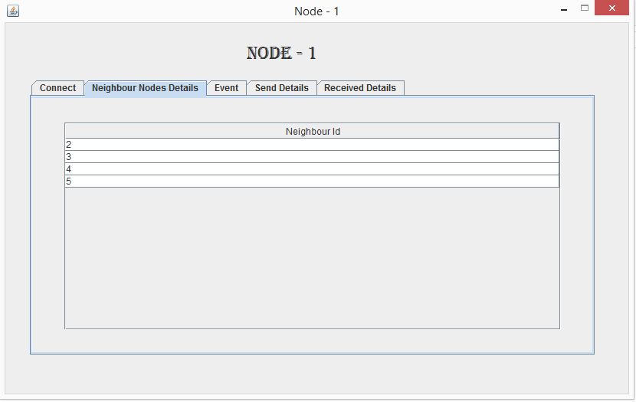
NODE NEIGHBOUR DETAILS

Slide 23
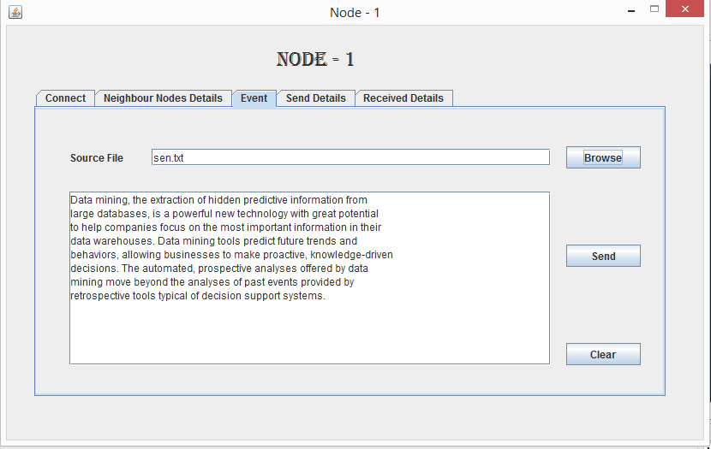
NODE DATA TRANSFER

Slide 24
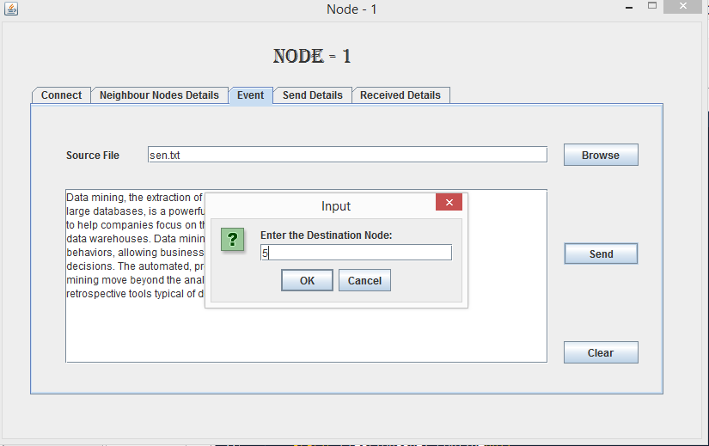
NODE DATA TRANSFER

Slide 25
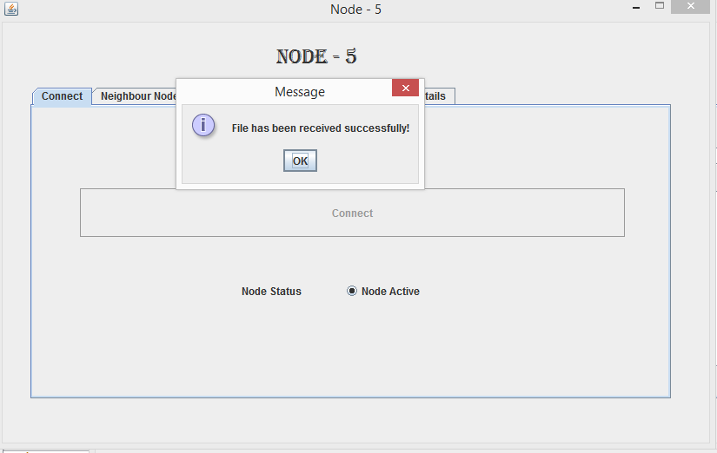
DATA RECEIVED STATUS

Slide 26
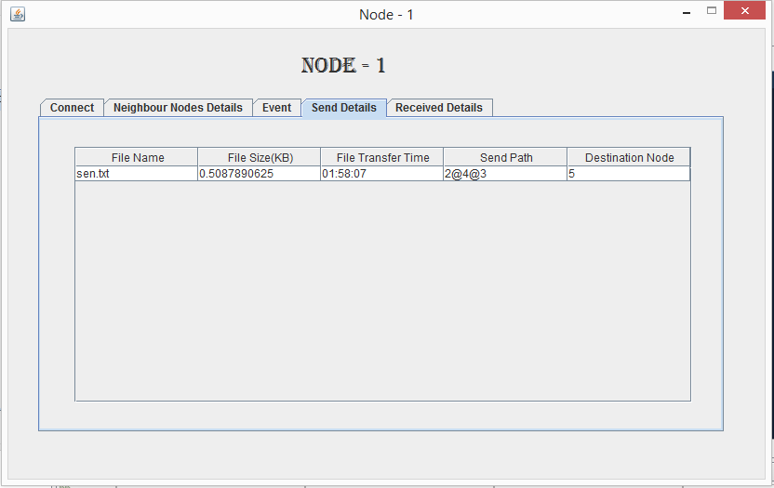
DATA SENT LOG DETAILS

Slide 27
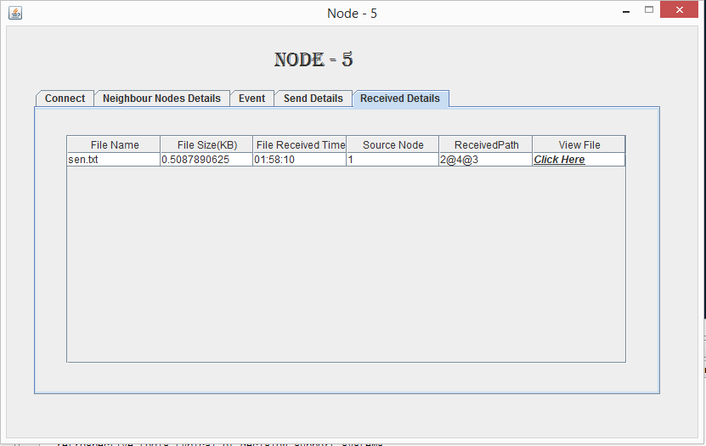
DATA RECEIVED LOG

Slide 28
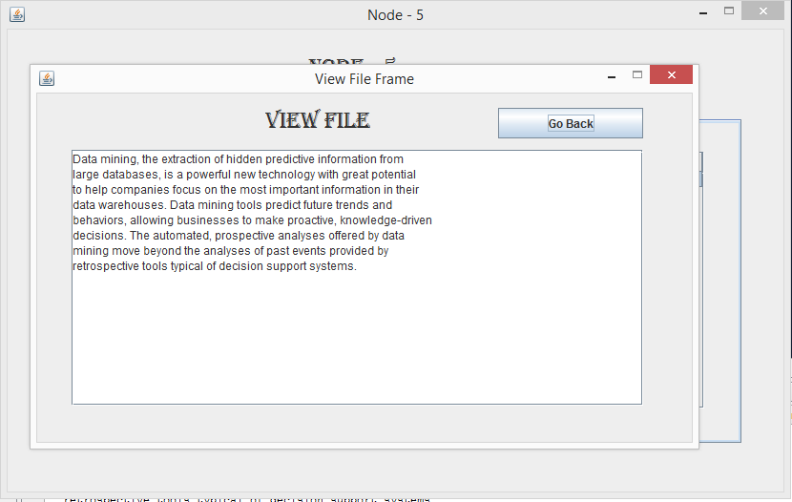
VIEW TRANSFERRED DATA

Slide 29
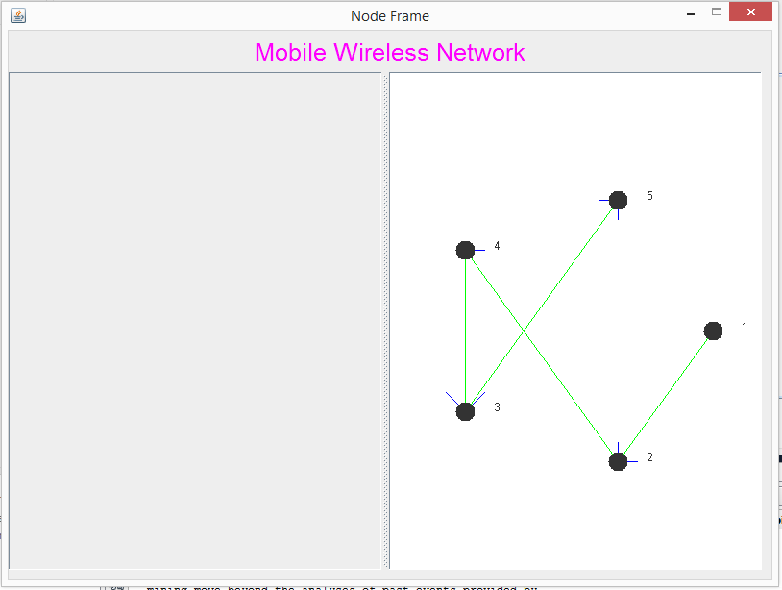
ROUTE DETERMINATION WITH ALL NODES IN ACTIVE STATE

Slide 30
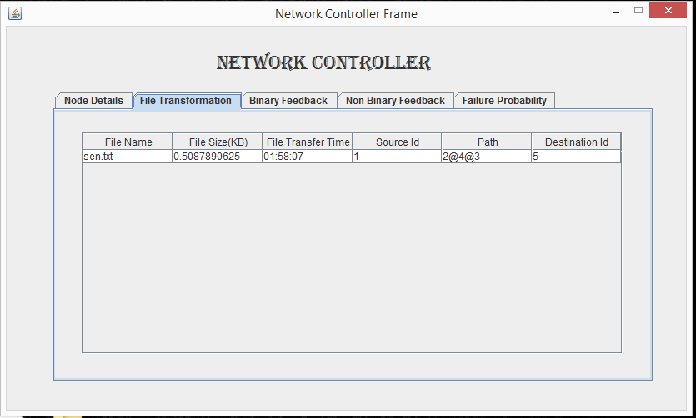
NETWORK CONTROLLER LOG

Slide 31
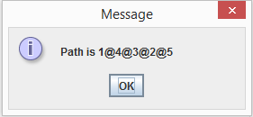
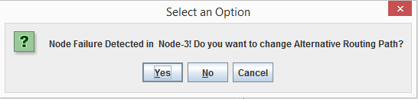
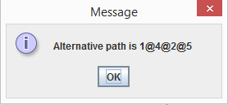
DATA TRANSFER WHEN A INTERMEDIATE NODE FAILS

Slide 32

DATA RECEIVED STATUS AFTER FAILURE OF A NODE

Slide 33
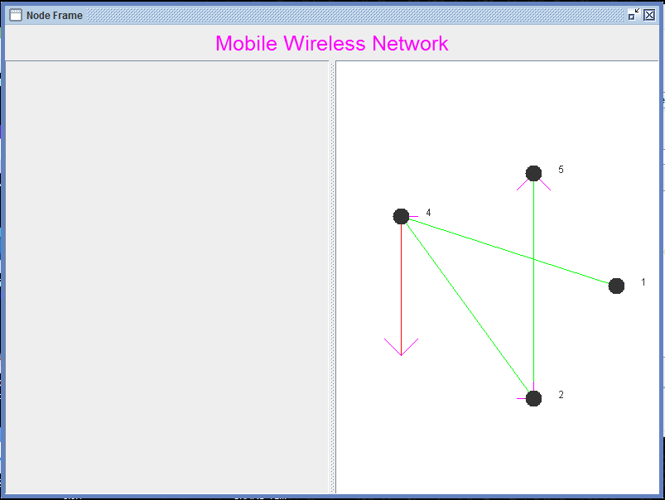
ROUTE DETERMINATION WITH ONE FAILURE NODE

Slide 34
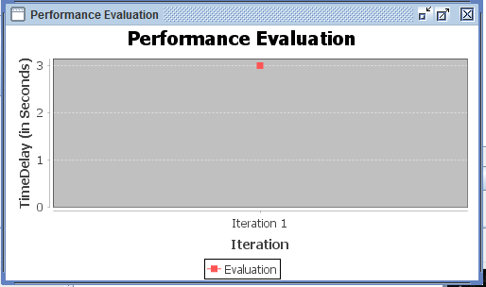
PERFORMANCE EVALUATION GRAPH

Slide 35
CONCLUSION
Re-enactment results exhibit that the confinement precision of the proposed calculation is better than the beforehand hub restriction calculation.
The confinement mistake of the KELM-HQ calculation is improved by 34.6%, 19.2% and 11.9% contrasted and that of the fast SVM, the GADV-Hop and the DV-Hop-ELM calculation separately.
The proposed calculation is helpful in hub confinement applications, can profoundly decrease the hub restriction mistake and keep a decent confinement exactness

Slide 36
FUTURE ENHANCEMENT
A model can be developed by taking a larger sample and by further authenticating and validating the findings.
Some concrete ideas can be generated to solve the localization errors and also extend accuracy level.

Slide 37
References
F. Zhu and J. Wei, Localization algorithm for large scale wireless sensor networks based on fast-SVM, Wireless Pers. Commun., vol. 95, pp. 1859- 1875, Sept. 2016.
L.Y. Chen et al, RLAN: range-free localisation based on anisotropy of nodes for WSNs, Electronics Lett., vol. 51, no. 24, pp. 2066-2068, Nov. 2015.
S.C. Wang et al, Low-complexity message-passing cooperative localization in wireless sensor networks, IEEE Commun. Lett., vol. 21, no. 9, pp. 2081-2084, Sept. 2017.
X.H. Chang and X. Luo, An improved self-localization algorithm for ad hoc network based on extreme learning machine, in Proc. World Congress on Intelligent Control and Automation Conference, pp. 564-569, Jun. 2014

Slide 38
QUERY

Slide 39
THANK YOU

