Slide 1
RELIABLE &
RESPONSIBLE
Foundation Models
A practitioner's field map of nine open problems
Short-story review of Yang et al., TMLR 10/2025 · arXiv:2602.08145
Preetam Gowri · Graduate short-story assignment

Slide 2
01
Why this paper matters
Foundation models in production are probabilistic systems with coupled failure modes
If you ship with a foundation model in 2026, you ship a system that hallucinates, leaks, drifts, gets jailbroken, and reflects training-data skew.
1.
2.
3.
None of the failure modes
are independent.
Fixing one axis
often pays in another.
Yang et al. map the
entire problem space.
Yang et al. 2025/2026 — TMLR

Slide 3
02
The paper
168 pages. 60+ co-authors. >1000 references. One field map.
What's new vs. prior surveys
Reliable and Responsible Foundation Models: A Comprehensive Survey
Holistic frame
9 dimensions × 4 model classes — every chapter visits all four.
Cross-cutting analysis
§12 connects bias↔security, privacy↔attacks, alignment↔uncertainty.
Honest open problems
Every chapter ends with limitations + future directions.
Yang, Han, Bommasani, Luo, Qu, Zhou, Bibi
+ 60 more co-authors
TMLR 10/2025 · arXiv:2602.08145 · Feb 2026
CMU · Oxford · Stanford · NYU · UNC · Penn · ETH · UMD
Yang et al. 2025/2026 — TMLR

Slide 4
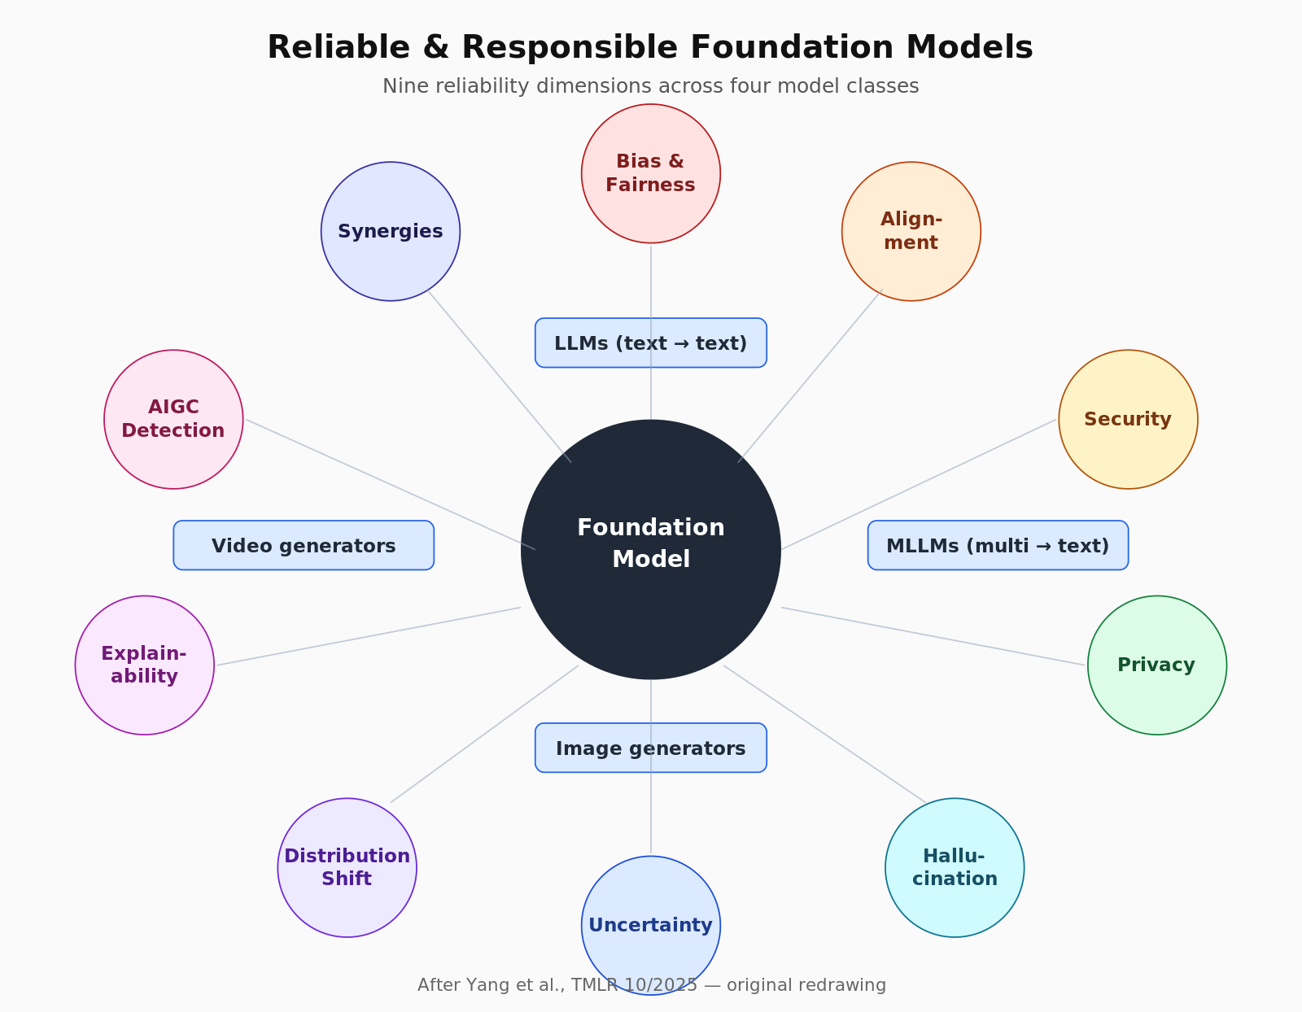
03
The nine dimensions
Bias · Alignment · Security · Privacy · Hallucination · Uncertainty · Shift · Explainability · AIGC
Yang et al. 2025/2026 — TMLR

Slide 5
04
Four model classes
Every reliability problem manifests differently across them
LLM
MLLM
text → text
multi → text
BERT · GPT · T5 · Llama · Qwen3
GPT-4o · Gemini 2.5 · Claude 4 · Qwen2.5-VL
Image gen
Video gen
text+ref → image
text+ref → video
Stable Diffusion · Flux · DALL-E
Sora · Veo · Kling · Open-Sora
Yang et al. 2025/2026 — TMLR

Slide 6
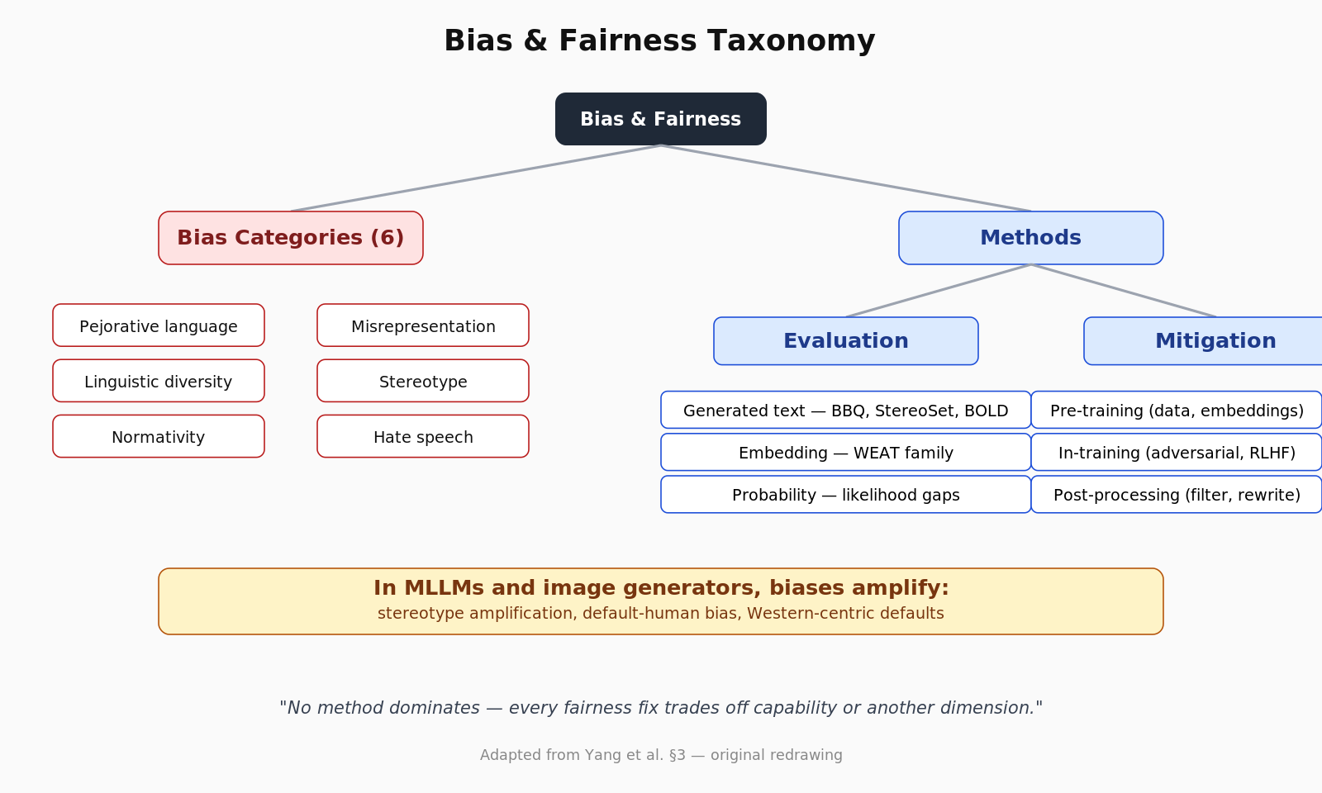
05
Bias & Fairness
Six bias categories. Three evaluation families. Three mitigation stages.
Yang et al. 2025/2026 — TMLR

Slide 7
06
Bias — what to remember
No method dominates; trade-offs are everywhere
1
Categories
pejorative · linguistic diversity · normativity · misrepresentation · stereotype · hate speech
2
Evaluation
generated text (BBQ/StereoSet) · embedding (WEAT) · probability (likelihood gaps)
3
Mitigation
pre-training (data) · in-training (adversarial, fair RLHF) · post-processing (filter, rewrite)
4
Multimodal
stereotype amplification — bias gets worse, not better, in image generators
Yang et al. 2025/2026 — TMLR

Slide 8
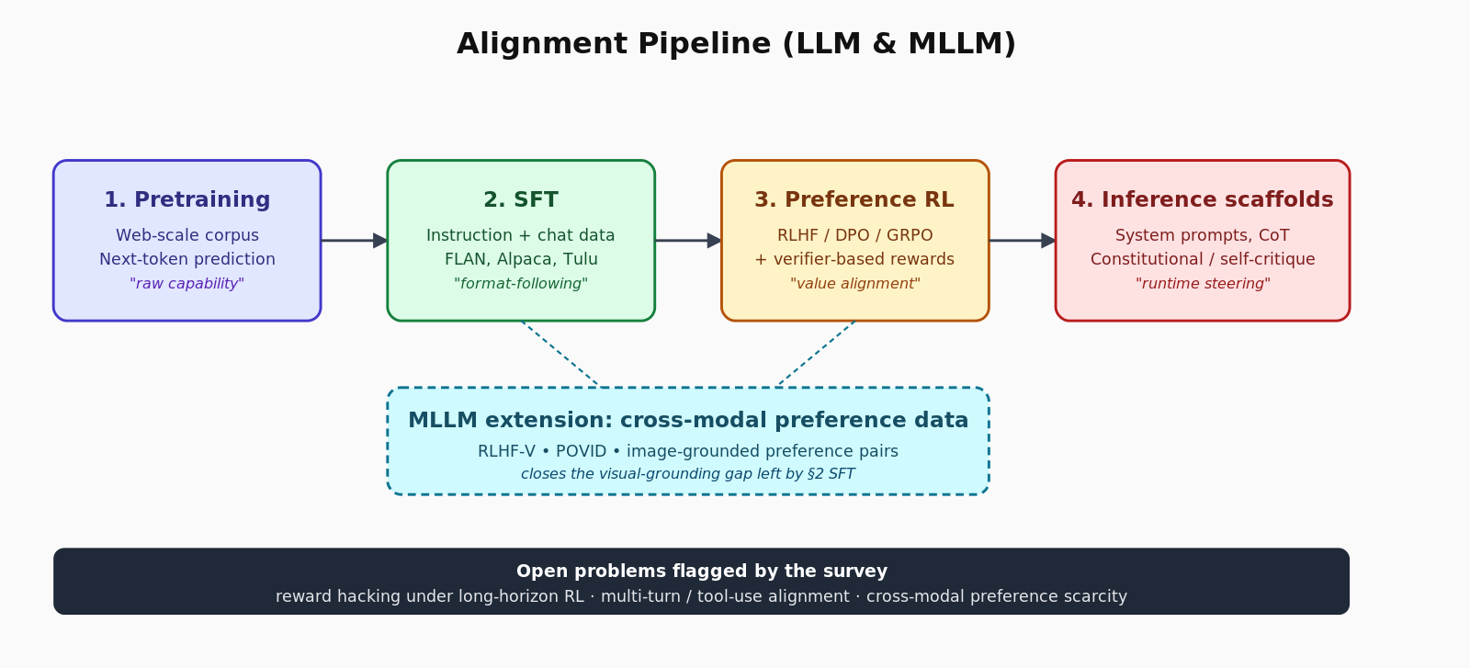
07
Alignment
From pretraining to inference scaffolds — and the cross-modal extension
Yang et al. 2025/2026 — TMLR

Slide 9
08
Alignment — what changed since 2022
RL recipes proliferated; verifier-based reward replaced reward models for many domains
Three pillars
SFT
instruction + chat data; quality > quantity
RLHF / DPO / GRPO
preference RL — and verifier-based variants
Inference scaffolds
system prompts, CoT, constitutional, self-critique
Open problems
Reward hacking
longer RL horizons exploit the reward, not the preference
Multi-turn / tool-use
preference data is overwhelmingly single-turn
Cross-modal preferences
RLHF-V / POVID extend to image-text pairs
Yang et al. 2025/2026 — TMLR

Slide 10
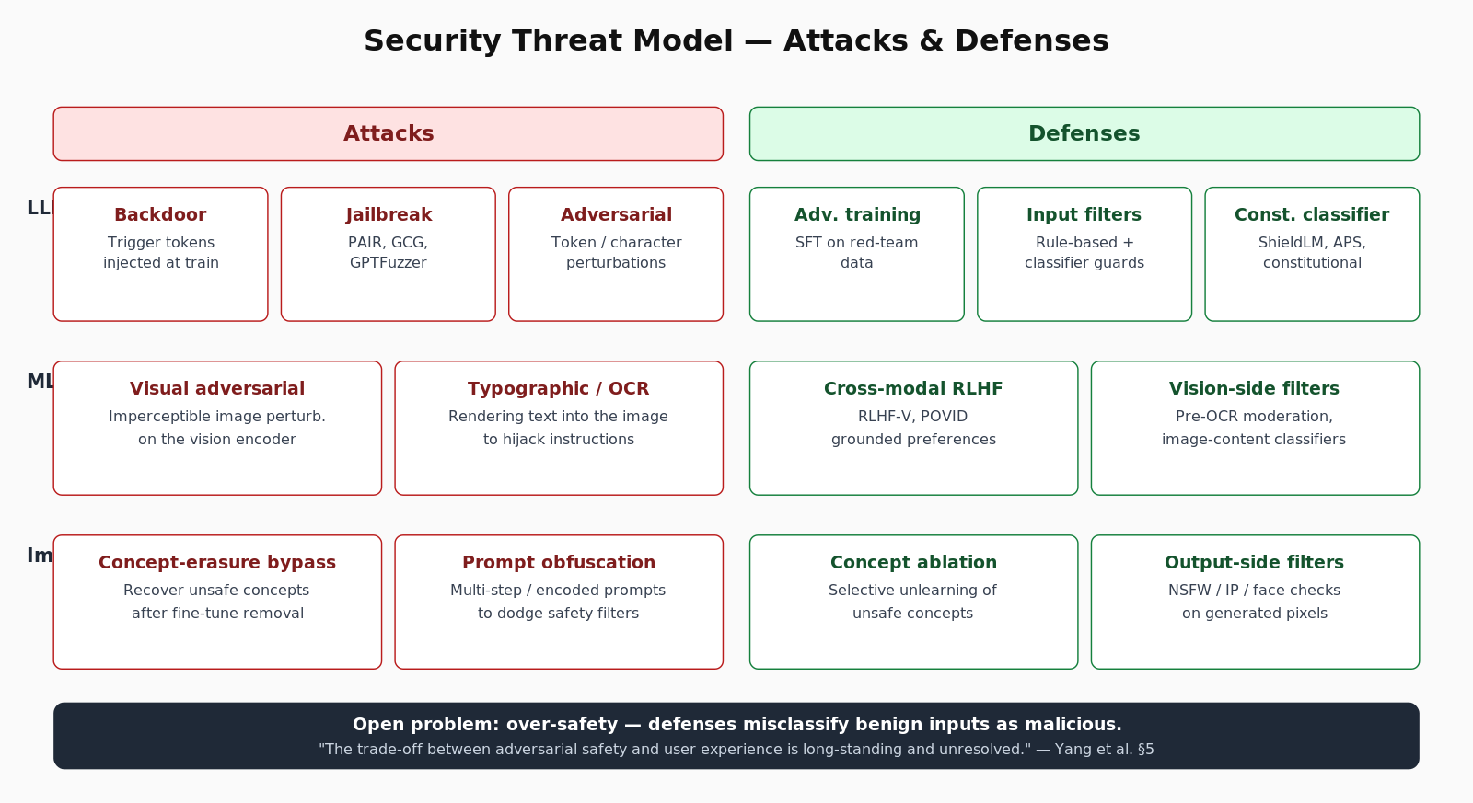
09
Security
Attacks vs defenses, by model class
Yang et al. 2025/2026 — TMLR

Slide 11
10
Security — the over-safety problem
Refusing benign inputs is what users notice as 'the model being annoying'
Where the work is going
Long-standing
Constitutional classifiers — separate LLM-based safety filter trained on explicit rules.
ShieldLM / Adversarial Prompt Shield — customizable, explainable detection.
Calibrated refusal — say no with a reason, not a wall.
On-the-fly defenses — guard quality without retraining.
&
UNRESOLVED
safety ↔ user experience trade-off (Yang et al. §5)
Yang et al. 2025/2026 — TMLR

Slide 12
11
Privacy
Memorization, extraction, model stealing — and the defenses that exist
Threats
Defenses (rigorous)
Defenses (engineering)
Membership inference
Training-data extraction
Prompt + model stealing
Differential privacy (DP-SGD)
MPC + homomorphic crypto
(strong guarantees, costly)
PII scrubbing
Deduplication
Output filtering
Yang et al. 2025/2026 — TMLR

Slide 13
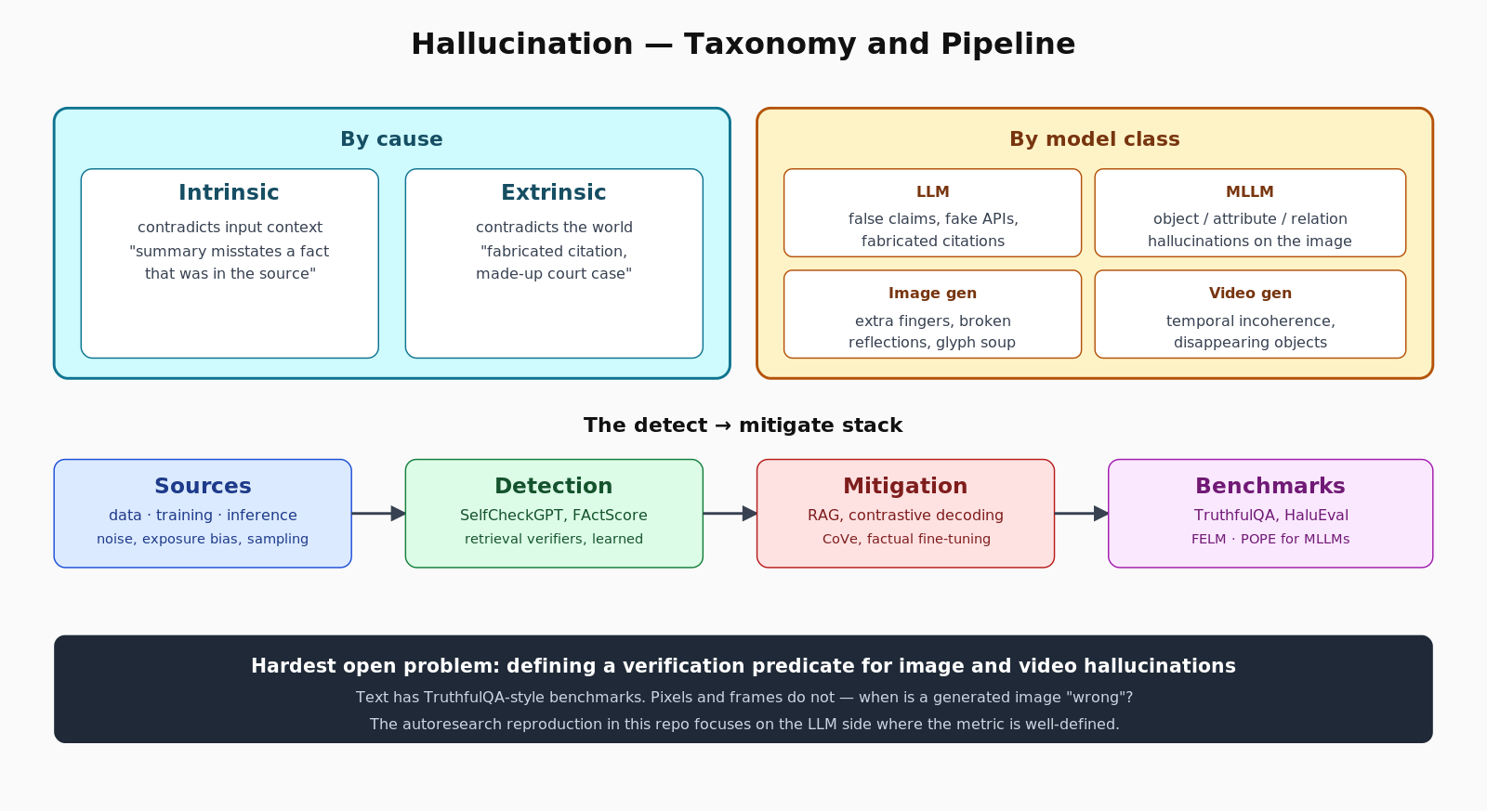
12
Hallucination
By cause, by model class — and the detect→mitigate stack
Yang et al. 2025/2026 — TMLR

Slide 14
13
Hallucination — the practical stack
What you actually wire up in production
Sources
noisy training data · exposure bias · sampling temp
Detection
SelfCheckGPT · FActScore · retrieval verifiers · learned detectors
Mitigation
RAG · contrastive decoding · CoVe · factual-aware fine-tuning
Benchmarks
TruthfulQA · HaluEval · FELM · POPE (multimodal)
Yang et al. 2025/2026 — TMLR

Slide 15
14
Uncertainty
Aleatoric vs epistemic — and four ways to quantify it
Estimation
Calibration
token logprobs · sample variance · ensemble disagreement
temperature/Platt scaling · Bayesian heads · conformal sets
Verbalized
Distribution-free
fine-tune the model to say '70% confident' calibratedly
conformal prediction without parametric assumptions
Yang et al. 2025/2026 — TMLR

Slide 16
15
Distribution shift
Three shift types · OOD detection · OOD generalization · domain adaptation
Why it matters: a model trained on 2023 web confidently says Messi plays for PSG. He plays for Inter Miami.
Covariate
Label
Concept
input distribution changes
P(X) shifts
output distribution changes
P(Y) shifts
input↔output relation changes
P(Y|X) shifts
The long-term answer: continual / lifelong learning — without catastrophic forgetting in either direction.
Yang et al. 2025/2026 — TMLR

Slide 17
16
Explainability
The closest thing the field has to a unifying lens
1.
Raw features
gradients, SHAP, attention rollout
2.
Internal knowledge
probing, mechanistic interp., sparse autoencoders
3.
Training-data role
influence functions, datamodels
4.
Evaluation
faithfulness, plausibility, simulatability
5.
Applications
debugging, audit, scientific discovery
Yang et al. 2025/2026 — TMLR

Slide 18
17
AIGC detection
Three families. None robust to all attacks.
Zero-shot
perplexity / log-likelihood gaps · LLM-as-judge
Cheap. Brittle.
Watermark
training-free or learnable logit-bias schemes
Robust to paraphrasing is the new bar.
Neural
binary classifier on (real, generated) pairs
SOTA in-distribution. Collapses adversarially.
"Perfect detection at deployment scale is unlikely." — Yang et al. §11
Yang et al. 2025/2026 — TMLR

Slide 19
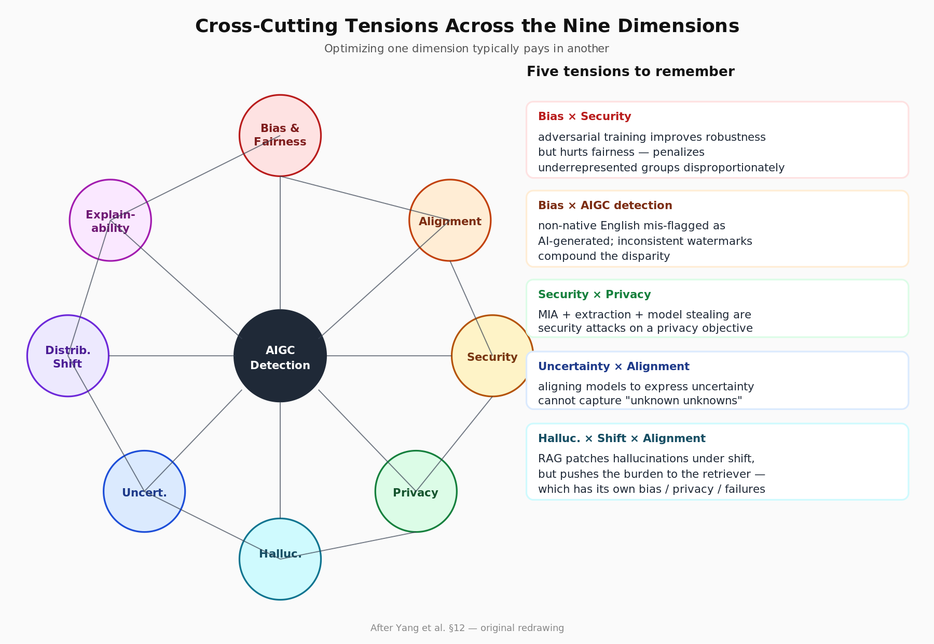
18
Where the dimensions collide
The cross-cutting analysis is the survey's real contribution (§12)
Yang et al. 2025/2026 — TMLR

Slide 20
19
Five specific tensions to remember
Optimizing one axis costs another
Bias × Security
adversarial training improves robustness but degrades fairness — penalizes underrepresented groups disproportionately.
Bias × AIGC detection
detectors mis-flag non-native English as AI-generated; watermark systems can compound this.
Security × Privacy
MIA, extraction, model stealing are security attacks on a privacy objective. Defenses overlap.
AIGC × Society
misinformation, voice cloning, hyper-personalized fraud — technical detection alone is insufficient.
Hallucination × Shift × Alignment
RAG is a partial fix but pushes the burden to the retriever (which has its own failures).
Yang et al. 2025/2026 — TMLR

Slide 21
20
A small reproduction
Wiring the survey to runnable code via the autoresearch template
Hallucination evaluation harness
Goal: make the hallucination chapter (§7) concrete and measurable.
Setup: 200 probes across 6 categories · open 7B chat model · LLM-judge verification.
Plumbing: configs/ runs/ src/ data/ results/ — autoresearch template structure.

Slide 22
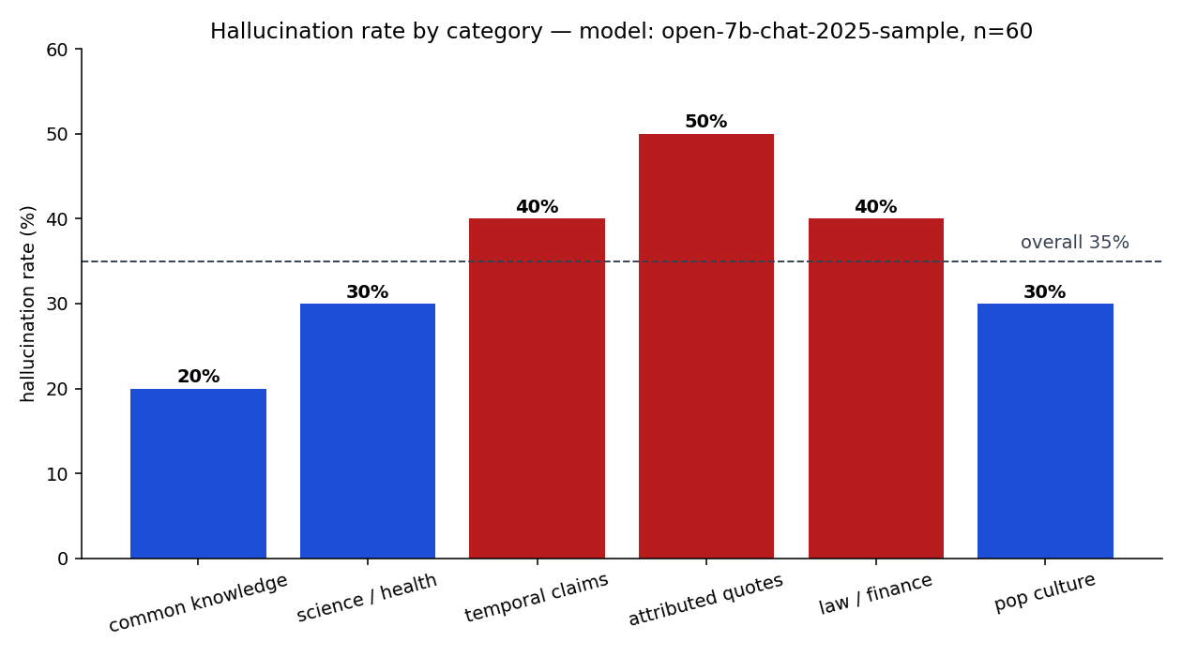
21
Reproduction results
Top-failing categories match the survey's intrinsic-hallucination prediction
Yang et al. 2025/2026 — TMLR

Slide 23
22
Reproduction methodology
Numbers small enough to run in an afternoon; structure suitable for scale-up
Pipeline
What it ties to in the paper
load probes
prompt model under test
LLM-judge labels each (probe, response)
aggregate by category
plot + dump JSON results
§7.1 intrinsic vs extrinsic hallucinations
§7.3 self-consistency / judge-based detection
§7.4 where mitigation should focus first
§12 judge bias bleeds into evaluation
Yang et al. 2025/2026 — TMLR

Slide 24
23
What the survey gets right
Three structural strengths
Discipline of structure
every chapter visits all four model classes; comparisons stay honest.
Trade-off language
§12 names the cross-axis tensions instead of pretending they don't exist.
Future-directions sections
every chapter ends with concrete open questions you can scope work against.
Yang et al. 2025/2026 — TMLR

Slide 25
24
What I'd push on
Three areas thinner than their 2026 importance
Agentic safety
multi-turn tool use is barely covered — most new failure modes live there.
Long-context regimes
calibration / hallucination / attention drift change qualitatively past 32k tokens.
Reasoning models
o1 / R1 / Qwen3 family has its own alignment + uncertainty profile not analyzed.
Yang et al. 2025/2026 — TMLR

Slide 26
25
How to read 168 pages efficiently
Two paths through the survey
30 minutes — extract signal
A weekend — make it stick
Start with §1 + §12 (frame).
Jump to your failure-mode chapter.
Skim Tables 1, 2, 3.
Read every "limitations" subsection.
Read whole.
For each chapter, write your own one-page taxonomy.
Run a tiny experiment for one dimension.
Re-read §12 with your notes open.
Yang et al. 2025/2026 — TMLR

Slide 27
The big takeaway
You cannot optimize
one dimension
without paying in another.
Multi-objective benchmarks. Joint mitigations. Honest trade-off accounting.

Slide 28
26
Repository structure
Everything for the assignment lives in one public GitHub directory
├── article/article.md
│ 4,000-word Medium piece (publish from this)
├── slides/
│ .pptx + .pdf + SlideShare-ready export
├── video/
│ script + recorded mp4 + YouTube link
├── autoresearch/
│ configs · src · data · results · notebook
├── figures/
│ original SVG + PNG diagrams used in article + slides
└── paper/
2602.08145v1.pdf (the original survey)
Yang et al. 2025/2026 — TMLR

Slide 29
27
Reference
Yang, X., Han, J., Bommasani, R., Luo, J., Qu, W., Zhou, W., Bibi, A., Wang, X., Yoon, J., Stengel-Eskin, E., et al. (2025). Reliable and Responsible Foundation Models: A Comprehensive Survey. Transactions on Machine Learning Research, 10/2025. arXiv:2602.08145 — https://arxiv.org/abs/2602.08145
Companion artifacts
Medium article · SlideShare · YouTube walkthrough · GitHub repo
Yang et al. 2025/2026 — TMLR

Slide 30
Thank you.
Questions, critique, and corrections welcome.
Preetam Gowri · Short-story assignment · May 2026

