Slide 1
Profiles
Profiles
Notes:
POINTS TO MAKE

Slide 2
Maven – Profiles
Profiles allows you to accommodate environmental variations in the build lifecycle. Variations like:
Connecting to a different database for tests
Running on a different JVM
Referencing the local file system
DEV, QA, PROD builds will have different profiles specified using a subset of POM elements
To ensure maximum portability, encapsulate as much as you can in the POM

Slide 3
Maven – Profiles [contd...]
Profiles can be defined in 3 ways:
The Maven settings file (typically <user_home>/.m2/settings.xml)
A file in the same directory as the POM, called profiles.xml
The POM itself
Which one takes precedence ?
POM => profiles.xml => settings.xml
Notes:
POINTS TO MAKE

Slide 4
Maven – Profiles [contd...]
settings.xml profiles
potential to affect all builds
sort of a "global" location for profiles
profiles.xml
allows you to augment a single project's build without altering the POM
POM-based profiles
are preferred, since these profiles are portable
Notes:
POINTS TO MAKE

Slide 5
Maven – Profile Elements
<profiles>
<profile>
<id>test</id>
<activation>...</activation>
<build>...</build>
<modules>...</modules>
<repositories>...</repositories>
<pluginRepositories>...</pluginRepositories>
<dependencies>...</dependencies>
<reporting>...</reporting>
<dependencyManagement>...</dependencyManagement>
<distributionManagement>...</distributionManagement>
</profile>
</profiles>
Notes:
POINTS TO MAKE

Slide 6
Maven – Activating Profiles
Profiles can be activated explicitly using the –P CLI option. This option takes an argument that contains a comma-delimited list of profile-ids
When this option is specified, no profiles other than
those specified in the option argument will be
activated
For Ex:
F A S T P O R T F O L I O | Presented by FC Frameworks
mvn –Pprofile1, profile2 install
F I R M W I D E E N G I N E E R I N G & A R C H I T E C T U R E
Notes:
POINTS TO MAKE

Slide 7
Maven – Activating Profiles [contd...]
Profiles can be activated in the Maven settings, via the activeProfiles section. This section takes a list of activeProfile elements, each containing a profile-id. Potential to affect all the builds
For Ex:
<settings>
[...]
<profiles>
<profile>
<id>development</id>
[...]
</profile>
</profiles>
<activeProfiles>
<activeProfile>development</activeProfile>
</activeProfiles>
[...]
</settings>
F A S T P O R T F O L I O | Presented by FC Frameworks
F I R M W I D E E N G I N E E R I N G & A R C H I T E C T U R E
Notes:
POINTS TO MAKE

Slide 8
Maven – Activating Profiles [contd...]
Profiles can be triggered automatically based on the detected state of the build environment. These activators are specified via an activation section in the profile itself
Currently, this detection is limited to prefix-matching of the JDK version, the presence of a system property, or the value of a system property
<profile>
<id>jdk1.4_profile</id>
...
<activation>
<jdk>1.4</jdk>
</activation>
</profile>
F A S T P O R T F O L I O | Presented by FC Frameworks
F I R M W I D E E N G I N E E R I N G & A R C H I T E C T U R E
Notes:
POINTS TO MAKE

Slide 9
Maven – Activating Profiles [contd...]
This will activate the profile when the system property "debug" is specified with any value
This last example will activate the profile when the system property "environment" is specified
with the value "test”
<activation>
<property>
<name>debug</name>
</property>
</activation>
<activation>
<property>
<name>environment</name>
<value>test</value>
</property>
</activation>
F A S T P O R T F O L I O | Presented by FC Frameworks
F I R M W I D E E N G I N E E R I N G & A R C H I T E C T U R E
Notes:
POINTS TO MAKE

Slide 10
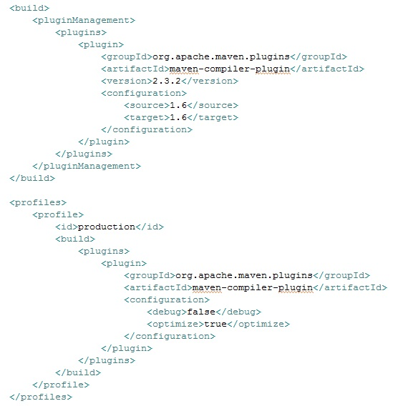
Profiles Example – Activation using -p

Slide 11
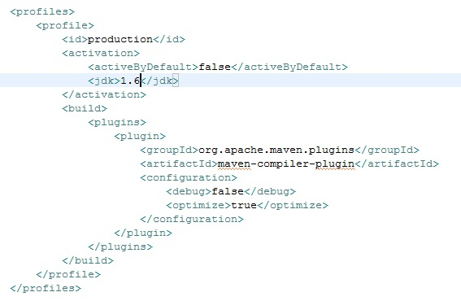
Profiles Example – Activation using jdk version

