Slide 1
Statistical Inference
CS5651
Assignment – Survey Analysis
Gowshalini Rajalingam
219335N

Slide 2

Introduction
One of the foundational parts of the student-teacher-university connection is communication in the university environment.
As more institutions migrate to the red scenario, which means that nearly the entire educational process transfers to the online system on educational teaching and learning platforms, the COVID-19 pandemic has proved the usefulness of these platforms.
As a result, the purpose of the study is to conduct a survey and evaluate the knowledge, attitude, and practice of undergraduate students on e-learning platforms.

Slide 3

Research Question
Do e-learning platforms create a positive impact in the education of undergraduate students in terms of knowledge, attitude, and practice?

Slide 4
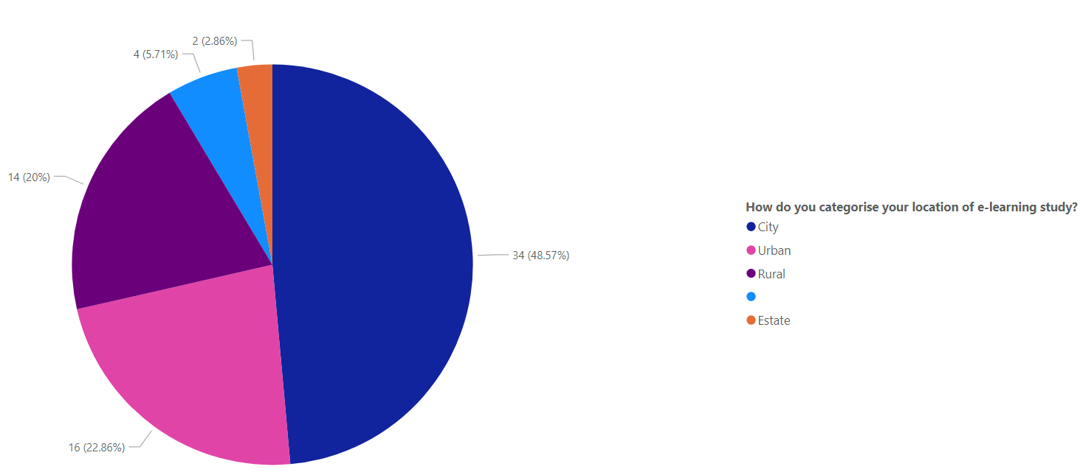
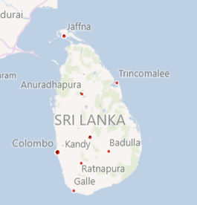
Data
Data collected month – October 2021
Data collection method – Telephone calls, Google Form
Questionnaire structure –
1) Basic Information
2) Availability of e-learning resources
3) Attitude towards e-learning
4) Practice e-learning
5) Knowledge towards e-learning
6) User feedback
Totally 70 responses covering undergraduate students from 8 districts of Sri Lanka
Initially, a pilot study have been done among 5 participants to identify the issue in the questionnaire. Then the modifications have been done

Slide 5
Method - Analysis
The questionnaire was distributed among around all over the universities in Sri Lanka after brief introduction of study to the participants.
Analysis Plan
Initially a descriptive analysis will be done to understand the patterns and insights for KAP(Knowledge, Attitude, Practice).
Since the current education system has been moved rapidly to e-learning platforms due to Covid19 pandemic; the suitable way to evaluate KAP (knowledge, attitude and practice) among undergraduate students on e-learning platforms will be comparing before and after Covid19 pandemic.
Conclusion/ Discussion

Slide 6


Availability of internet resources
Regarding availability of computers and internet facility for purpose of e-learning, 35 (53.03%) owned a personal laptop or computer; majority 65 (98.48%) of them had access to internet facility as shown in Table2.
Table1
Table2

Slide 7
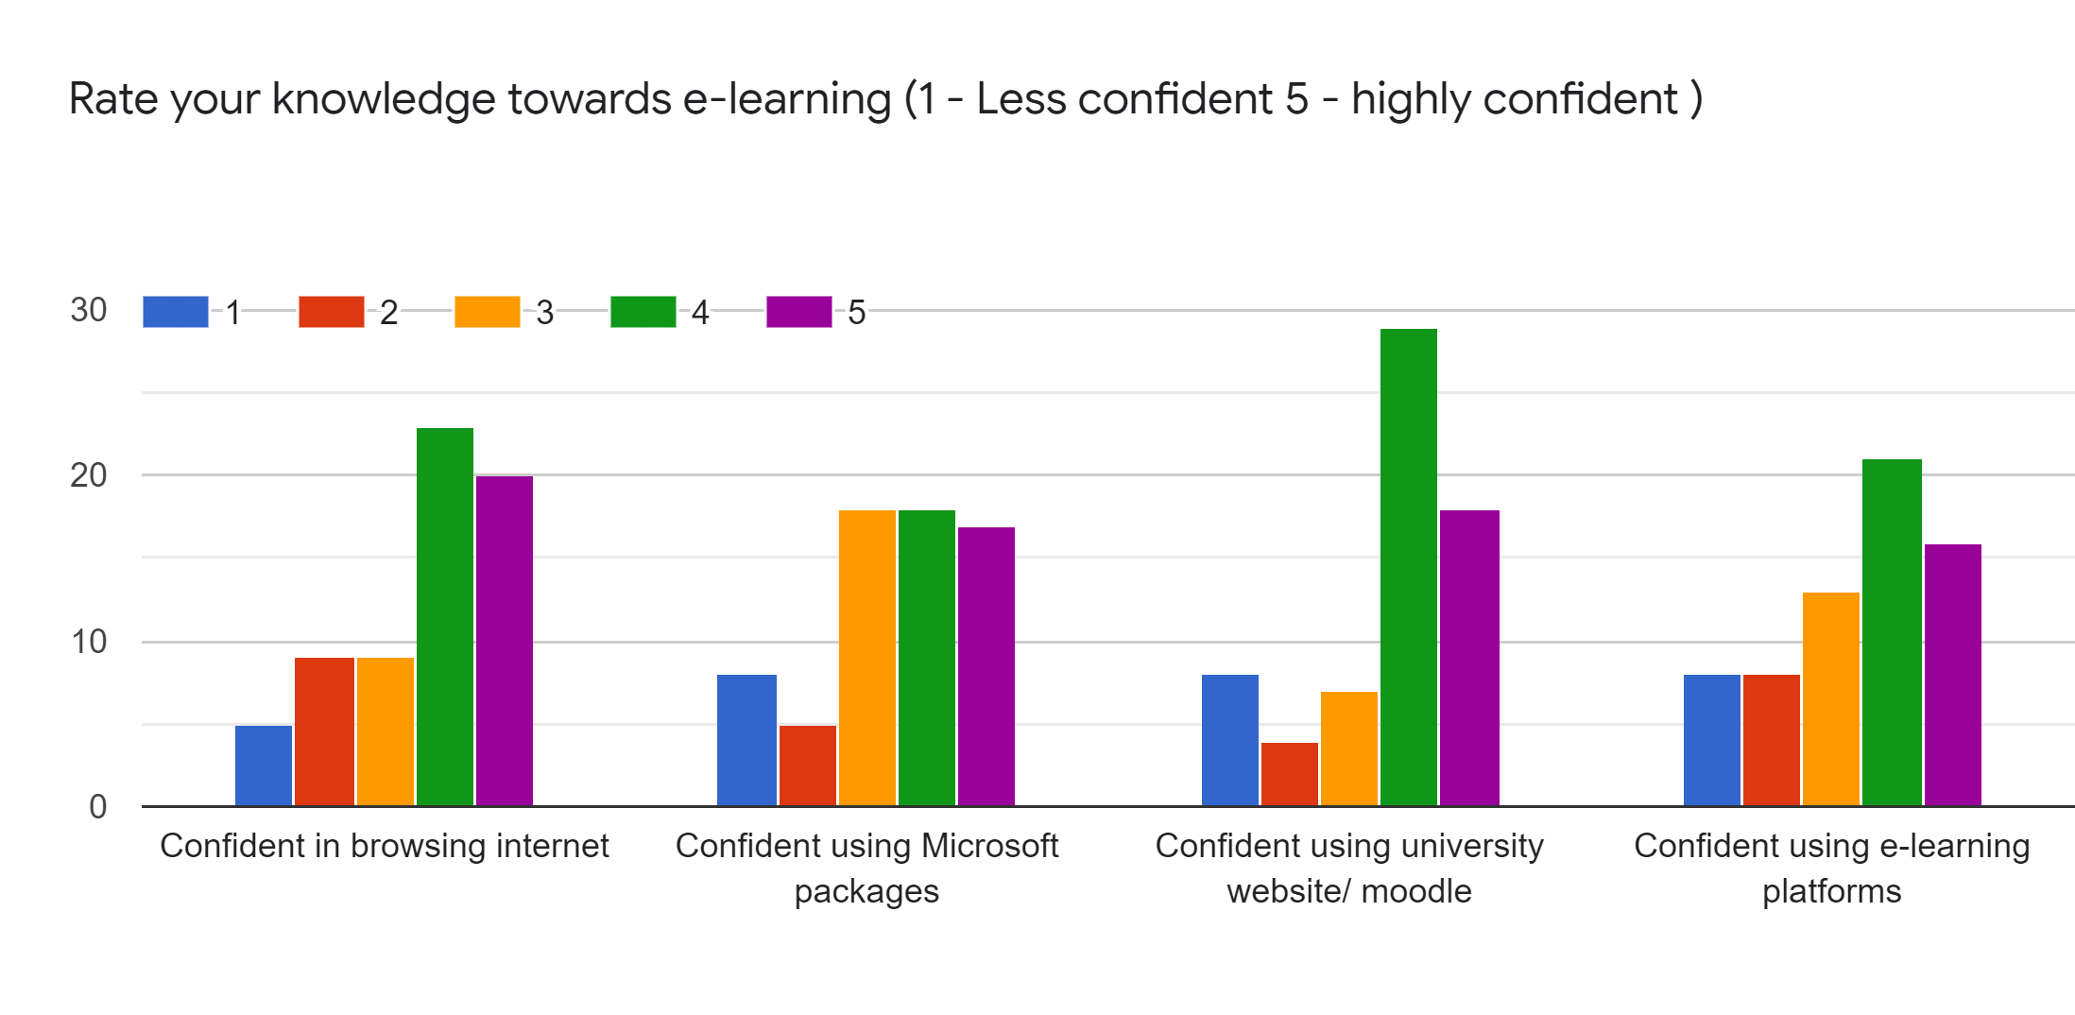
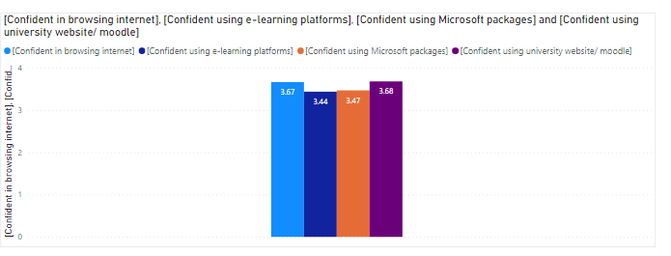
Knowledge towards e-learning
On average all have given around 4 points for confidence in browsing internet, using MS packages, using moodle and using e-learning platforms.

Slide 8
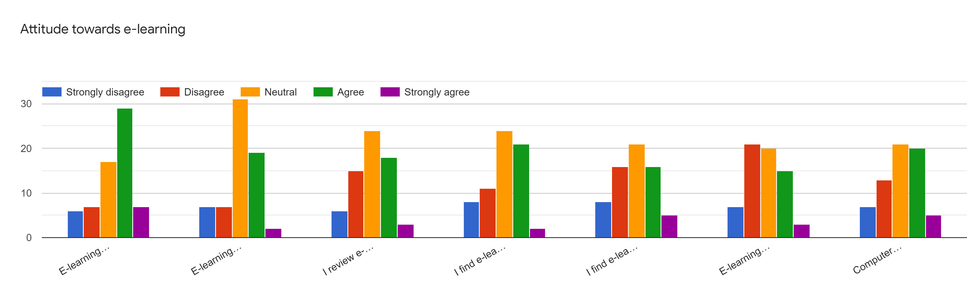
Attitude towards e-learning
E-learning is method of learning and teaching using electronic media
E-learning is useful in my academic performance
I review e-learning material prior to my learning sessions
I find e-learning useful in my self-assessment
I find e-learning useful in exam preparation
E-learning improves standardization of teaching
Computer or web based training should be made available to supplement lectures
Majority are neutral in attitude

Slide 9
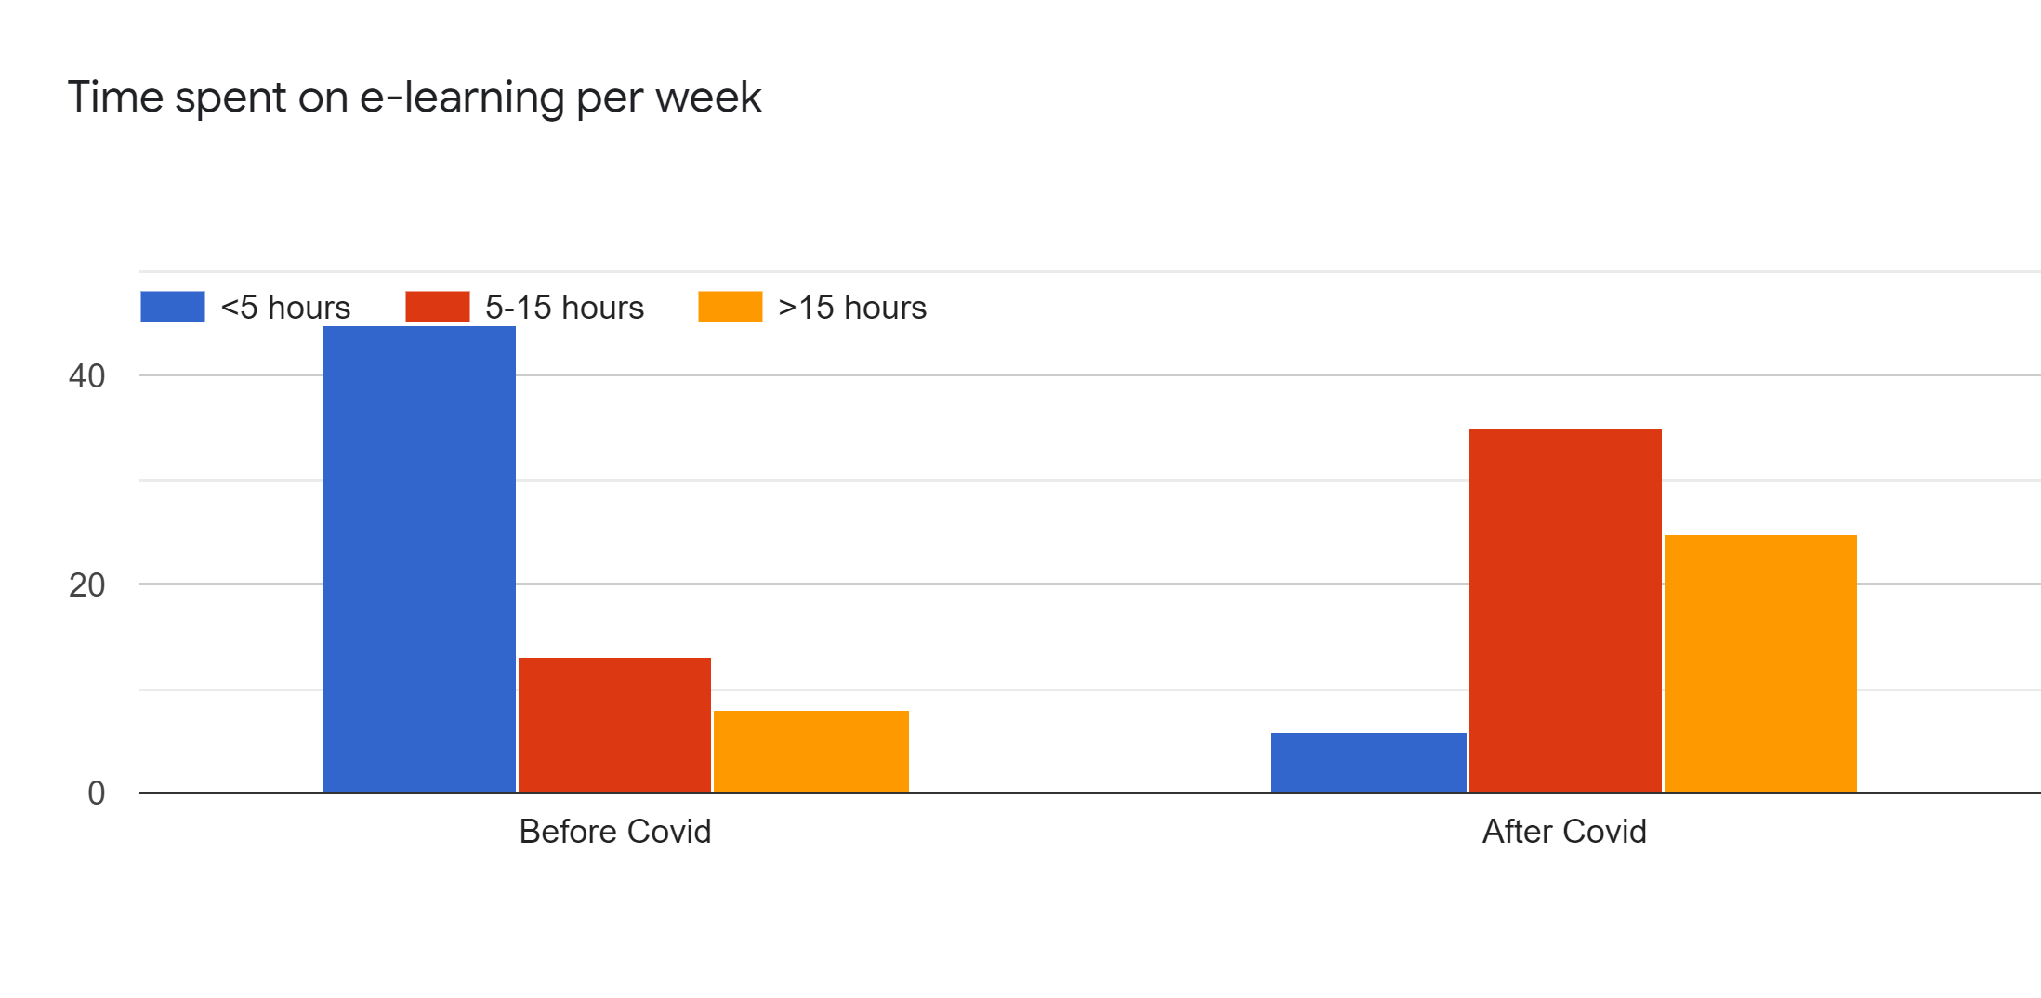
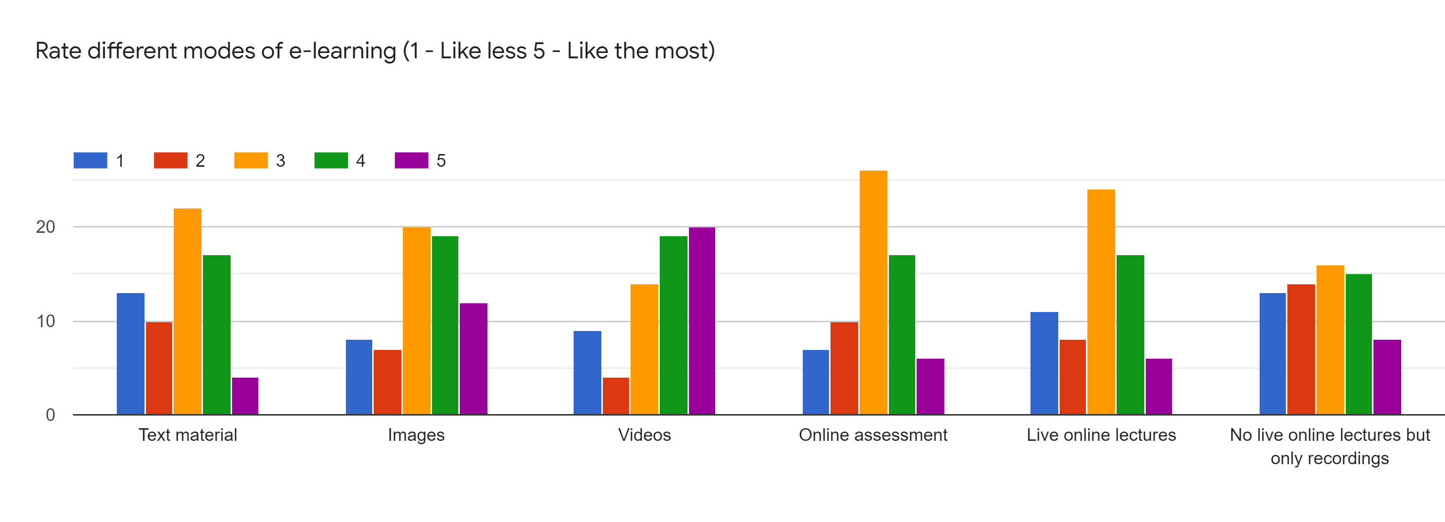
Practice towards e-learning

Slide 10

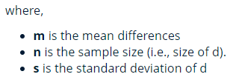
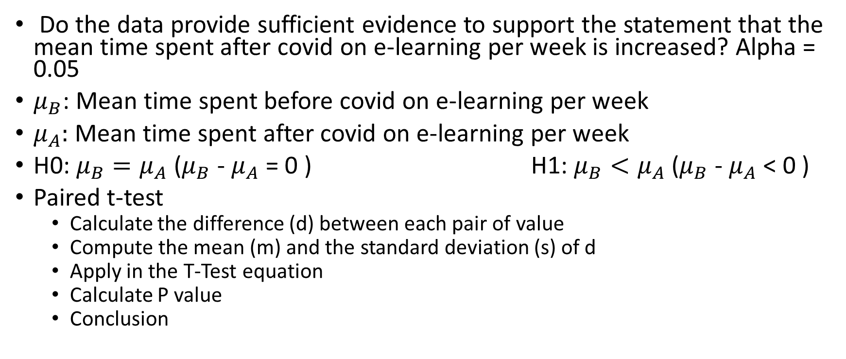
Statistical Test – Comparing two dependent population
Do the data provide sufficient evidence to support the statement that the mean time spent after covid on e-learning per week is increased? Alpha = 0.05
$μ_{B}$: Mean time spent before covid on e-learning per week
$μ_{A}:$Mean time spent after covid on e-learning per week
H0: $μ_{B}=μ_{A}$ ($μ_{B}$ - $μ_{A}$ = 0 ) H1: $μ_{B}<μ_{A}$ ($μ_{B}$ - $μ_{A}$ < 0 )
Paired t-test
Calculate the difference (d) between each pair of value
Compute the mean (m) and the standard deviation (s) of d
Apply in the T-Test equation
Calculate P value
Conclusion

Slide 11

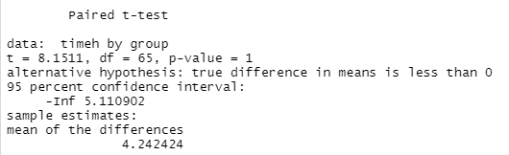
Mean and sd
Assumption 1: Are the two samples paired?
Yes, since the data have been collected from same sample twice.
Assumption 2: Is this a large sample?
Yes. Because n>30
T-Test
t is the t-test statistic value (t = 8.1511),
df is the degrees of freedom (df= 65),
p-value is the significance level of the t-test (p-value = 1).
conf.int is the confidence interval (conf.int) of the mean differences at 95% is also shown (conf.int= [-Inf, 5.110902])
sample estimates is the mean differences between pairs (mean = 4.24).
The p-value of the test is 1 which is greater than the significance level alpha = 0.05. We don’t reject null hypothesis at 5% significant level. We don’t have enough evidence to conclude that mean time spent after covid on e-learning per week is greater than mean time spent before covid on e-learning per week at 5% significant level.
.

Slide 12
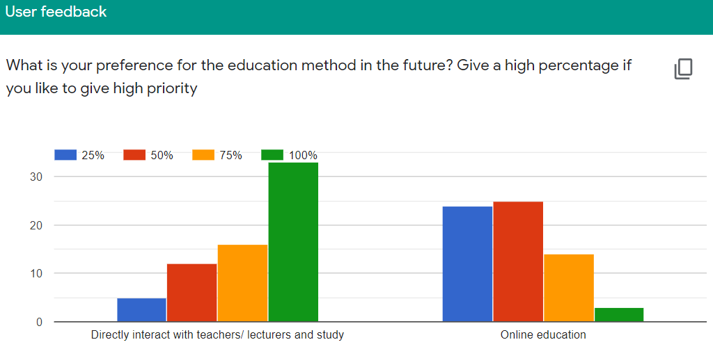
User feed back

Slide 13
Discussion
A total of 70 undergraduate students from all over the Sri Lanka participated in the study. Out of 70 only 66 are studying via online. 44 (66.67%) were females, 22 (33.33%) were males belonging to the age group 19-25 years with mean age of 20.28±2 years.
The dis-satisfied and very dis-satisfied percentage in availability of resources for e-learning is 9.09%. Therefore, there is need to provide necessary resources.
Students had neutral KAP towards e-learning and accepted supplementation of e-learning in regular traditional teaching methods. Lack of knowledge in computer skills along with poor technological infra-structure and resources at the institution could be a challenge for implementation of e-learning.
According to the user feed back majority of the students are felt that Directly interact with teachers/ lecturers is better than Online education.
In future we can analyze binary data, ranked data and quantitative data with the chi-square test, rank sum test and t-test, respectively. We will do multivariate analysis to find the impact factors of KAP on e-learning platforms.

Slide 14
Reference
R paired test: http://www.sthda.com/english/wiki/paired-samples-t-test-in-r

