Slide 1
Project Name:
SHOPNEST STORE
POWER BI DASHBOARD
Platform:
Power BI Desktop
Data Source:
ShopNest Store
Period:
2016 – 2018
Metrics:
Revenue · Orders · Ratings · Delays · Payment Methods
Developed by:
Gowtham V

Slide 2
Agenda
6-Step Framework to Build the ShopNest Store Power BI Dashboard
Problem Understanding
DAX Usage
01
04
Define business questions & KPI objectives
Core measures: Revenue, Delays, Ratings, YoY
Data Preparation
Dashboard Design
02
05
Source, clean & structure 9 datasets
Layout, visuals, slicers & UX best practices
Data Modelling
Business Insights
03
06
Build star schema relationships in Power BI
Key findings and recommendations

Slide 3
Step 1 – Problem Understanding
Defining Business Questions & Goals
What Problem Are We Solving?
ShopNest has no unified view of sales performance, delayed orders, and customer ratings across 9 separate data tables
Data is scattered across multiple systems — no single source of truth to track KPIs like delayed orders, top categories, or payment trends
Leadership cannot identify which product categories drive revenue or which states have the highest/lowest sales in real time
Manual analysis makes it impossible to drill from state-level sales down to product-level ratings and seasonal patterns
Dashboard Objective
Build a Power BI dashboard that gives ShopNest a real-time interactive view of Revenue, Orders, Delays, Ratings, and State-wise Sales — enabling faster decisions and clear identification of top/bottom performing categories and regions.

Slide 4
Step 2 – Data Preparation
Loading, Cleaning & Transforming the 9 Datasets
Dataset Overview
Data Cleaning Steps (Power Query)
9 source tables: Customers, Geolocation, Orders, Order Items, Payments, Reviews, Products, Sellers, Product Categories
Period: 2016–2018 | Market: Portugal
~100K orders with lat/lng geolocation data
Product categories in English
Remove duplicates and null rows from all tables
Parse date columns: order_purchase, estimated_delivery, actual_delivery
Create IsDelayed column: actual > estimated delivery date
Merge product_category_name_english for readable labels
Column Data Types
Derived Columns to Add
Date → Date | Price → Decimal | Qty → Whole Number
Review Score → Whole Number (1–5)
Payment Type → Text | Customer State → Text
Freight Value → Decimal Number
IsDelayed = IF(actual_delivery > estimated_delivery, 1, 0)
Year = YEAR(order_purchase_timestamp)
Quarter = 'Q' & ROUNDUP(MONTH(Date)/3, 0)
Total Revenue = SUM(price) + SUM(freight_value)

Slide 5
Step 2 – Source Data Snapshot
Raw Data Structure from 9 Source Files
Order ID | Customer State | Category | Price | Is Delayed | Review Score | Payment Type | Revenue | Billing Qty
ORD-0001 | SP | beleza_saude | $45.90 | No | 5 | credit_card | $4.2M | 1.3M
ORD-0002 | RJ | relogios_presentes | $120.00 | Yes | 2 | boleto | $5.1M | 1.2M
ORD-0003 | MG | cama_mesa_banho | $89.50 | No | 4 | credit_card | $3.8M | 1.0M
ORD-0004 | RS | esporte_lazer | $55.00 | Yes | 3 | voucher | $2.1M | 1.0M
ORD-0005 | BA | informatica_acess | $220.00 | No | 5 | debit_card | $4.6M | 0.9M
ORD-0006 | PR | moveis_decoracao | $310.00 | No | 4 | credit_card | $3.9M | 0.7M
Source Tables:
Orders
Customers
Products
Payments
Reviews
Geolocation
Sellers
Order Items
Categories

Slide 6
Step 3 – Data Modelling
Building the Star Schema in Power BI
Date
Product
FACT TABLE
Date
Product ID
Year / Quarter
Fact_Orders & Fact_OrderItems
Category Name (EN)
Month
Order ID · Customer ID · Product ID
Weight / Dimensions
Half Year (H1/H2)
Photos Qty
Seller ID · Payment Type
Customer
Seller
Price · Freight Value
Customer ID
Seller ID
Customer City
Review Score · Is Delayed
Seller City
Customer State
Seller State
Zip Code Prefix
Zip Code Prefix
Star Schema — 1-to-Many Relationships (Orders as Fact, all others as Dimensions)

Slide 7
Step 4 – DAX Usage (Part 1)
Core Measures for Revenue, Delays, Ratings & YoY
Total Revenue
Delayed Orders Count
Total Revenue =
SUMX(
Order_items,
Order_items[price]
+ Order_items[freight_value]
)
Delayed Orders =
CALCULATE(
COUNTROWS(Orders),
Orders[IsDelayed] = 1
)
Sums price + freight across all order line items. Drives KPI card and YoY.
Counts rows where actual delivery exceeded estimated delivery date.
Average Review Score
Avg Rating =
AVERAGEX(
Reviews,
Reviews[review_score]
)
Row-by-row average of review scores 1–5. Shown in KPI card (target ≥ 4.0).

Slide 8
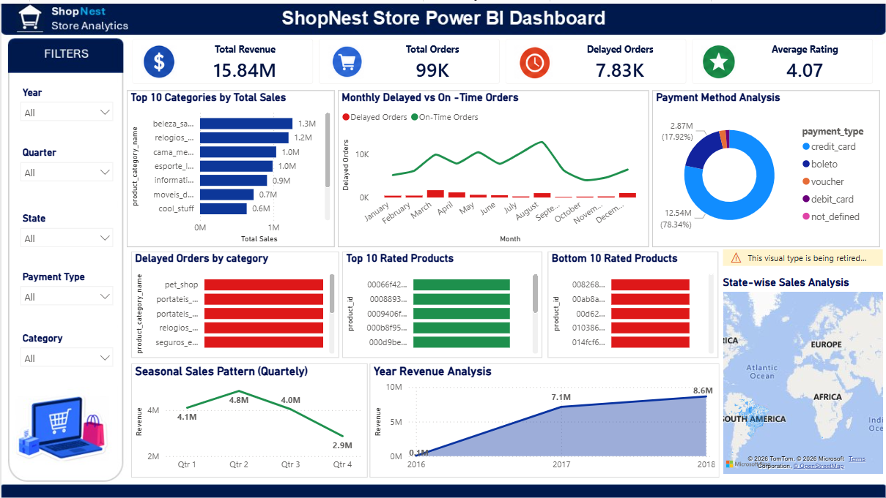

Slide 9
Step 5 – Monthly Trend Analysis
How Metrics Changed 2016 → 2018
📌
Jul–Sep peak: Delayed orders spike to 820 — likely tied to holiday demand surge. On-Time orders peak at 10.2K in Aug. Q4 sees recovery as logistics improve. Seasonal pattern consistent across 2016–2018.

Slide 10
Step 6 – Business Insights
Category & Order-Level Findings
TOP CATEGORIES | ⚡ REVENUE DRIVER
DELAYED ORDERS | ⚠ LOGISTICS RISK
beleza_saude: $1.3M — #1 category, consistently top seller
relogios_presentes & cama_mesa_banho round out top 3 ($1.2M, $1.0M)
Action: Prioritize inventory & promotions for top 3 categories
7,830 delayed orders out of 99K total (~7.9% delay rate)
pet_shop, portateis_cozinha, portateis_casa lead in delays
Action: Review shipping SLA agreements for high-delay categories
PRODUCT RATINGS | ✓ QUALITY BENCHMARK
REVENUE TREND | 🔴 CRITICAL GROWTH
Average rating: 4.07 / 5.0 — above target benchmark
Top 10 products rated 4.5–5.0, bottom 10 below 2.5
Action: Investigate bottom-rated product fulfillment issues
Revenue grew from $0.1M (2016) → $7.1M (2017) → $8.6M (2018)
Q3 seasonal peak every year — Q4 slight dip pattern
Target: Maintain ≥$10M run rate in 2019 via retention programs

