Slide 1
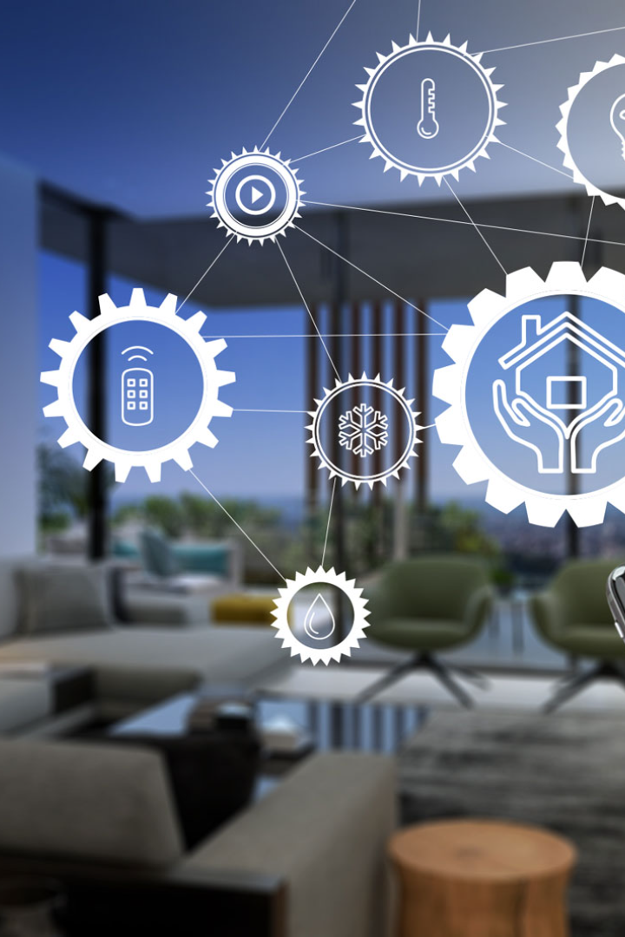
Transform Your Home into a Smart Living Space with IBM Cloud Functions
Imagine a home that can sense your presence, adjust the temperature to your liking, and alert you to possible dangers - all on its own. In this presentation, we'll explore how IBM Cloud Functions can help you make this a reality.

Slide 2
Integrating Smart Devices into Your Home Ecosystem
Thermostats
Motion Sensors
Set the ideal temperature based on your schedule and preferences.
Get notified of movement in your home and track your pets' activity.
Cameras
Alexa/Google Home
Monitor your home while you're away and keep an eye on package deliveries.
Voice control your smart devices and receive reminders or news updates.

Slide 3

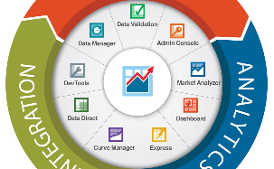
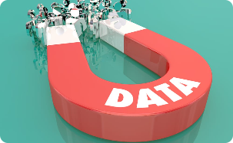
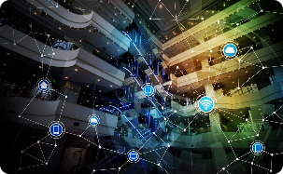
Collecting Data from Your Smart Devices
Connectivity
Data Management
Collection
Ensure your devices have a reliable internet connection for seamless data transfer.
Choose IoT protocols that work for your home devices and that are secure for data sharing and storage.
Set up data collection from your devices to start processing real-time data and make informed decisions.
Sensor Network
Implement a network of sensors to gather data and generate insights for better decision making.

Slide 4
Real-Time Data Processing with IBM Cloud Functions
1
Advantages of Real-Time Data Processing
Receive alerts and take action at the moment of an incident, such as a water leak or unauthorized access.
2
Cloud-Based Processing
Leverage the benefits of cloud-based processing to make real-time decisions on data collected from your smart home devices.
3
Scalability
Handle processing of data from multiple sources and quickly adjust your processing capabilities based on need.

Slide 5
Automating Smart Routines for Energy Efficiency and Home Security
Energy
Security
Automation
Adjust thermostat settings based on your schedule and optimize energy use for maximum efficiency.
Receive alerts and take action when motion is detected or doors/windows are opened or closed.
Set up routines for turning off lights when you leave the room or locking the door when you go to bed.

Slide 6
Storing and Analyzing Data to Gain Insights
IBM Cloud Object Storage
Securely store and manage data from your smart devices in the cloud.
Data Analysis
Analyze data patterns and trends to gain insights into energy usage, security events, and more.
Visualization
Visualize data with easy-to-read graphs and charts and make informed decisions about your home.

Slide 7
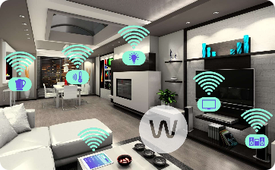
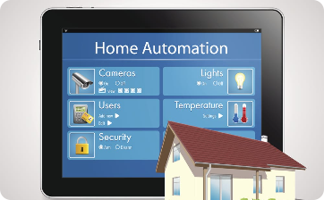

The Power of IBM Cloud Functions for Transforming Your Home into a Smart Living Space
Complete Smart Home Solution
Simplify Your Life
The Future is Here
With IBM Cloud Functions, you can automate routines and simplify your life, leaving more time for the things you love.
Be at the forefront of technology and shape the future of how we live with IBM Cloud Functions.
IBM Cloud Functions offers a complete solution for transforming your home into a smart living space, including device integration, data collection, real-time processing, automation, storage, and analysis.

