Slide 1

Introduction to CZ ID
Notes:
Slides updated 07/02/2024

Slide 2
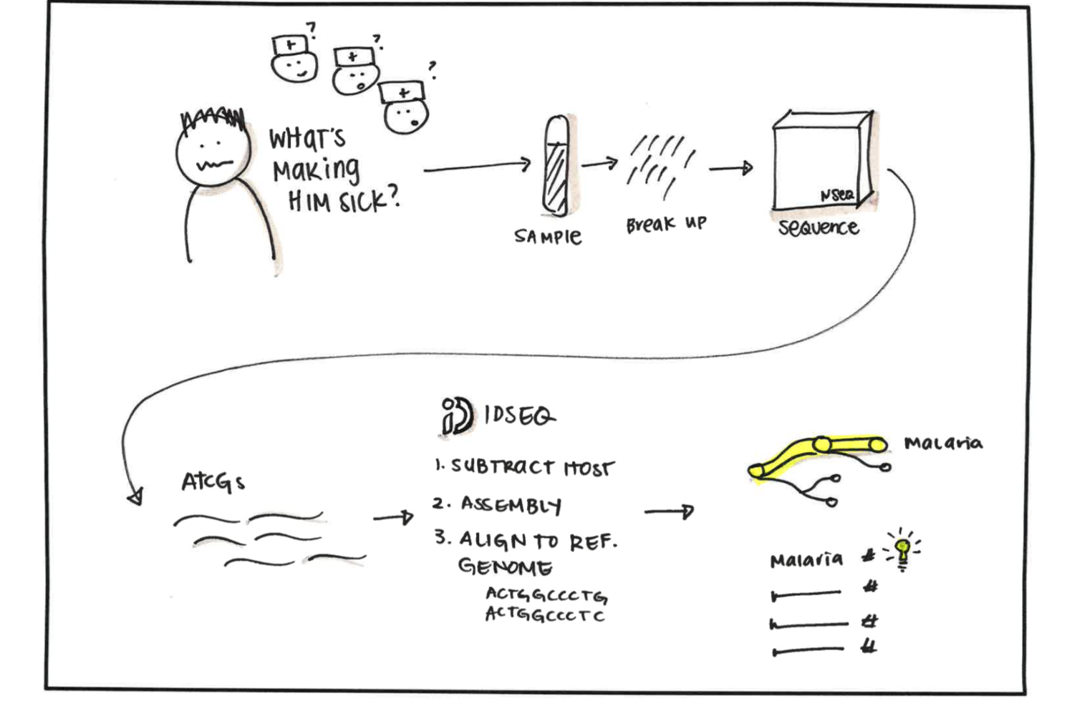
CZ ID is a free platform used to identify microbes of interest from NGS data

Slide 3
CZ ID integrates bioinformatic tools to enable NGS analysis regardless of available computational resources
General Workflow:
Run Pipeline
(Integrates > 10 third party and custom tools)
Upload NGS Data
View, Analyze, and Download Results
Plug-and-play, cloud-based platform
(optimized for scalable Amazon Web Services (AWS) cloud deployment)
Notes:
No worries about storage solutions, easy data sharing

Slide 4
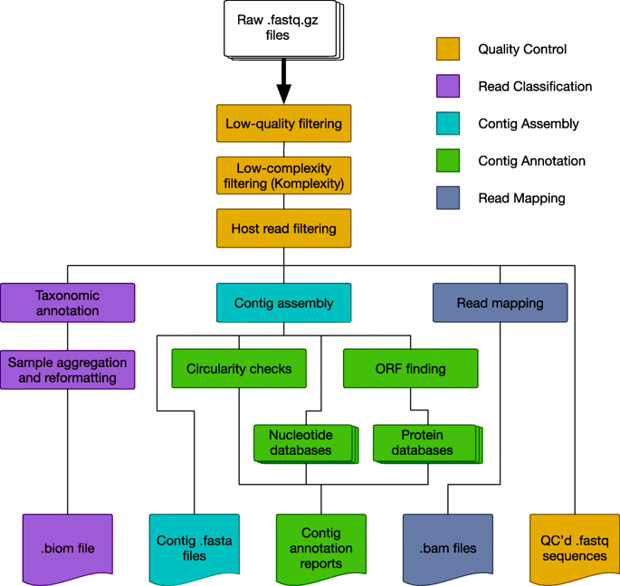
NGS data analysis requires computational power and includes MANY steps
Source: https://microbiomejournal.biomedcentral.com/articles/10.1186/s40168-019-0658-x, https://www.nature.com/articles/s41598-018-25022-6,
http://anaranalytics.com/whole-genome-sequencing/

Slide 5
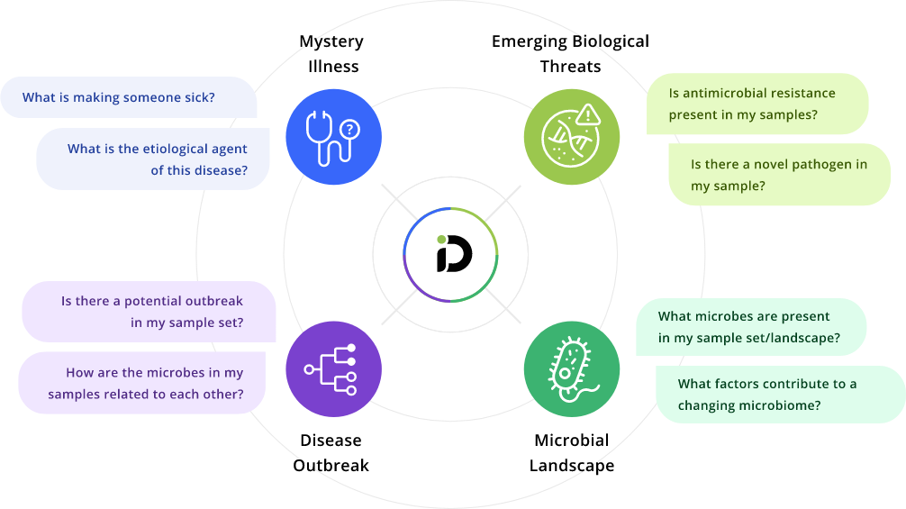
CZ ID supports multiple uses
CZ ID Pipelines:
Metagenomic (mNGS) analysis
Antimicrobial Resistance (AMR) gene detection
Viral consensus genome assembly

Slide 6
CZ ID supports multiple uses
CZ ID Pipelines:
Metagenomic (mNGS) analysis
Antimicrobial Resistance (AMR) gene detection
Viral consensus genome assembly

Slide 7
CZ ID mNGS Analysis Highlights
With just a few clicks, easily:
Evaluate sample quality
Explore and evaluate identified taxa through interactive reports
Compare samples using interactive heatmaps
Generate viral consensus genomes
Keep track of pipeline steps

Slide 8
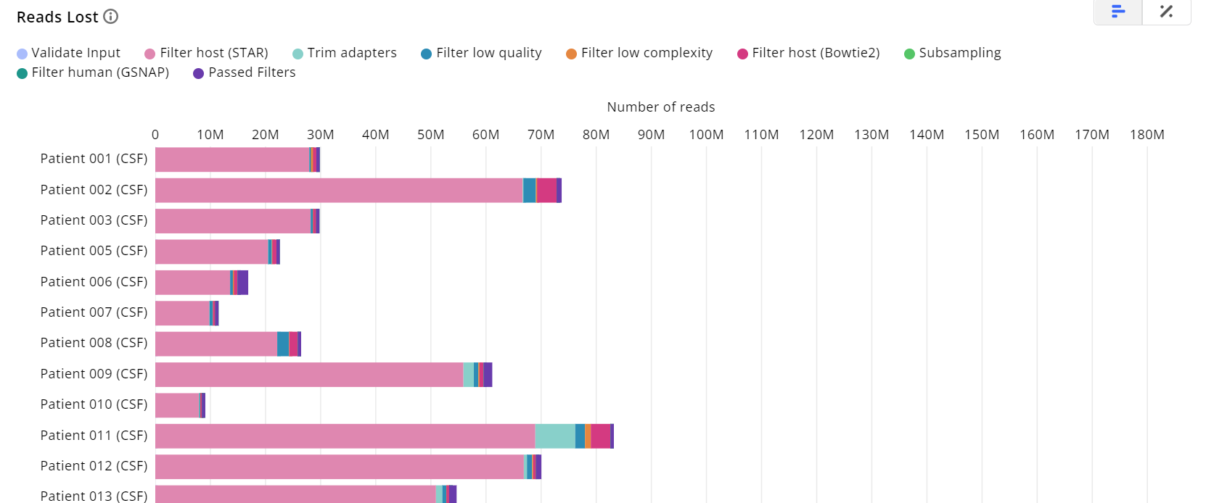
Perform QC

Slide 9
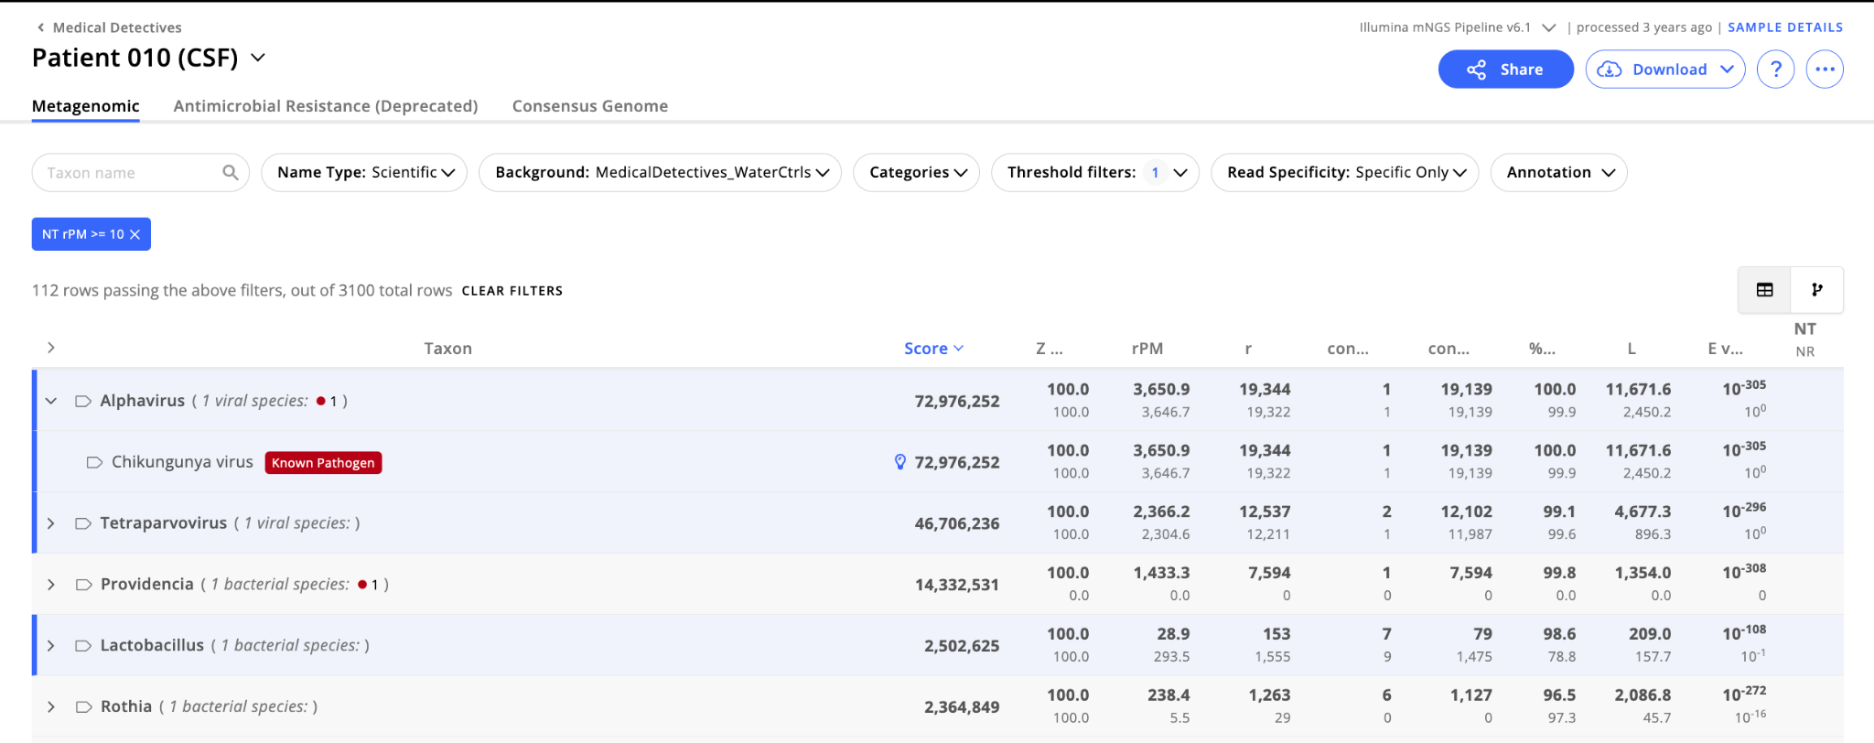
Explore and evaluate metrics for detected microbes

Slide 10
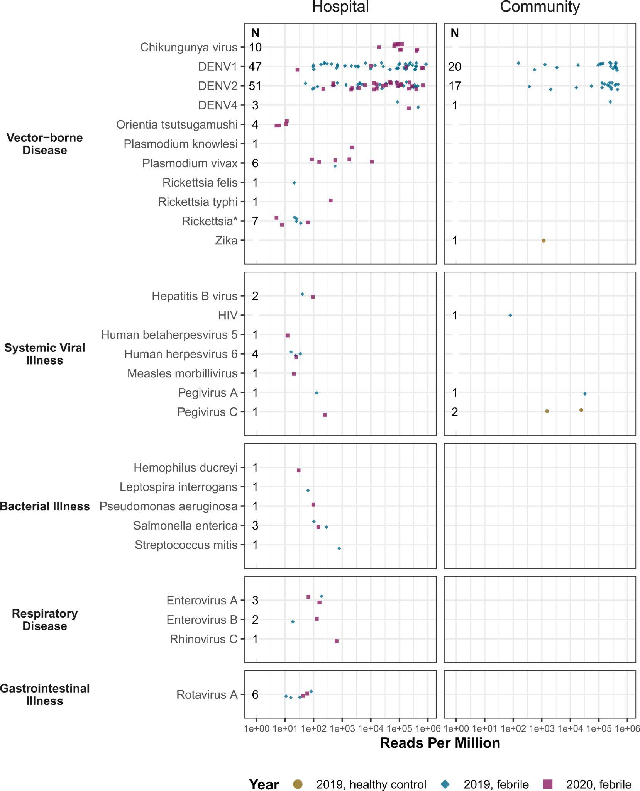
Example
Study: Pathogen landscape associated with febrile illness in Cambodia
Sample type: Serum
Results: 203 pathogens detected from 489 samples
Figure: Pathogens organized by disease category. Detection distinguished by participant cohort (community- (n = 87) vs hospital-based cohorts (n = 377)]
Bohl et al 2021
Notes:
92% (125 of 135) of DENV cases were from crop land
Early detection of chikungunya virus presaged a larger national outbreak of more than 6,000 cases

Slide 11
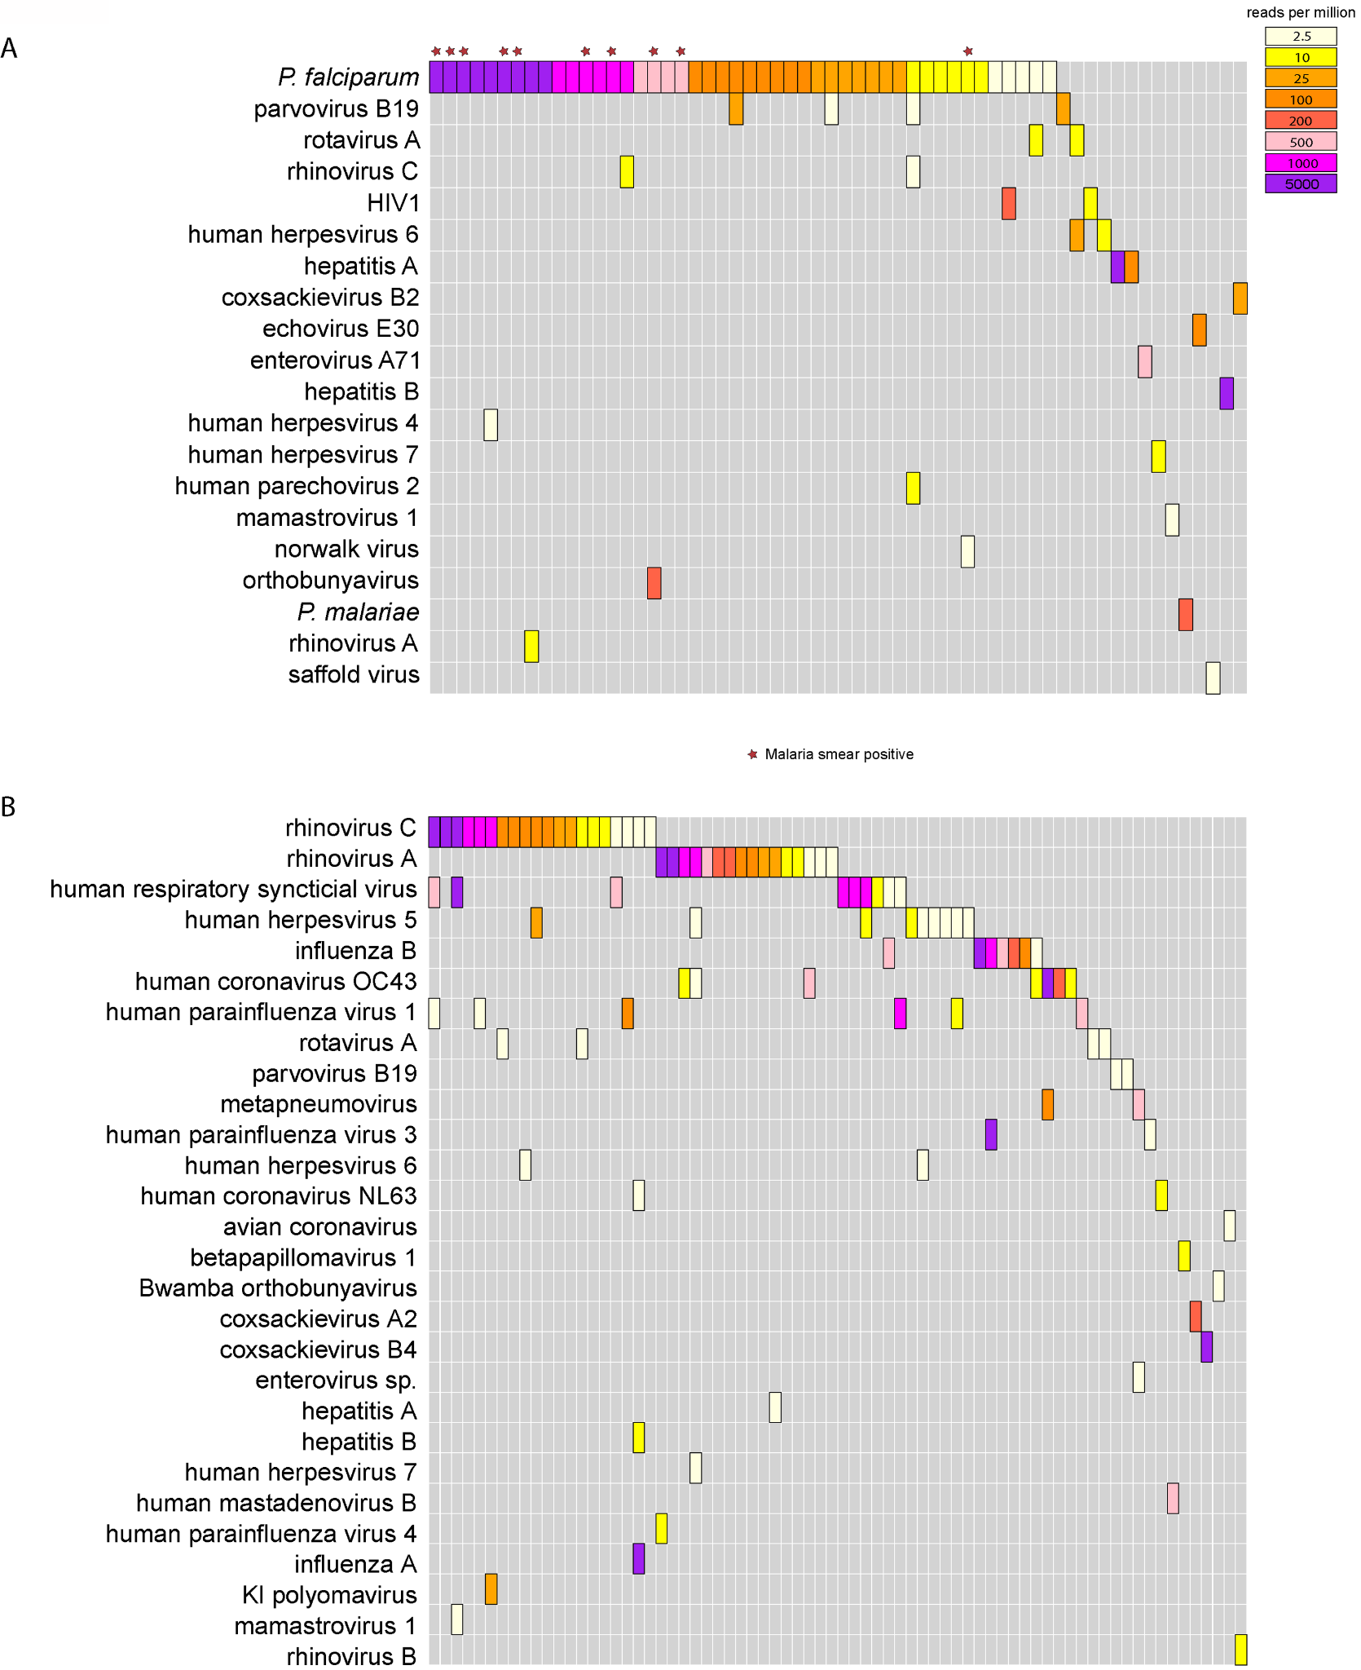
Serum
Example
Study: Pathogen landscape associated with pediatric febrile illness in Tororo, Uganda
Sample type: Serum and Nasopharyngeal (NP) swabs
Results: Pathogens detected in more than half of serum and NP samples.
Figure: Pathogens organized by sample type
*P. falciparum + (blood smear test)
NP Swabs
Ramesh et al 2019
Notes:
Most common in serum: Plasmodium falciparum (51.1% of samples) and parvovirus B19 (4.4%). P. falciparum was detected in 10/12 samples from patients reported as smear-positive. mNGS detected Plasmodium spp. in 37 additional samples that were smear negative (36 P. falciparum, 1 P. malariae)
The same microbial species was identified in the NP swab and serum samples from only six patients (on independent sequencing runs), one each with HRV-A, HRV-C, hepatitis A virus, hepatitis B virus, rotavirus A, and parvovirus B19.

Slide 12
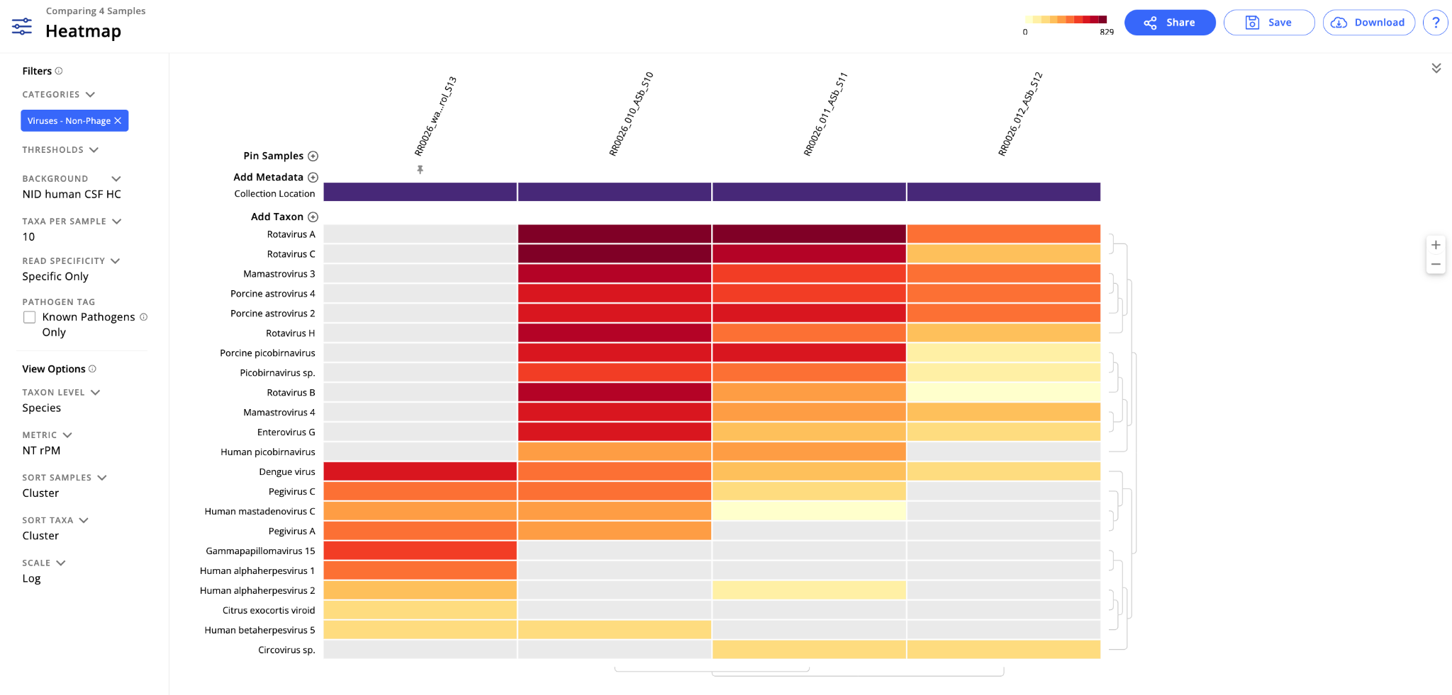
Compare samples visually to identify patterns of interest

Slide 13
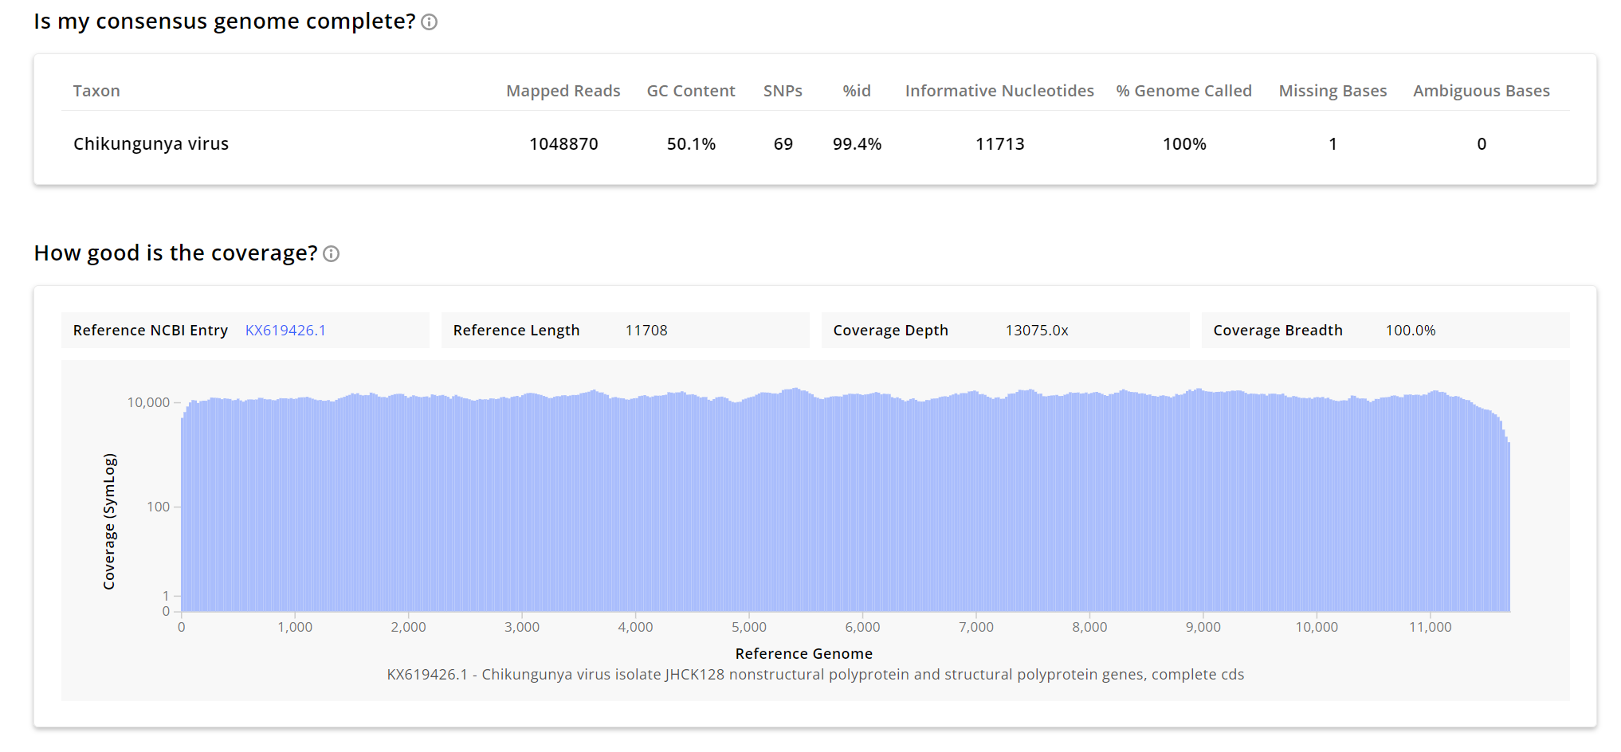
Create viral consensus genomes

Slide 14
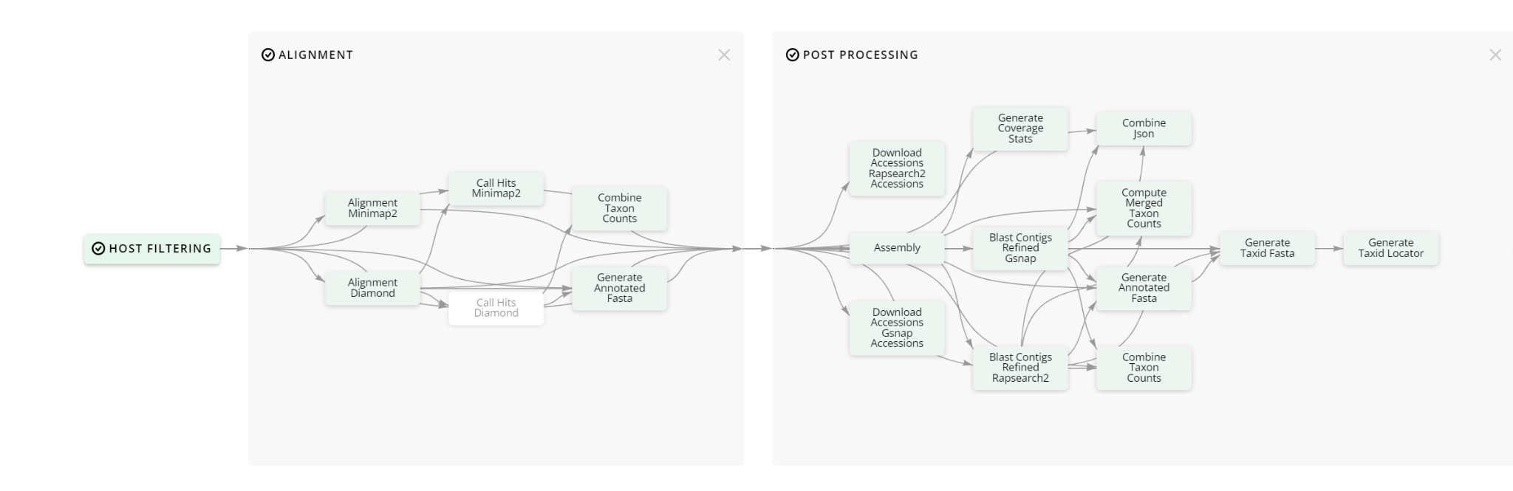
View pipeline steps and access intermediate files
Pipeline visualization

Slide 15
And more!
Let’s look at the pipeline…

