Slide 1

DEPARTMENT OF COMPUTER SCIENCE & ENGINEERING
“MARRIAGE EVENT MAKER”
COURSE NAME : MINI PROJECT IN WEB FRAMEWORKS
COURSE CODE: 20CSE68
Under the Guidance of,
Dr. JAYA R
Presentation by,
NAME: Solleti Gowtham kumar
USN: 1NH18CS747

Slide 2
INTRODUCTION
This is an online event management system software project that serves the functionality of an event manager. The system allows only registered users to login and new users are allowed to resister on the application. This is proposed to be a web application.
The project provides most of the basic functionality required for an event. It allows the user to select from a list of event types. Once the user enters an event type eg(Marriage, Dance Show etc), the system then allows the user to select the date and time of event, place and the event equipment’s.
All this data is logged in the database and the user is given a receipt number for his booking. This data is then sent to the administrator (website owner) and they may interact with the client as per his requirements and his contact data stored in the database.
Using wedding planners is one way to handle everything with a minimum of fuss while also making sure you meet all the traditional expectations of a wedding.

Slide 3
PROBLEM STATEMENT
Marriage event maker is a fully functional where we can book for any type of marriage events. Marriage event management is one of the fastest and the most glamorous upcoming professions today. it means rubbing shoulders and hand without even doing a single thing because every thing is done by event managers and we should sit and enjoy the elegance of the marriage remaining everything will we done just like that without your presence. Event organization, the most profound form of advertising and marketing, is a glamorous and thrilling profession. It provides an opportunity for unleashing one's creative potential to a very high degree. It demands a lot of hark work and effort but at the same time offers enormous scope. Weddings may seem fairly simple at first, but they are not. Regardless of your religion or even if you don’t have a particular faith; there are lots of traditions and issues to take into account.

Slide 4
COURSE OBJECTIVE
The project is all Marriage event maker is truly based on how the event is to be designed and organized in a better way that through online and limited staff organizers.
I created is based for village and rural area peoples and organizers, this portal is mainly is used to plan the wedding according to their style through online only because of this pandemic more than 50 members are not allowed to be a part of weeding.
So to decrease the members and to maintain the same level of wedding organizing I created this portal where it shows every thing from basic venue to large venues in your selected areas.
our executive will take to them and make a deal for best price and also this portal will send staff to your place who are working in your surrounding areas because it might be a risk to send staff from far places.

Slide 5
METHODOLOGY
Create web pages with all the links in the navbar section and footer section connected to all the respective pages.
Build home page
Build about page with mission and vision
Build Marriage page
Build Room page
Build Food page
Connect all the forms to the database.

Slide 6
OUTCOMES
The main outcome is that the whole event managementing is digitalized
Easy to access for rural area people
User can see everything on website which is related to the user like which event is going on everything is displayed in process bar in website
User friendly with integration with chatbot also
User can book for any event they want in any style
Event should be planned how they want and we only work with limited staff because of this pandemic.

Slide 7
DESIGN
To create a website where in the users can lend their support in creating a beautiful life on our mother earth.
Navigation bar which contains links to various MARRIAGE EVENT MAKER pages such as homepage, our wings page, contact page, own events page,share option,QR code
Our wings page will display the events like marrige events,food orders,room bookings and conserts.
Marriage page, food orders page, contact page, room bookings page will have marriage form, food orders form and room bookings form respectively.
Footer will consists of quick links of all the pages ,our wings, contact and social media links.
Home page is also integrated with full fleged chatbot.
The whole is also integrated with payment gateways.

Slide 8
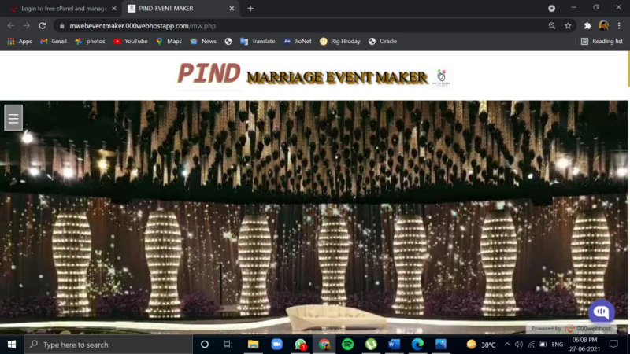
SAMPLE OUTPUTS(1)
Marriage event maker Home page

Slide 9
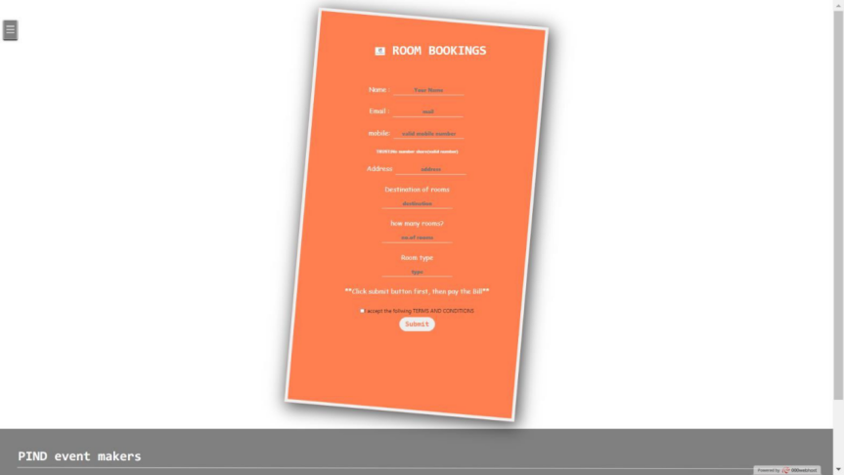
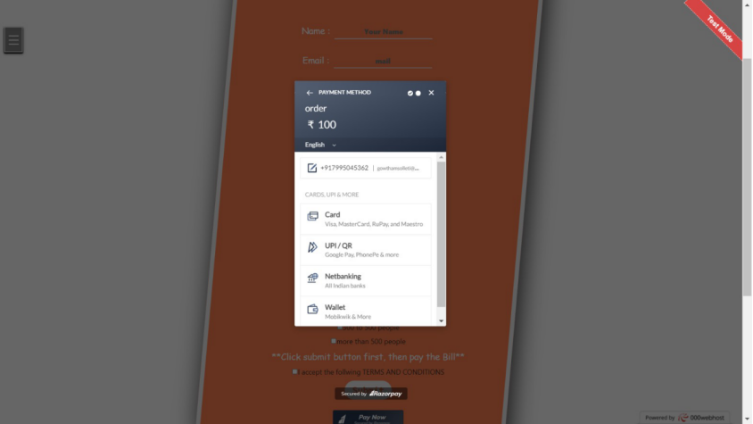
SAMPLE OUTPUTS(2)
Payment page
Room bookings

Slide 10
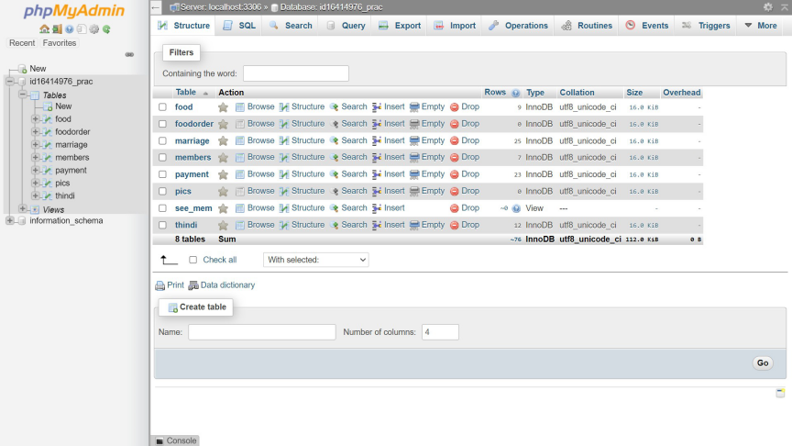
SAMPLE OUTPUTS(6)
MARRIAGE EVENT MAKER database

Slide 11
CONCLUSION
The project is all Marriage event maker is truly based on how the event is to be designed and organized in a better way that through online and limited staff organizers. I created is based for village and rural area peoples and organizers, this portal is mainly is used to plan the wedding according to their style through online only because of this pandemic more than 50 members are not allowed to be a part of weeding. So to decrease the members and to maintain the same level of wedding organizing I invented this portal where it shows everything from basic venue to large venues in your selected areas, our executive will take to them and make a deal for best price and also this portal will send staff to your place who are working in your surrounding areas because it might be a risk to send staff from far places. It demands a lot of hardwork and effort but at the same time offers enormous scope.

Slide 12
THANK YOU

