Slide 1
AI E-Health Chatbot
Gowtham Kumar.B
121810302019 – 4B2

Slide 2
Abstract
This project is focusing on creating a chatbot to be used by people to get their queries responded easily from the online website. This chat bot is based on machine learning algorithms, this bot can answer ambiguous questions which means the user do not have to be specific while asking questions. Thus, these bots create replies for the user’s queries using Natural Language Tool Kit (NLTK).
The project is done using python programming language in Visual Code Studio IDE and HTML, CSS are used for creating the user interface.

Slide 3
Problem Statement
In this pandemic situation many people are unable to visit hospitals and are unable to meet the doctor’s in physical mode.
In-order to respond to all the queries raised by the people regarding any disease a chatbot is designed, which answers the queries given by the people.
The Chatbot application is user-friendly and easy to use.

Slide 4
Methodology
In this project we used a Sequential model for predicting the output for the query entered by the end user.
Using NLTK tokenize function the predefined data and the user’s queries are divided into single words or tokens which will then be reduced to their base meaning using the NLTK lemmatize function.
We used python for building the model, and HTML, CSS for building the user interface. We used Flask framework and this project is done in Visual Studio Code IDE.

Slide 5











Identify
Building a
Analyzing
Intents
response
the
and
request
Entities
The basic process of how a chatbot works is shown by the above picture. The query given by the user is analyzed
and it identifies the suitable class and builds a response from the dataset.
The chatbot analyzes the query entered by the user and divides the query into words or tokens using the NLTK-tokenizer
Function.
Then these tokens are brought to their base meaning using the nltk-lemmatizer function and are stored in
another list.

Slide 6
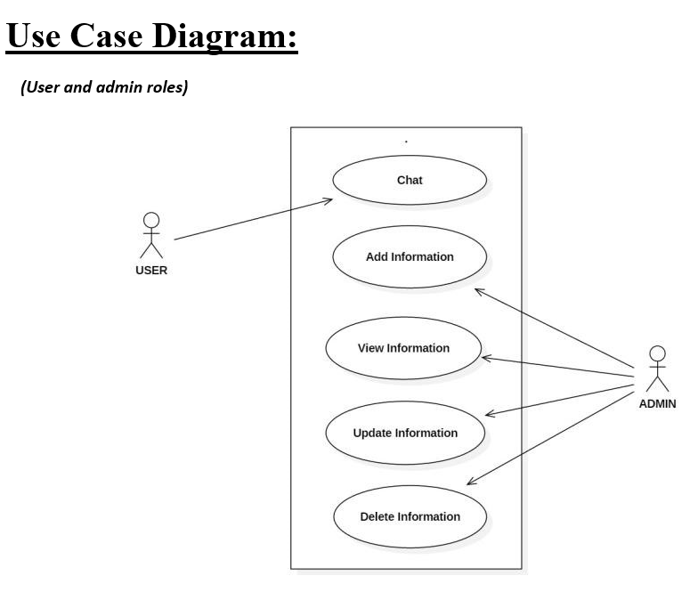
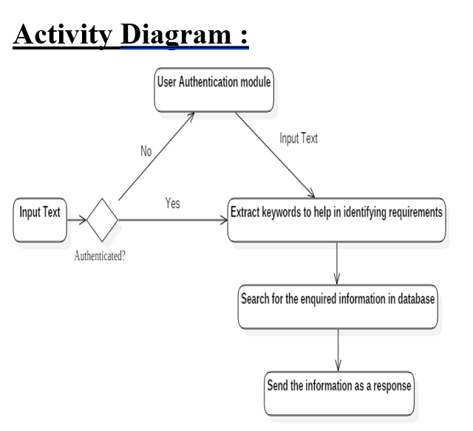
Diagrams explaining the working of the Chatbot :

Slide 7
Modules Imported
NLTK :
It is a platform used for building Python programs that work with human language data for applying in statistical natural language processing (NLP). It contains text processing libraries for tokenization, parsing, classification, stemming, tagging and semantic reasoning.
NumPy :
NumPy, which stands for Numerical Python, is a library consisting of multidimensional array objects and a collection of routines for processing those arrays. Using NumPy, mathematical and logical operations on arrays can be performed.
Keras :
Keras is a deep learning API written in Python, running on top of the machine learning platform TensorFlow. It was developed with a focus on enabling fast experimentation.
TensorFlow :
TensorFlow provides a collection of workflows to develop and train models using Python or JavaScript, and to easily deploy in the cloud, on-prem, in the browser, or on-device no matter what language you use.

Slide 8
Flask :
Flask is a micro web framework written in Python. It is classified as a microframework because it does not require particular tools or libraries. Flask supports extensions that can add application features as if they were implemented in Flask itself.
JSON :
JSON stands for JavaScript Object Notation. JSON is a lightweight data format used for data interchange between multiple different languages. It is easy to read for humans and easily parsed by machines.
Sequential Model :
Sequential is the easiest way to build a model in Keras. It allows you to build a model layer by layer. Each layer has weights that correspond to the layer the follows it. We use the 'add()' function to add layers to our model.

Slide 9
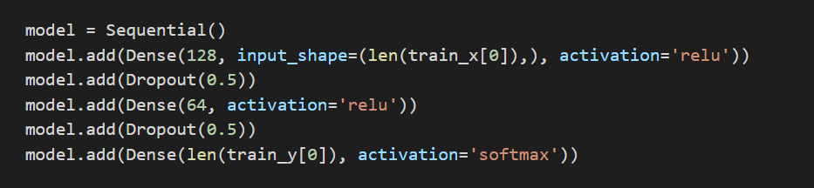
A sequential model consisting of 3 layers is created ( Input layer, Hidden layer, Output layer ).
The hidden layer consists of 128 neurons and it is a fully connected layer which calculates weights of the input
classes with the output classes.
SoftMax Activation Function :
SoftMax is a mathematical function that converts a vector of numbers into a vector of probabilities, where the
probabilities of each value are proportional to the relative scale of each value in the vector.
The most common use of the SoftMax function in applied machine learning is in its use as an activation function in
a neural network model.

Slide 10
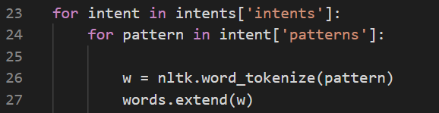
The NLTK tokenization function takes the string and divides it into words and stores it into a list. Here the pre-defined
data which is given in the json file is being tokenized and is being stored into the words list.
The NLTK lemmatize : Lemmatization is the process of grouping together the different inflected forms of
a word so they can be analyzed as a single item. Lemmatization is similar to stemming but it brings context
to the words. So it links words with similar meanings to one word.

Slide 11
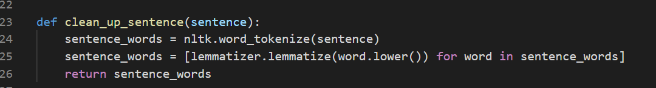
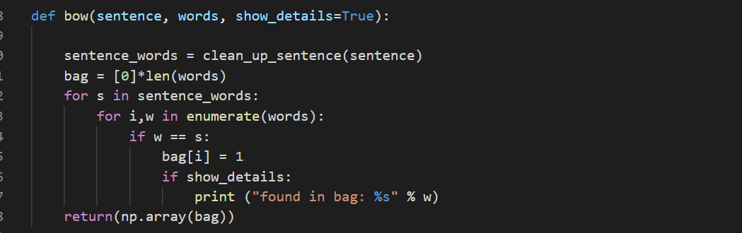
The clean up sentence function does the division of the user’s query into individual words as shown in the above picture.
Here the lemmatized words are stored in the sentence_words list.
Bow refers to Bag Of Words. It stores the lemmatized words and matches it with the user’s query and tries to find
the most suitable class from the output classes.

Slide 12
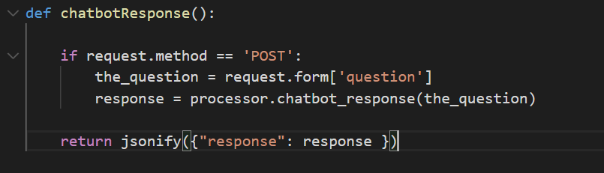
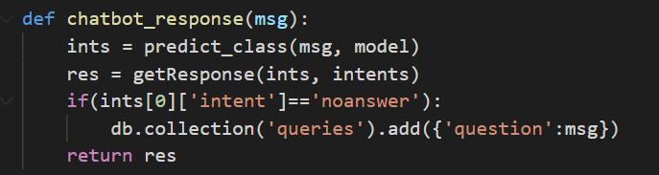
The above chatbotResponse function does the process of receiving the user’s query and sending it to the processor.py
file in order to generate a response.
The processor.py file will be returning the response predicted by the sequential model.
The above function is used to predict the class and return the response which is stored in the res attribute.
If there is no answer for the user’s query then as shown it will be added to the database collection.

Slide 13
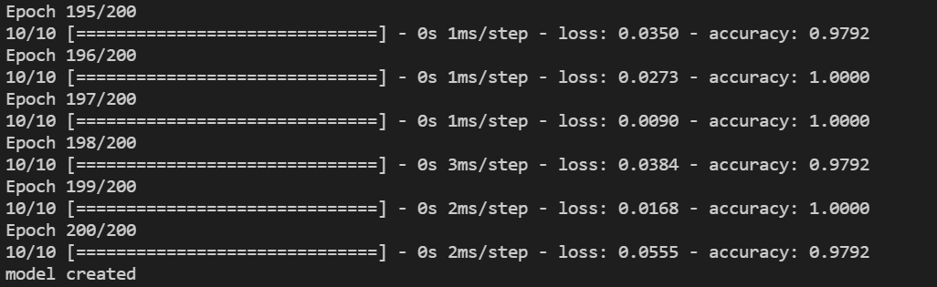
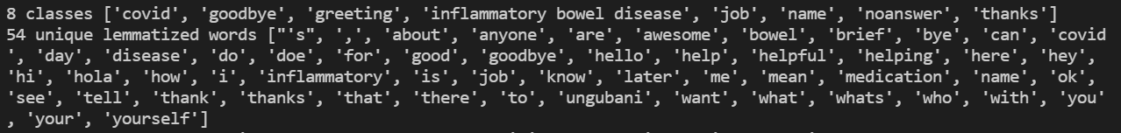
The model is created and the value of epoch is set to 200 which means the model is being trained for 200 times on the
given dataset.
After the data set is transformed into a list of individual words by using tokenizer and lemmatizer functions of NLTK
it is being displayed.

Slide 14
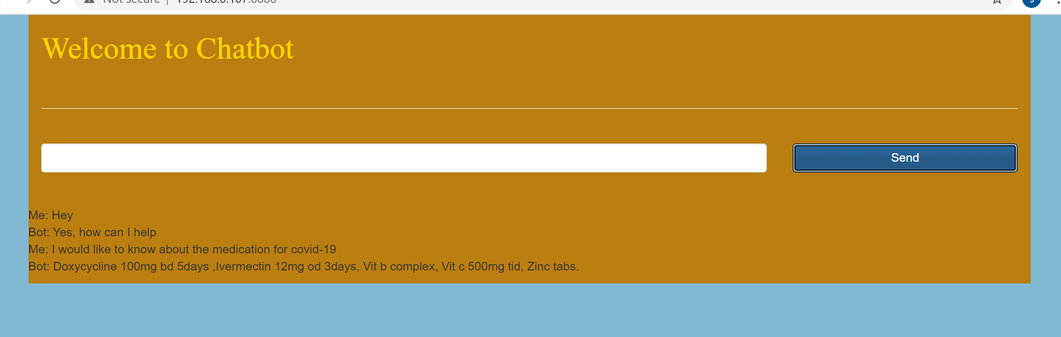
This is the user interface of our E-Health Chatbot which is done by using HTML and CSS.
The Chatbot generates replies according to the user’s input as it tries to return the most similar class as response
to the user.
This Chatbot returns the response from the classes only if the threshold value is more than 0.25, else it would be
returning that I am unable to understand.
A firebase database is connected to this chatbot where the user’s queries will be stored.

Slide 15
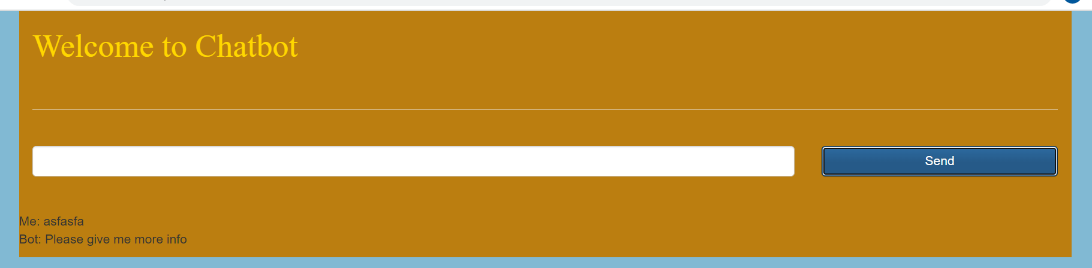
The above the screenshot depicts that when a unknown query is given by the user an the input then the chatbot
it returns the response that I am unable to understand and this query will be stored into the database which will be
periodically checked by the administrators.
If at all the threshold value is less than 0.25 only then it would be storing it in the firebase database.
The query will be stored in the form of a question in the chatbot and a output of the above case is displayed
in the next slide.

Slide 16
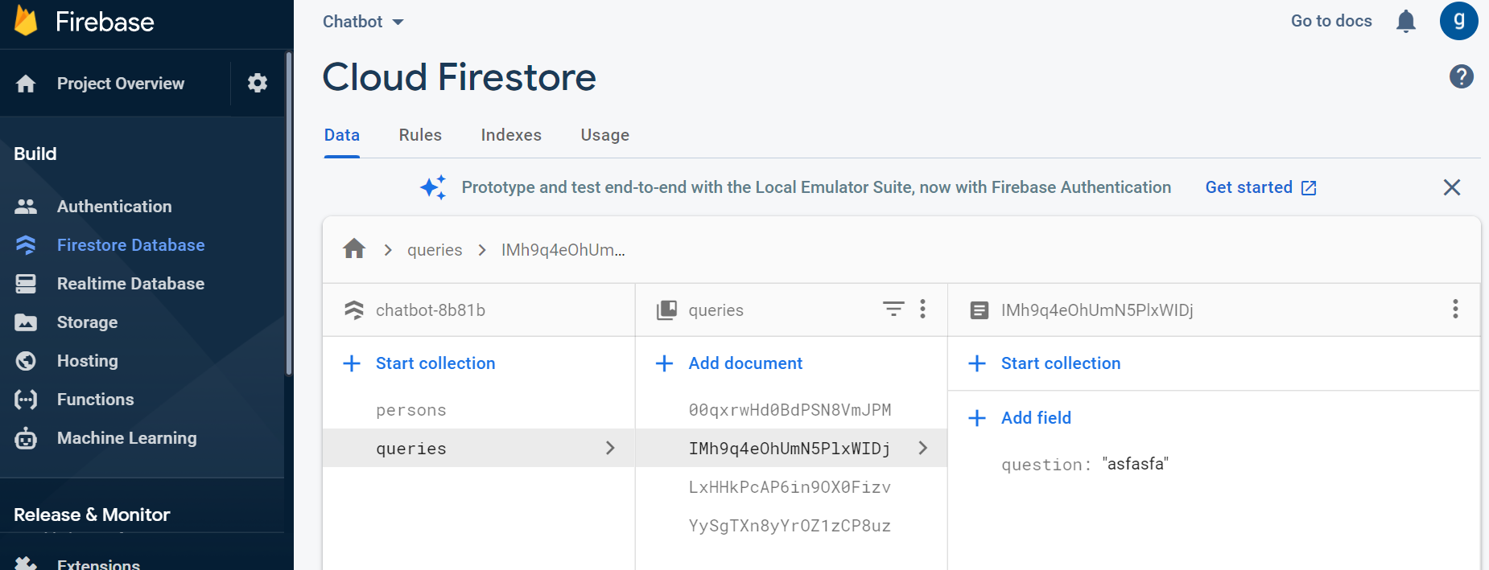
The firebase database is connected to the chatbot. And only the queries which are unanswered or when the bot
is unable to predicts output then those user’s queries will be stored into the database.
When the admin comes online he/she will be viewing the queries and will be updating the data set.

Slide 17
Future Enhancements
Since we need to provide the intents externally, By using API’s we can fetch data and provide the data as intent.
Including voice based queries:
The users will have to give voice input and the system will take the input and extracts the text in the voice-message and returns the required output in the form of text.
Introducing language translator:
People who speak different languages can also access the chatbot for any queries.
By adding providing data we can implement the bot in different sectors like colleges, sports, etc.

Slide 18
Thank You

