Slide 1
Digital Portfolio
STUDENT NAME: Gowtham T B
REGISTER NO AND NMID:
222403556/FE097D9101B995693994FD07F1B1D9D1
DEPARTMENT: Bsc computer science
COLLEGE: Sri devi arts and science college/Madras University

Slide 2
PROJECT TITLE
Epic Spawn Store

Slide 3


AGENDA
Problem Statement
Project Overview
End Users
Tools and Technologies
Portfolio design and Layout
Features and Functionality
Results and Screenshots
Conclusion
Github Link
3/21/2024 Annual Review

Slide 4

PROBLEM STATEMENT
High Costs & Poor Discovery: The digital video game market is fragmented, leading to high prices for new releases and difficulty in discovering trending and affordable games, particularly from independent developers.
Weak Community Engagement: Many existing platforms lack a robust and unified community environment where players can connect and share their experiences, which limits engagement.
Subpar User Experience: The combination of these issues creates a fragmented and challenging experience for gamers, who are forced to navigate multiple platforms and miss out on a vibrant, connected ecosystem.

Slide 5

PROJECT OVERVIEW
The project is a web-based game store with a clean and organized layout.
The main page showcases a variety of games using a grid of cards, each displaying the game's title, cover art, price, and rating.
There is also a separate screen for processing payments, suggesting a complete e-commerce flow.
The design uses a dark theme with vibrant blue and yellow highlights.

Slide 6

WHO ARE THE END USERS?
Want to discover and purchase new games.
Are looking for information on games, such as prices, ratings, and screenshots.
Need a way to process payments for their purchases.

Slide 7

TOOLS AND TECHNIQUES
Front-End Development: The structure and layout would be built with HTML.
Styling: The visual appearance, including the dark theme, card-based layout, and gradient "Pay Now" button, would be created using CSS. A framework like Tailwind CSS or a preprocessor like Sass could have been used to manage the styles more efficiently.
Interactivity: The functionality of the "Add to Cart" buttons, the dropdown menu for payment methods, and any other interactive elements would be handled by JavaScript.
Design & Mockup: Before development, the design itself was likely created using a UI/UX design tool such as Figma, Sketch, or Adobe XD to create a visual mock-up of the user interface.

Slide 8
POTFOLIO DESIGN AND LAYOUT
Header: There is a main header banner with a vibrant purple gradient, which immediately draws attention. It uses large, bold text for the name and smaller text for the roles, establishing a clear visual hierarchy.
"About Me" Section: This section features a large, centered profile picture in a circle on the left, next to a brief "About Me" description. The text is concise and introduces the person's skills and passion.
"My Projects" Section: This is a simple and effective way to showcase work. Each project, represented by a card, has a title, a short description, and a clear "View Project" button. The use of a simple card with a soft shadow effect makes the project stand out.
Color Scheme: The design uses a clean white background with accents of purple and blue. This consistent color palette ties the different sections together and gives the site a cohesive feel. The use of gradients adds a modern touch
8

Slide 9
FEATURES AND FUNCTIONALITY
Game Display and Discovery: The home page shows a variety of games in a grid layout. Each game is represented by a card that includes the title, cover art, price, and a star rating, which helps users discover new and trending games.
Shopping Cart Integration: Each game card has an "Add to Cart" button, indicating a functioning e-commerce system.
Payment Processing: A separate screen is dedicated to "Payment Details," which includes a dropdown menu to select a payment method and a "Pay Now" button. This confirms the functionality of a secure checkout process.
User Navigation: The top of the page includes a navigation bar with links like "Home," "Games," "About," and "Contact," allowing users to easily browse different sections of the website.
User Interaction: The user can interact with the site by clicking on buttons to add games to their cart and finalize their purchase.

Slide 10
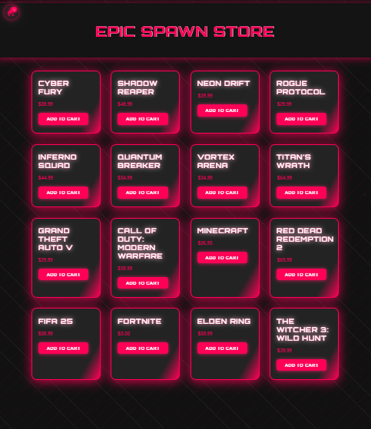
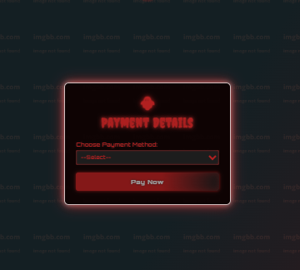

RESULTS AND SCREENSHOTS
3/21/2024 Annual Review
10

Slide 11
CONCLUSION
The "Epic Game Store" project effectively addresses the key challenges in the digital video game market by providing a user-centric solution. The platform's core design and functionality demonstrate a clear understanding of the needs of modern gamers.
The clean, card-based layout on the home page facilitates seamless game discovery, while the integrated shopping cart and dedicated payment screen ensure a smooth and secure purchasing experience. The project not only offers a functional e-commerce solution but also lays the groundwork for a robust, user-friendly platform that could foster a strong gaming community.
The overall design, with its use of a dark theme and vibrant color accents, is visually appealing and aligns with the aesthetic preferences of the gaming audience. By providing an all-in-one solution for discovery, purchase, and community engagement, the "Epic Game Store" project offers a compelling answer to the fragmented nature of the current market.
11

Slide 12
GitHub Link
https://github.com/gowtham24106/Gowtham-TB.git

