Slide 1
Data Software Research Company Private Limited
CORE JAVA DAY 1
04/02/2017

Slide 2
Introduction to OOP
04/02/2017

Slide 3
Learning Objectives
After this session you will be able to understand:
Introduction to OOP
Overview of Java
Setting Up and configuring Eclipse
A Java Hello World Program
Data Types
Arrays in java
Operators
Arithmetic Operators
Shortcut Arithmetic Operators
String Concatenation
Relational Operators
Logical Boolean Operators
Statements and Flow Control
04/02/2017

Slide 4
History of Object Oriented Programming.
Introduction to OOP
OOP concepts started surfacing in the mid-1960s with a programming language called Simula.
It further evolved in the 1970s with advent of Smalltalk.
In 1980 OOP languages such as C++ and Eiffel became popular with mainstream computer programmers
OOP continued to grow in popularity in the 1990s, most notably with the advent of Java.
In 2002, in conjunction with the release of the .NET Framework, Microsoft introduced a new OOP language, C#
04/02/2017

Slide 5
BENEFITES OF OBJECT ORIENTED PROGRAMMINE
Introduction to OOP
Transition from business analysis models to software implementation models
The ability to maintain and implement changes in the programs more efficiently and rapidly
The ability to more effectively create software systems and allowing developers to work on parts of the system
The ability to reuse code components in other programs and purchase components written by third-party developers to increase the functionality of programs with little effort
Better integration with loosely coupled distributed computing systems
Improved integration with modern operating systems
The ability to create a graphical user interface for the users

Slide 6
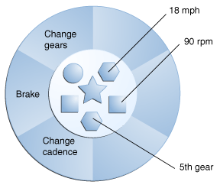
WHAT IS AN OBJECT?
Introduction to OOP
An object is a software construct that encapsulates data, along with the ability to use or modify that data, into a software entity.
An object is a self-contained entity which has its own private collection of properties (ie. data) and methods (ie. operations) that encapsulate functionality into a reusable and dynamically loaded structure.
A bicycle modeled as a software object
04/02/2017

Slide 7
ADVANTAGES OF OOP
Introduction to OOP
Real-world programming
Reusability of code
Modularity of code
Information hiding
04/02/2017

Slide 8
FEATURES OF OOPS
Introduction to OOP
Abstraction
Encapsulation
Inheritance
Polymorphism

Slide 9
ABSTRACTION
Introduction to OOP
“An Abstraction denotes the essential characteristics of an object that distinguishes it from all other kinds of objects and thus provides crisply defined conceptual boundaries, relative to the perspective of the viewer.”
Encapsulation hides the irrelevant details of an object and Abstraction makes only the relevant details of an object visible.

Slide 10
ENCAPSULATION
Introduction to OOP
Encapsulation is the ability of an object to place a boundary around its properties (ie. data) and methods (ie. operations).
“Encapsulation is the process of hiding all of the
details of an object that do not contribute to its
essential characteristics.”
Encapsulation = data Hiding + abstraction
04/02/2017

Slide 11
INHERITANCE
Introduction to OOP
Inheritance is the capability of a class to use the properties
and methods of another class while adding its own
functionality.
Enables you to add new features and functionality to an existing class without modifying the existing class.
A superclass or parent class is the one from which another class inherits attributes and behavior.
A subclass or child class is a class that inherits attributes and behavior from a superclass and adds it own attributes and behaviours.
Superclass and Subclass

Slide 12
POLYMORPHISM
Introduction to OOP
Derived from two Latin words - Poly, which means many, and
morph, which means forms.
It is the capability of an action or method to do different things
based on the object that it is acting upon.
In object-oriented programming, polymorphism refers to a
programming language's ability to process objects differently
depending on their data type or class.

Slide 13
Overview of Java
04/02/2017

Slide 14
HISTORY OF JAVA
Overview of Java
In 1991, a team of software developers at Sun Microsystems, USA, was designing a language for consumer electronic devices that relied heavily on software, as a part of a research project. The language was called Oak.
It could be used as a remote control for a television or VCR and as an electronic program guide, and it also had some of the functions that are now associated with PDAs
The team comprised of James Gosling, Patric Naughton, Chris Warth, Ed frank, and Mike Sherin. The development team was headed by James Gosling.
In response to this requirement, Sun renamed Oak to Java and used it build a cross-platform browser called Hot Java and licensed Java to Netscape, which incorporated it into its own browser.
Thus, the world was introduced to Java applets.

Slide 15
Overview of Java
WHAT IS JAVA
SIMPLE HIGH LEVEL PROGRAMMING LANGUAGE
OBJECT ORIENTED PROGRAMMING SUPPORT
ROBUST AND SECURE
SUPPORT FOR MULTITHREADING
DESIGNED TO HANDLE DISTRIBUTED APPLICATION AND NETWORK SUPPORT
WEB APPLICATION SUPPORT
GUI SUPPORT
ARCHITECTURE NEUTRAL , PLATFORM INDEPENDENT AND PORTABLE
04/02/2017

Slide 16
Overview of Java
WHAT IS JAVA
Simple:
The language syntax is based on the familiar programming
language ‘c++’ ,troublesome features of ‘c++’ are avoided
(multiple inheritance , pointer )
Object Oriented:
Java supports all four pillars of object-oriented programming
Abstraction Encapsulation Inheritance and Polymorphism
Java supports the object-oriented approach to develop programs.
Compiled and Interpreted:
The Java Interpreter can execute Java byte code, directly on any machine to which the interpreter has been ported.
( Interpreted code is slower than compiled code )
04/02/2017

Slide 17
Overview of Java
Architecture Neutral , Platform Independent and portable:
java compiler generates an intermediate byte code
which does not depend on any hardware and so can be
used on any machine this makes program architecture
neutral and platform independent
Once compiled, java code runs on any platform
“Write Once Run Anywhere”
Designed to handle distributed application and security:
Java is used to develop applications that can be distributed among
various computers on the network.
Java is designed for the distributed environment of the Internet
because it supports the various Internet protocols
Java support client-server based applications.
WHAT IS JAVA

Slide 18
WHAT IS JAVA
Overview of Java
Robust:
Program failure can be attributed to two main reasons:
memory management mistakes and mishandled exceptional
conditions (that is, run-time errors).
Java is a strictly typed language, it checks your code at compile time.
Memory management is taken care by the Java Runtime Environment.
Support for multitasking :
Multitasking is ability for one program to do more then on
task at once.
Compared to other language its easy to implement multithreading
that achieve Multitasking
04/02/2017

Slide 19
WHAT IS JAVA
Overview of Java
Security:
The built-in security feature of Java verifies programs during execution and prevents them from performing destructive tasks such as accessing the files on the remote system.
Java language does not support pointers hence illegal access of memory locations is not possible .
In Java, the compiled Byte code is strongly type checked. Any changes made in the Byte code are flagged as errors and the program does not execute. This ensures the security of the Java program over the Internet.
In addition, if Java applets are downloaded from the Internet, they cannot access the resources on the local computer.
04/02/2017

Slide 20
JAVA DEVELOPMENT PLATFORM
Overview of Java
:
J2SE: (Java 2 Standard Edition) Window Based Application Development.
J2EE: (Java 2 Enterprise Edition) Web Application Based Development for the Internet.
J2ME: (Java 2 Micro Edition) Used for developing applications and games for mobile phones, set- top boxes and other handheld devices.

Slide 21
JAVA ARCHITECTURE
Overview of Java
JVM
Class Loader
Source File (HelloWorld.java)
Byte Code Verifier
Compiler (javac)
Interpreter
JIT Code Generator
Runtime
Machine Code or Byte code (HelloWorld.class)
Operating System
Hardware
04/02/2017

Slide 22
Overview of Java
JAVA DEVELOPMENT PROCESS
Source Code of java program is saved as .java file
Java compiler (javac) compiles .java file into byte code which is stored in .class file
JVM interprets .class file byte code and converts to machine language of the underlying platform
Java Class
File
Java
Compiler
Bytecode
Java File
JVM
Java
Interpreter
Machine
Code
04/02/2017

Slide 23
TYPES OF JAVA PROGRAM
Overview of Java
Application:
Java application runs on desktop
locally installed java virtual machine executes these applications
Applet:
Applet small java program that runs inside web page on the browser
Applet read and write files.
Applet integrates with desktop services (e.g., e-mail).
It is connected to other servers.
It is also built with security in mind.
If the user allows, an applet can be given more authority

Slide 24
WHY JAVA?
Overview of Java
Open Source
Java can be used to build a variety of applications:
Applications that use Character User Interface (CUI): Applications are executable programs that are controlled by the operating system.
Applications that use Graphical User Interface (GUI): These applications are used in the Windows environment.
Applets: Applets are small executable programs that run on a Web page.
Servlets: Servlets are the programs that are used to extend the functionality of Web servers.
04/02/2017

Slide 25
ECLIPSE CONFIGURATION
04/02/2017

Slide 26
SETTING UP JAVA ENVIRONMENT VARIABLES
Eclipse Configuration
JAVA_HOME: home for java use to derive all other environment
variables
PATH : use to locate executable files
CLASSPATH : use to locate class file
On Windows Platform:
set JAVA_HOME=c:\jdk1.7
set PATH=%PATH%;JAVA_HOME%\bin;
set CLASSPATH=%CLASSPATH%;%JAVA_HOME%\lib\tools.jar;
On Unix Platform:
Export JAVA_HOME=/var/usr/java
set CLASSPATH=$CLASSPATH:$JAVA_HOME/lib/tools.jar;
set PATH=$PATH:$JAVA_HOME/bin;

Slide 27
SETTING UP AND CONFIGURING ECLIPSE
Eclipse Configuration
Eclipse is the open platform that facilitates and encourages the development of third party plugins
Best known as Integrated Development Environment
Provides tools for coding ,building, running and debugging applications
Support for different languages Java , c , c++ ,Python
JDK is required to launch eclipse on your system
04/02/2017

Slide 28
SELECTING WORKSPACE
Eclipse Configuration
In Eclipse all code will live under workspace
A workspace is location where we store our source code in a project and configuration
Start eclipse :
create new work space
To create a project File->New -> Java project
Project appears in package explorer
To create class select File->new ->class
Enter class name and other necessary info
And click finish
Add the source code and save it (compilation is done)
To run the file Run->Run As ->java Application
04/02/2017

Slide 29
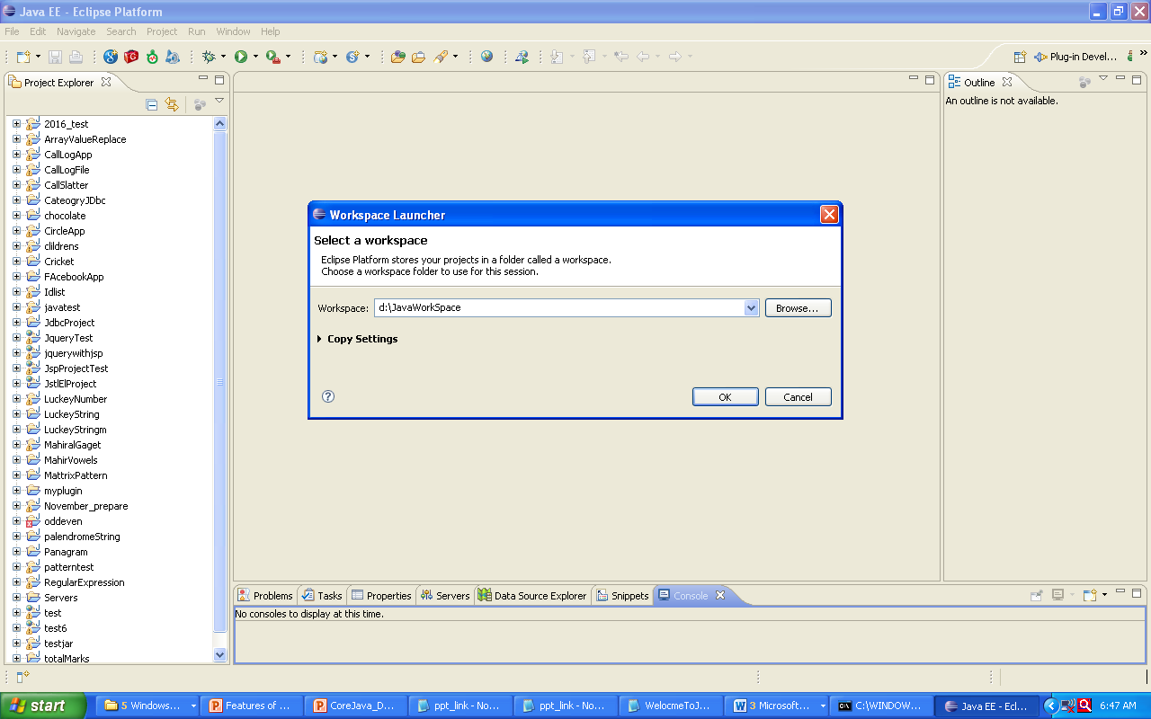
CREATING WORK SPACE File->Switch Workspace

Slide 30
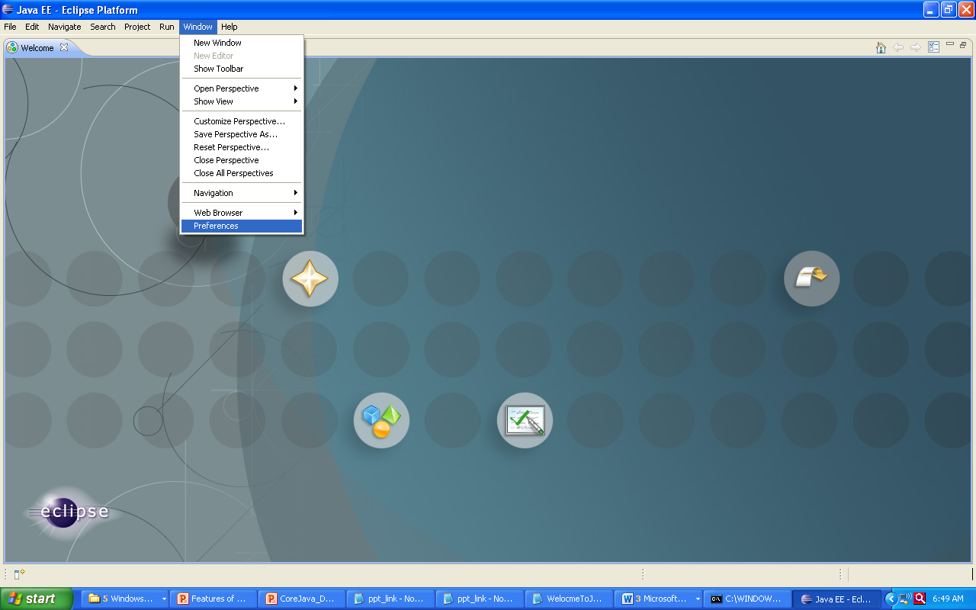
CONFIGURING JDK window->preferences
Eclipse Configuration
04/02/2017

Slide 31
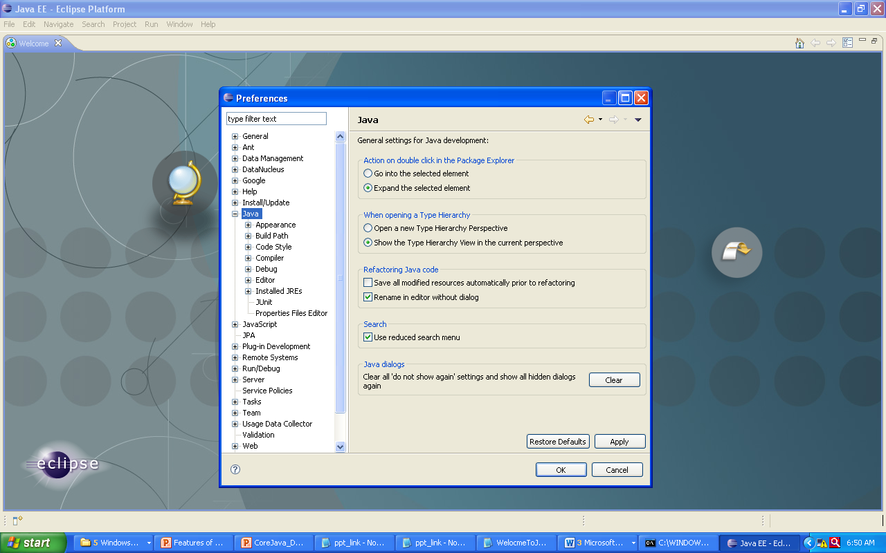
CONFIGURING JDK select java
Eclipse Configuration
04/02/2017

Slide 32
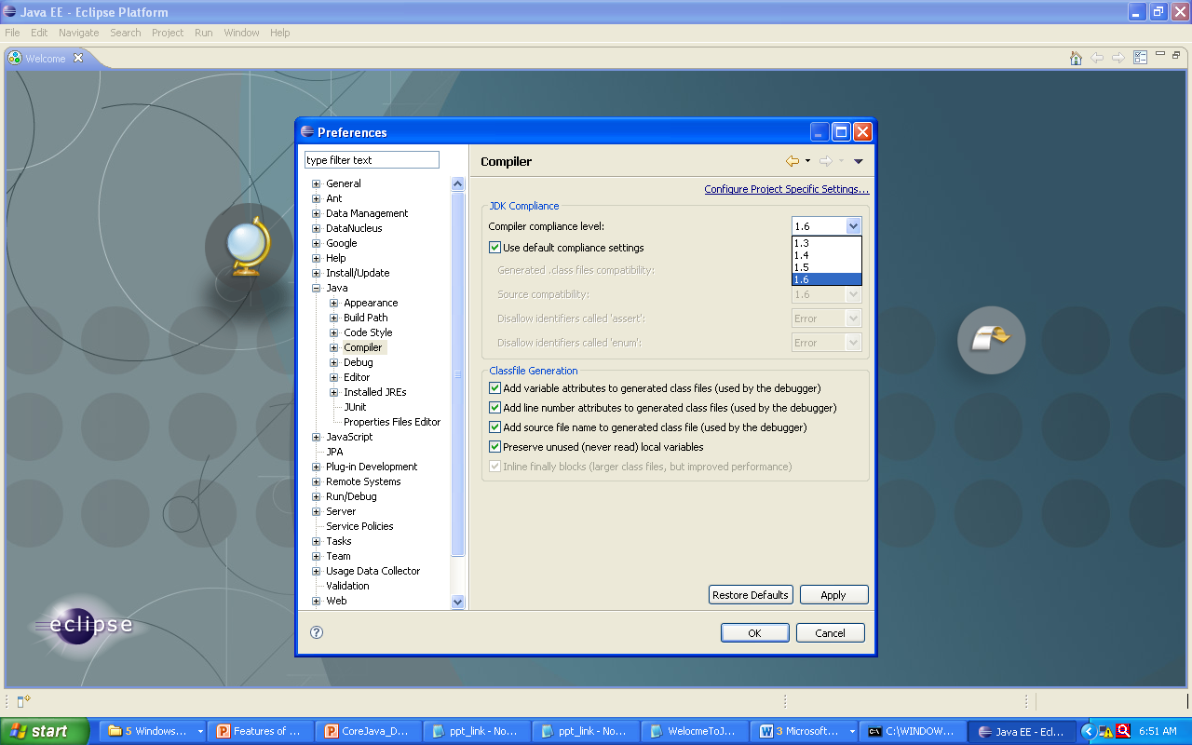
CONFIGURING JDK SELECT COMPILER set as 1.7
Eclipse Configuration

Slide 33
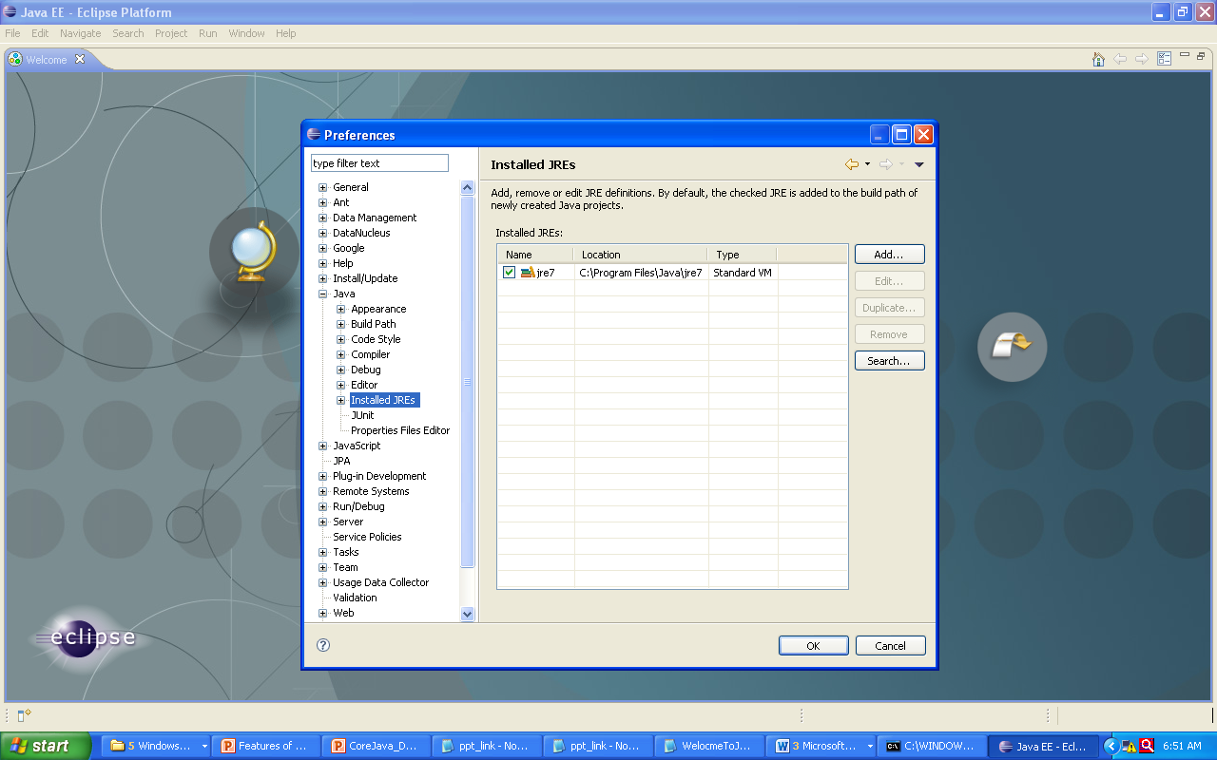
CONFIGURING JDK SELECT INSTALLED JRE
Eclipse Configuration
04/02/2017

Slide 34
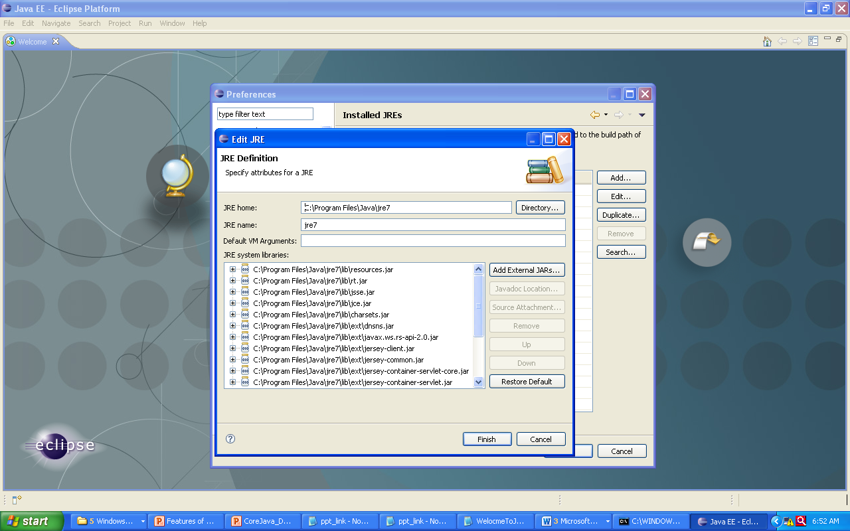
CONFIGURING JDK ->EDIT OR ADD NEW JRE PATH
Eclipse Configuration
04/02/2017

Slide 35
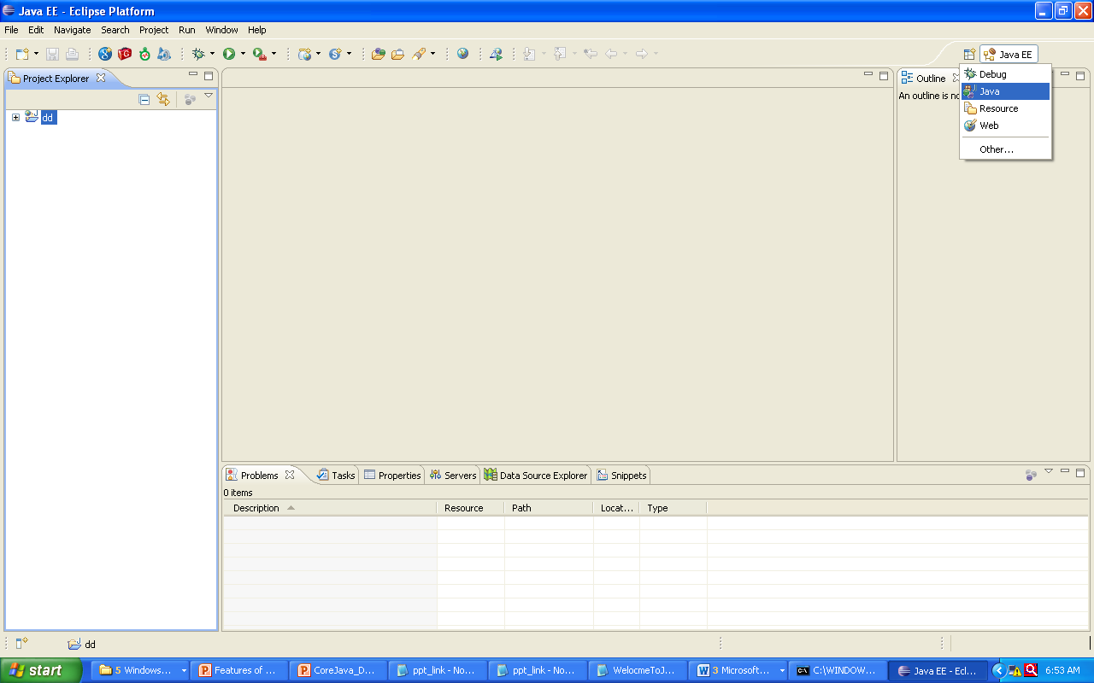
SELECTING JAVA ENVIRONMENT
Eclipse Configuration

Slide 36
A JAVA HELLO WORLD PROGRAM
04/02/2017

Slide 37
CREATING JAVA APPLICATION WITH HelloWord PROGRAM
Java Hello Word Program
/***
Class level comments
**/
public class HelloWorld{
/* method level comment */
public static void main(String[]args){
//statement level comment
System.out.println(“welcome to Java !”);
}
}

Slide 38
KEYWORDS
Java Hello Word Program
abstract | boolean | break | byte
case | catch | char | class
const | continue | default | do
double | else | extends | final
finally | float | for | enum
if | implements | import | instanceof
04/02/2017
04/02/2017

Slide 39
KEYWORDS
Java Hello Word Program
int | interface | long | native
new | package | private | protected
public | return | short | static
strictfp | super | switch | synchronized
this | throw | throws | transient
try | void | volatile | while
04/02/2017

Slide 40
JAVA IDENTIFIERS
Java Hello Word Program
Identifiers are the names of variables , methods, class
packages and interface
Identifier must be composed of letters,numbers,the
underscore _ and dollar sign $
eg MyVariable
_MyVariable
_myvariable
$myvariable

Slide 41
COMPILING AND RUNNING JAVA PROGRAM
Java Hello Word Program
Open the Notepad Editor
Create Java Source save the file as HelloWorld.java
Open the command prompt and set the environment variables
Type javac HelloWorld.java in the same directory where file is present
Type java HelloWorld
Check the command prompt result
04/02/2017

Slide 42
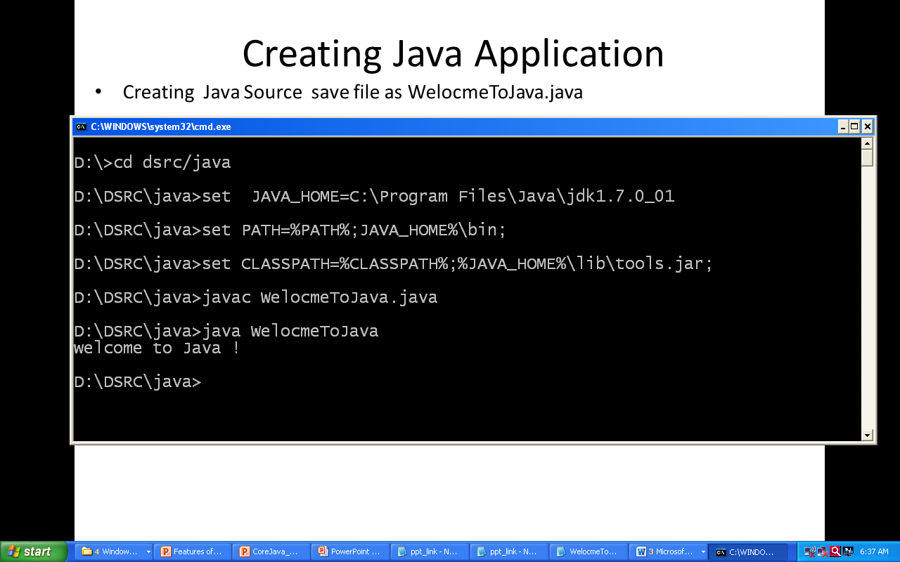
COMPILING AND RUNNING JAVA PROGRAM
04/02/2017

Slide 43
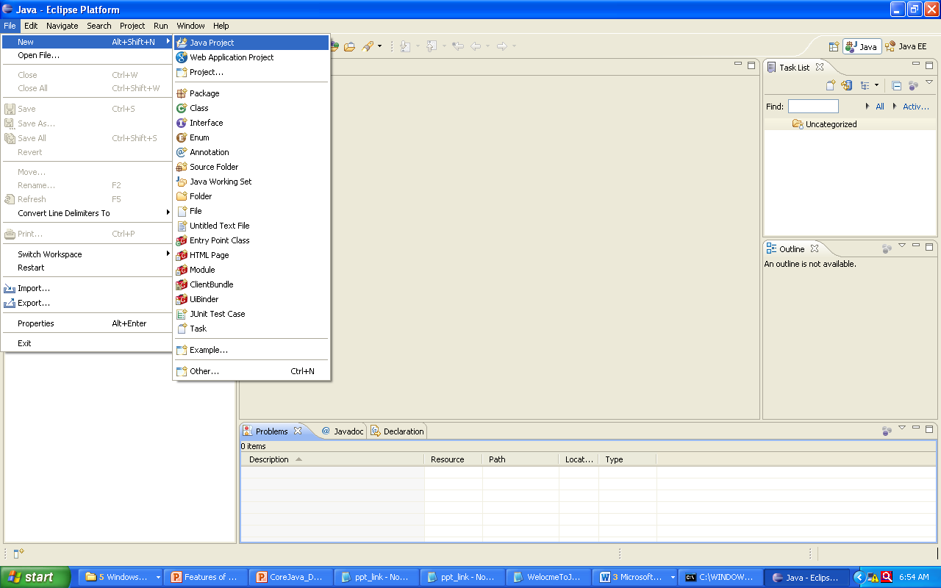
CREATING JAVA PROJECT FILE->NEW ->JAVA PROJECT
Java Hello Word Program

Slide 44
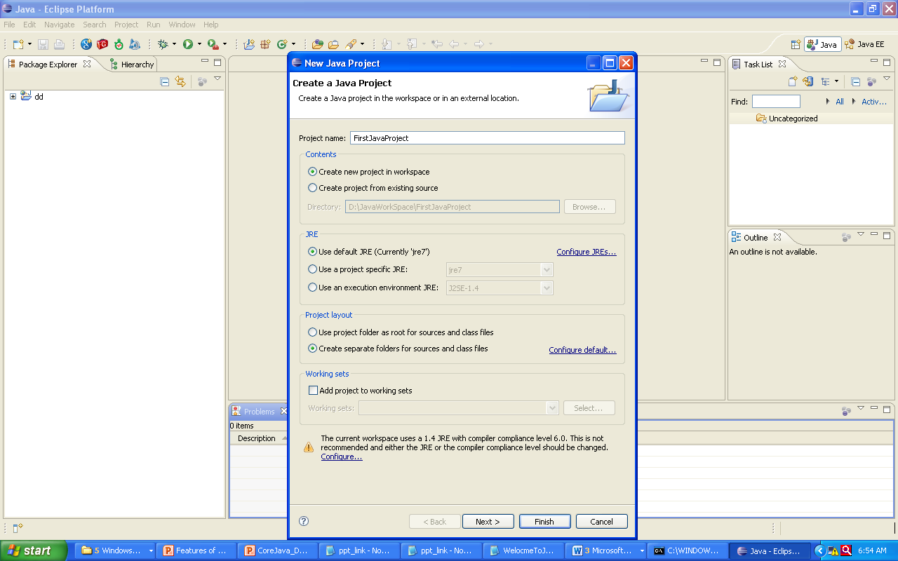
CREATING JAVA PROJECT
Java Hello Word Program
04/02/2017

Slide 45
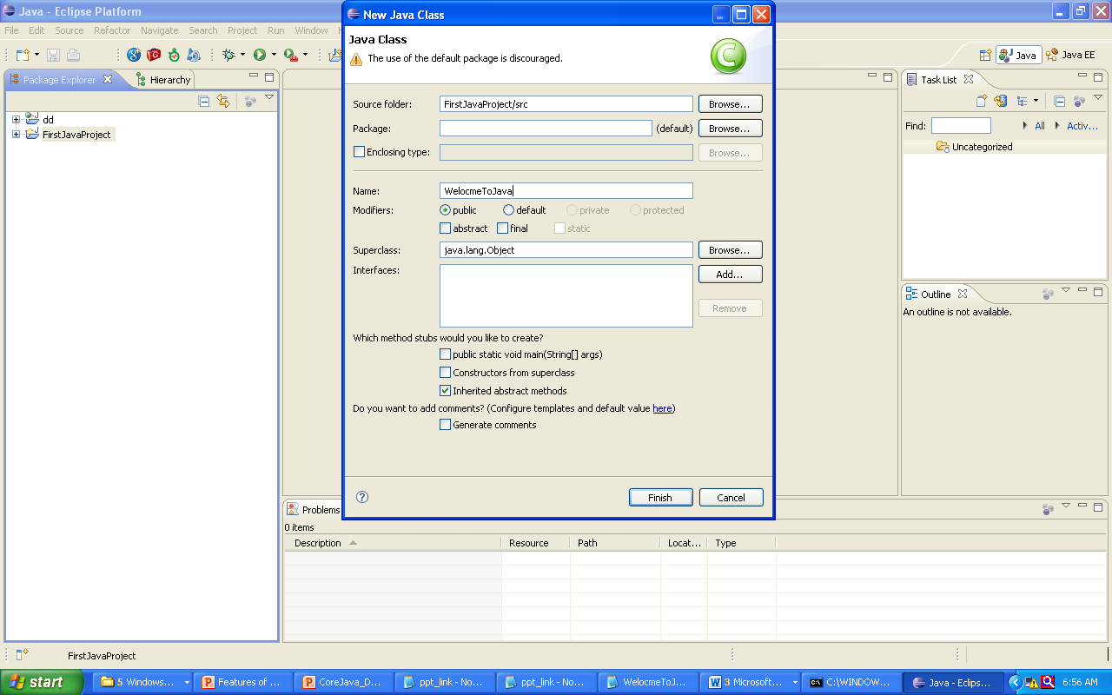
CREATING CLASS IN JAVA PROJECT NEW -> CLASS
Java Hello Word Program
04/02/2017

Slide 46
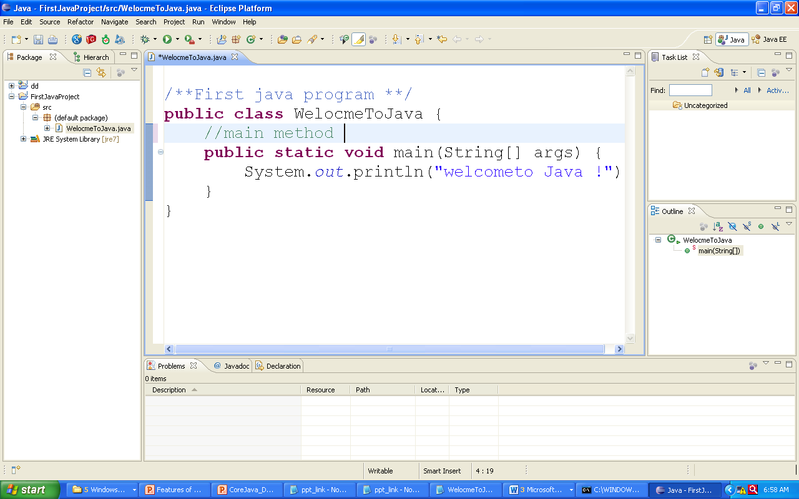
IMPLEMENTING CLASS CODE
Java Hello Word Program

Slide 47
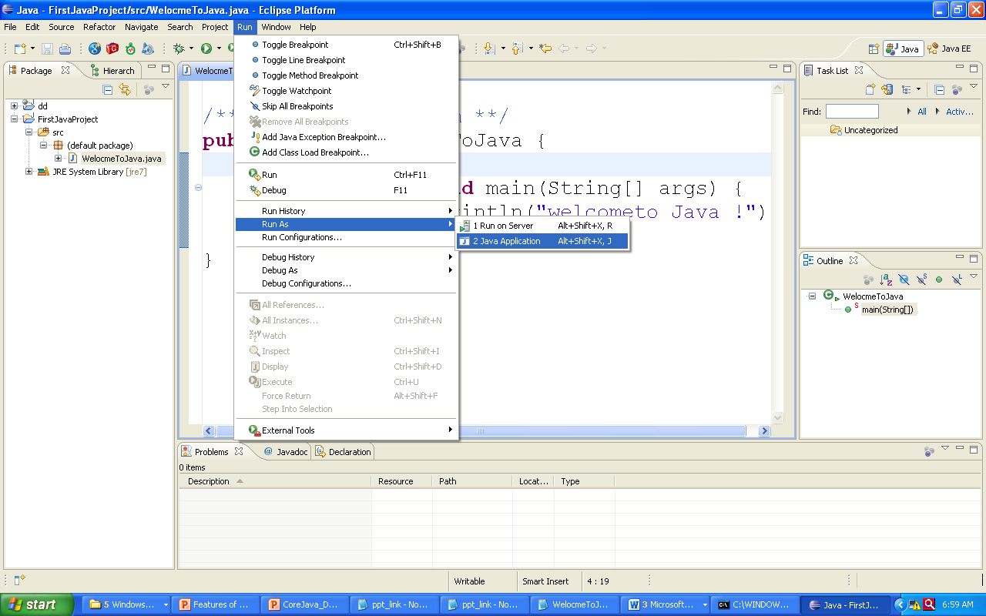
EXECUTING CLASS IN ECLIPSE RUN->RUN AS-> JAVA APPLICATION
Java Hello Word Program
04/02/2017

Slide 48
Java Hello Word Program
COMMENTS IN JAVA
A single line comment in Java starts with //
// This is a single line comment in Java
A multi line comment starts with /* & ends with */ /*This is a multi line
comment
in Java */
The javadoc tool uses doc comments when preparing
Java documentation
/** Java Documentaton comment */
04/02/2017

Slide 49
COMMENTS IN JAVA
Java Hello Word Program
/**
The Hello Word Program implements a application
That displays message welcome to java
@author mahendra
@version 1.0
@since 2017
*/
public class HelloWorld{
/*
Main method with command line arguments
Entry point for java application
*/
public static void main(String[]args){
// statement displays welcome message on std output
System.out.println(“welcome to Java !”);
} }
Appears in Java
Documentation
Multi line Comment
Single line comment

Slide 50
Data Types

Slide 51
DECLARING AND ASSIGNING VARIABLES
Data Types
Variables, Literals , Keywords
Data types
Expressions, Statements and Blocks
Operators
Arrays
Controls flow
04/02/2017

Slide 52
VARIABLES
Data Types
A variable is the name that refers to a memory location where some
data value is stored.
Each variable that is used in a program must be declared.
VARIABLE NAMING CONVENTIONS
A variable name must be unique.
A variable name must begin with a letter, an underscore (_), or the
dollar symbol ($), which can be followed by a sequence of letters or
digits (0 to 9), ‘$’, or ‘_’ .
A variable name should not start with a digit.
A variable name should not contain embedded white spaces .
A variable name should not consist of a keyword.
A variable name in Java is case sensitive.

Slide 53
JAVA LITERALS
Data Types
String literals
Ex : “DSRC Chennai”
Boolean literals
Ex: true, false
Character literals
Ex : ‘v’, ’p’, ‘1’, ’9’
Integer literals
Ex: 123, 5985, 2488
Floating literals
Ex: 343.244, 5.3949f, 984938.934
04/02/2017

Slide 54
JAVA DATA TYPES
Data Types
Java is a strongly typed language
Unlike C, type checking is strictly enforced at run time
Impossible to typecast incompatible types
Data types may be:
Primitive data types
Reference data types
04/02/2017

Slide 55
PRIMITIVE DATA TYPES IN JAVA
Data Types
Integer Data Types
byte | (1 byte)
short | (2 bytes)
int | (4 bytes)
long | (8 bytes)
Floating Data Types
float | (4 bytes)
double | (8 bytes)
Character Data Types
char | (2 bytes)
Logical Data Types
boolean | (1 bit) (true/false)
All numeric data types are signed
The size of data types remain same on all platforms
char data type is 2 bytes as it uses the UNICODE character set. Java supports internationalization

Slide 56
Data Types
EXAMPLE OF VARIABLE DECLARATION AND ITS TYPE:
DataType variableName
int empAge, empCell;
double empSalary;
char processCheck;
The data type can either be:
built-in primitive types (e.g. int, double, char object classes)
reference data types (e.g. String,BufferedReader)
Naming Convention (Coding standard for java)
Variable Name: First word lowercase & rest initial capitalized
(Camel Casing)
e.g. thisIsALongVariableName
04/02/2017

Slide 57
REFERENCE DATA TYPES
Data Types
Hold the reference of dynamically created objects which are in the heap
Can hold three kinds of values:
Class type: Points to an object / class instance
Interface type: Points to an object, which is implementing the
corresponding interface
Array type: Points to an array instance or “null”
Difference between Primitive & Reference data types:
Primitive data types hold values themselves
Reference data types hold reference to objects, i.e. they are not objects, but reference to objects
04/02/2017

Slide 58
REFERENCE DATA TYPES
Data Types
Objects & Arrays are accessed using reference variables in Java
A reference variable is similar to a pointer (stores memory address of an object)
Java does not support the explicit use of addresses like other languages
Java does not allow pointer manipulation or pointer arithmetic
Memory Representation
int primitive = 5;
String reference = “Hello” ;
primitive
5
reference
Hello

Slide 59
TYPECASTING PRIMITIVE DATA TYPES
Data Types
Automatic type changing is known as Implicit Conversion
A variable of smaller capacity can be assigned to another variable of bigger capacity
int i = 10;
double d;
d = i;
Whenever a larger type is converted to a smaller type, we have to explicitly specify the type cast operator
double d = 10
int i=0;
i = (int) d;
This prevents accidental loss of data
Type casting (int)
04/02/2017

Slide 60
ARRAY IN JAVA
Data Types
How To Declare and Create An Array
int intArr[];
Declaration of an Single Dimension Array
int intArr[][];
Declaration of an Two Dimension Array
int intArr[][][];
Declaration of an Multi Dimension Array
intArr = new int[3];
Creation of an Single Dimension Array
intArr = new int[3][2];
Creation of an Two Dimensional Array
intArr = new int[2][2][3];
Creation of an Multi Dimension Array
An array is a container object that holds a fixed number of values
of a single type.

Slide 61
ARRAY STRUCTURE IN JAVA
Data Types
intArr = new int[3];
intArr stores the address of the first element.
0
0
0
intArr[0]
intArr[1]
intArr[2]
intArr = new int[2][3][2];
intArr stores the address of the first element.
0
1
0
1
2
0
1
2
0
1
0
1
0
1
0
1
0
1
0
1
04/02/2017

Slide 62
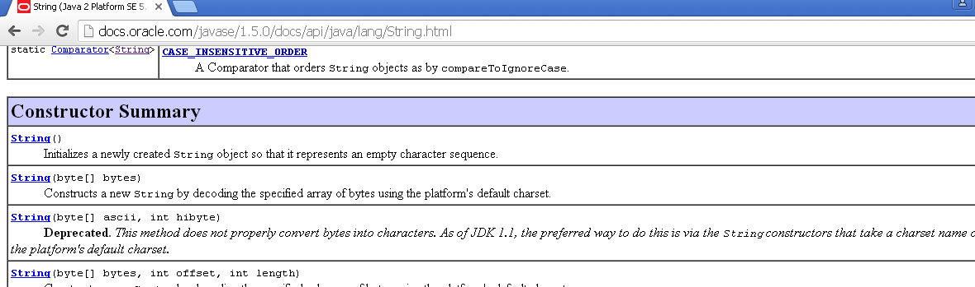
REFERRING JAVA DOCUMENT
Data Types
Java provides a rich set of library classes
Java API Documentation provides detailed support on all classes
Browse Java API Documentation from docs.oracle.com
04/02/2017

Slide 63
STRING CLASS
Data Types
Present in java.lang package
An object of the String class represents a fixed length, immutable sequence of characters
Has overridden equals( ) method of the Object class that should be used to compare the actual string values
A lot of other string manipulation methods are available
Javadoc's can be referred for a detailed list of methods
String Class methods
Concat() split()
toUpper() equals()
toLower() hashCode()
subString()

Slide 64
STRING CLASS
Data Types
Defines a data type used to store a sequence of characters
Strings are objects
String objects can’t be modified:
If attempted to do so, Java creates a new object having the
modified character sequence
String empName = “Jack”;
empName = “John”;
empName =
Value=“Jack”
Value=“John”
04/02/2017

Slide 65
OPERATORS IN JAVA
04/02/2017

Slide 66
OPERATORS
Operators In Java
Arithmetic Operators
Comparison Operators
Boolean Operators
Unary Operators
Bitwise Operators
Class & Object Operators

Slide 67
ARITHMETIC OPERATORS
Operators In Java
OPERATOR | Description
+ | Addition
- | Subtraction
* | Multiplication
/ | Division
% | Mod(Remainder)
Operators precedence
First priority
* / %
Second priority
+ -
Operators with higher priority are applied first
Operators with same priority are applied from left to right
04/02/2017

Slide 68
COMPARISON OPERATORS
Operators In Java
OPERATOR | Description
== | Equality
< | Less Then
> | Greater Then
!= | Inequality
<= | Less Then or Equal To
>= | Greater Then or Equal To

Slide 69
CONDITIONAL OPERATORS
Operators In Java
OPERATOR | Description
&& | Conditional and operator ((x<y)&&(y<z)) If(x<y) ->true and (y<z)->then returns true if any of condiiton is flase returns false
|| | Conditional or operator ((x<y)||(y<z)) Any one condition (x<y) or(y<z) is true Returns true result
BOOLEAN OPERATORS
OPERATOR | Description
& | Boolean and operator If (x<y)&(y<z)) If either x or y are false the result is flase Both condition are checked bfore result
04/02/2017

Slide 70
STATEMENTS AND FLOW CONTROL

Slide 71
CONDITIONAL STATEMENTS
Statements And Flow Control
To change the execution order of program
As the method of controlling the execution order
Conditional statement : if and switch .
Repeat statement : for , while , do-while .
Branch statement : break , continue , return .
Form of if Statement
if ( <conditional expression> ) <statement>
if ( < conditional expression > ) <statement1> else <statement2>
Result of conditional expression : Logical Type (true or false)
if (number< 0) number = 0;
if (number1 > numbe2) result = number1;
else result = number2;
04/02/2017

Slide 72
SWITCH STATEMENT
Statements And Flow Control
Form of switch statement
break statement
switch (value) {
case <constant> : <statement 1>
case <constant> : < statement 2>
:
case < constant > : < statement n>
default : < statement>
}
04/02/2017

Slide 73
REPETAE STATEMENT: FOR STATEMENT
Statements And Flow Control
Repeat the sequence of statement more then once
Form of for statement
for ( <expression1> ; < exprresson2> ; < expression3>) <statement>
< expression1 > : initialize the variable (once only)
<exprresson2> : check the condition ( true/false)
< expression3 > : change the variable
result = 0;
// adding numbers to limit : index increment
for (index=1; index<=limit; ++index)
result += index;

Slide 74
FOR STATEMENT
Statements And Flow Control
Execution order of for statement
1
2
5
4
for
(
initialize
condition
change
)
3
True
6
Statement
False
04/02/2017

Slide 75
WHILE STATEMENT
Statements And Flow Control
Form of while statement
while ( condition ) <Statements>
Order of Execution
( condition)
index = 1; result = 0;
// add numbers from 1 to limit
while (index <= limit) {
result += index; ++index;
}
(1)
while
(4)
(2)
True
(3)
<
>
False
Statement
False
04/02/2017

Slide 76
CONTINUE AND BREAK STATEMENT
Statements And Flow Control
To move control to the start of next repetition :continue
To terminate the loop on particular condition : break
for (index=0; index<=5; ++index) {
if (index % 2 == 0)
continue;
System.out.println(“statement executed" + index + " time’s");
}
for (index=0; index<=5; ++index) {
if (index % 2 == 0)
break;
System.out.println(“statement executed" + index + " time’s");
}
04/02/2017

