Slide 1
JAVA PRESENTATION
Topics-
OPTIONAL CLASS
COLLECTORS CLASS

Slide 2
Java 8 Features
Java 8 provides following features for Java Programming:
Lambda expressions,
Functional interfaces,
Stream API,
Optional class,
Collectors class,
ForEach() method,
Parallel array sorting,
IO Enhancements,
JDBC Enhancements etc.

Slide 3
Java Optional Class
Java introduced a new class Optional in jdk8.
It is a public final class and used to deal with NullPointerException in Java application.
You must import java.util package to use this class.
It provides methods which are used to check the presence of value for particular variable.

Slide 4
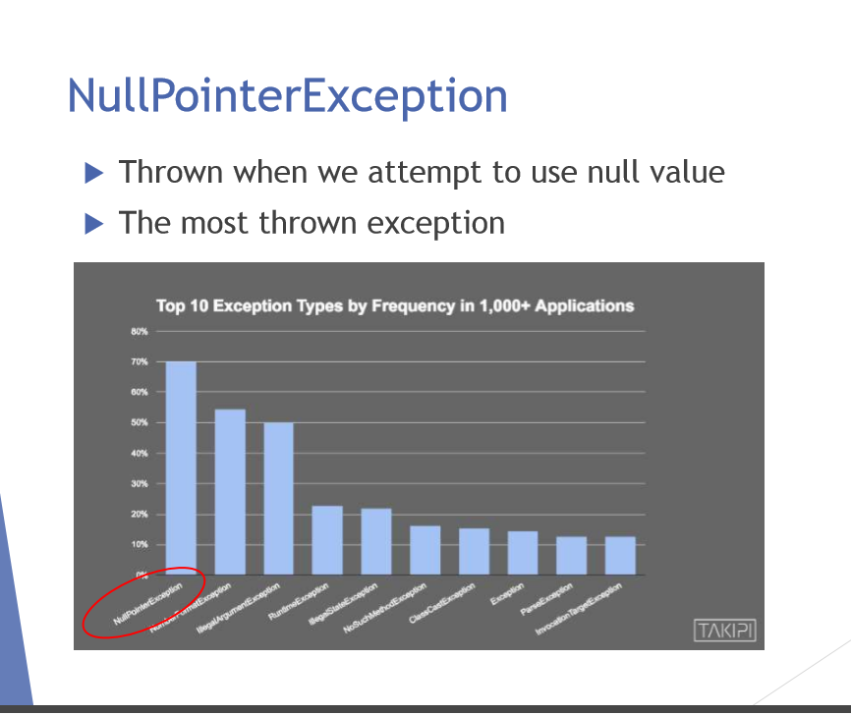

Slide 5
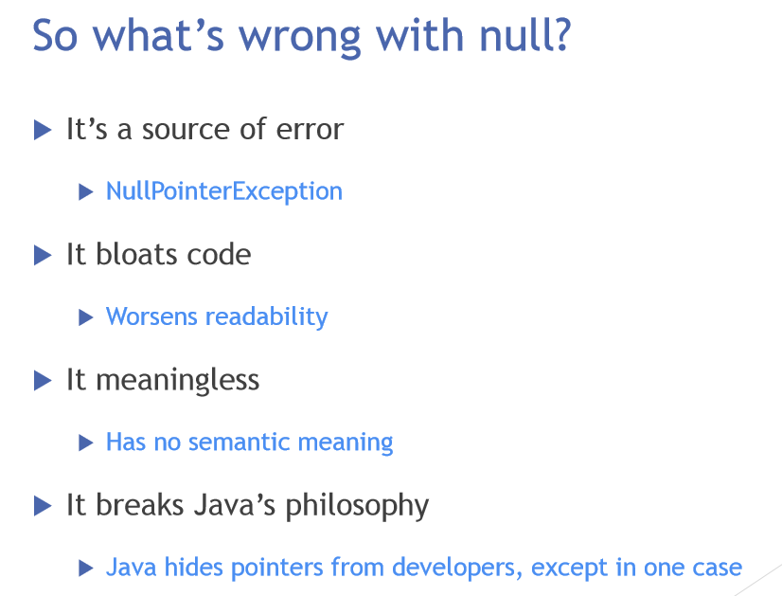

Slide 6
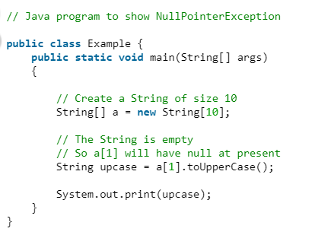

NullPOinterException without Using optional Class
Output:

Slide 7
Java Optional Class Methods
Methods & Description
public static <T> Optional<T> empty() (It returns an empty Optional object. No value is present for this Optional).
public static <T> Optional<T> of(T value) (It returns an Optional with the specified present non-null value).
public static <T> Optional<T> ofNullable(T value) (It returns an Optional describing the specified value, if non-null, otherwise returns an empty Optional)..
public boolean isPresent() (It returns true if there is a value present, otherwise false).
public T orElse(T other) (It returns the value if present, otherwise returns other).

Slide 8
NullPOinterException with Using optional Class:
import java.util.Optional;
public class Example {
public static void main(String[] args)
{ // Create a String of size 10
String[] a = new String[10];
// Create an Optional Class instance
// and get the state for a[1] element for Null value
Optional<String> check = Optional.ofNullable(a[1]);
// If the value in the current instance is null, it will return false, else true
if (check.isPresent()) {
// The String is empty. So a[1] will have null at present
String upcase = a[1].toUpperCase();
System.out.print(upcase);
}
else
// As the current value is null
System.out.println("String value is not present");
} }
Output:
// String value is not present //

Slide 9
Java Collectors
  Collectors is a final class that extends Object class.
  It provides reduction operations, such as accumulating elements into collections, summarizing elements according to various criteria, etc.
  Java Collectors class provides various methods to deal with elements

Slide 10
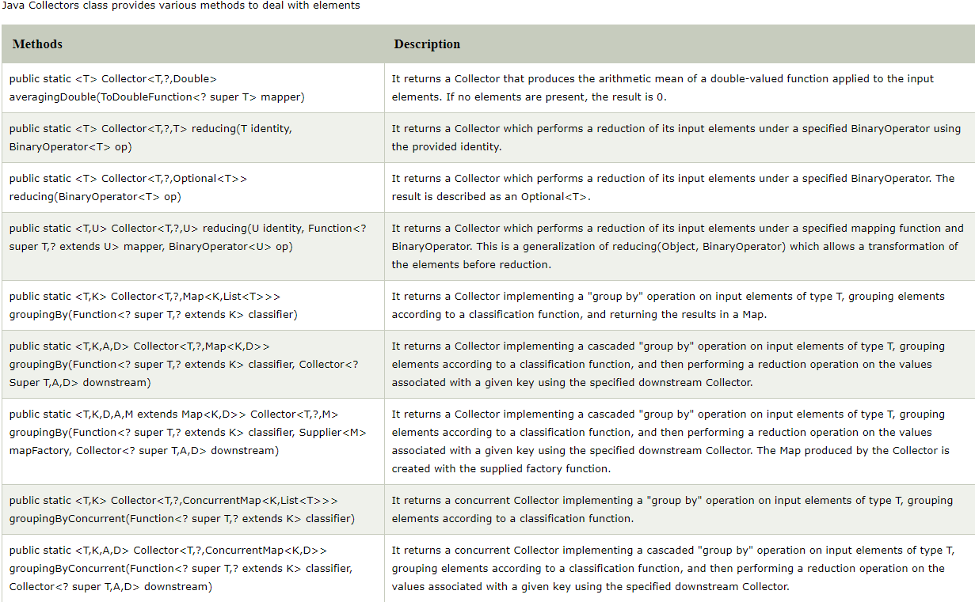
Some of the methods in Java collectors are:

Slide 11
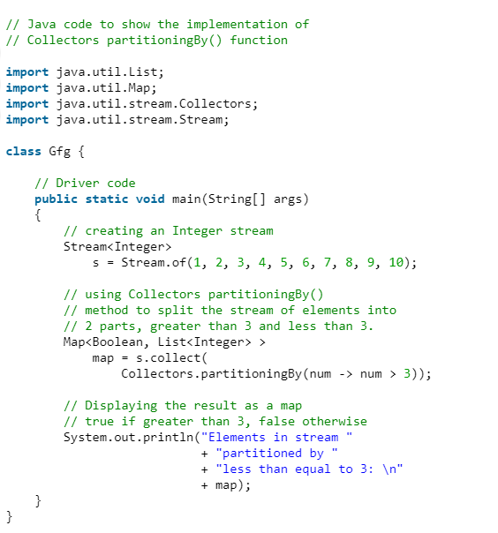


Slide 12
// Accumulate names into a List
List<String> list = people.stream().map(Person::getName).collect(Collectors.toList());
// Accumulate names into a TreeSet
Set<String> set = people.stream().map(Person::getName).collect(Collectors.toCollection(TreeSet::new));
// Convert elements to strings and concatenate them, separated by commas
String joined = things.stream()
.map(Object::toString)
.collect(Collectors.joining(", "));
// Compute sum of salaries of employee
int total = employees.stream()
.collect(Collectors.summingInt(Employee::getSalary)));
// Partition students into passing and failing
Map<Boolean, List<Student>> passingFailing =
students.stream()
.collect(Collectors.partitioningBy(s -> s.getGrade() >= PASS_THRESHOLD));

Slide 13
THankYou

