Slide 1
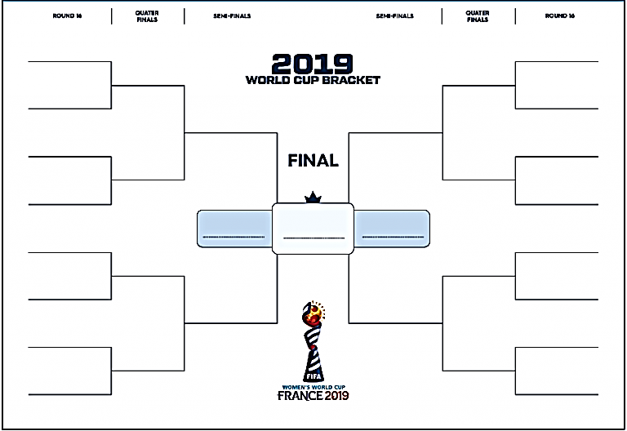


















ROUND OF 16 QUARTERFINAL SEMIFINAL SEMIFINAL QUARTERFINAL ROUND OF 16
FINAL

Slide 2





ROUND OF 16 QUARTERFINAL SEMIFINAL SEMIFINAL QUARTERFINAL ROUND OF 16
FINAL

Slide 3





ROUND OF 16 QUARTERFINAL SEMIFINAL SEMIFINAL QUARTERFINAL ROUND OF 16
FINAL

Slide 4
ROUND OF 16 QUARTERFINAL SEMIFINAL SEMIFINAL QUARTERFINAL ROUND OF 16
FINAL

Slide 5
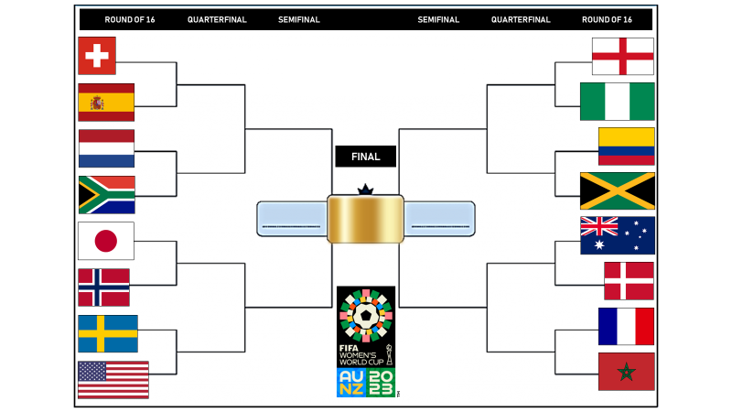
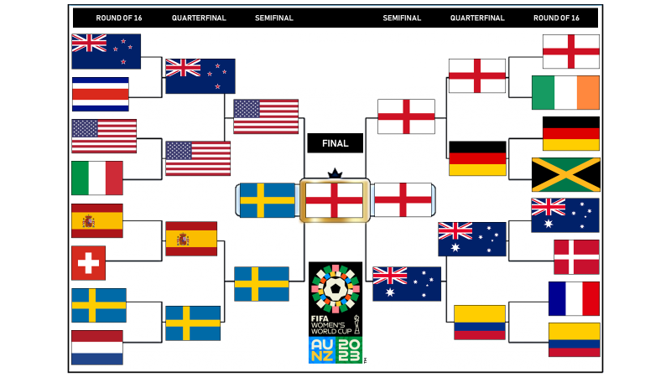
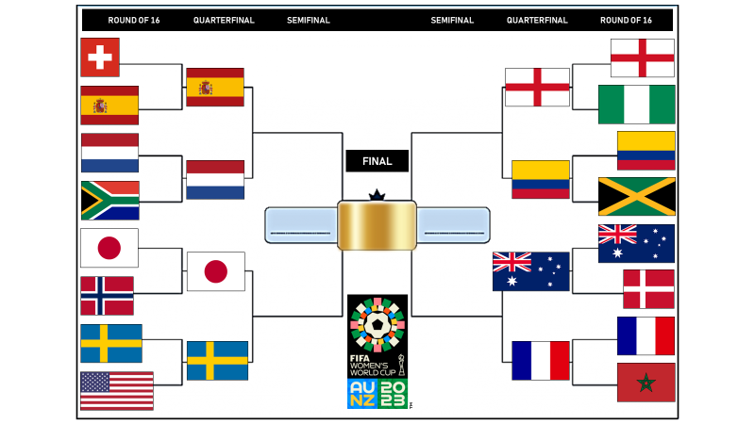
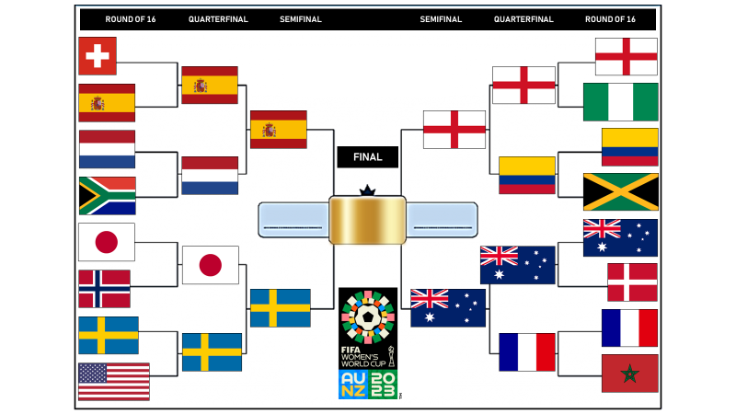
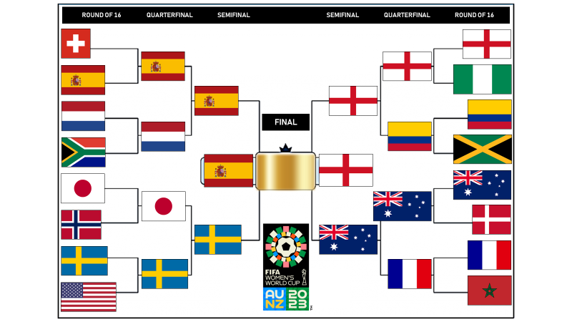
ROUND OF 16 QUARTERFINAL SEMIFINAL SEMIFINAL QUARTERFINAL ROUND OF 16
FINAL

